Slide 1
SPATIAL ONCOLOGY | EXECUTED PUBLIC-DATA PROJECT
CRC Liver-Metastasis
Invasion-Front Model
A compartment-aware heterogeneous graph of tumour-host contact, partial EMT and metastatic niche programs
GSE225857 | 22,260 Visium spots | leave-section-out validation | research use only
Notes:
Open by framing the model as an auditable hypothesis generator, not a clinical biomarker. The scientific object is the tumour-liver interface, not the whole slide.
[Sources]
- https://www.ncbi.nlm.nih.gov/geo/query/acc.cgi?acc=GSE225857
- https://doi.org/10.1126/sciadv.adf5464
[/Sources]

Slide 2
The interface may encode two different invasion ecosystems
CENTRAL QUESTION
Which malignant and host-cell programs distinguish the inferred tumour front from the malignant core?
Host-contact front
Metabolically stressed core
Damaged hepatocyte context
Partial EMT and hypoxia
Macrophage and ECM-contact messages
Glycolytic programs
Direct tumour-liver adjacency
Fibroblast and ECM-rich neighborhoods
Hypothesis: typed spatial context will transfer between liver sections better than unstructured spot features.
02
Notes:
Explain that the two ecosystems are competing, testable interpretations. The pipeline does not assume that pEMT must peak at the visible boundary.
[Sources]
- https://pmc.ncbi.nlm.nih.gov/articles/PMC5680474/
- https://pmc.ncbi.nlm.nih.gov/articles/PMC7217855/
[/Sources]

Slide 3
Public data support discovery, reference construction and audit
The model uses only openly documented assets and reports missing labels instead of inventing them.
22,260
56,072
48
Visium spots
single cells
GeoMx AOIs
4 primary CRC + 2 liver metastasis sections
Matched malignant, fibroblast, myeloid and endothelial pseudobulk reference
Downloaded as orthogonal evidence; site labels remain unresolved
Important: hepatocytes were absent from the processed scRNA clusters and were not imputed into the matched reference.
03
Notes:
Use this slide to demonstrate evidence discipline. The GeoMx table was retained but not assigned primary/metastasis labels because its public count file lacks a machine-readable annotation table.
[Sources]
- https://www.ncbi.nlm.nih.gov/geo/query/acc.cgi?acc=GSE225857
- https://doi.org/10.5281/zenodo.7520789
- https://www.ncbi.nlm.nih.gov/geo/query/acc.cgi?acc=GSE224235
[/Sources]

Slide 4
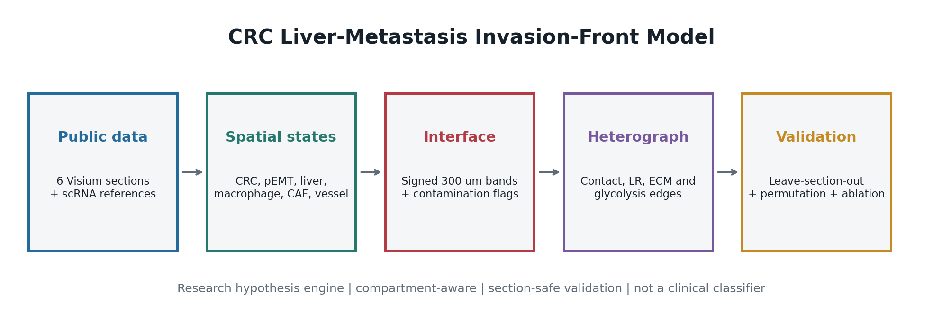
Compartment identity is preserved end to end
04
Notes:
Walk left to right. Emphasize section-wise normalization, CRC-lineage gating, signed graph distance, relation-specific messages, held-out-section testing, and a pathology review queue.
[Sources]
- Repository pipeline: scripts/run_crc_liver_invasion_front.py
- https://doi.org/10.1126/sciadv.adf5464
[/Sources]

Slide 5
A signed 300 micrometre coordinate makes the boundary testable
Tumour core
Tumour front
Boundary
Liver front
Liver parenchyma
→
→
→
→
-3 hops
0
+3 hops
Boundary seeds require high-confidence malignant-hepatocyte contact.
Primary CRC sections are explicitly marked not applicable.
pEMT requires epithelial, mesenchymal and CRC-lineage support; fibroblast-high mixtures are flagged.
05
Notes:
Three graph hops approximate 300 micrometres. This mirrors recent pathologist-reviewed CRLM spatial work but remains a sensitivity-tested approximation.
[Sources]
- https://www.nature.com/articles/s41416-026-03567-y
- https://pmc.ncbi.nlm.nih.gov/articles/PMC5680474/
[/Sources]

Slide 6
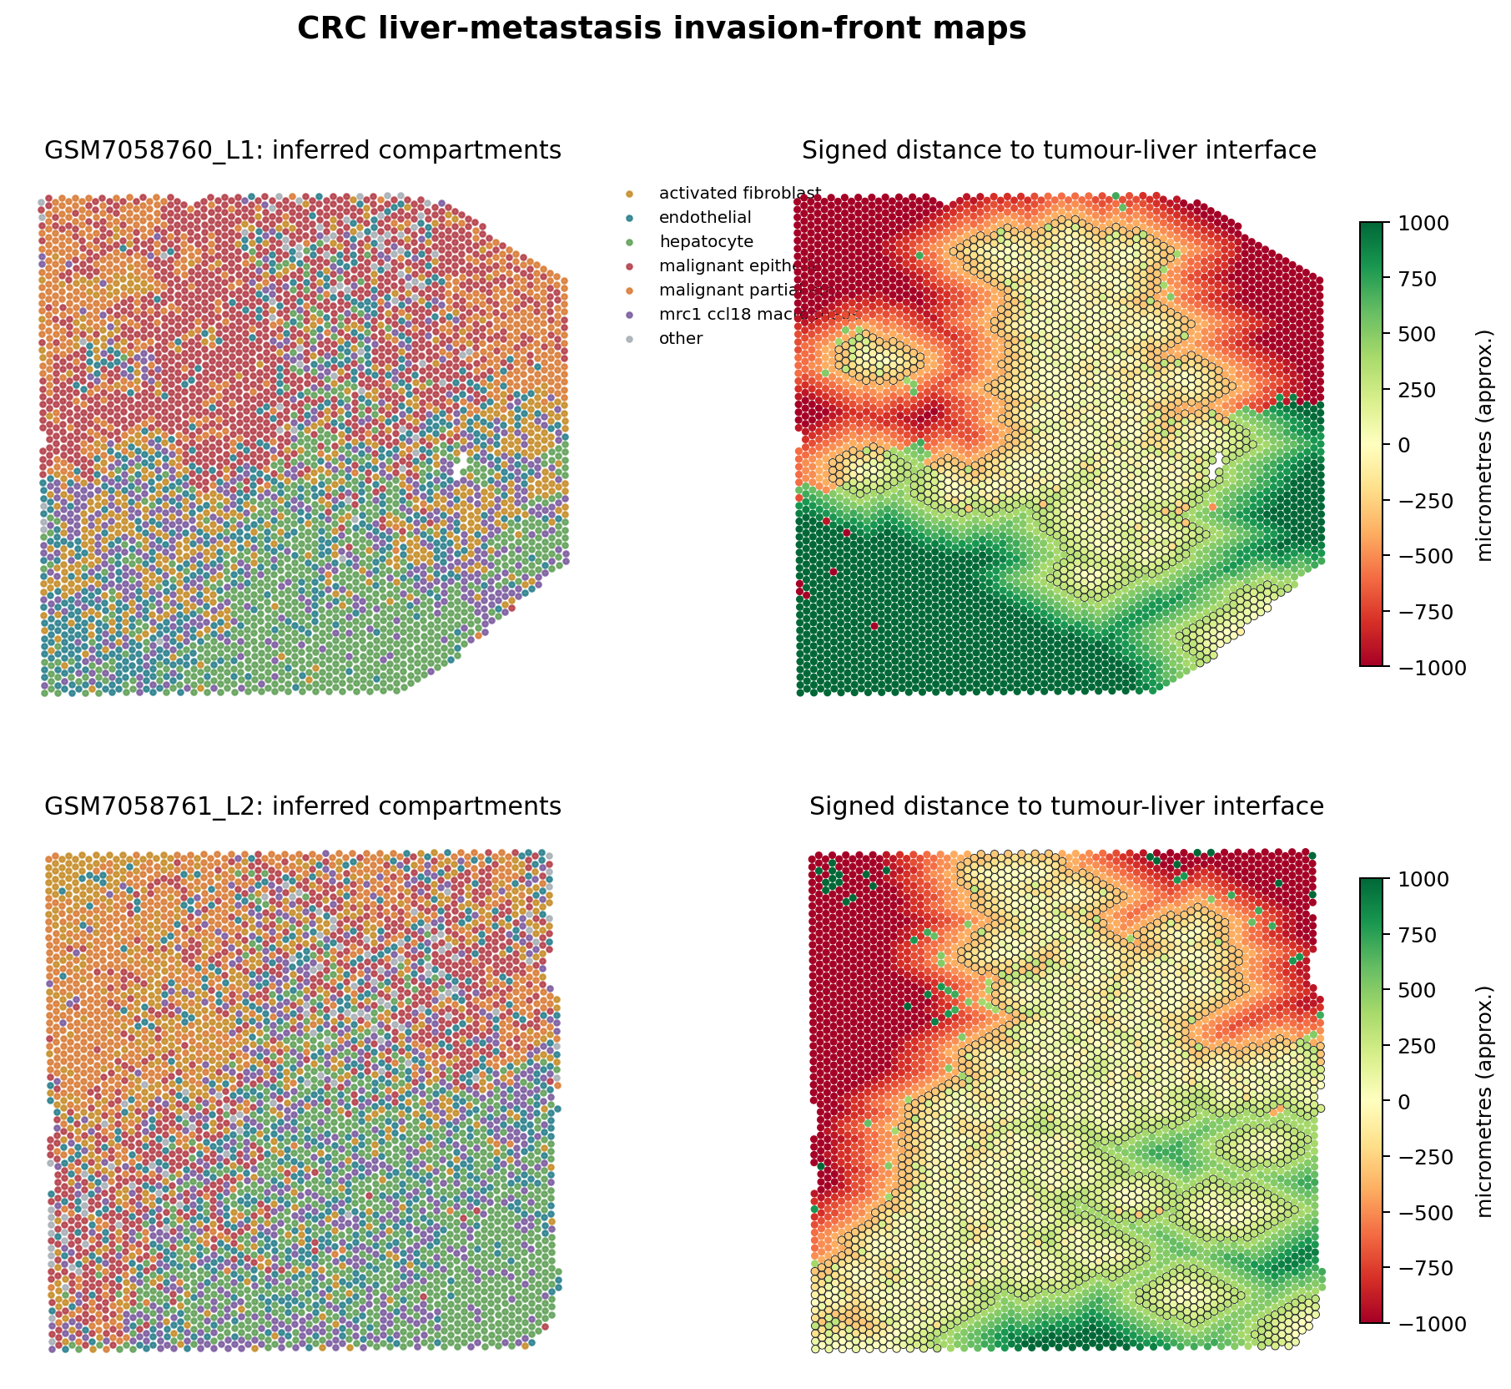
Both liver sections yield coherent but weak-label interfaces
L1
303 boundary pairs
1,562 interface spots
861 tumour-front spots
L2
452 boundary pairs
2,597 interface spots
1,130 tumour-front spots
Both: mixed or uncertain HGP proxy
06
Notes:
Do not call these pathologist-confirmed invasive fronts. They are reproducible marker-plus-spatial candidates intended to organize human review and downstream experiments.
[Sources]
- https://www.ncbi.nlm.nih.gov/geo/query/acc.cgi?acc=GSE225857
- https://pmc.ncbi.nlm.nih.gov/articles/PMC6611753/
[/Sources]

Slide 7
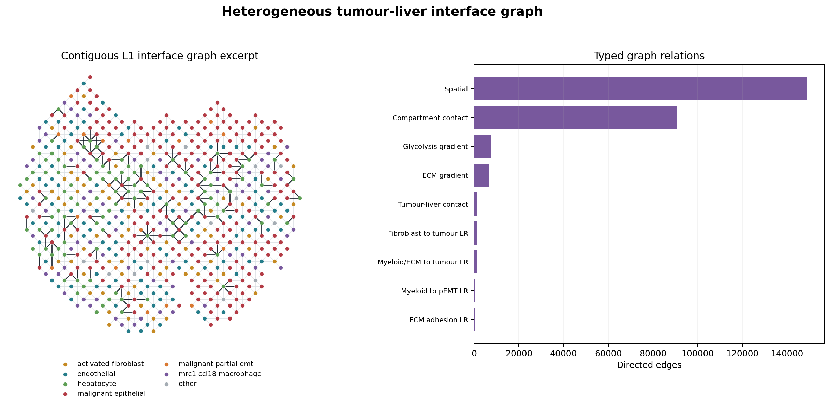
Typed edges retain the biological meaning of neighbourhoods
07
Notes:
Physical neighbours, compartment contacts, gradient directions and ligand-receptor opportunities are distinct edge types. Ligand-receptor edges require positive expression above the within-section 80th percentile and are interface-local.
[Sources]
- Repository module: src/crc_liver_invasion_front/graph.py
- https://doi.org/10.1126/sciadv.adf5464
[/Sources]

Slide 8
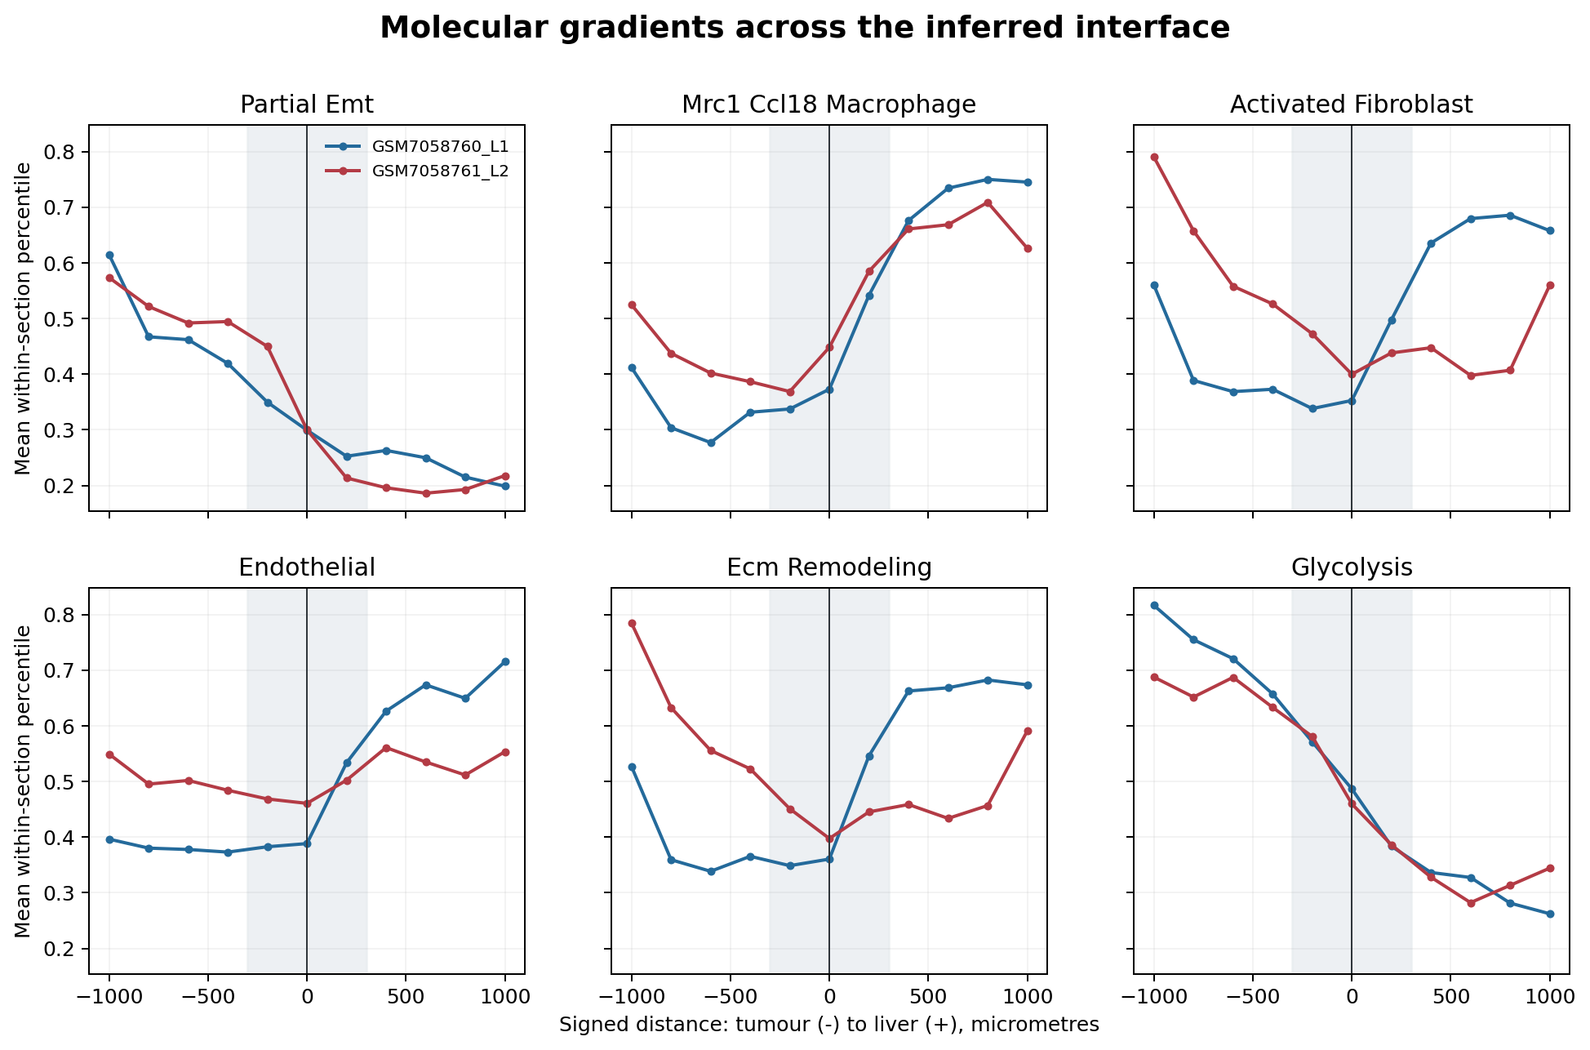
The inferred front is host-contact rich, not uniformly pEMT high
+0.060
damaged-hepatocyte
front minus core
-0.117
ECM remodelling
front minus core
pEMT, glycolysis and hypoxia also trend toward the inferred malignant core.
08
Notes:
This is the most interesting negative result. A simplistic invasive-ring story is not supported. Alternatives include a host-contact front around a stressed core, section-specific architecture, and residual spot mixing.
[Sources]
- Generated table: data/processed/crc_liver_invasion_front_v1/front_vs_core_statistics.tsv
- https://www.nature.com/articles/s41416-026-03567-y
[/Sources]

Slide 9
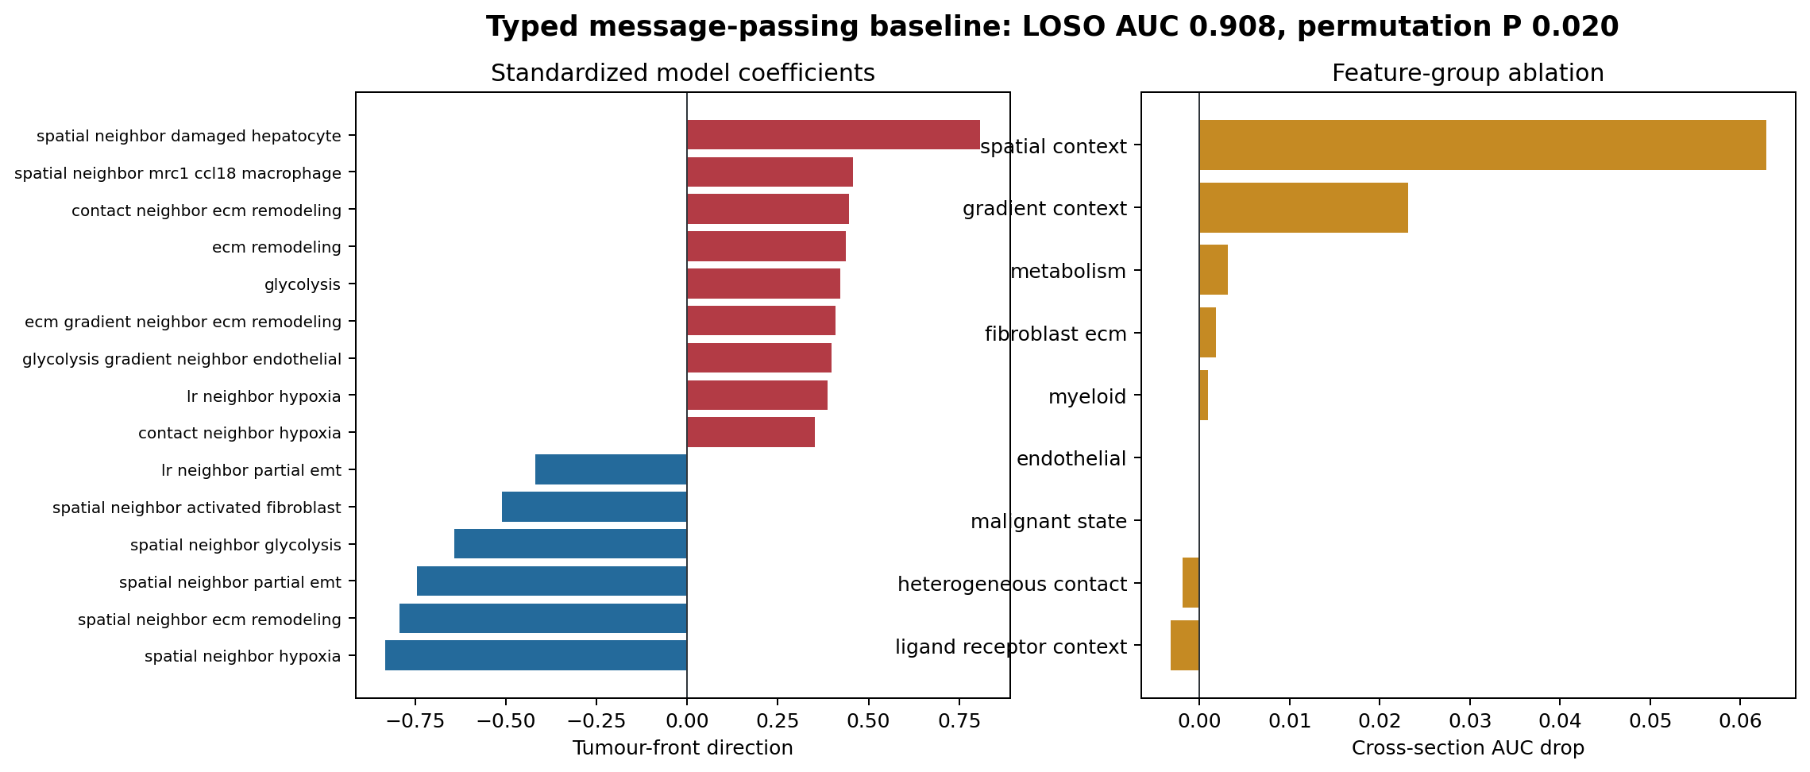
Held-out sections recover transferable weak-label structure
0.908
0.857
0.831
0.020
ROC AUC
Average precision
Balanced accuracy
Permutation P
2 held-out liver sections
3,439 malignant spots
1,290 tumour-front spots
48 local and relation-aware features
50 within-section permutations
09
Notes:
AUC measures recovery of an inferred spatial label across two sections. Boundary-defining cross-interface messages are excluded from model features to reduce label leakage.
[Sources]
- Generated metrics: data/processed/crc_liver_invasion_front_v1/model_metrics.json
- Repository module: src/crc_liver_invasion_front/modeling.py
[/Sources]

Slide 10
The model prioritizes a host-injury axis for experimental follow-up
FRONT-ASSOCIATED
CORE-ASSOCIATED
+0.809
Neighbour damaged-hepatocyte program
-0.832
Neighbour hypoxia program
+0.457
Neighbour MRC1/CCL18-like macrophage program
-0.745
Neighbour partial-EMT program
+0.446
Contact-neighbour ECM program
-0.641
Neighbour glycolysis program
Predictive coefficients generate mechanisms to test; they are not causal effects or drug recommendations.
10
Notes:
Frame the result as a ranked experimental agenda: hepatocyte injury and macrophage contact at the front versus pEMT, hypoxia and glycolysis in the core.
[Sources]
- Generated table: data/processed/crc_liver_invasion_front_v1/model_feature_importance.tsv
- https://www.nature.com/articles/s41416-026-03567-y
[/Sources]

Slide 11
Interpretability is the main strength; label quality is the main constraint
Advantages
Limitations
Separates malignant pEMT from stromal mesenchymal RNA
Only two liver-metastasis sections
Preserves spatial direction and edge semantics
Weak interfaces and HGP proxies
Uses held-out sections, permutation and ablation
Visium spots mix several cell types
Reports unavailable metadata and reference compartments
Co-expression edges do not prove signalling
No survival, treatment-response or causal endpoint
Best use: auditable hypothesis generation and pathologist-guided experiment design.
11
Notes:
This slide is important in an interview. State the limitation before being asked, then explain how each next experiment addresses a specific uncertainty.
[Sources]
- https://pmc.ncbi.nlm.nih.gov/articles/PMC6611753/
- Repository report: docs/crc_liver_invasion_front/executed_project_report.md
[/Sources]

Slide 12
Next: convert weak spatial labels into validated mechanism
1
Pathology
Trace tumour-liver boundaries and score consensus HGP percentages
2
Protein
Validate EPCAM/KRT20, VIM/LAMC2, MRC1/CCL18, FAP/POSTN, CD31 and CA9/GLUT1
3
Perturb
Test CCL18-PITPNM3, SPP1-CD44/ITGAV, TGF-beta and CXCL12-CXCR4 axes
4
Generalize
Repeat in independent CRLM cohorts with patient-level endpoints
Pitch: a reproducible map of where malignant plasticity meets liver biology, built to tell us what to validate next.
12
Notes:
Close with the decision enabled by the project: it identifies what regions, cell states and interaction axes deserve pathology review and perturbation, while keeping unsupported clinical claims out of scope.
[Sources]
- https://pmc.ncbi.nlm.nih.gov/articles/PMC5680474/
- https://www.nature.com/articles/s41416-026-03567-y
- Repository workflow: scripts/run_crc_liver_invasion_front.py
[/Sources]

