Slide 1
COUNTRY-AID CLUSTERING ASSIGNMENT
Created by –
Rahul Sarkar

Slide 2
PROBLEM STATEMENT
HELP International is an international humanitarian NGO that is committed to fighting poverty and providing the people of backward countries with basic amenities and relief during the time of disasters and natural calamities. It runs a lot of operational projects from time to time along with advocacy drives to raise awareness as well as for funding purposes.
After the recent funding programmes, they have been able to raise around $ 10 million. Now the CEO of the NGO needs to decide how to use this money strategically and effectively. The significant issues that come while making this decision are mostly related to choosing the countries that are in the direst need of aid. So, we are building models to find such countries to which the NGO can AID.

Slide 3
ANALYSIS APPROACH
We have built models using both K-Means and Hierarchical Clustering Techniques to find 5 countries which are in direst need of AID.
The dataset that we have used has many socio-economic and health factors. The countries having very high Net Income per person, GDP per Capita and high Child Mortality rate, are the ones in need of AID.
We have also performed analytics and created visualizations on different factors to better our understanding of the data, so that the end result can be the best result possible.
We believe, the 5 countries found out will help the CEO of HELP International to decide where to use the raised $10 million for the right cause.

Slide 4
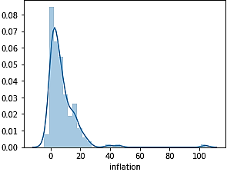
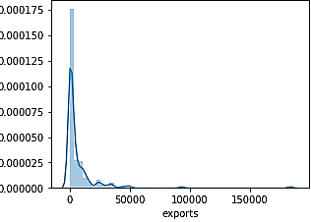
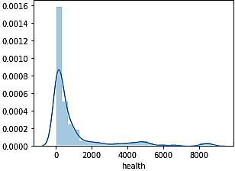
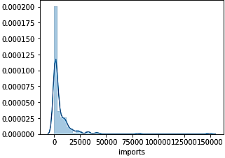
DISTRIBUTION PLOT OF ALL FEATURES
Plotting the distribution of data of all the features that we are analysing to understand its importance in finding the countries in direst need of AID.
The features exports, health, imports and inflation have a normal distribution of data and these features will not contribute to forming clusters.

Slide 5
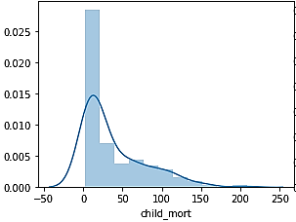
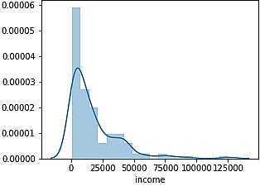
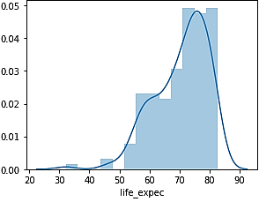
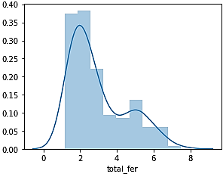
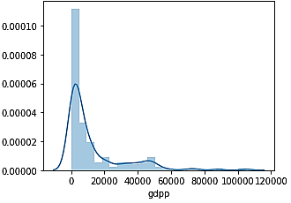
The features child mortality rate, income, life expectancy, total fertility, GDP per capita have groups formed in their distribution of data and these features will contribute to forming clusters. These will be most important to find the countries in need of AID.

Slide 6
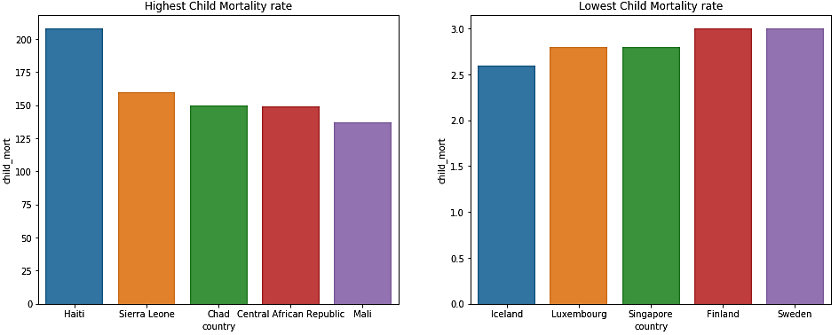
CHILD MORTALITY RATE
Plotting the countries with Highest & Lowest Child Mortality Rate.
Haiti is the country having the highest & Iceland the lowest Child Mortality rate index.

Slide 7
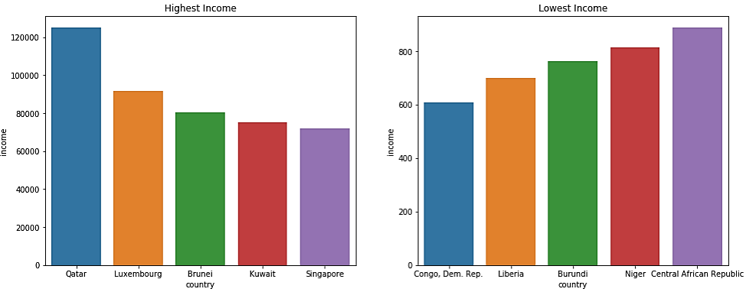
NET INCOME PER PERSON
Plotting the countries with Highest & Lowest Net Income per person.
Qatar is the country having the highest & Congo the lowest Net Income per person.

Slide 8
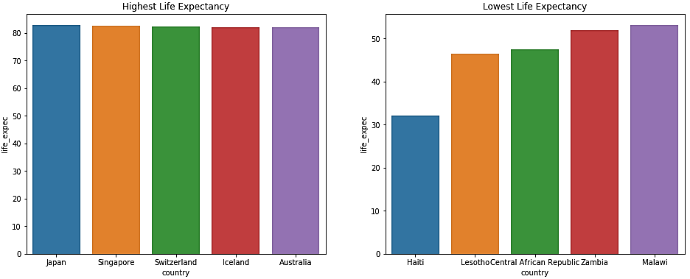
LIFE EXPECTANCY
Plotting the countries with Highest & Lowest Life Expectancy.
Japan is the country having the highest & Haiti the lowest Life Expectancy.

Slide 9
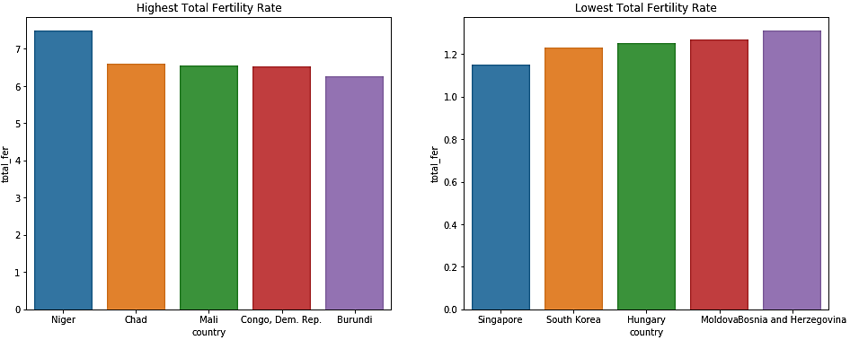
TOTAL FERTILITY RATE
Plotting the countries with Highest & Lowest Total Fertility rate.
Niger is the country having the highest & Singapore the lowest Total Fertility rate.

Slide 10
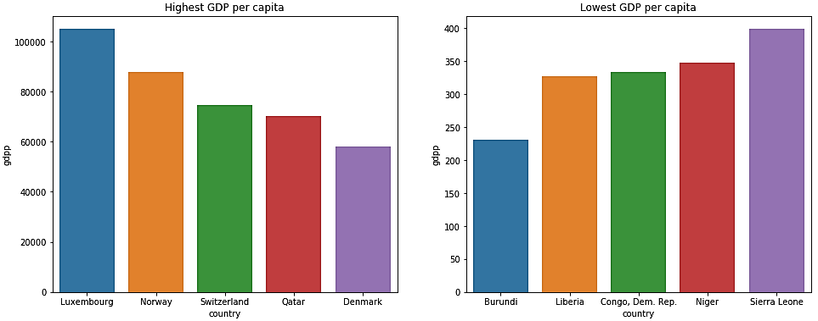
GDP PER CAPITA
Plotting the countries with Highest & Lowest GDP per Capita.
Luxembourg is the country having the highest & Burundi the lowest GDP per Capita.

Slide 11
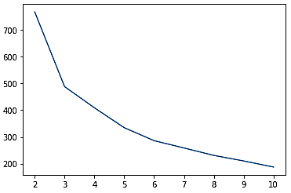
ELBOW-CURVE ANALYSIS
The Elbow-Curve analysis is used to determine the optimal number of Clusters that can be formed from the data for K-Means Clustering. The optimal number of clusters (k) is decided using the point where the graph has the first bend/deviation.
According to the plot, the best value of k looks like to be 3.

Slide 12
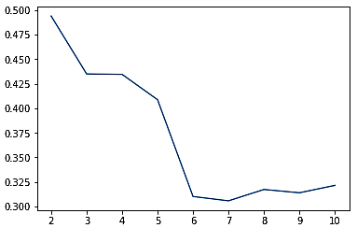
SILHOUETTE ANALYSIS
The Silhouette analysis is another technique used to determine the optimal number of Clusters that can be formed from the data for K-Means Clustering. The optimal number of clusters (k) is decided from the highest point in the curve.
According to the plot, the best value of k looks like to be 2. The value of 3 also has a high value in the plot, and looking at both the elbow-curve analysis and Silhouette analysis, we can continue with the value of k as 3.

Slide 13
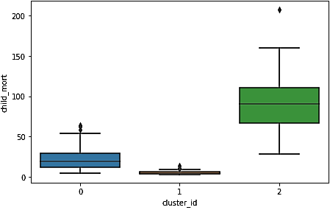
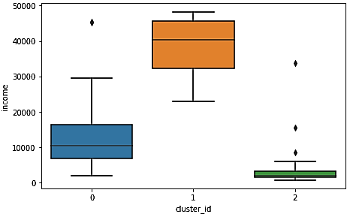
K-MEANS CLUSTERING
We have built a Clustering model using K-Means Clustering and divided the countries into 3 clusters.
We have plotted box plots for the 3 clusters against Child Mortality Rate, Net Income per person & GDP per Capita features.
From the plots we can understand the characteristics of each cluster and will help in deciding countries in need of AID.
Child Mortality Rate Plot
Income Plot

Slide 14
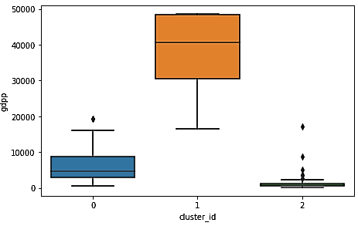
CLUSTER_ID 1 is the cluster of countries which have very high average Income & GDP per Capita and very low average Child Mortality rate.
CLUSTER_ID 0 is the cluster of countries having moderate average Income, GDP per Capita & Child Mortality rate.
CLUSTER_ID 2 is the cluster of countries having very low average Income & GDP per Capita and high average Child Mortality rate. So, countries in this cluster are the countries in direst need of AID.
GDP per Capita Plot

Slide 15
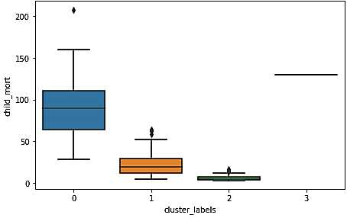
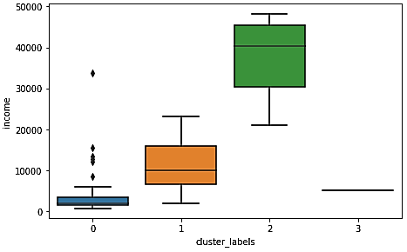
HIERARCHICAL CLUSTERING
We have built a Clustering model using Hierarchical Clustering as well and divided the countries into 4 clusters.
The number of clusters have been decided using Dendrogram.
We have plotted box plots for the 3 clusters against Child Mortality Rate, Net Income per person & GDP per Capita features.
From the plots we can understand the characteristics of each cluster and will help in deciding countries in need of AID.
Child Mortality Rate Plot
Income Plot

Slide 16
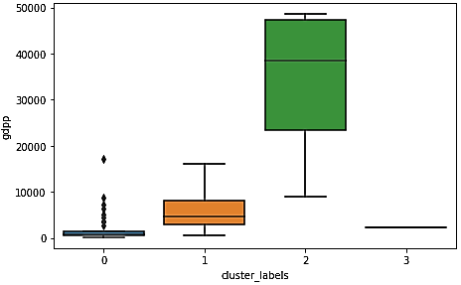
CLUSTER_LABELS 2 is the cluster of countries which have very high average Income & GDP per Capita and very low average Child Mortality rate.
CLUSTER_LABELS 1 is the cluster of countries having moderate average Income, GDP per Capita & Child Mortality rate.
CLUSTER_LABELS 0 and CLUSTER_LABELS 3 are the cluster of countries having very low average Income & GDP per Capita and high average Child Mortality rate. So, countries in this cluster are the countries in direst need of AID.
GDP per Capita Plot

Slide 17
CONCLUSION
After using K-Means Clustering & Hierarchical Clustering, we have found the clusters which have a very high average Child Mortality rate and low average Net Income per person & GDP per Capita, and these are very important factors in pushing the countries to poverty.
Consolidating both the analysis we have picked 5 countries from these clusters, which have very high impact of these factors and in direst need of AID and they are Burundi, Liberia, Congo Dem. Rep., Niger & Sierra Leone.
We hope HELP International can use the raised funds in providing AID to these countries.

