Slide 1

Design of Adaptive Hybrid Machine Learning Algorithms based
Model Predictive Control Schemes:
Application to Precision Agriculture
CP303 - CAPSTONE PROJECT II
Supervisor:
Dr. Jayaram Valluru
Presented by:
Rahul Kumar Saw (2021CHB1052)

Slide 2
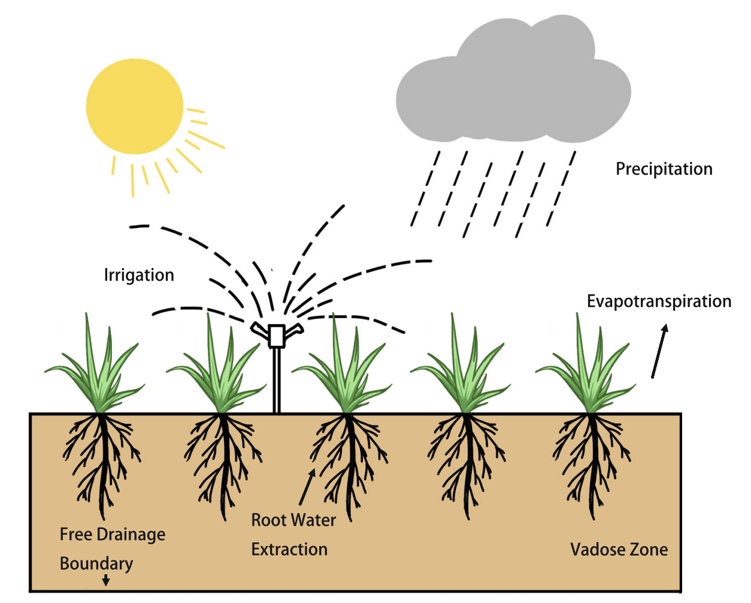
Introduction
Water Scarcity: More Population & Climate Change
Farming uses about 70% of all freshwater available
Current Scenario:
Open-loop systems: Based on experience, not real-time data
(low irrigation efficiency)
Precision Agriculture:
Improve irrigation efficiency
Develop smarter, data-driven watering methods
Real time feedbacks are considered
Huang et al., 2023
Notes:
This problem is growing worldwide, and one of the biggest factors is how we use water in agriculture.
Did you know that farming uses about 70% of all our freshwater? That’s a huge amount, which is why improving how we use water in agriculture is so important.
Currently, most irrigation systems are what we call ‘open-loop’. This means farmers often rely on experience or guesswork to decide when and how much to water their crops. They’re not using real-time information from the fields.
The problem with this approach is that it’s not very efficient. Sometimes crops get too much water, and sometimes not enough. This wastes water and can affect crop yields.
Our goal is to find smarter ways to irrigate. We want to develop systems that use real-time data to make better decisions about watering. This could significantly improve water efficiency in agriculture and help address the global water scarcity issue.
In the next part of our presentation, we’ll look at some innovative solutions to this challenge.

Slide 3
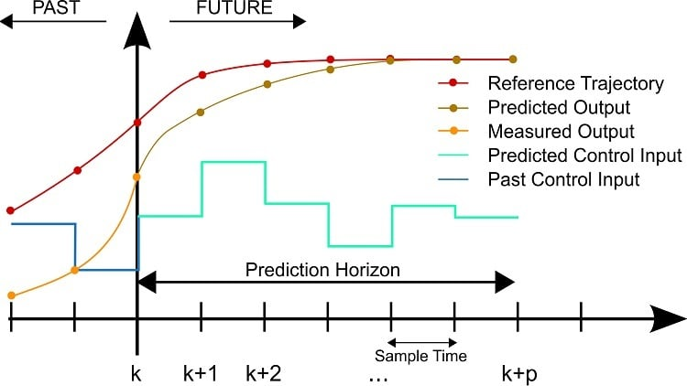
Model Predictive Control
Mechanism:
Collect real-time soil moisture data (sensors)
Predict future soil moisture levels
Calculate optimal irrigation actions (water)
Apply irrigation to the field
Repeat at next time step
Control Objective:
Minimize the amount of irrigation, while keeping the soil moisture content within target Challenge:
High computational cost (complex soil-water dynamics)
Model reduction/approx techniques: Neural Networks
https://electronics360.globalspec.com/article/17088/advantages-and-applications-of-model-predictive-control
Notes:
Reference Trajectory (Red Line): Represents the desired soil moisture level or target range for optimal crop growth.
Measured Output (Yellow Dots): The actual soil moisture levels measured in real time using sensors in the field.
Predicted Output (Orange Line): The soil moisture levels predicted by the MPC model based on current conditions and control inputs.
Predicted Control Input (Blue Steps): The irrigation actions (e.g., water amount) calculated by MPC to achieve the desired soil moisture levels while staying within constraints.
Past Control Input (Black Line): The irrigation actions that have already been applied in previous time steps.
Prediction Horizon: he future time window over which MPC predicts and optimizes soil moisture dynamics.
Sample Time: The interval at which new measurements are taken, predictions are updated, and control inputs are recalculated. How It Works in Precision Agriculture At each time step , MPC collects real-time data from soil moisture sensors (yellow dots).
Using this data, it predicts how the soil moisture will change over the prediction horizon (orange line).
Based on these predictions, MPC calculates the optimal irrigation actions (blue steps) to bring the soil moisture closer to the reference trajectory (red line).
These actions are applied to the field, and the process repeats at the next sample time.
Real-Time Feedback: MPC continuously adjusts irrigation based on real-time sensor data.
Efficiency: By predicting future conditions, it avoids over-irrigation or under-irrigation.
Adaptability: It accounts for weather changes and other disturbances.
Optimization: Ensures water use is minimized while maintaining optimal soil conditions for crop growth. Model approximation techniques: 1. project the high dimension original state space onto a lower dimension subspace (physical meaning of the original states are not preserved)
2. Data-based model identification methods (no first principal relations required) 3. Neural Network based optimization (Long Short Term Memory, LSTM ability to capture the complex dynamics of the system) Ultimate goal of the project: Propose a two layer Neural Network framework to approximate the agro-hydrological dynamics

Slide 4
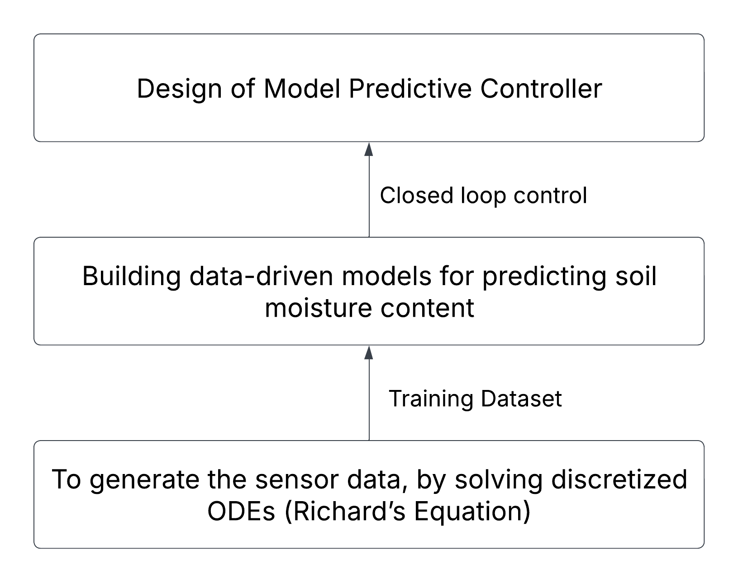
Objective
To develop a advanced controller which can maintain the soil moisture at desired level.
.
Model Discretization

Slide 5
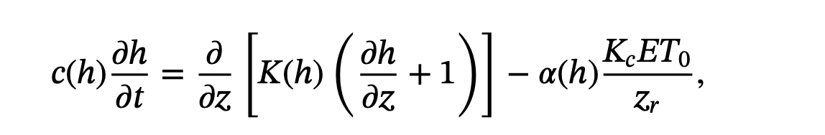
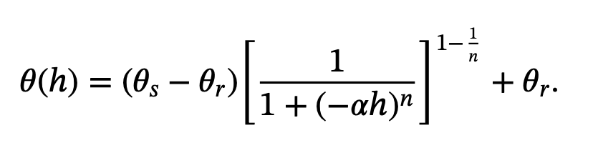
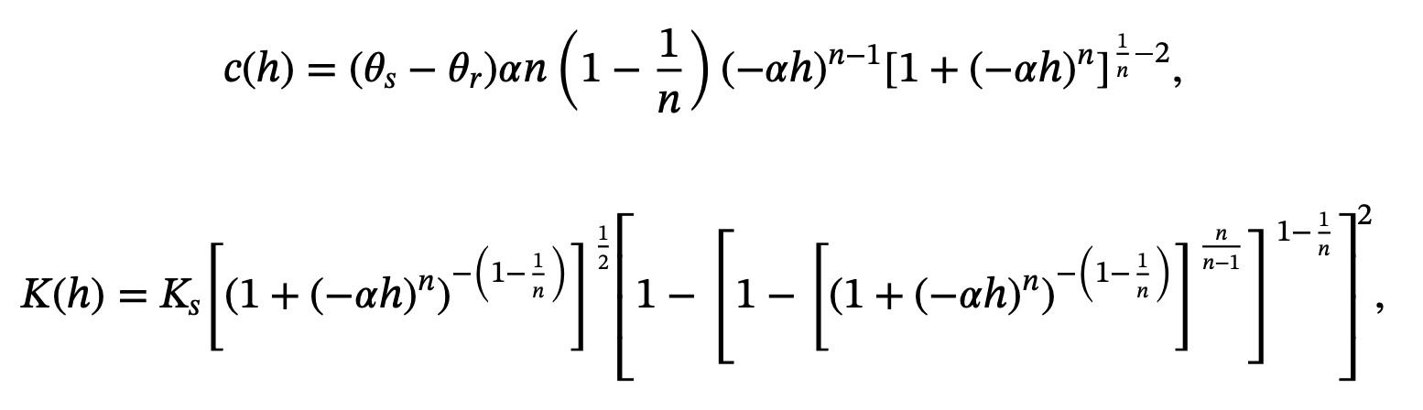
Soil Water Dynamics
1-dimensional Richards equation given by,
van Genuchten–Mualem soil hydraulic model given by,
Soil-water retention equation of van Genuchten
where,
h(m) - capillary potential
c (m⁻¹) - the soil capillary capacity
ET₀ (m) - reference evapotranspiration
z_{r}(m)- rooting depth of crop
z(m) - vertical axis of the soil
K (h) - soil hydraulic conductivity
K_{c} - dimensionless crop coefficient
Ks - saturated hydraulic conductivity
𝜃s and 𝜃r - saturated and the residual soil moisture
𝛼, n - van Genuchten–Mualem parameters(soil specific)
Notes:
First Step - generation of molecular descriptors or fingerprints from chemical structures using SMILES.
SMILES - to represent chemical compounds
SMILES (Simplified Molecular Input Line Entry System)
2nd Step - Calculating the molecular descriptors using SMILES notations.
Pubchem FP - binary vector of fixed length where each bit represents the presence (1) or absence (0) of particular structural feature or pattern within the molecule.
3rd Step - using the desired molecular descriptors to predict the target variable.

Slide 6
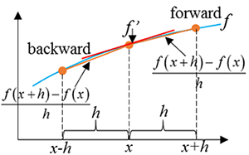
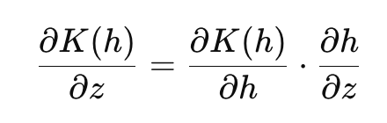
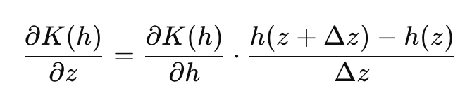
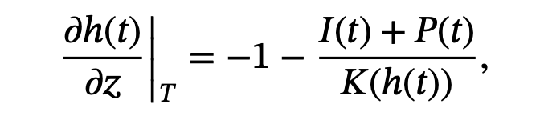
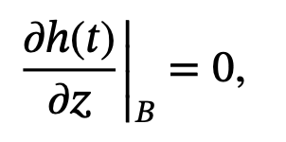
Model Discretization: Finite Difference
Assumptions:
Total depth (z) of soil is 0.5 m, evenly discretized into 26 nodes.
Center of each node is used to represent the dynamics of entire node
System Input: Irrigation/Precipitation rate
Model states: capillary potential (h) at nodes
Forward Difference:
https://www.multiphysics.us/FDM.html
Boundary Conditions:
Top: Bottom:
Notes:
IC50 - It indicates how much drug is needed to inhibit a biological process by half.
PaDEL Descriptor (or PaDEL-Descriptor) is a software tool used for calculating molecular descriptors and fingerprints from chemical structures.
Target Variable - pIC50 values
Input Features - Puchem Fingerprints

Slide 7
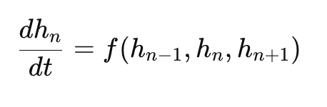
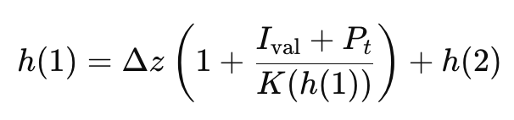

Model Discretization Continued..
After Model Discretization (PDE to ODEs),
[ time domain ]
Generalized form of ODEs, (n = 1, 2, 3, ……….., 23, 24)
Relations from BCs,
non-linear
Non-linear differential term
Notes:
IC50 - It indicates how much drug is needed to inhibit a biological process by half.
PaDEL Descriptor (or PaDEL-Descriptor) is a software tool used for calculating molecular descriptors and fingerprints from chemical structures.
Target Variable - pIC50 values
Input Features - Puchem Fingerprints

Slide 8
Open Loop Simulation: MATLAB
Non-linear solver: fsolve
fsolve('algebraic_equation',H1_initial);
Ordinary Differential Equations solver: ode45
(variable step solver to approximate the solution of an ODE)
[t, H_vals] = ode45(@(t, H) pde_model(H), time_span, H_initial);
41 X 24
h₂, h₃, h₄, …………., h₂₄, h₂₅
Calculate h₁ and h₂₆ using the boundary conditions
Calculate the soil moisture profile for all 26 nodes
3. Non-linear differential term: Numerical Jacobian

Slide 9
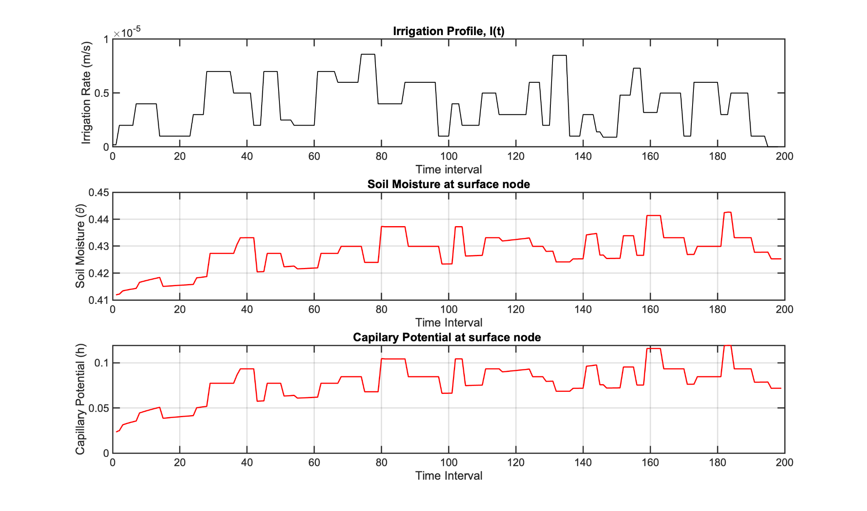
Results

Slide 10
Conclusion & Future Work
In summary, this work focused on:
Discretizing Richard’s equation (PDE) in the z-direction using the finite difference method.
Obtaining and solving the system of 24 ODEs in MATLAB with boundary conditions.
Deriving capillary potential (h) and soil moisture profile (θ) at nodes.
Generating sensor data (training set) for model development.
Future work:
To develop deep learning based predictive model which can predict the soil moisture content for longer periods of time.
To integrate the developed model with the advanced control scheme to maintain the soil moisture at desired operating zones.

Slide 11
References
Huang, Z., Liu, J., & Huang, B. (2023). Model predictive control of agro‐hydrological systems based on a two‐layer neural network modeling framework. International Journal of Adaptive Control and Signal Processing, 37(6), 1536-1558.
https://in.mathworks.com/help/optim/ug/fsolve.html
https://in.mathworks.com/help/matlab/ref/ode45.html
https://in.mathworks.com/help/mpc/gs/what-is-mpc.html
https://www.do-mpc.com/en/latest/theory_mpc.html
L.A. Richards (1931). Capillary Conduction of Liquids Through Porous Mediums. Journal of Applied Physics

Slide 12

THANK YOU

