Slide 1

CS5800 - ALGORITHMS
OPTIMIZING SHOPPING EXPERIENCE
Members:
Rahul Chandak Darshan Bhokare Ganavi Jayaram Shreya Ale

Slide 2
Contents
Introduction
Use Cases
Approach
About Knapsack Algorithm (Algorithm, Code, Test Case, Complexities)
Naive Approach
Knapsack using dynamic programming
Application
Limitation and weaknesses
Future Scope
Conclusion
References

Slide 3
Introduction
Shopping can be challenging for many people, as they often struggle to stick to their budget or carrying capacity or the nutritional value of the contents they buy. Our algorithm aims to address this issue by providing personalized recommendations on which items to purchase, prioritizing the items of the highest value (weight or nutritional value) according to the user's budget. By following these recommendations, users can maximize the efficiency of their shopping trip, ensuring they purchase the most important items first.

Slide 4
Use Cases
Students: While shopping for groceries they could use the algorithm to prioritize which food items to purchase based on their weight value. Students usually don’t own private vehicles so they can maximize the weight of the cart and carry it back in a ‘single’ taxi trip.
Someone who is moving to a new city and needs to furnish their apartment on a limited budget could use this algorithm to prioritize which items to purchase first based on their relative importance, value, and weight.
A family that is grocery shopping on a tight budget could use this algorithm to prioritize which food items to purchase based on their nutritional value.
Holiday shopping: The algorithm would help them to prioritize which gifts to purchase based on their value and weight, ensuring that the total cost of the purchased items does not exceed their budget limit and that they can carry the purchased items home.

Slide 5
Why we chose this topic?

Slide 6
Approach to the solution
We plan to apply the knapsack algorithm with various parameters like weight, nutritional value, etc. to optimize the shopping experience for the user.
The plan is to demonstrate by comparing a naïve approach with the optimized solution involving dynamic programming.
In the course, we learned about dynamic programming in Module 8 and Module 9. To be specific knapsack algorithm was covered in Module 8: 8.4.
Initially, we will cover the solution with a greedy algorithm approach and then optimize it with a dynamic programming approach concluding why the latter is better than the two.
Assumptions:
User has pre-decided the list of items from which they wish to buy.
The approximate cost of the items entered by the user is close to the actual price of the item in the store.

Slide 7
About Knapsack Algorithm
Knapsack is a classic optimization problem in computer science.
It involves selecting a subset of items that maximizes the value while staying within a weight limit.
There are two main variations of the problem: 0/1 Knapsack, where each item can only be selected once, and Fractional Knapsack, where items can be divided and selected partially.
0/1 Knapsack is an NP-hard problem, which means there is no known efficient algorithm to solve it exactly in polynomial time for large instances. However, dynamic programming can be used to solve it approximately or find an optimal solution for small instances.
Fractional Knapsack can be solved optimally using a greedy algorithm that sorts items by their value-to-weight ratio and selects them in descending order until the weight limit is reached.
Knapsack problems have many real-world applications, such as resource allocation, budgeting, and scheduling.

Slide 8
Naive Approach(0/1 Knapsack using recursion)
The algorithm is a recursive implementation of the Knapsack problem, which seeks to maximize the value of items packed into a knapsack of limited capacity. The algorithm defines a function called knapsack, which considers each item in turn and decides whether to include it in the knapsack or not. The function returns the maximum value obtained by including or excluding the current item, and the algorithm calls the function with the total number of items and the knapsack capacity to obtain the optimal solution.
Time Complexity: O(2^n)
Space Complexity: O(n)

Slide 9
Optimized Approach
0/1 Knapsack using dynamic programming
User provides the items, cost and weight of the items
creates 2D array for dp
dp[i][j] = 0, if i = 0 or j = 0
dp[i][j] = dp[i-1][j], if w[i] > j
dp[i][j] = max(dp[i-1][j], v[i] + dp[i-1][j-w[i]]), if w[i] <= j

Slide 10
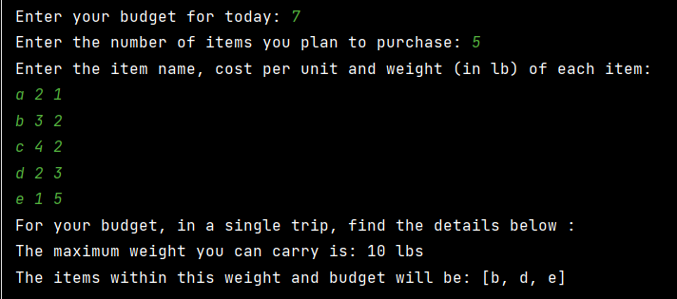
Test Case

Slide 11
Time Complexity
O(N * W). where ‘N’ is the number of elements and ‘W’ is capacity.

Slide 12
Space Complexity
O(N * W). The use of a 2-D array of size ‘N*W’.

Slide 13
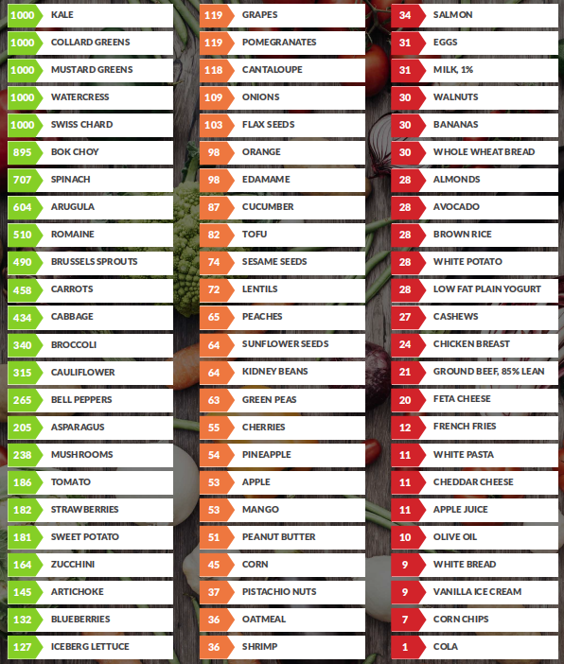
Application - Optimizing the
nutritional value of the cart
Knapsack can be used to maximize the nutritional content of the cart within the budget of the user.
Dr. Fuhrman created the ANDI (Aggregate Nutrient Density Index) to show how popular foods stack up in terms of micronutrient density per calorie.
The more nutrient-dense food you consume, the more you will be satisfied with fewer calories.

Slide 14
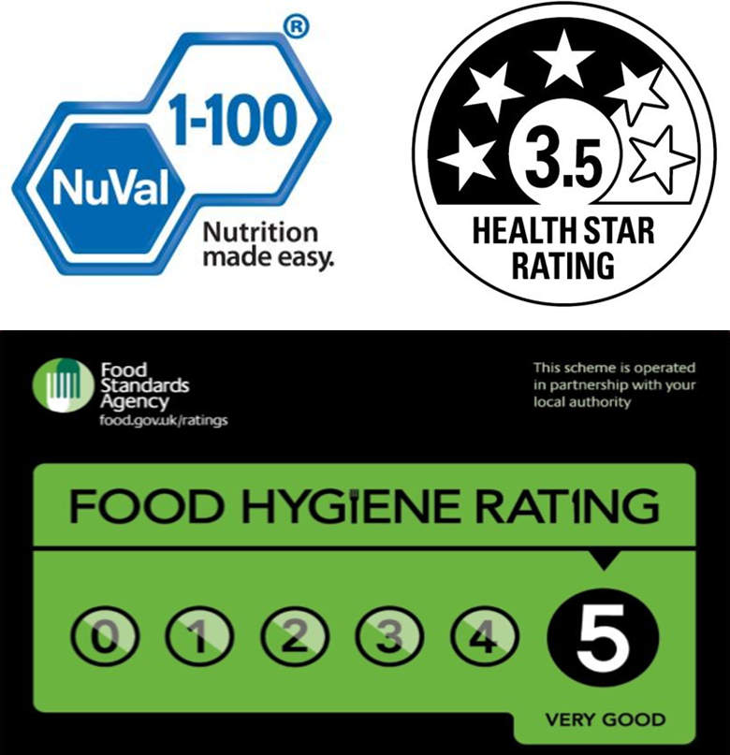
Other Scoring Systems
NuVal Nutritional Scoring System
HSR (Health Star Rating)
FSA Score (Food Standards Agency Score)
NRF (Nutrient Rich Foods Index)
and many more…

Slide 15
Limitation and Weaknesses
We assume that the user knows the exact price or weight or nutritional value of the product.
It is limited to one-time shopping.
It also doesn’t account for dependent products. For example, a user may need to buy a specific accessory or component to use a particular product. This might result in an incomplete or inefficient shopping experience.

Slide 16
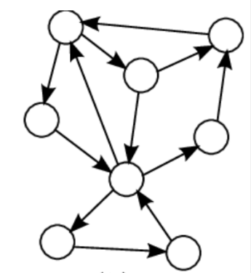
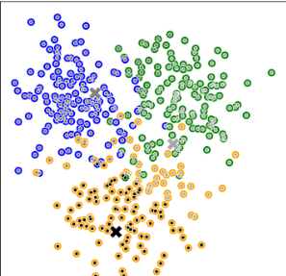
Future Scope
This solution can be extended and incorporated with shortest distance algorithms like Dijkstra’s algorithm, which will guide people in the order they should purchase items.
Use a multidimensional knapsack algorithm to optimize the shopping experience based on multiple criteria, such as price, quality, and nutritional value.
Use k-means clustering to group similar products together. This can help to provide user’s suggestions on what items to buy based on their preferences.

Slide 17
Conclusion
The Knapsack algorithm with dynamic programming proves to give us an optimized solution which can provide relevant suggestions to users on prioritizing what items they should buy.
It can help people save a lot of time, money and efforts.
This algorithm can be extended with the addition of more parameters which allows more choices for the user in a long run.

Slide 18
What we learnt from this project?

Slide 19
References
https://www.sciencedirect.com/science/article/abs/pii/S0377221715009212 ·
https://inviarobotics.com/blog/knapsack-problem-and-warehouse-optimization/#:~:text=The%20Knapsack%20Problem%20is%20an,most%20value%20into%20the%20knapsack.
https://apmonitor.com/me575/index.php/Main/KnapsackOptimization
https://www.drfuhrman.com/blog/128/andi-food-scores-rating-the-nutrient-density-of-foods

Slide 20
Thank
You

