Slide 1
Concrete strength prediction using a Neural Network

Slide 2
Overview
Predicts concrete compressive strength using 8 parameters like cement, slag, water etc. for a given sample
Implemented in R statistical programming language using “neuralnet” package
Uses a 1 hidden layer feed-forward artificial neural network

Slide 3
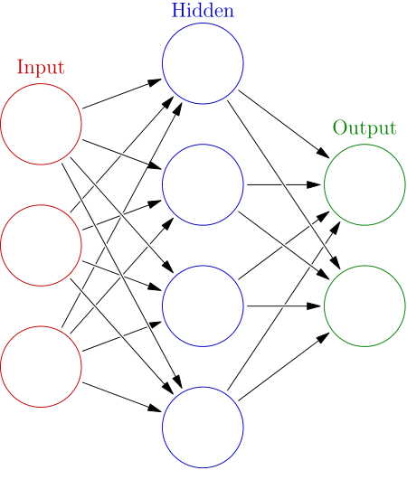
Artificial Neural Network
Artificial Neural Networks are computational networks of “neuron” units based on biological neurons
ANNs consist of neurons connected to each other the input to a neuron determining its activation, which in turn is used as an input to other neurons
The links between the neurons have “weights” that modify the input
A feed-forward network has no connections that form a directed cycle

Slide 4
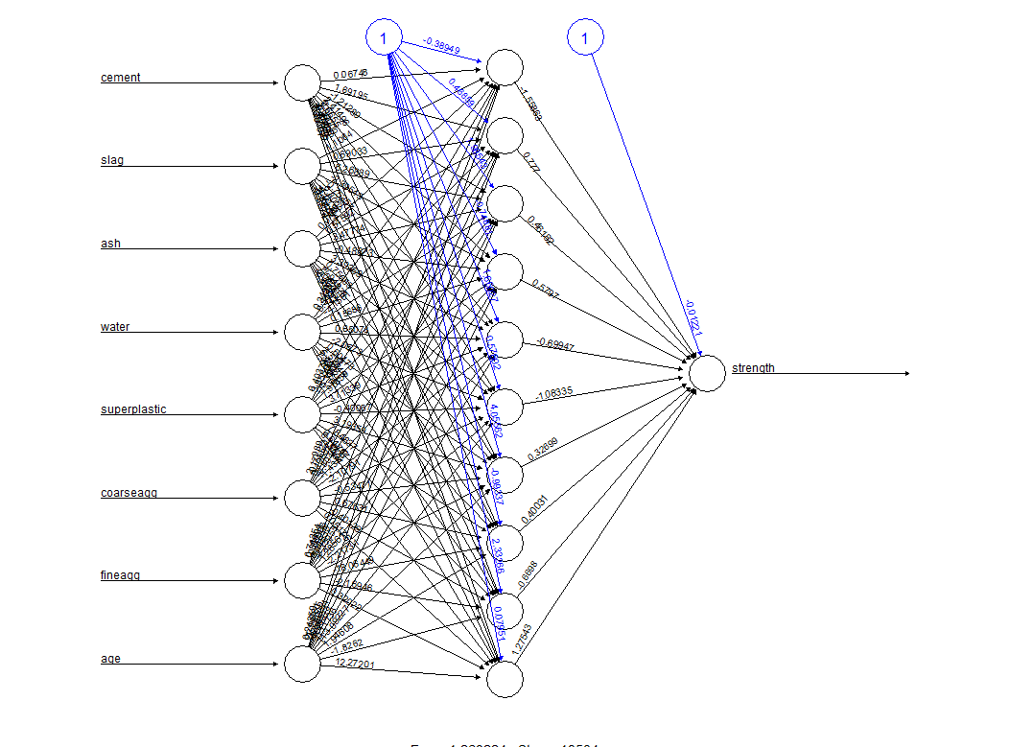
Neural Network Layout for 10-unit hidden layer model

Slide 5
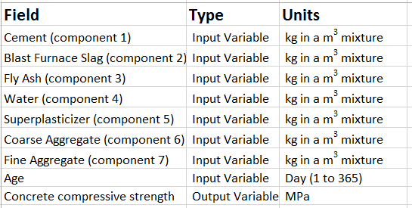
The data
The dataset was donated by Prof. I-Cheng Yeh, Department of Information Management, Chung-Hua University, Taiwan and is hosted at the University of California, Irvine’s Machine Learning repository
The dataset contains 1030 examples of concrete mixtures each with different amounts of the 8 input variables along with their known compressive strengths

Slide 6
Program flow
Load the dataset into R environment. Normalize the variables
Divide the dataset into training and test sets (80:20)
Use “neuralnet” package to import neural network implementation to R. Train it using training data. Keep number of neurons in the hidden layer at 1
Test the model with test data.
Repeat train and test again but with 5, 10, 50 hidden units

Slide 7
Results
No. of hidden units | Correlation
1 | .717
5 | .801
10 | .932
50 | .939
Since the task is numerical prediction, we use correlation to measure our model’s accuracy
We notice that the as the number of hidden units increase, the processing time increases greatly. The final run with 50 hidden units took around 250 seconds to run on a 6-core 3.4 GHz CPU
The model performance improves dramatically from when the hidden units are increased from 1 to 10 but hardly any improvement is seen beyond that.

Slide 8
Discussion
A simple feed-forward ANN can be deployed relatively easily with number of hidden units in different layers being the main parameters to be decided by the user.
ANNs can consume significant CPU time. Parallel implementations using GPUs allow us to vastly increase the computation speed
Having more hidden units may not always result in significant improvements in model performance

Slide 9
References
Dataset download link http://archive.ics.uci.edu/ml/datasets/Concrete+Compressive+Strength
Modeling of strength of high performance concrete using artificial neural networks, Cement and Concrete Research, Vol. 28,pp. 1797-1808, by I-C Yeh (1998)
“R: A language and environment for statistical computing”, R Development Core Team (2014), R Foundation for Statistical Computing, Vienna, Austria. http://www.R-project.org
“Machine Learning with R”, Brett Lantz, Packt Publishing

