Slide 1
Market Basket Analysis using Apriori algorithm on “Groceries” dataset

Slide 2
Overview
Identifies frequently purchased groceries from given transactional data
Implemented in R statistical programming language using “arules” package
Uses “Apriori” algorithm to efficiently search large databases of transactional data for association rules

Slide 3


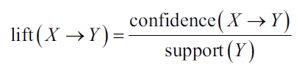
Apriori algorithm
Apriori algorithm employs a simple a priori belief as guideline for reducing the association rule search space: all subsets of a frequent item-set must also be frequent
The support of an item-set or rule measures how frequently it occurs in the data
A rule's confidence is a measurement of its predictive power or accuracy. It is defined as the support of the item-set containing both X and Y divided by the support of the item-set containing only X
Lift is a measure of how much more likely one item is to be purchased relative to its typical purchase rate, given that you know another item has been purchased

Slide 4
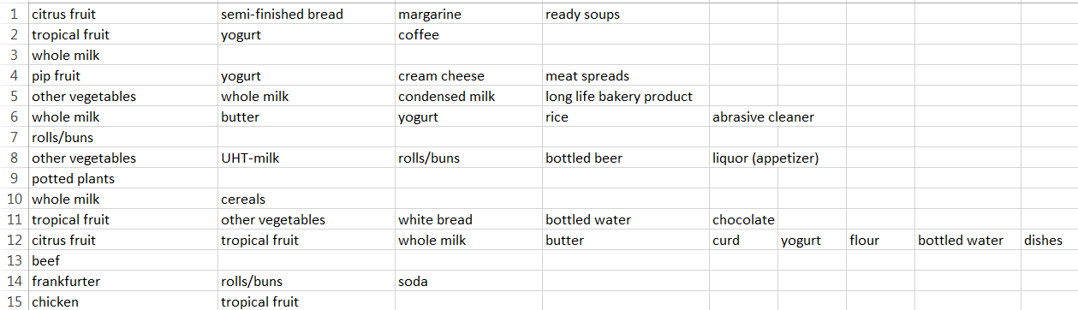
The data
The dataset has been created by researchers Department of Information Systems and Operations, Wirtschaftsuniversitat Wien, Austria
The “Groceries” data set contains 1 month (30 days) of real-world point-of-sale transaction data from a typical local grocery outlet. The data set contains 9835 transactions and the items are aggregated to 169 categories
Item categories have been used instead of brands, for simplicity. So “milk” can refer to any brand of milk.

Slide 5
Program flow
Load the dataset into R environment
The data is in the form of transactions. The transactions have different item-lengths and the items in a transaction are arranged in no apparent sequence
We use a sparse matrix to represent this information. The matrix has 169 columns (corresponding to 169 item categories) and 9835 rows (corresponding to 9835 transactions)
Apply Apriori algorithms with different support/confidence and lift parameters to generate association rules

Slide 6
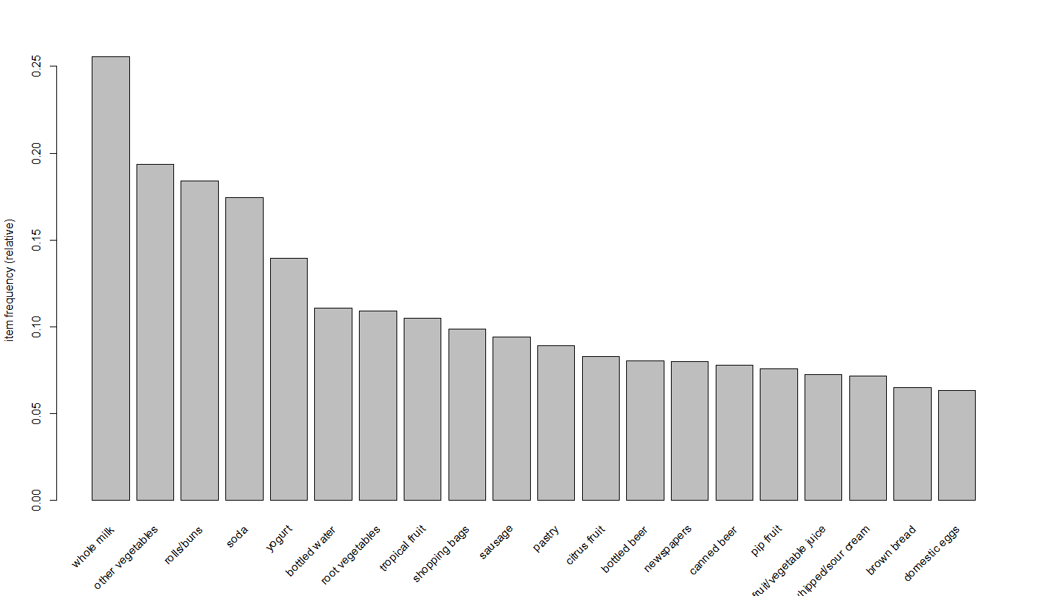
Top 20 most frequent items

Slide 7
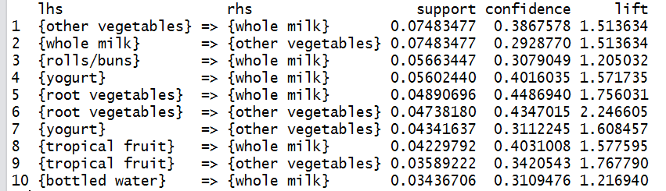
Results: Top 10 rules by “support”

Slide 8
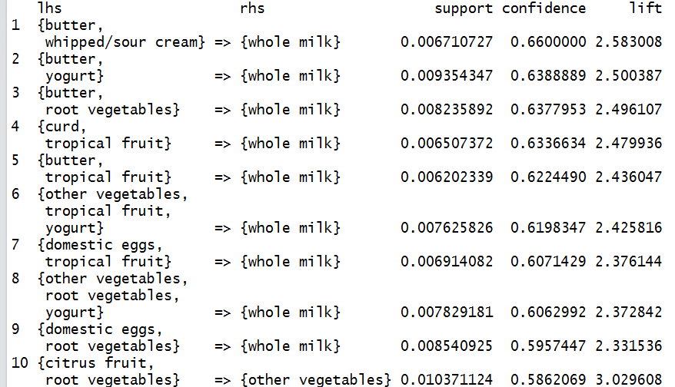
Results: Top 10 rules by “confidence”

Slide 9
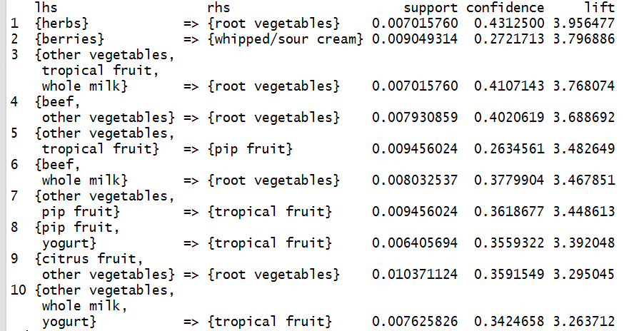
Results: Top 10 rules by “lift”

Slide 10
Discussion
We can see that the top rules when sorted by “support” and “confidence” are dominated by “whole milk” and “other vegetables”, which are the two most frequently bought items overall
However, when “lift” is considered we get rules not involving “whole milk” and “other vegetables”. A lift value of greater than 1 implies that LHS and RHS sets are found more often than purely by chance
Although such market basket analysis may yield many rules, not all of them would be useful. Some would be trivial, some inexplicable and only a very few of them would be actually useful. Further analysis and extra domain knowledge and common-sense is often required to subjectively judge the real-world usefulness of the rules

Slide 11
References
Dataset download link (via “arules” package) http://cran.r-project.org/web/packages/arules/index.html
"Fast algorithms for mining association rule", in Proceedings of the 20th International Conference on Very Large Databases, pp. 487-499, by R. Agrawal, and R.Srikant, (1994).
“Implications of probabilistic data modelling for mining association rules” , in Studies in Classification, Data Analysis, and Knowledge Organization: from Data and Information Analysis to Knowledge Engineering, pp. 598–605, by M. Hahsler, K. Hornik, and T. Reutterer, (2006).
“R: A language and environment for statistical computing”, R Development Core Team (2014), R Foundation for Statistical Computing, Vienna, Austria. http://www.R-project.org
“Machine Learning with R”, Brett Lantz, Packt Publishing

