Slide 1
Music Classifier using Fast Fourier Transform

Slide 2
Overview
Classifies a music file into either “metal” or “classical” genres
Implemented in Python using “scikit-learn” machine learning package
Uses Fast Fourier Transform to extract features from .wav files
Features are learnt by a logistic regression classifier to predict the genre of test music files

Slide 3
Using Fast Fourier Transform
A Fourier transform converts time (or space) to frequency and vice versa
A fast Fourier transform (FFT) is an algorithm to compute the discrete Fourier transform (DFT) and its inverse
Computing the DFT of N points in the naive way takes O(N^2) operations, while a FFT can compute the same DFT in only O(N*log N) operations
FFT algorithm used is contained in “SciPy” numerical routines library

Slide 4
The data
The data is taken from the “GTZAN” music dataset put together by Prof. George Tzanetakis of Carnegie Mellon University
The dataset consists of 8 different genres and 100 x 30-second samples of each type
Here only 2 of the genres i.e. “metal” and “classical” have been chosen
“metal” genre includes music by Iron Maiden, Metallica, Black Sabbath etc.
“classical” genre includes music by Mozart, Bach, Beethoven, Vivaldi etc.
90 randomly chosen pieces from each of the 2 categories make up the training set
The remaining 10 of each are the test set and not used while training

Slide 5
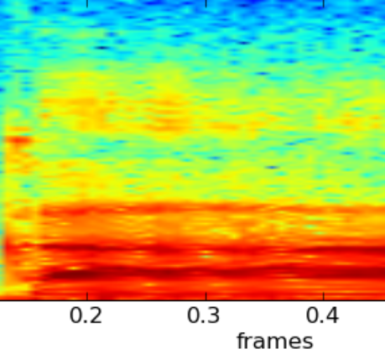
create_fft Function
This function takes a .wav file as input and extracts FFT features from it
Only 1000 features are used. The features are stored in a 1 x 1000 matrix in file with “.fft.npy extension”
Eg. “classical.00000.fft.npy”
Option to view spectrogram of each .wav file is there in the function. It has been commented out to speed up the process
Sample Spectrogram

Slide 6
read_fft Function
This function takes a *.fft.npy file as input and extracts reads its contents
The FFT contents for each and every of the 180 songs in the training set are stored in “X_array” variable (180 x 1000 matrix)
“Y_array” contains the labels i.e. {“metal” , “classical”} for the respective .wav files
Similarly “X_test” and “Y_test” contain features and labels of the test set

Slide 7
Program flow
Use “create_fft” function to extract FFT features and save them in *.fft.npy files for all 200 .wav files
Use “read_fft” twice , 1st to populate “X_array” and “Y_array” and 2nd time to populate “X_test” and “Y_test”
Train scikit-learn’s Logistic Regression classifier.
Use the trained model to predict the test set

Slide 8
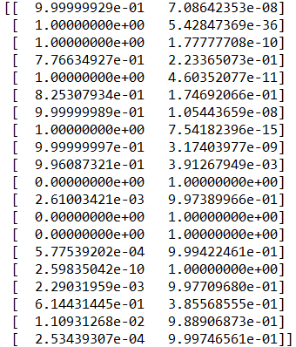
Results
The first 10 test entries are “classical” and the last 10 are “metal”
The two columns give the probability of a test .wav file as belonging to “classical” (1st column) and “metal” (2nd column)
We can see that for the 1st 10 entries(true class : “classical”), almost all are classified correctly with high accuracy (i.e. 1st column for these 10 is ~1 and 2nd column is ~0). However, 4th and 6th test examples are classified correctly but with probabilities much lesser than 1 i.e. 0.776 and 0.825 . If we had kept a threshold of 0.500, we would have still classified all of them correctly
For the next 10 test entries(true class: “metal”), we see that all except one was classified with near perfect accuracy of ~1. However the 7th “metal” entry(3rd from the bottom) was misclassified as “classical” with only 0.385 probability for its true class “metal”

Slide 9
Discussion
This is a rather simple application of machine learning to signal processing. Without using advanced signal processing concept to analyse the music files, we were able to achieve very good classification
FFT is one of the most basic methods of analyzing signals. More advanced techniques that can be used to extract features from sound files
One common feature extracted is the Mel-Frequency Cepstral Coefficient (MFCC) which is a measure of the timbre of a piece of music. Other features may be employed to represent the chords, harmonies, melody, main pitch, beats per minute or rhythm in the piece.

Slide 10
References
Dataset download link http://opihi.cs.uvic.ca/sound/genres.tar.gz
“The GTZAN dataset: Its contents, its faults, their effects on evaluation, and its future use, Sturm”, Sturm, Bob L., http://arxiv.org/abs/1306.1461
Scikit-learn: Machine Learning in Python, Pedregosa et al., JMLR 12, pp. 2825-2830, 2011.
“SciPy: Open source scientific tools for Python”, Eric Jones and Travis Oliphant and Pearu Peterson and others, http://www.scipy.org/
“Building Machine Learning Systems with Python”, Willi Richert and Luis Pedro Coelho, Packt Publishing

