Slide 1
GPU-accelerated Neural Networks

Slide 2
Overview
Modified a pre-existing C code to include CUDA directives to show how the GPU can be used via Microsoft Visual Studio
Review existing tools that can be used to implement GPU-accelerated neural networks
Used “Multiple Back-Propagation” free software to implement a GPU-accelerated neural network-based parity checker

Slide 3
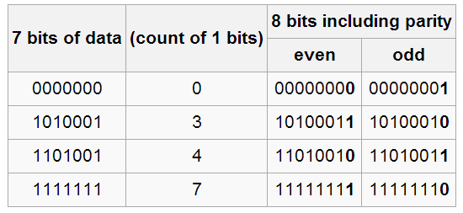
Parity-bit checking
A parity bit is a bit added to the end of a string of binary code that indicates whether the number of bits in the string with the value one is even or odd.
Here we use even parity i.e. “1” if the code has an odd number of “1” bits. And “0” if the code has an even number of “1” bits.
It can be calculated via an XOR sum of the bits, yielding 0 for even parity and 1 for odd parity
One of the simplest forms of error detecting codes

Slide 4
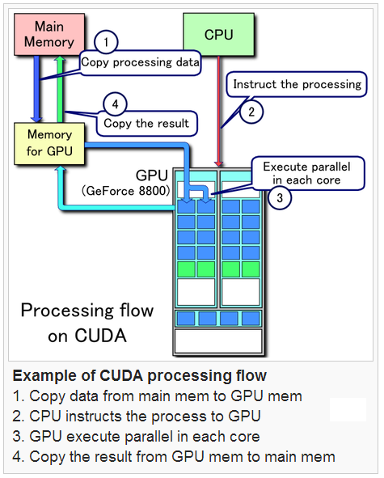
CUDA
GPUs have a parallel throughput architecture that emphasizes executing many concurrent threads slowly, rather than executing a single thread very quickly
CUDA (Compute Unified Device Architecture) is a parallel computing platform and programming model created by NVIDIA and implemented by the NVIDIA graphics processing units (GPUs)
Using CUDA, the GPUs can be used for general purpose processing and not just for graphics
We use NVIDIA GTX 650 Ti Boost 2GB Graphics card and CUDA Toolkit version 5.5

Slide 5
Parallelizing code for CUDA-enabled GPU
We access CUDA via Microsoft Visual Studio 2012 Visual C
Original code can be found at http://www.cs.bham.ac.uk/~jxb/NN/nn.html
The C code implements a 1-hidden layer feed-forward neural network for parity checking
It outputs approximately 1 if the number of “1”s in the input is odd, or approximately 0 if the number of “1”s is even
It has been modified to use 10-bit binary input strings (instead of 2-bit) as training examples. 50 training examples have been hard-coded

Slide 6
Parallelizing code for CUDA-enabled GPU
A simple and naïve way to parallelize the serial C code would be to parallelize the vector-multiplication part
Vector-multiplication is very time-consuming as the size of the matrices grows
For multiplying two vectors of lengths “l”, we need to perform element-element multiplication “l” times serially
But using a GPU, we can multiply the element-element pairs with each other simultaneously
These concepts can be extended to matrix-multiplication and other vector/matrix related operations

Slide 7
Basic CUDA concepts
Host – The CPU and its memory (host memory)
Device – The GPU and its memory (device memory)
GPUs are programmed as a sequence of ”kernels”; typically, each kernel completes execution before the next kernel begins, with an implicit barrier synchronization between kernels
The host program launches a sequence of kernels. A kernel is organized as a hierarchy of threads. Threads are grouped into blocks, and blocks are grouped into a grid. Each thread has a unique local index in its block, and each block has a unique index in the grid. A kernel can access this information via “threadIdx” and “blockIdx” data structures

Slide 8
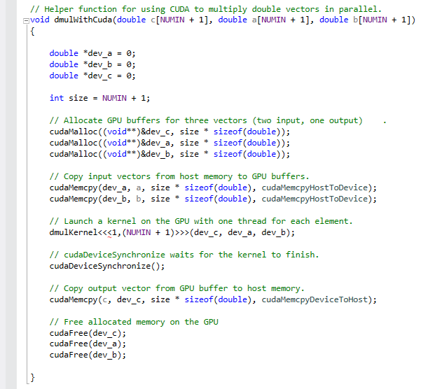
CUDA Code
This a C function that multiplies two vectors of type “double” using CUDA
The “cudaMalloc” function tells the NVIDIA C compiler to allocate memory on the GPU whereas “cudaFree” de-allocates memory
“cudaMemcpy” transfers data between the CPU and GPU
dmulKernel<<<>>> launches the kernel on 1 thread block consisting of (NUMIN + 1) threads

Slide 9
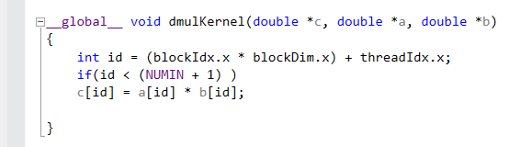
CUDA Code
This a CUDA C kernel that multiplies two vectors of type “double” using CUDA
Each kernel identifies itself using “id”. The unique “id” is calculated using the block index and the thread index within the block
Kernels are launched in groups of 32, so extra kernels may be launched. The “if” check ensures that only kernels that fall within the vector length carry out the multiplication

Slide 10
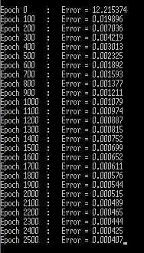
Output
The training Mean Squared Error has been set to 0.0004. So once this MSE threshold has been attained the training will stop
Training the neural network is the most time-consuming part of using neural networks. Predicting outputs using a trained neural network is a many orders of magnitude faster
We can see that the training error drops significantly in the 1st 100 epochs and continues to drop, though slowly
The training process has been set to terminate either after reaching the MSE threshold of 0.0004 or 10000 epochs. By 2500 epochs it has reached 0.000407

Slide 11
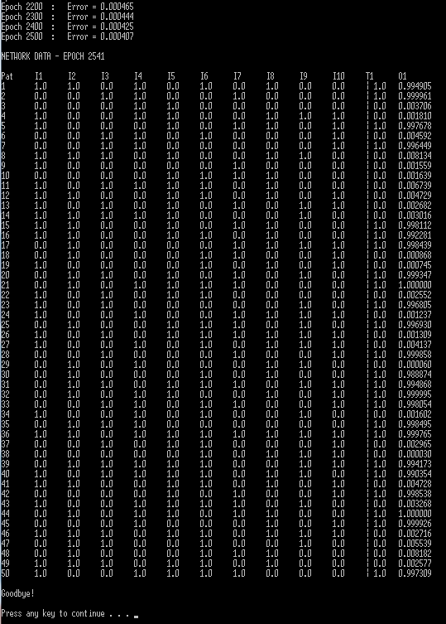
Output
The training stopped after 2541 epochs
The 1st column “Pat” is the pattern number. 50 training patterns have been hard-coded
The next 10 columns “I1 to I10”, represent one input pattern made of 10 bits
T1 represents the ideal output. Here, since we have implemented a parity bit checker, it should give “1” when there are an odd number of “1”s in the input sequence and give “0” otherwise
O1 is the output predicted by the neural network on the individual training examples

Slide 12
Discussion
In this implementation, we just changed the serial code to do just 1 vector multiplication i.e. we replaced one nested “for” loop with the GPU kernel
The GPU implementation actually was ~100,000 times slower than the CPU implementation! It would have been even slower had we modified more instances of the serial vector multiplication to use the GPU kernel code
This is because there are severe bottlenecks while transferring the data from the CPU to the GPU, initializing the GPU, running the kernels and transferring data back to the CPU
Hence to fully harness the power of the GPU while training, the program has to be built from the ground up to use the GPU while minimizing the data transfer to and fro.
Ideally, the entire training data, NN parameters etc. should be fed into the GPU just once at the start. All intermediate calculation results must be held within the GPU as well. This necessitates a large GPU memory (2GB+)
We now look at some professionally made open-source GPU-accelerated neural network packages which achieve 10x-20x speed-ups

Slide 13
Theano
“Theano” is a Python library that allows to define, optimize, and evaluate mathematical expressions involving multi-dimensional arrays efficiently
Theano was made for Linux and uses the CUDA(NVIDIA specific) as well as other open frameworks like OpenCL to interact with the GPU
Theano was created in 2007 at LISA Lab, University of Montreal. It is still under active development and is used by the university in its IFT6266 classroom course on deep layer learning
Theano is extremely well-documented and has ready-made code examples that implement different types of neural networks
Theano http://deeplearning.net/software/theano/introduction.html
Multi-layer perceptron using Theano http://deeplearning.net/tutorial/mlp.html
Convolutional Neural Network using Theano http://deeplearning.net/tutorial/lenet.html

Slide 14
OverFeat
OverFeat is an image recognizer and feature extractor built around a convolutional network http://cilvr.nyu.edu/doku.php?id=software:overfeat:start
OverFeat was built by the “Computational Intelligence, Learning, Vision, and Robotics” (CILVR) Lab at the Ney York University
OverFeat has been built mainly for large scale image classification tasks with datasets involving hundreds of thousands of images
Pierre Sermanet, a Phd student at the CILVR Lab who primarily developed OverFeat won the 1st prize at “Cats and Dogs” image classification task on Kaggle.com using OverFeat, achieving an error of just 1.09% http://cs.nyu.edu/~sermanet/
OverFeat has been successfully used in many image recognition contests including the yearly “ImageNet” challenges

Slide 15
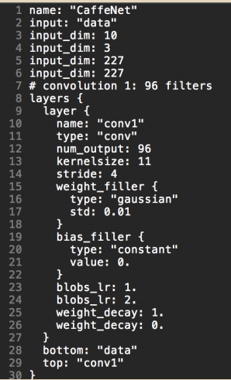
CAFFE
CAFFE (Convolutional Architecture for Fast Feature Embedding) is a framework for convolutional neural network algorithms
It was created by Yangqing Jia, and is in active development by the Berkeley Vision and Learning Centre, University of California, Berkeley
Rather than writing code, CAFFE let’s us define the model and solving strategy
CAFFE is claimed to be the fastest GPU Convolutional Neural Network implementation publicly available, and is able to process more than 40 million images per day with a single NVIDIA K40 or Titan GPU
http://caffe.berkeleyvision.org/

Slide 16
cuda-convnet
“cuda-connet” is a fast C++/CUDA implementation of convolutional (or more generally, feed-forward) neural networks.
It can model arbitrary layer connectivity and network depth. Training is done using the back-propagation algorithm.
It was created by Alex Krizhevsky and members of Geoffrey Hinton’s group at the University of Toronto
It is not in active development currently
https://code.google.com/p/cuda-convnet/

Slide 17
Fast Artificial Neural Network Library
Fast Artificial Neural Network Library is a free open source neural network library, which implements multilayer artificial neural networks in C
It was developed by Steffen Nissen while at the University of Copenhagen
It was started over 10 years ago in 2003 and has been actively developed since
Many support tools are available that extend its capabilities. For example, FANNTool is a GUI to the FANN library which allows its easy usage without the need for programming.
GPU support is currently experimental
http://leenissen.dk/fann/wp/

Slide 18
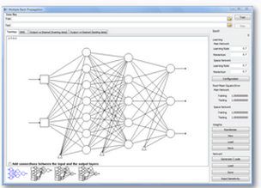
Multiple Back-Propagation
Multiple Back-Propagation algorithm and its software implementation was developed by Prof. Noel Lopes of University of Coimbra, Portugal
The software implements both regular feed-forward neural networks as well as multiple feed-forward neural networks(which can partition the input space using selective neurons)
The software was developed in C++ and CUDA with a small portion of the interface developed in C#
We use this software to implement a regular feed-forward neural network and train it in order to implement a parity-bit checker
http://mbp.sourceforge.net/index.html

Slide 19
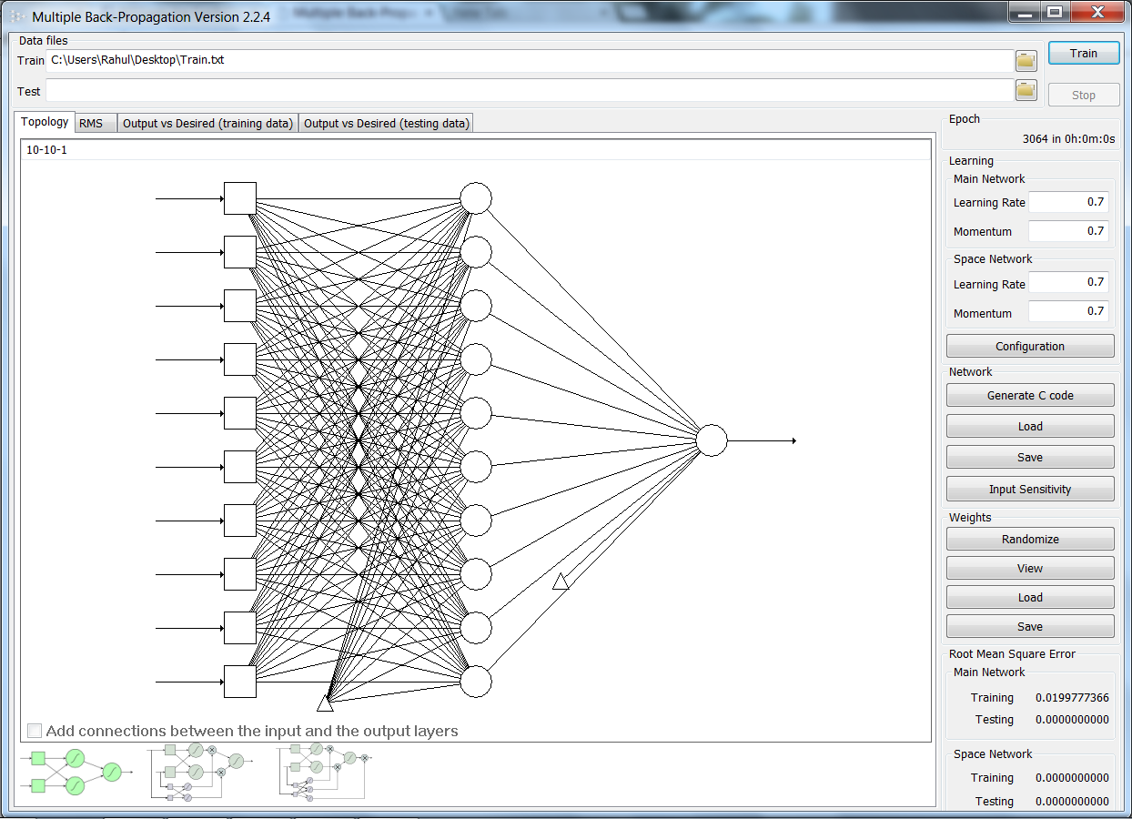
Using MBP software
We load the data in space separated form
We then specify the network topology as “10-10-1” i.e. 10 neurons in the input layer, 10 in the hidden layer and 1 in the output layer
The network graph is generated

Slide 20
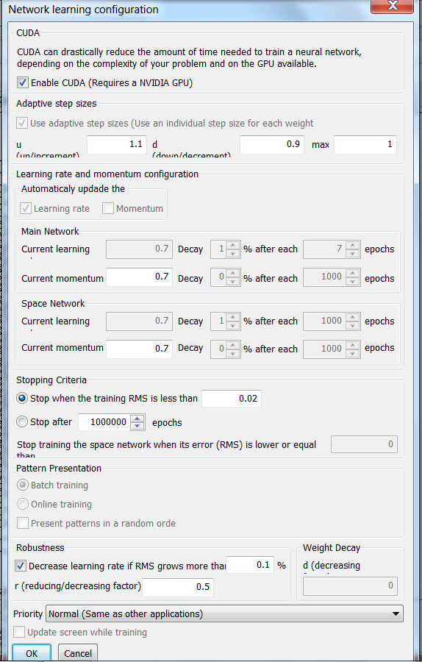
Using MBP software
We can change the network learning configuration
We set the RMS as 0.02 corresponding to the squared error of 0.0004
Checking the top-most box lets us use the GPU. This software specifically requires a CUDA-supported NVIDIA GPU with CUDA toolkit installed on the system
We press “OK”, then randomize the weights and finally press “Train” in the main window to start training

Slide 21
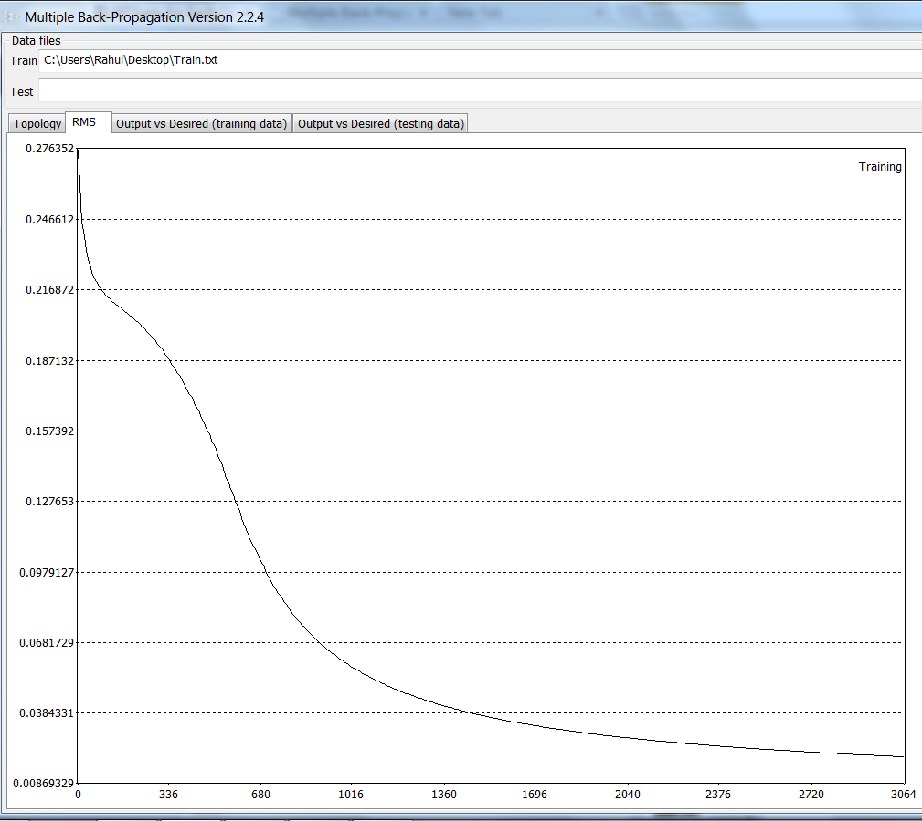
Using MBP software
The training stops after 3064 epochs
We can see how the training error decreases with number of epochs

Slide 22
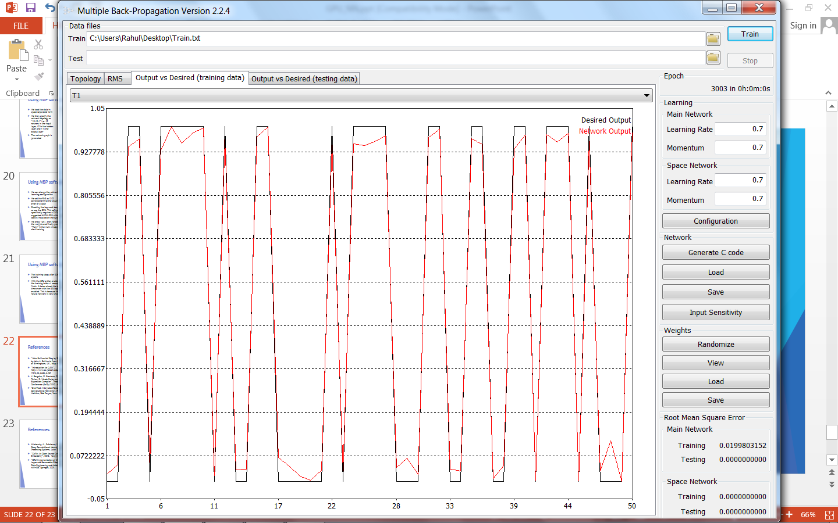
Using MBP software
Here the black line represents the desired outputs (1 or 0) for the 50 inputs training examples
The red line shows how closely the NN predicts the training examples
With the GPU option enabled, the training takes ~1 second to finish. It takes almost the same time even with the GPU option enabled. This is because the neural network is very small.
We re-run the same training data but through a much larger NN to see the speed-up

Slide 23
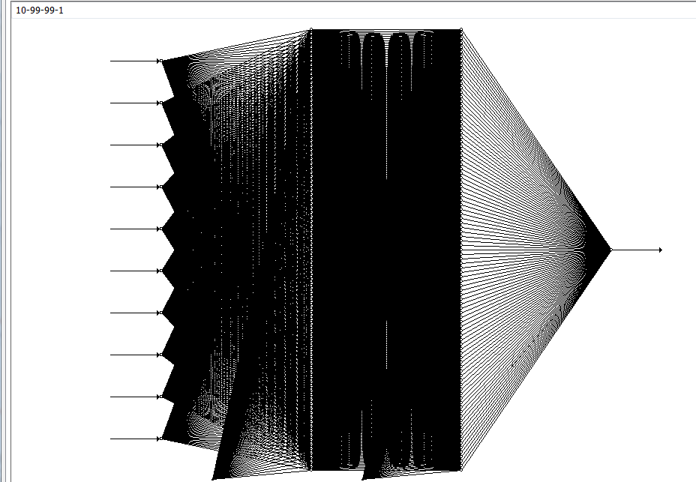
Using MBP software
Now rather than having just a 10-10-1 network, we expand it to a 10-99-99-1 network
The input and output layers are same as before but now we have two hidden layers, each with 99 neurons
With the GPU option enabled, the training still takes ~1 second to finish. But without the GPU enabled, it takes almost 30 seconds
Thus we can see that a GPU implementation of a neural network can greatly reduce training time

Slide 24
References
“John Bullinaria's Step by Step Guide to Implementing a Neural Network in C” by John A. Bullinaria from the School of Computer Science of The University of Birmingham, UK , http://www.cs.bham.ac.uk/~jxb/NN/nn.html
“Introduction to CUDA”, http://www.cc.gatech.edu/~vetter/keeneland/tutorial-2011-04-14/01-intro_to_cuda_c.pdf
J. Bergstra, O. Breuleux, F. Bastien, P. Lamblin, R. Pascanu, G. Desjardins, J. Turian, D. Warde-Farley and Y. Bengio. “Theano: A CPU and GPU Math Expression Compiler”. Proceedings of the Python for Scientific Computing Conference (SciPy) 2010. June 30 - July 3, Austin, TX
"OverFeat: Integrated Recognition, Localization and Detection using Convolutional Networks", Pierre Sermanet, David Eigen, Xiang Zhang, Michael Mathieu, Rob Fergus, Yann LeCun http://arxiv.org/abs/1312.6229

Slide 25
References
Krizhevsky, A., Sutskever, I. and Hinton, G. E. ,“ImageNet Classification with Deep Convolutional Neural Networks”, NIPS 2012: Neural Information Processing Systems, Lake Tahoe, Nevada
“Caffe: An Open Source Convolutional Architecture for Fast Feature Embedding”, 2013, Yangqing Jia, http://caffe.berkeleyvision.org/
“GPU implementation of the multiple back-propagation algorithm”, by Noel Lopes and Bernardete Ribeiro, in 10th International Conference on Intelligent Data Engineering and Automated Learning (IDEAL 2009), LNCS 5788, pages 449-456. Springer, 2009.

