Slide 1
Holt-Winters forecast of Foreign Tourist Arrivals

Slide 2
Overview
Forecasted inbound foreign tourist arrivals to India for the period January 2011 to June 2013
Used Holt-Winters Exponential Smoothening method
Foreign tourist arrivals data collected from Ministry of Tourism Reports for the period January 2001 to June 2013
Plotted the forecasted values and compared them with actual recorded values
Implemented in R statistical programming language using “forecast” package

Slide 3
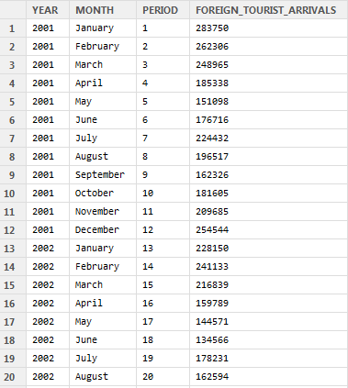
Data
Dataset was created in “comma separated values” (csv) format by compiling data from successive “India Tourism Statistics” reports released by Ministry of Tourism, Government of India
The reports have month-wise foreign tourist arrival data from January 2001 to June 2013 (150 months)
Reports can be found at http://tourism.gov.in/TourismDivision/AboutDivision.aspx?Name=Market%20Research%20and%20Statistics
CSV file https://drive.google.com/file/d/0Bxm3hHSmNFk1VS1DRkVwMFJMTFE/edit?usp=sharing

Slide 4
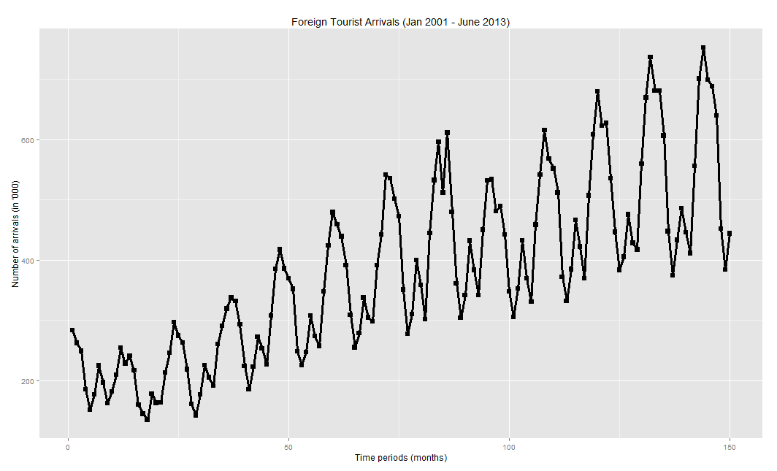

Slide 5
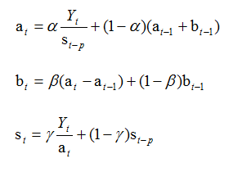
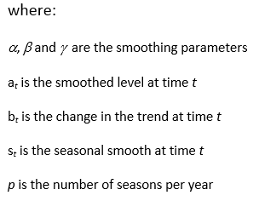
Holt-Winters Exponential Smoothening
Exponential smoothing methods give forecasts that are weighted averages of past observations, with the weights decaying exponentially as the observations get older
The Holt-Winters model uses a modified form of exponential smoothing. It applies three exponential smoothing formulae to the series :
Firstly, the level (or mean) is smoothed to give a local average value for the series
Secondly the trend is smoothed
Lastly each seasonal sub-series is smoothed separately to give a seasonal estimate for each of the seasons
If the time series shows a constant seasonal component, the Holt-Winters Additive model is used. However, if the seasonal component shows variability, we use the Holt-Winters Multiplicative model
Holt-Winters Multiplicative Model

Slide 6
Program Flow
Load the data into the R Environment
Use “ts” function to create time-series objects:
“fta_ts” with entire 150 monthly foreign tourist arrival figures
“fta_ts_train” with first 120 figures i.e. January 2001 to December 2010
“fta_ts_test” with last 30 figures i.e. January 2011 to June 2013
Use “HoltWinters” function with “fta_ts_train” as the input data and seasonal = “mult”
Use “forecast” function to forecast the next 30 months foreign tourist arrival figures i.e. January 2011 to June 2013
Calculate the accuracy of the forecasted values and actual recorded values (fta_ts_test)
Plot the actual and forecasted values

Slide 7
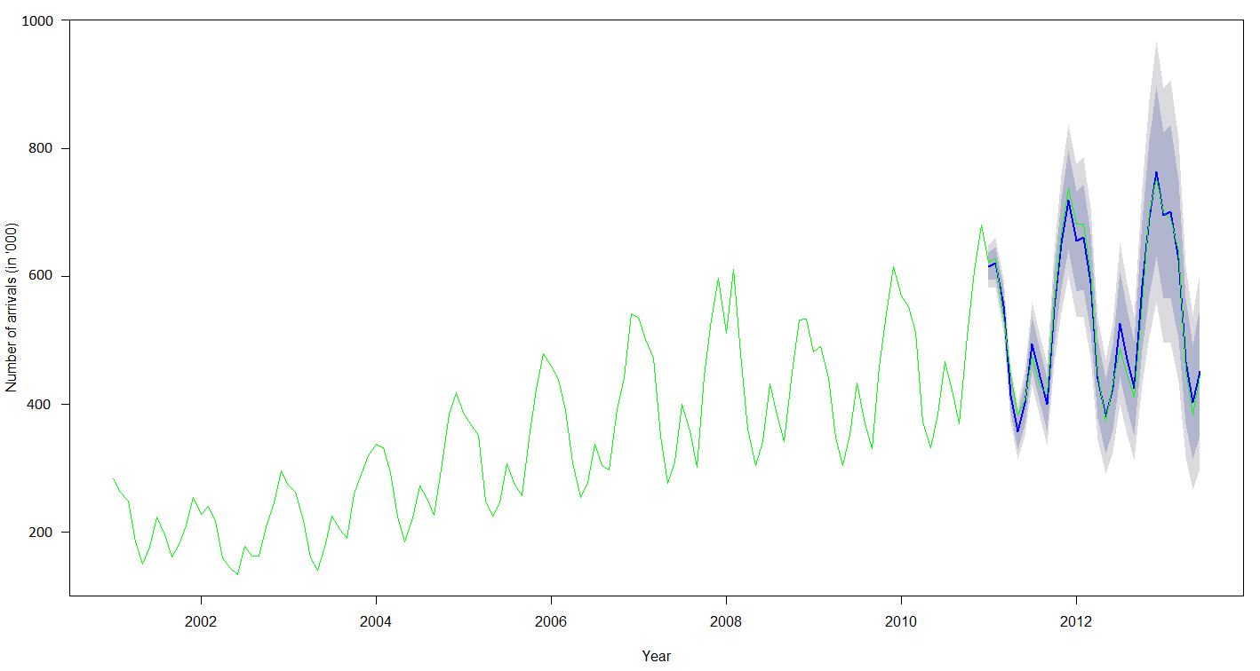
Holt-Winters Forecast Result
The green line represents the actual data.The blue line represents predicted values for the last 30 months (i.e. from January 2011 to June 2013)
The darker inner shaded area represents 80% confidence level. The outer lighter shaded area represents 95% confidence level

Slide 8
References
“India Tourism Statistics”, Ministry of Tourism, Government of India. http://tourism.gov.in/TourismDivision/AboutDivision.aspx?Name=Market%20Research%20and%20Statistics
“R: A language and environment for statistical computing”, R Development Core Team (2014), R Foundation for Statistical Computing, Vienna, Austria. http://www.R-project.org
“Forecasting: Principles and Practice”, Hyndman & Athanasopoulos, OTexts Publishing. http://robjhyndman.com/fpp/
“Machine Learning with R”, Brett Lantz, Packt Publishing

