Slide 1
SMS spam filter using Naïve-Bayes Classifier

Slide 2
Overview
Predicts if an SMS is spam or ham
Implemented in R statistical programming language using “tm” package (for text mining) and “e1071” package (for Naïve Bayes classifier)
Uses “Bag of words” approach to analyze SMS text content

Slide 3
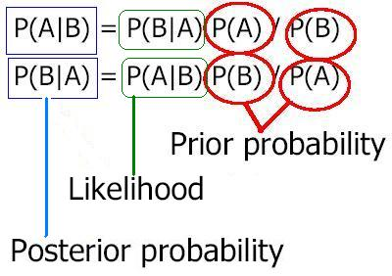
Naïve Bayes Classifier
A Naive Bayes classifier is a simple probabilistic classifier based on applying Bayes' theorem with strong (naive) independence assumptions
A Naive Bayes classifier assumes that the value of a particular feature is unrelated to the presence or absence of any other feature, given the class variable
Here, we assume that each word independently contributes to an SMS being spam or not, without caring for the presence of other possibly related words

Slide 4
The data
SMS | Type
Hope you are having a good week. Just checking in | ham
K..give back my thanks. | ham
Am also doing in cbe only. But have to pay. | ham
complimentary 4 STAR Ibiza Holiday or Â£10,000 cash needs your URGENT collection. 09066364349 NOW from Landline not to lose out! Box434SK38WP150PPM18+ | spam
okmail: Dear Dave this is your final notice to collect your 4* Tenerife Holiday or #5000 CASH award! Call 09061743806 from landline. TCs SAE Box326 CW25WX 150ppm | spam
The dataset has been created by Tiago A. Almeida and José María Gómez Hidalgo by taking ham and spam messages from National University of Singapore, Grumbletext forum etc.
The dataset contains 5559 examples of SMS text messages (max 160 characters) and its type as “spam” (undesirable message, 13%) or “ham” (legitimate message, 87%)

Slide 5
Program flow
Load the dataset into R environment as a corpus of SMSes
Clean the corpus by setting all letters to lower-case, removing punctuations, numbers, stop words and additional whitespaces
Create a document term matrix (a sparse matrix) from the cleaned corpus
Create training and test sets (75:25). Use only those words which occur more than 5 times in the document term matrix
Apply Naïve Bayes classifier with Laplace predictor set to 1

Slide 6
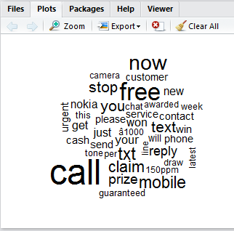
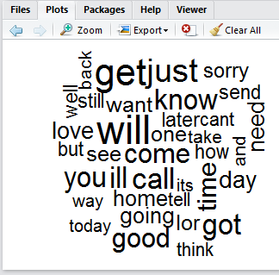
WordCloud
“WordCloud” visualization of spam (left) and ham (right) messages

Slide 7
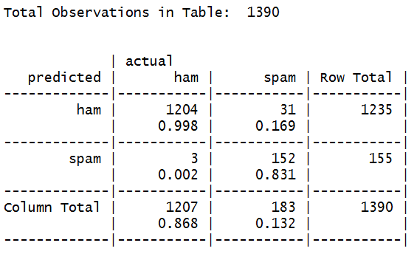
Results
We can see that only 0.2% of ham messages were misclassified as spam whereas almost 17% of spam messages were misclassified as ham
While misclassifying spam as ham is relatively benign and just a nuisance, misclassifying ham as spam can prove very costly.
Hence we can not have a very aggressive filtering mechanism which could potentially classify a great many important ham messages as spam

Slide 8
Discussion
We can see that using “naïve” assumption of independence helps us build a reasonably good spam filter despite the original data not having such a relationship
Implementing a Bayes theorem-based classifier without naïve assumptions would be computationally very expansive (often infeasible) for large datasets

Slide 9
References
Dataset download link http://www.dt.fee.unicamp.br/~tiago/smsspamcollection/
“On the Validity of a New SMS Spam Collection” by J.M. Gómez Hidalgo, T.A. Almeida, and A. Yamakami in Proceedings of the 11th IEEE International Conference on Machine Learning and Applications, (2012.)
“R: A language and environment for statistical computing”, R Development Core Team (2014), R Foundation for Statistical Computing, Vienna, Austria. http://www.R-project.org
“Machine Learning with R”, Brett Lantz, Packt Publishing

