Slide 1
Support Vector-based Classifier for Optical
Character Recognition

Slide 2
Overview
Performs Optical Character Recognition for the 26 alphabets of the English language
Implemented in R statistical programming language using “kernlab” package
Uses SVM approach to analyze features of images of alphabets and classify them

Slide 3
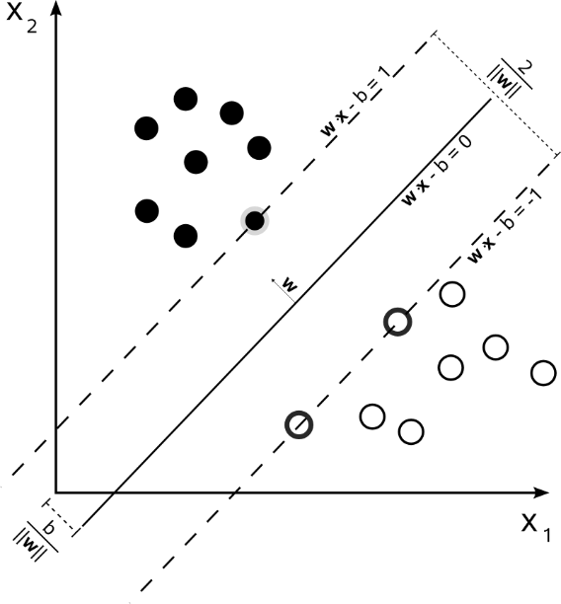
Support Vector Machines
Formally, a support vector machine constructs a hyperplane or set of hyperplanes in a high- or infinite-dimensional space, which can be used for classification
In addition to performing linear classification, SVMs can efficiently perform a non-linear classification using what is called the kernel trick, implicitly mapping their inputs into high-dimensional feature spaces.

Slide 4
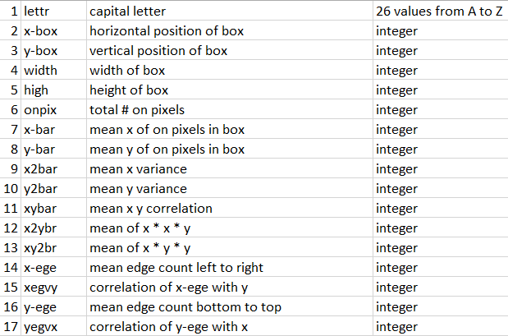
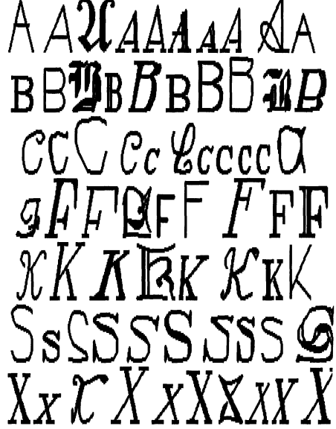
The data
Dataset donated by David J. Slate of Northwestern University, Illinois, USA
The character images were based on 20 different fonts and each letter within these 20 fonts was randomly distorted to produce a file of 20,000 unique stimuli
Each stimulus was converted into 16 primitive numerical attributes (statistical moments and edge counts) which were then scaled to fit into a range of integer values from 0 through 15

Slide 5
Program flow
Load the dataset into R environment
Create training and test sets (80:20
Apply SVM classifier using “vanilladot” parameter to denote that we are using linear kernel
Repeat again but using “rbfdot” parameter to denote a Gaussian Radial Basis function kernel
Since the confusion matrix will be quite large (26 * 26), we also find out the “agreement” percentage i.e. what % of the test samples were classified correctly

Slide 6
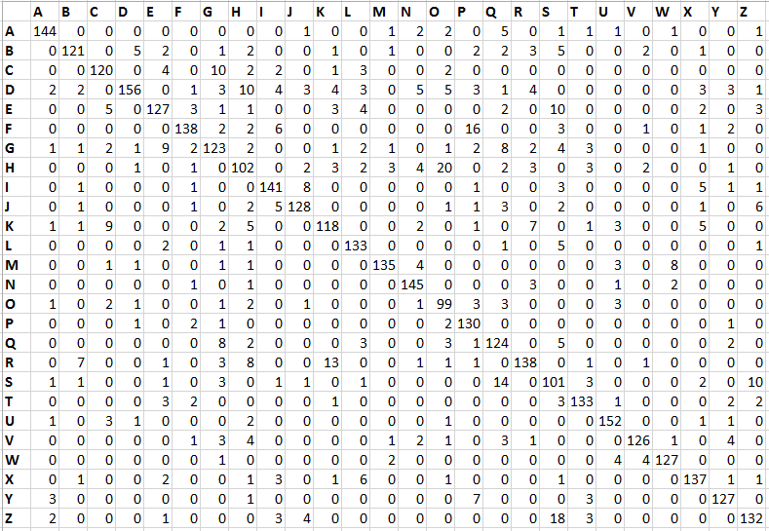
Results with linear kernel
Actual
Predicted
Approx. 84% of the test samples were classified correctly and 16% were misclassified

Slide 7
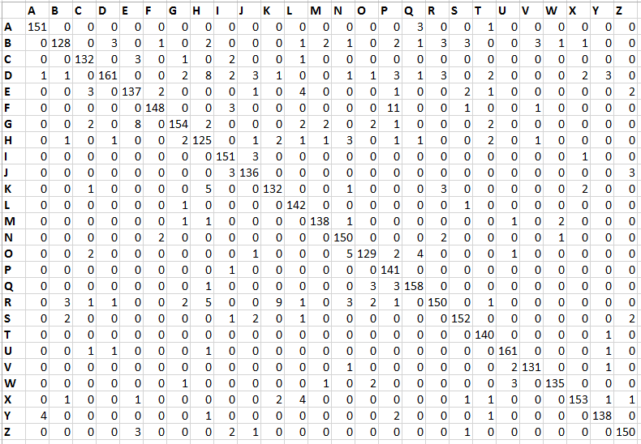
Results with RBF kernel
Actual
Predicted
Approx. 93% of the test samples were classified correctly and 7% were misclassified

Slide 8
Discussion
We can that by simply changing the kernel function, we were able to increase the accuracy of our character recognition model from 84 percent to 93 percent
An SVM does some extremely complex data transformations, then figures out how to separate different classes based on the labels or outputs defined by the user. Though it is extremely difficult to comprehend what transformations the SVM is doing, we are still able to deploy it with relative ease and use it to solve real-life problems

Slide 9
References
Dataset download link http://archive.ics.uci.edu/ml/datasets/Letter+Recognition
Letter recognition using Holland-style adaptive classifiers, Machine Learning, Vol. 6, pp. 161-182, by W. Frey and D.J. Slate (1991).
“R: A language and environment for statistical computing”, R Development Core Team (2014), R Foundation for Statistical Computing, Vienna, Austria. http://www.R-project.org
“Machine Learning with R”, Brett Lantz, Packt Publishing

