Slide 1
K-Nearest Neighbors classifier for Breast Cancer Detection

Slide 2
Overview
Predicts if a given biopsy sample is cancerous or not
Implemented in R statistical programming language using “class” package
Uses features extracted from digitized images of fine-needle aspirate of a breast mass

Slide 3
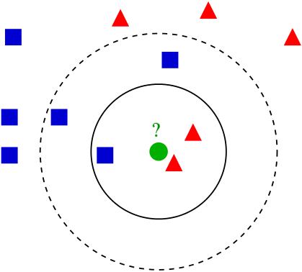
k-nearest neighbours algorithm
In k-NN classification, an object is classified by a majority vote of its neighbours, with the object being assigned to the class most common among its k nearest neighbours
k is a positive integer, typically small. If k = 1, then the object is simply assigned to the class of that single nearest neighbour.
If k is set to the total number of data points, then all objects are classified as the majority class for all data points
The solid circle shows k-NN algorithm for k =3 , whereas the dashed line shows for k = 5

Slide 4
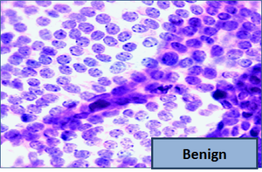
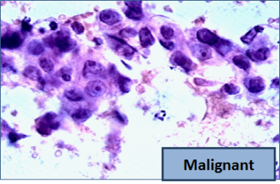
The data
The dataset has been created by researchers at University of Wisconsin-Madison
Features are computed from a digitized image of a fine needle aspirate (FNA) of a breast mass. They describe characteristics of cell nuclei present in the image
The data includes 569 examples of cancer biopsies and 30 features (mean, standard error, and worst values for the 10 characteristics)
Image : Google App Engine Blog link
 | Cell Nuclei Characteristics
1 | radius (mean of distances from centre to points on the perimeter)
2 | texture (standard deviation of grey-scale values)
3 | perimeter
4 | area
5 | smoothness (local variation in radius lengths)
6 | compactness (perimeter^2 / area - 1.0)
7 | concavity (severity of concave portions of the contour)
8 | concave points (number of concave portions of the contour)
9 | symmetry
10 | fractal dimension ("coastline approximation" - 1)

Slide 5
Program flow
Load the dataset into R environment and explore the data. We find that “Benign” consist of 62.7% and Malignant, 37.3% of the examples
Normalize the data
Randomly create training and test sets with 470 and 100 examples respectively
Apply k-NN algorithm

Slide 6
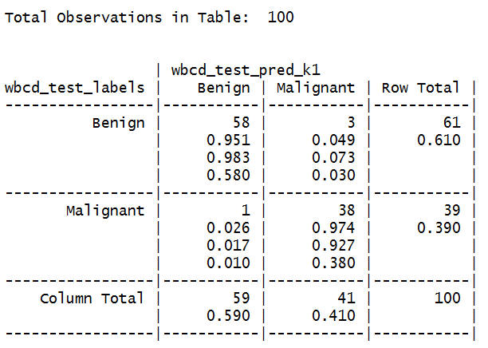
Results with k = 1
We can see that 1 malignant sample was misclassified as benign (“false negative”) and 3 benign samples were misclassified as malignant (“false positive”)

Slide 7
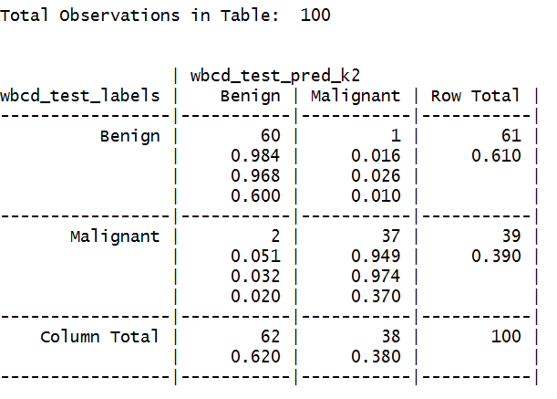
Results with k = 2
We can see that 2 malignant samples were misclassified as benign ( “false negative”) and 1 benign sample was misclassified as malignant (“false positive”)

Slide 8
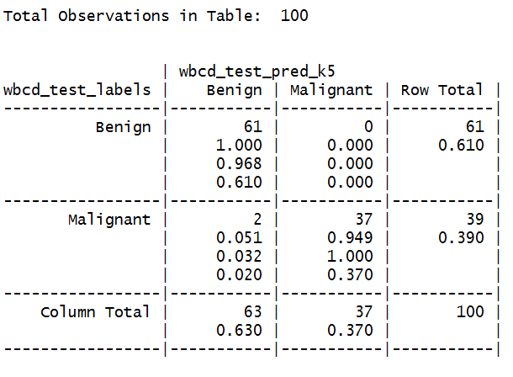
Results with k = 5
We can see that 2 malignant samples were misclassified as benign ( “false negative”) and 0 benign samples were misclassified as malignant (“false positive”)

Slide 9
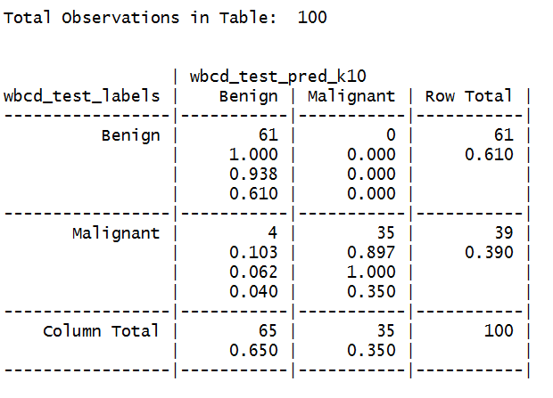
Results with k = 10
We can see that 4 malignant samples were misclassified as benign ( “false negative”) and 0 benign samples were misclassified as malignant (“false positive”)

Slide 10
Discussion
kNN is a “lazy classifier” meaning it doesn’t generalize the data by performing any computation on the training data. It simply matches the incoming test examples using majority class of its k nearest neighbors
With k = 5, we were able to classify all 100% of the benign samples correctly and ~95% of malignant samples correctly.
Even though we were using one of the simplest machine learning algorithms and almost no knowledge of oncology, we were able to classify cancerous cells quite well

Slide 11
References
Dataset download link https://archive.ics.uci.edu/ml/datasets/Breast+Cancer+Wisconsin+(Diagnostic)
“Nuclear feature extraction for breast tumor diagnosis”, IS&T/SPIE 1993 International Symposium on Electronic Imaging, Science and Technology, volume 1905, pp 861-870 by W.N. Street, W.H. Wolberg, and O.L. Mangasarian, 1993
“R: A language and environment for statistical computing”, R Development Core Team (2014), R Foundation for Statistical Computing, Vienna, Austria. http://www.R-project.org
“Machine Learning with R”, Brett Lantz, Packt Publishing

