Slide 1
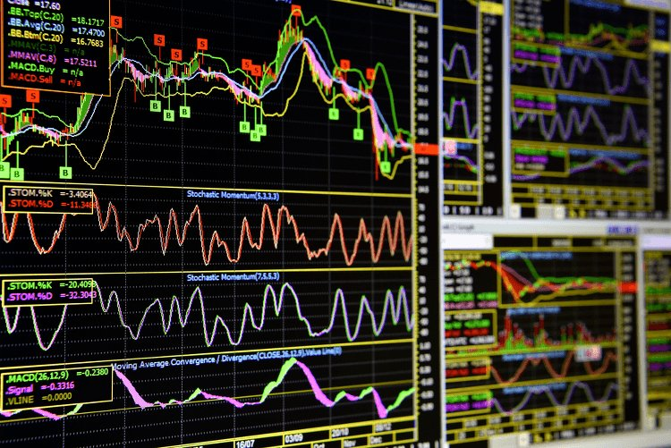
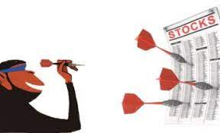
World of Stock Market: MACD, RSI, Currency Value, Intercountry Trade Policy Changes
1. Predicting Stocks could include many variables and could get really complicated.
2. As much as 90% of people lose money in stock markets, including both new and seasoned investors. -researchandranking.com
Blindfolded Monkey Beats Humans With Stock Picks –
By Alfred Kueppers, The Wall Street Journal.

Slide 2
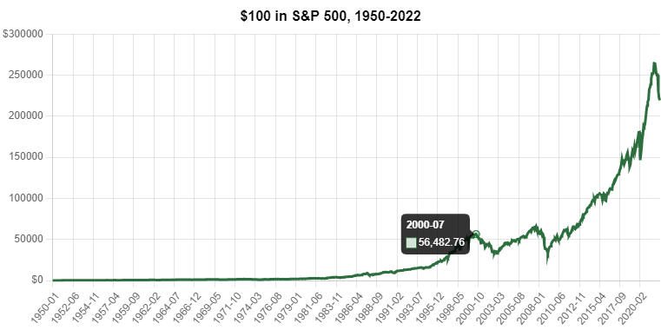
2020: The COVID-19 Crash
Market loss: 34%
2008: The Subprime Mortgage Crisis
S&P 500 loss: 57%
2000: The Dotcom Bubble
Nasdaq loss: 77%
1973: The Oil Crisis and Economic Recession
Market loss: 48%
1929: The Worst Crash in History
Dow loss: 89%
S&P returns from 1929 & Power of compounding: If you invested $100 in the S&P 500 at the beginning of 1929, you would have about $472,968.28 at the end of 2022, assuming you reinvested all dividends.

Slide 3
Question: Why beat market? when you can win with it!
Fact: According to a 2020 report, over a 15-year period, nearly 90% of actively managed investment funds failed to beat the market. -businessinsider.com
Our Approach: Trying to predict stock price on basis of 4 AI models which are as follows
ARIMA
Random Forest
LSTM
Linear Regression
Taking into account the model with best accuracy, it would be tested across 40-50 stocks and their profits, losses would be generalised to get an average case of return.
Return could further be compared with a simple SIP investment strategy in S&P500, to conclusively determine what is better.
--End of the slides--

