Slide 1
Chat System Over LAN
Submitted By:
Rahul Shah(075BCT063)
Roshan Subedi(075BCT068)
Rupak Raj Pantha(075BCT070)

Slide 2
Introduction
Chat refers to the process of communicating, interacting and exchanging messages over the Internet.
A chat application has basic two components, server and client.
A server is a computer program or a device that connects clients to allow them to communicate with each other.
Clients who want to chat with each other connect to the server.
A chat application is created based on Transmission Control Protocol (TCP) where TCP is connection oriented protocol.

Slide 3
Objective
To develop an instant messaging solution to enable users to communicate with each other seamlessly.
To develop a user friendly application so that any person can use the program without any complications.
To have a good user interface.
To be expandable.

Slide 4
Applications
This chat system could be used in many fields such as:
Offices
School
Home

Slide 5
Methodology
It is made up off two component: the client which runs on the user PC and the server application which runs on any PC on the network.
At the same time, there can be more than one client which can be handled by the TCP connection.
All clients need to be connected to same server or use their dedicated IP address to receive and send messenger through broadcasting central server.
A user friendly GUI using wxWidgets.

Slide 6
Network Programming Implementation
To implement the networking service in the project we studied the Winsock documentation provided by Microsoft.
We also viewed a number of YouTube tutorials and premade examples to have our knowledge on this new topic.

Slide 7
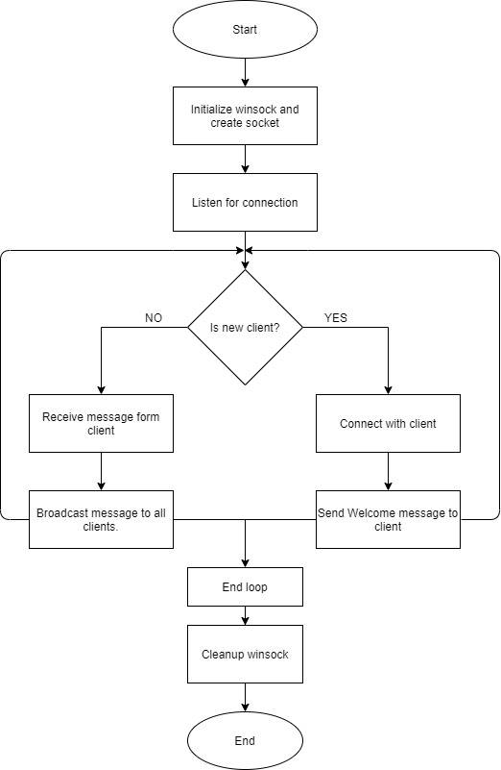
Flow Chart for Server Operation:

Slide 8
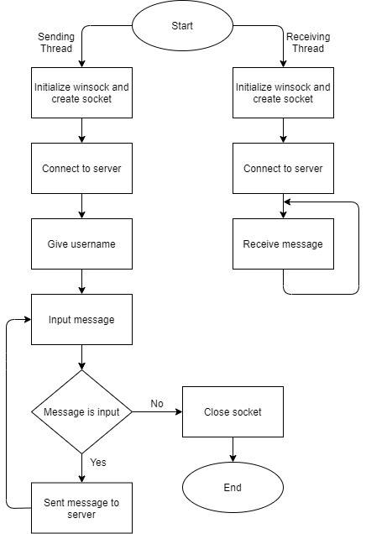
Flow Chart for Client Operation:

Slide 9
GUI Implementation
We have used wxWidgets for giving graphical user interface to our project.
We have used many elements from wxWdgets such as:
Menu bar and its shortcut keys for user guidance and some important stuffs,
buttons to responds to some events like sending messages ,
TextCtrl boxes to write messages to be send,
Listboxes to Show the messages that had been send or received,
StaticText to display Some Text,
Panels and frame to display contents,
Splitter Screen to split between two panels,
Status bar to Show Current status of server events
wxMessages boxes to pop up some messages,
Bitmap to import picture
And many other things like giving colour, fonts etc…
Unfortunately ,we cannot assemble backhend and fronthend due to linkers errors

Slide 10
Limitation and Future Enhancement
Limitations:
The clients can only chat by connecting to a local server.
Two clients on different network cannot chat together.
The purposed system of direct message couldn’t be completed.
Future Enhancement:
Adding database to save all the messages
The feature of direct messaging ought to be added.
Different user profile for each user.

Slide 11
Problems Faced and Solutions:
The main problem was faced while integrating the “Winsock” into the wxWidgets framework we created. Here we tried many different ways to integrate but we weren’t able to do it on GUI.
Then we tried using the built in network in wxWidgets i.e. wxSocket. Here we face the problem of not being able to send messages between many clients over a same LAN. We’re able to connect two clients.

Slide 12
Conclusion
Hence we’re able to built
Multi Server Client application on a console.
Chat room able to chat with a number of clients connected to the server.
Over the period of this project, we learned about programming GUI using wxWidgets and network programming using Winsock and wxSocket

Slide 13
THANK YOU

