Slide 1

PRESENTATION TITLE
Presenter Name

Slide 2
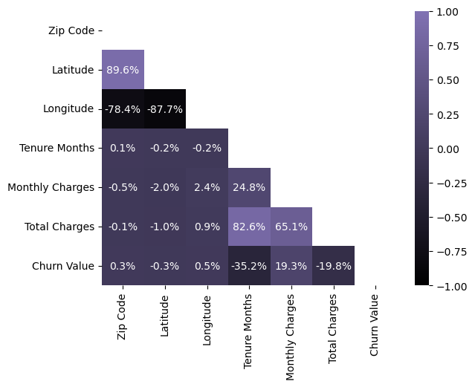
EDA
Correlations:
Given this heatmap, very few features have a direct correlation with the churn value. This relates to ‘Zip Code’, ‘Latitude’ and ‘Longitude’. Given that these features are based on geographical locations, it shows that where a customer lives does not affect their decision to churn or not.
Both ‘Monthly Charges’ and ‘Total Charges’ have little to no correlation with the churn value. More specifically, the ‘Monthly Charges’ feature has a small positive correlation, if not any, with a correlation of 19.3%, so the higher the ‘Monthly Charges’, the more likely someone will churn. Regarding the ‘Total Charges’ feature, the higher that goes the less likely someone is to churn, because it has a small, negative (or no) correlation of -19.8%. This shouldn’t make sense, because customers will usually churn if they are charged more, however ‘Total Charges’ has a strong positive relationship with ‘Tenure Months’ of 82.6%. This makes sense, because the longer a customer stays, the higher their total charge will be.
This explains why there’s a negative relationship between ‘Total charges’ and the ‘Churn Value’ because those with a higher total charge are most likely customers who have stayed for many months, and are more loyal, so they will not churn. As a result, based on this heatmap, the ‘Monthly Charges’ feature has the biggest effect on people’s decision to churn, however this effect is not anything huge, since their correlation metric is close to 0%.

Slide 3
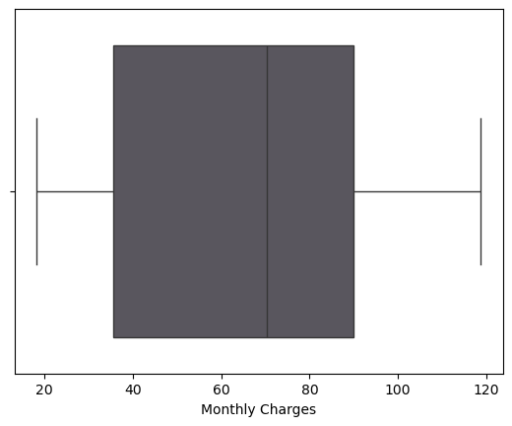
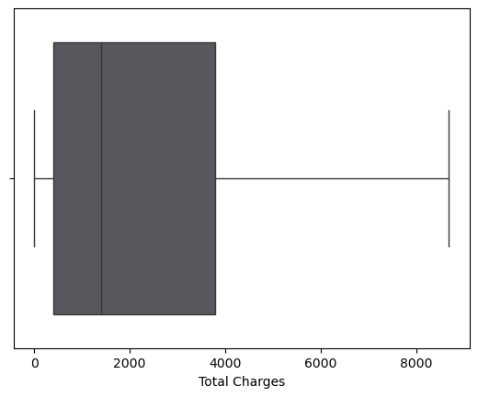
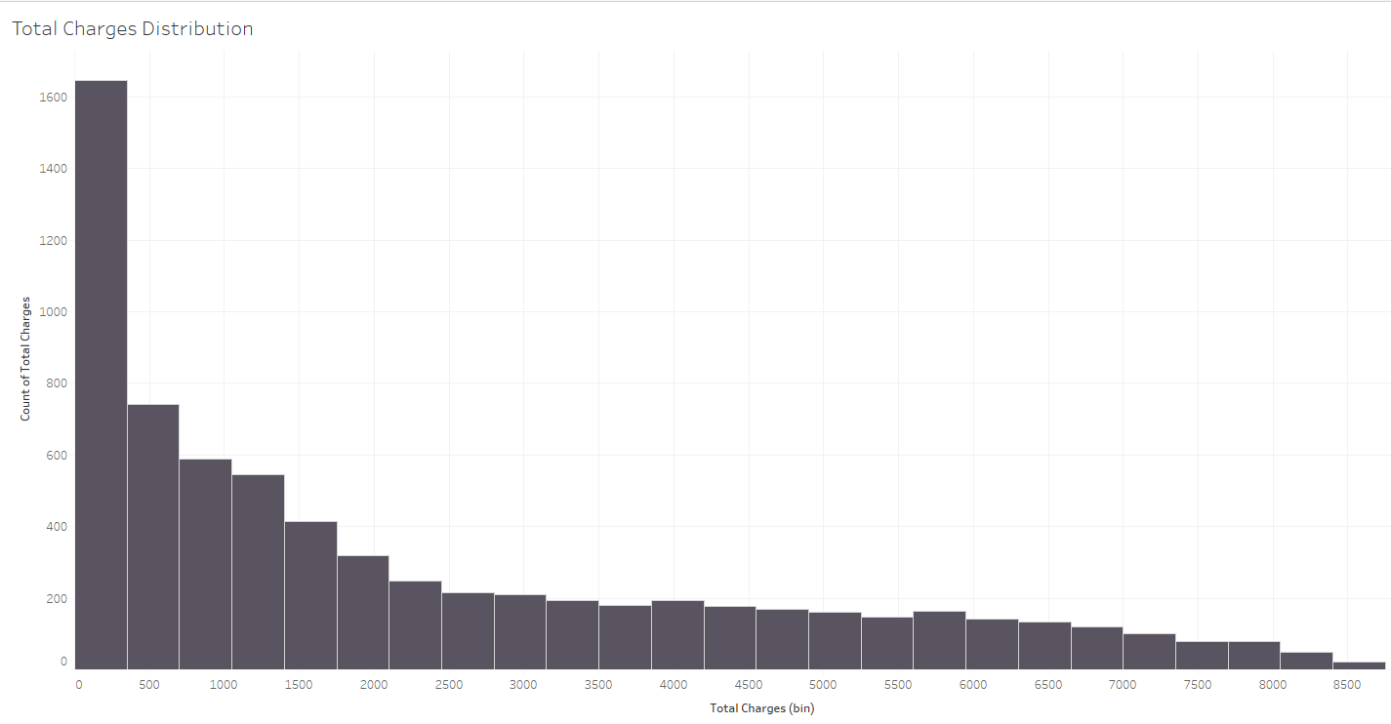
EDA
Distributions:
These two boxplot figures show the distribution of the ‘Monthly Charges’ and ‘Total Charges’ features. Neither feature have outliers, so no customers are being charged excessively high or low.
Unlike ‘Monthly Charges’, the ‘Total Charges’ feature is right-skewed, so most of the data is on the left. This means that majority of the customers are being charged a lower price. On face value, this is a good thing as customers are being charged a lower price during their tenure with the company. However, since there is a positive correlation between ‘Total Charges’ and ‘Tenure Months’, the lower ‘Total Charges’ could relate to customers with lower ‘Tenure Months’ values so less loyal customers, however it’s best to compare these features directly with the churn value.
Insights:
Based on both the correlations and distribution figures, it is best to promote loyalty and long-term contracts to customers. This is backed up by the correlation between 'Monthly Charges' and 'Churn Value', the correlations amongst 'Tenure Months', 'Total Charges' and 'Churn Value', and the distribution of 'Total Charges'. This is because higher charges, monthly, causes the chances

Slide 4
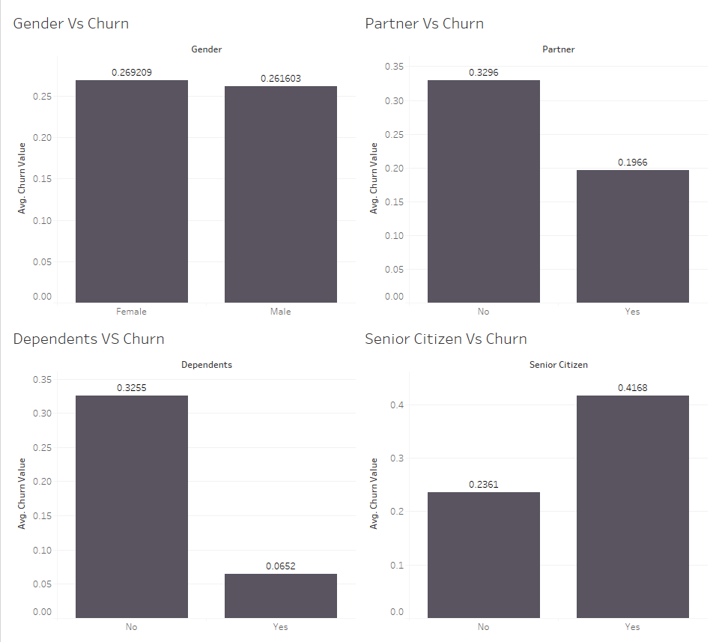
Demographic
When looking at the primary demographic information present within the data, some clear trends become evident. When extrapolated, this information can shape future business decision on where to focus.
When looking at the Gender chart it becomes evident that there is not a big difference in the number of Female customers churning compared to the number of Male customers (Female is 0.269 whereas Male is 0.261). This suggests that neither of these demographics need to be targeted specifically as it would not make as much a meaningful difference.
The Partners and Dependents graphs tell a different story however. The partners graph shows that single people account for over 12% more churns than people in relationships. This may be due to couples having more shared services while also making more shared decisions which makes impulsive churning practices less likely. The dependent graph shows over 25% disparity where people with dependants are less likely to churn. This could be accounted for people with kids needing more consistent programming for their dependents making it less likely to churn. If they were to leave then the shows that their kids would like would be lost.
The final graph shows an almost 20% increase in likelihood of churning when someone is a Senior Citizen. This may be due to the company’s products not being friendly towards this demographic requiring them to go to a service more suited to their needs.
INSIGHTS:
Future strategies should focus on singles with no dependants as well as Senior citizens as these are the demographics most likely to churn. Implementing more incentives and services aimed at them would allow for a lower churn rate from the demographic that contributes the most to it.

Slide 5
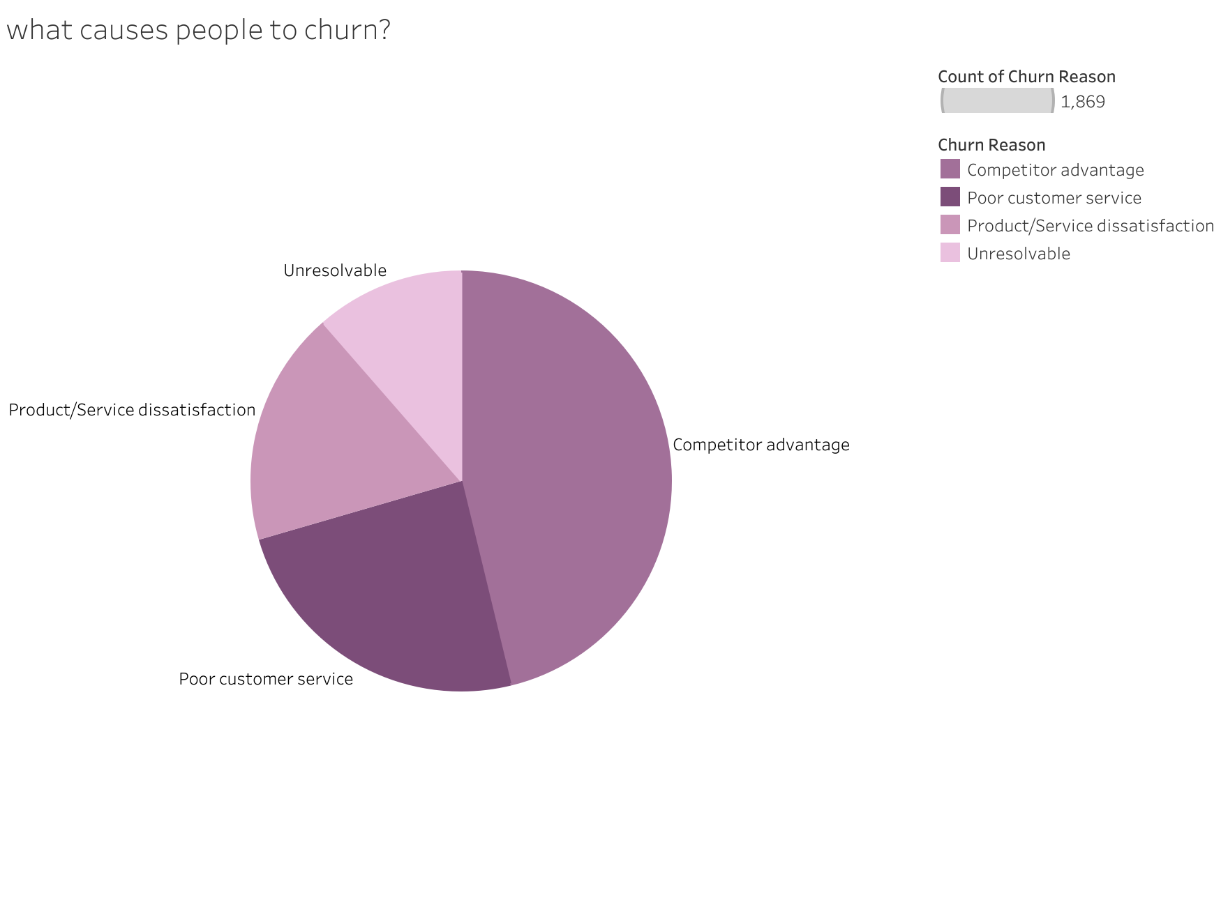
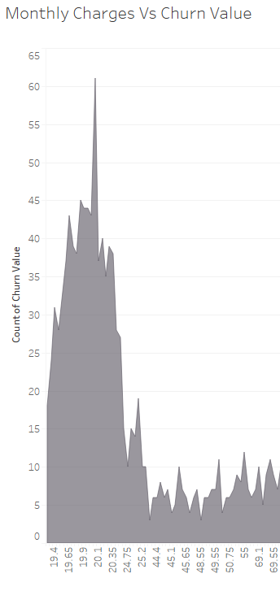
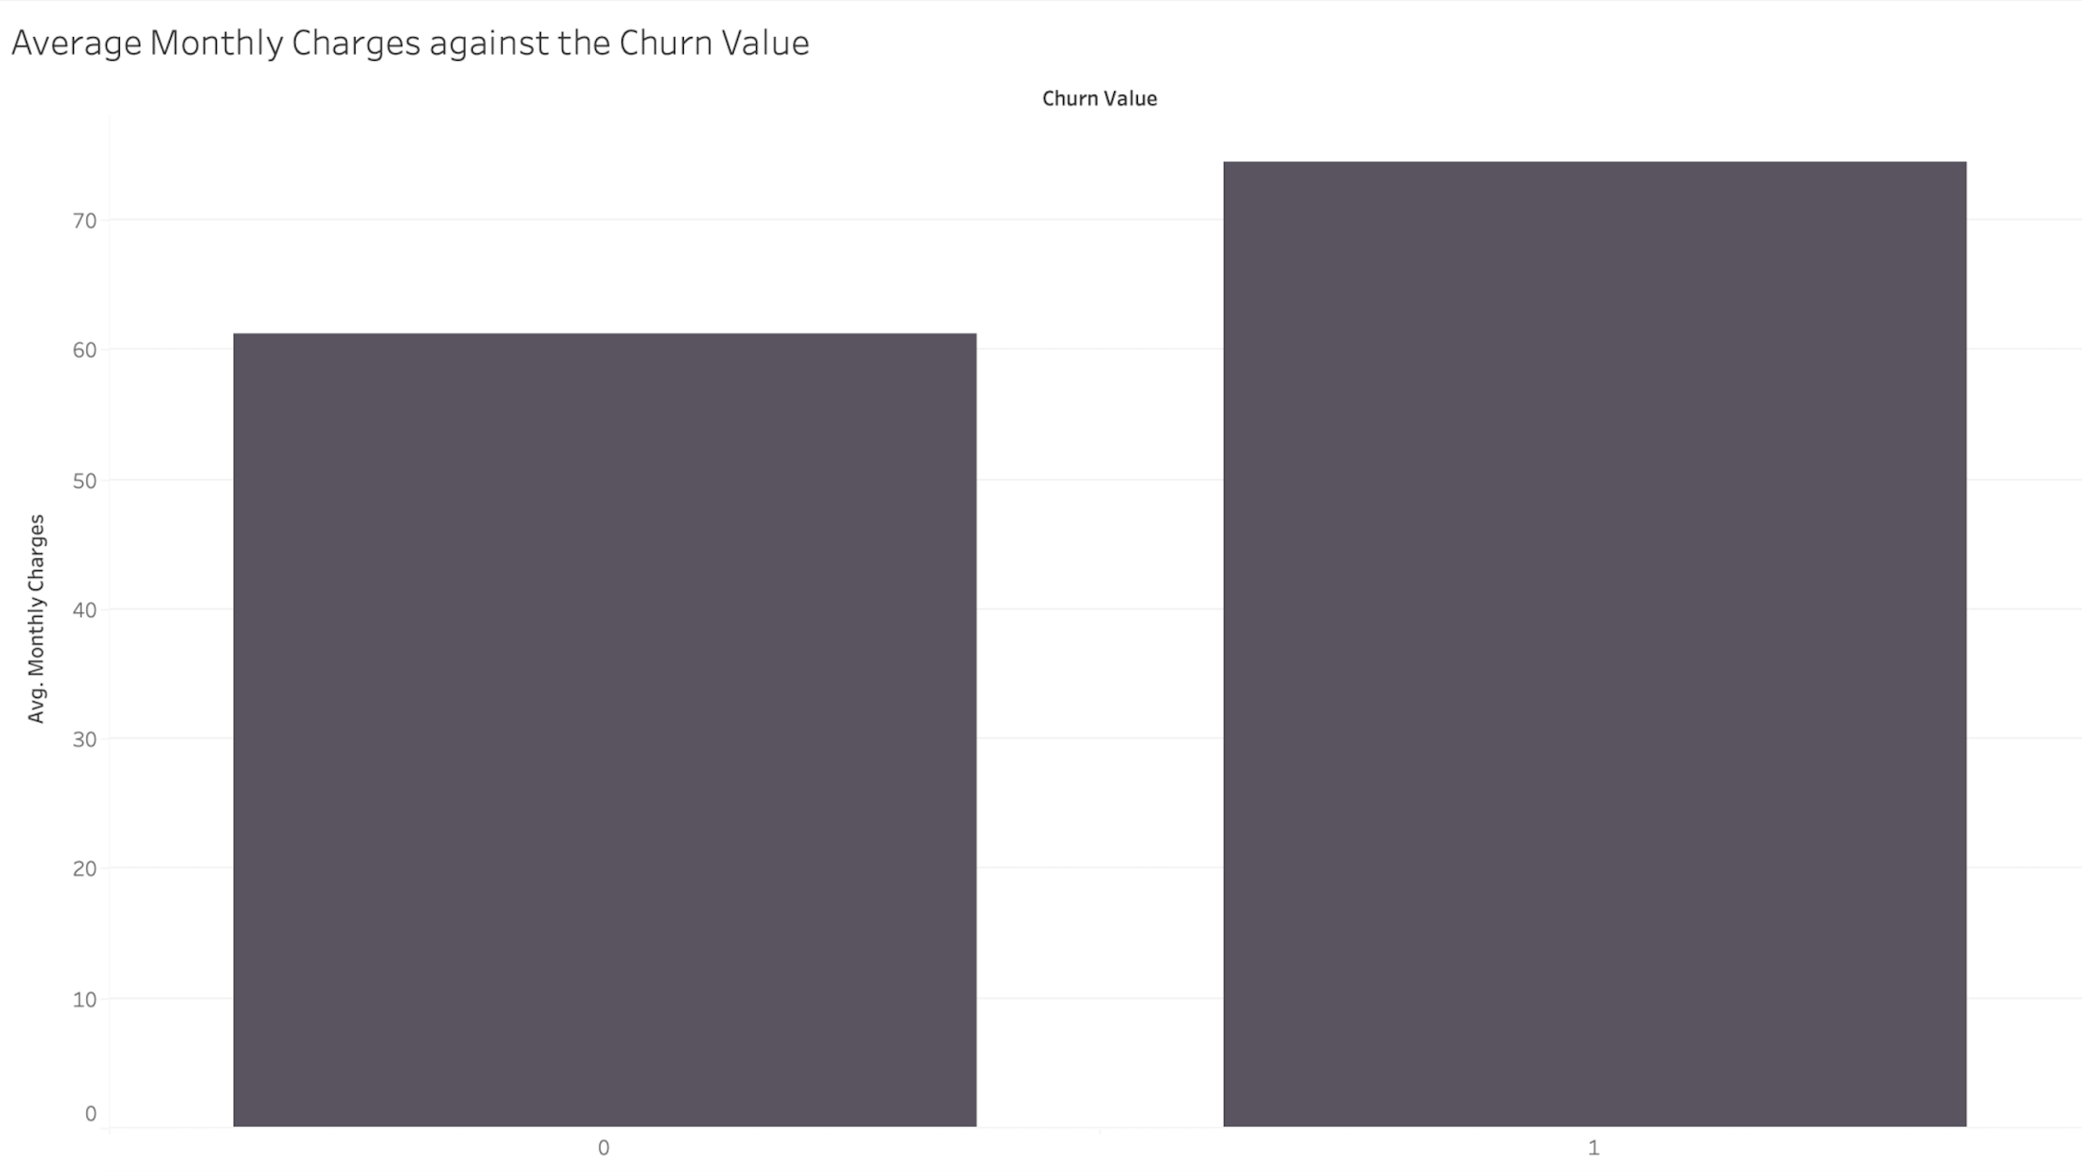
Key Factors
Customer churn is primarily driven by three key factors: customer service dissatisfaction, competitive device or price advantage, and service & network Limitations. While a small portion remains unresolvable (moving, death and no reason), the data overwhelmingly points to controllable factors related to customer experience, product competitiveness, and core service delivery. Addressing
these areas through improved training, device strategy, and infrastructure upgrades is critical for effective retention.
This analysis of monthly charges against churn reveals a dual challenge: while customers who churn have a noticeably higher average monthly charge (around 74 vs. 61 for non-churners), indicating potential dissatisfaction with value at higher price points. However the highest volume of churn actually occurs at the lowest end of the spectrum, peaking intensely around 19-21 monthly charges. This suggests distinct churn drivers across different price tiers—value perception for higher-paying customers versus potentially price sensitivity or basic service issues for lower-paying ones. A possible reason for the spike is due to competitor advantage, where the consumer is offered better prices, more data, which is overall better value for money.

Slide 6
Sign-up Factors
Services to promote:
DSL internet service
Online Security
Online Backup
Device Protection
Tech Support

Slide 7


THANK YOU
Presenter Name
Email
Website

