Slide 1
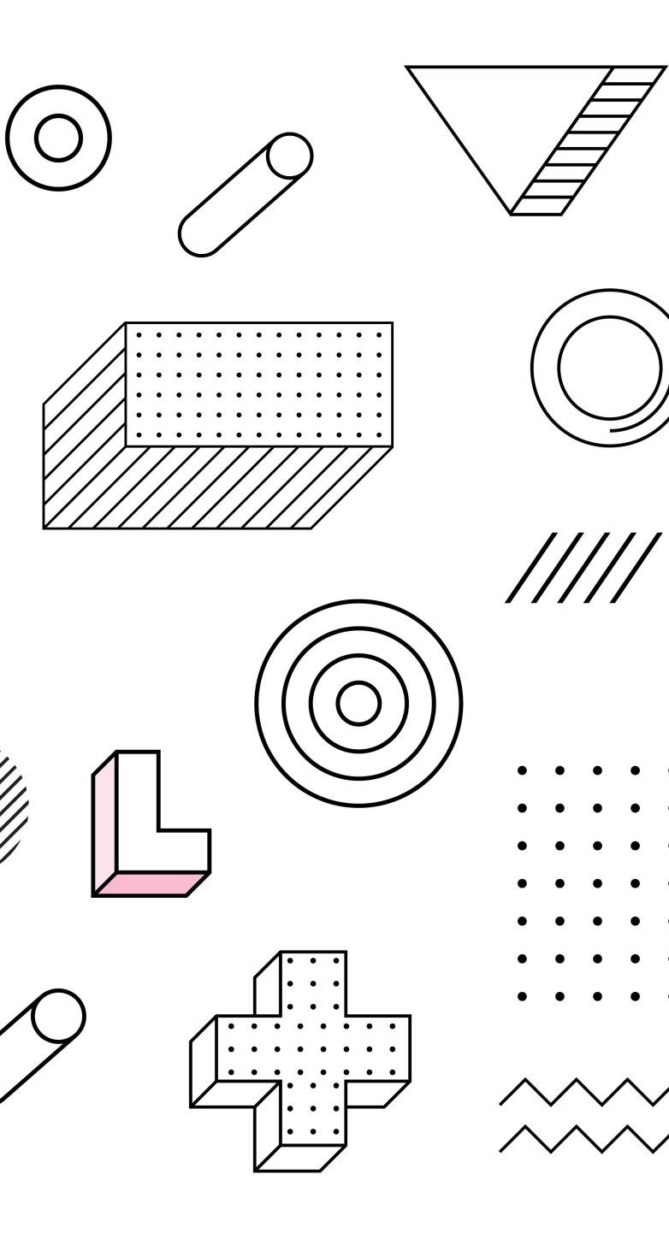
Vector Databases
Rahul Sharma (Ph.D.)
Informatics Architect, DBIDS, HSOM, UAB.

Slide 2
Introduction & Motivation
What are vector databases?
Why are they important in modern applications?
What is Retrieval Augmented Generation (RAG)?
Real-world applications: semantic search, recommendation systems, and gene expression analysis.
Notes:
"Welcome everyone. Today, we’re going to dive into vector databases and see how they power advanced applications like semantic search and recommendation systems.
Traditional databases store structured data in tables, but modern AI applications often require working with unstructured or high-dimensional data. Here, vector databases come into play: they store data as vectors—numerical representations that capture the essence of content such as text, images, or even gene expression profiles.
We’ll also cover Retrieval Augmented Generation, or RAG. RAG is a process that first retrieves contextually relevant information from a database and then uses that context to generate more informed and accurate responses with a generative model. In our case, we’ll use a small model referred to as “gpt4o-mini.”
To illustrate these ideas, we’ll use a gene expression data example, showing how biological data can be searched and interpreted using vector-based methods."

Slide 3
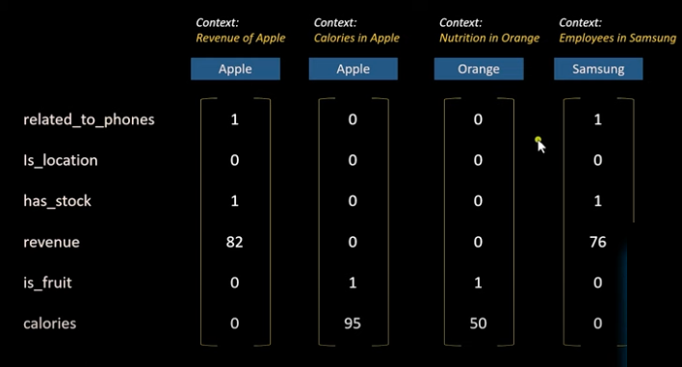
Fundamentals of Vector Databases

Slide 4
Fundamentals of Vector Databases
Embeddings: Mapping raw data to numerical vectors.
Similarity Search: Methods to find “close” vectors using metrics like cosine similarity and Euclidean distance.
Indexing: Techniques (e.g., FAISS, Annoy, HNSW) to efficiently store and search high-dimensional vectors.
Popular Tools: FAISS, Pinecone, Milvus, Qdrant.
Demo Notebook fundamentals.py
Notes:
"Let’s break down the core components of vector databases.
Embeddings: In modern AI, raw data—be it text, images, or even gene expressions—needs to be converted into a fixed-size vector representation. These embeddings capture semantic or contextual information in a high-dimensional space.
Similarity Search: Once data is embedded, we need a way to find similar items. We measure ‘closeness’ using distance metrics. Common choices include:
Cosine Similarity: Measures the cosine of the angle between vectors.
Euclidean (L2) Distance: Measures the straight-line distance.
Indexing: Searching through millions of vectors can be computationally intensive. Indexing techniques like FAISS (by Facebook), Annoy, or HNSW (Hierarchical Navigable Small World graphs) allow us to perform approximate nearest neighbor (ANN) searches quickly.
Popular Tools: Some vector database tools you might encounter are FAISS, Pinecone, Milvus, and Qdrant. Each offers different features, scalability options, and performance trade-offs.
Traditional vs. Vector Databases: Traditional relational databases excel at structured, tabular data. However, when it comes to unstructured or high-dimensional data, vector databases shine by supporting fast similarity searches and enabling applications like recommendation systems or semantic search.
Visual aids can help here—consider showing a diagram of data flowing from raw input to embeddings, then into an index, and finally to a similarity search process."

Slide 5
Retrieval Augmented Generation (RAG)
What is RAG? It’s a two-step process:
Retrieval: First, we take a user’s query, convert it to an embedding, and then retrieve the most relevant pieces of data from our vector database.
Generation: We then combine the original query with the retrieved context and feed it into a generative model. In our case, we’ll use a model called gpt4o-mini.

Slide 6
Retrieval Augmented Generation (RAG)
Why Use RAG? By providing the generative model with additional context, we help it generate more accurate and relevant answers. This is particularly useful when the question is domain-specific, such as interpreting gene expression data.
Challenges:
Ensuring that the retrieved context is truly relevant.
Seamlessly integrating the retrieval with the generation process.
DEMO RAG-example.py (Streamlit)

Slide 7
Hands-On Demo Part 1: Gene Expression Data & Vector Indexing
Data Preparation:
A sample gene dataset is created with 5 rows (you can expand this as needed).
A new column "Description" is built by concatenating the gene’s details.
Embedding Data:
The spaCy model "en_core_web_md" is loaded to obtain realistic 300-dimensional embeddings for each description.
The embeddings are stored in a NumPy array.
Indexing with FAISS:
A FAISS index is created with dimension 300 (matching the embedding dimension).
All embeddings are added to the index for efficient similarity search.
Query Example:
A query is defined that describes interest in genes involved in DNA repair and cell cycle regulation (with a hint toward breast cancer).
The query is embedded, and FAISS is used to retrieve the top 3 nearest neighbors.
The script prints out the retrieved gene details.
NOTEBOOK-Demo Gene-expression-example.py

Slide 8
Hands-On Demo Part 2: RAG with Gene Expression Data
Data Preparation: The app reads gene metadata from example.csv, ensures the required columns are present, and creates a combined description for each gene. A sample of gene descriptions is shown, and detailed metadata is displayed in the sidebar.
Vector Store Creation: Each gene description is converted into a document and embedded using a Hugging Face embedding model. The resulting embeddings are stored in a FAISS index for efficient similarity search.
RAG Chain Setup: The generative model is initialized using OpenAI’s Chat model (gpt-3.5-turbo), and a RetrievalQA chain is created using the FAISS vector store as the retriever.
Chatbot Interface: Users can enter queries about the gene data. The query is processed through the RAG chain, and the answer is appended to the conversation history, which is displayed in the app.

