Slide 1

Color Detection Project Report
Submitted
In partial fulfillment for the award of the degree of
Bachelors in Computer Application
(with specialization in Data Science)
Supervisor- Rishank Sharma Assistant Proffesor
Submitted by- Rahul Sharma
Enrollment No.:
Department of Computer Science Apex University Apex School of Computer & IT June-2022

Slide 2
Certificate
This is to certify that the project work under titled as
Color Detection Project
is the bonafide work of
Rahul Sharma(………………….)
During this project submission as a partial fulfillment of the
Requirement for the Bachelor of computer application IV semester, of the Apex University, Jaipur
------------------- -----------------------
Supervisor Dept. H.O.D of computer
i

Slide 3
ACKNOWLEDGEMENT
We have taken efforts in this project. However, it would not have been possible without the kind support and help of many individuals and organizations. We would like to extend my sincere thanks to all of them.
We are highly indebted to Mr.Rishank Sharma for his guidance and constant supervision. Also, we are highly thankful to them for providing necessary information regarding the project & also for their support in completing the project.
We are extremely indebted to Dr. KD Gupta , HOD, Department of Computer Science and Engineering, Mrs. Megha Yadav , Project Coordinator, Department of Computer Science and Engineering, for their valuable suggestions and constant support throughout our project tenure.
We also express gratitude towards our parents for their kind cooperation and encouragement which helped me in completion of this project. Our thanks and appreciation also go to our friends in developing the project and all the people who have willingly helped me out with their abilities.
Rahul Sharma
BCA(AU)
ii

Slide 4
TABLE OF CONTENT
Title
Page
CERTIFICATE i
ACKNOWLEDGEMENT ii
TABLE OF CONTENTS ii
LIST OF TABLES iv
LIST OF FIGURES v
ABSTRACT 1
1. Introduction ........................................................................................................................... 2
2. Description ............................................................................................................................ 3
a) The RGB Color Room...................................................................................................... 3
3. Different Measures ............................................................................................................... 5
a) Measures with different distance to the object............................................................... 5
b) Measures with different angel of the sensor................................................................... 6
c) Temperatures measurement............................................................................................ 7
d) Temperatures measurement of the monitor diode.......................................................... 8
4. Researches of methods for color identification................................................................ 12
a) First method.................................................................................................................. 13
b) Second method ............................................................................................................. 14
c) Third method ................................................................................................................ 14
d) Comparison of the three methods................................................................................. 14
e) Last method for color identification............................................................................. 15
5. Selection of the construction units - Hardware ............................................................... 16
a) Introduction .................................................................................................................. 16
b) Power supply ................................................................................................................ 16
c) Sensor ........................................................................................................................... 16
d) The Amplifier ............................................................................................................... 17
e) Microcontroller............................................................................................................. 17
f) Speech chip .................................................................................................................. 18
g) Schematic ..................................................................................................................... 19
h) Board ............................................................................................................................ 19
6. The design ........................................................................................................................... ..20
7. Introduction of Software Development ............................................................................ 21
a) The Program ................................................................................................................. 22
iii

Slide 5
LIST OF TABLES
Title
Page
Fig 2.1 : koordinaten 4
Fig 4.1 : Diff b/w measure& reference value 12
Fig 4.2: First method 13
Fig 4.3: Second method 14
Fig 4.4 : comparison of memory capacity& computing power 14
i v

Slide 6
List Of Figures
Title
Page
Fig 2.1 : The RGB Color Room 3
Fig 3.1 : Measure with diff. distance of the object 6
Fig 3.2 : : Measure with diff. angle of sensor 7
Fig 3.3 : Temperature measurement 8
Fig 3.4 : Temperature measurement of monitor diode 11
Fig 5.1 : Power supply 16
Fig 5.2 : Amplifier 17
Fig 5.3 : Speech chip 18
Fig 5.4 : Schematic 19
Fig 5.5 : Board 19
Fig 6.1 : The design 20
v

Slide 7
Abstract
Color detection is the process of finding a color name. Here it is a simple task for a person to see the color and choose one. But a computer cannot easily detect color. This is a difficult task for a computer to find color easily. So that’s why we chose this project. Most of the project and research papers have been written on this issue. But we use different strategies for this project. Panda and open CV libraries used in python languages. Open Source Computer Vision Library. Open CV is designed for computer performance and has a solid real-time field function that provides video and audio coding infrastructure.
1

Slide 8
1. Introduction
The task of the project was to make a device that can see different colors through
sensor ... of the company. The target group of device people are blind or people who know
not to see different colors. There are already different programs on the market, but there are
very expensive and not affordable.
The new device should be an integrated, simple and inexpensive solution
2

Slide 9
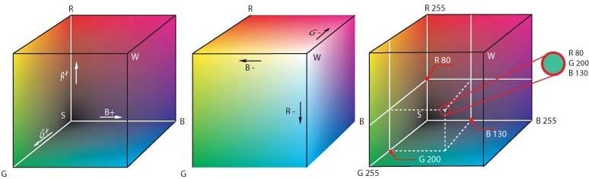
Description
The sensor contains three LEDs (red, green, blue), two Pin Diodes and a Monitor Diode. Subsequently the Led will be turned on and the Pin Diodes will measure the light reflection. Each color has a different display of three LEDs. If the display is high Pin Diodes have a small resistor, is there a small display of a high resistor. We convert this resistance value to voltage. So for each LED we get a voltage value that will convert to RGB Values. This value is compared to the reference color (selected color group), and the device receives the appropriate color. The color name is replaced by the speaker.
The RGB Color Room
For an overview of color rendering, we provide a brief overview of RGB Color Room.
RGB Color Room is an additional model. This means that three primary colors (Red, Green, and Blue) can be added to white. Almost each color can be defined by these three basic colors.
Figure:2.1 The RGB Color Room
In the graph we see the RGB Color Room. In x-Axes there is Red, in y-Axes there is Blue and in z-Axes there is Blue.
In the diagonal of the color room we find the gray scale. In the graph we can see that each color is a combination of three basic colors.
Estimates are made, to get an idea, which are important factors in finding the right color. For measurements we use a System that contains the Lab VIEW- Program, DAC-Card and Sensor. As colors we used the company "Digital ColorChecker SG" Gretagmacbeth, which contains the most common colors and colors.
In the following table are the color tests we used for our measurements.
3

Slide 10
Table 2.1: Koordinaten Table
Index | Koordinaten
1 | 2-E
2 | 2-F
3 | 2-G
4 | 2-H
5 | 2-I
6 | 2-J
7 | 3-E
8 | 3-F
9 | 3-G
10 | 3-H
11 | 3-I
12 | 3-J
13 | 4-E
14 | 4-F
15 | 4-G
16 | 4-H
17 | 4-I
18 | 4-J
19 | 5-E
20 | 5-F
21 | 5-G
22 | 5-H
23 | 5-I
24 | 5-J
4

Slide 11
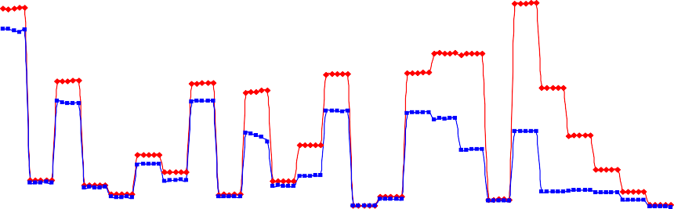
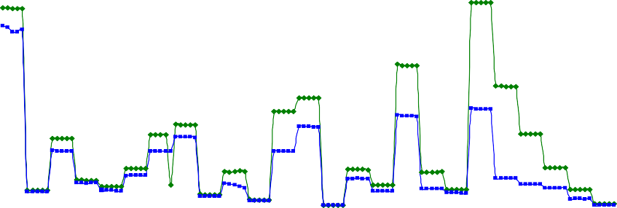
Different Measures
Measures with different distance to the object
The following measurements were made to determine the effect on RGB values, with different distances between sensor and color.
The distance that used to be 2mm we raised it to 4mm.
Difference by the Red-Led
300,000
250,000
200,000
values of the colors
RED-Led(2mm)
RED-Led(4mm)
150,000
100,000
50,000
0,000
0
20
40
60
Different Colors
80
100
120
Differnce by the Green-LED
250,000
200,000
values of colors
150,000
Green-LED(2mm)
Green-LED(4mm)
100,000
50,000
0,000
0
20
40
60
Differnet colors
80
100
120
5

Slide 12
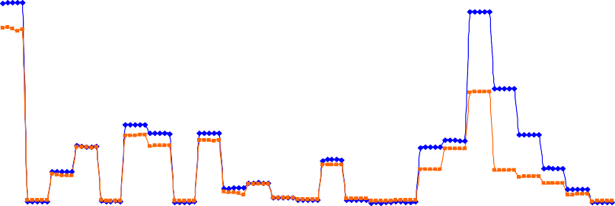
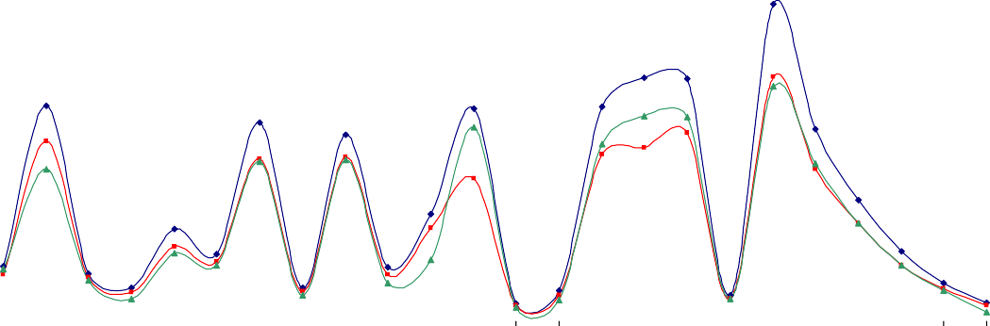
Difference Blue-LED
300,000
250,000
200,000
values of the colors
150,000
Blue-LED(2mm)
Blue-LED (4mm)
100,000
50,000
0,000
0
20
40
60
Differenc colores
80
100
120
Fgure:3.1 Measures with different distance to the object
Graphs show results with a distance of 2mm and a distance of 4mm on each LED. On the x axes there are 24 standard colors, but each color we took 5 measurements.
In these diagrams we can see, that the color range, which we want to measure, is important, because the values ​​of the three LEDs change due to distance.
b) Measures with different angel of the sensor
The following measurements were made to determine the effect on RGB values, with a different angle between sensor and object. We had fixed the sensor, with auxiliary construction, by three different angels (85 ° - / 85 ° + / 90 °). The following graphs describe 24 average colors.
Difference angle between the sensor and the object for the Red-LED
260,000
210,000
160,000
110,000
value of color
90°
85° +
85° -
60,000
10,000
1 2 3 4 5 6 7 8 9 10 11 12 13 14 15 16 17 18 19 20 21 22 23 24
different colors
6

Slide 13
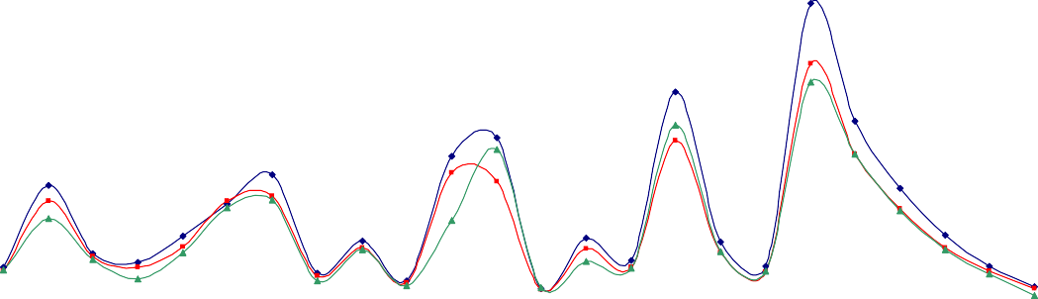
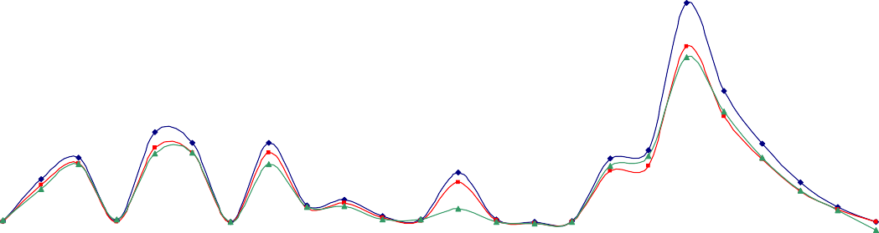
Difference angle between the sensor and the object for the Green-LED
250,000
200,000
150,000
100,000
value of the color
90°
85° +
85° -
50,000
0,000
1
6
11
different colors
16
21
Difference angle between the sensor and the object for the Blue-LED
300,000
250,000
200,000
150,000
value of the colors
90°
85° +
85° -
100,000
50,000
0,000
1
6
11
different colors
16
21
Figure:3.2 Measures with different angel of the sensor
The 85 ° + curve defines the dimensions, where the blue LED is at the beginning and the 85 ° curve - defines the dimensions, from which the red-LED comes from. A 90 ° curve describes the measurements, when the sensor is adjusted to color.
We think, in order to measure accuracy it is important that the angle between the sensor and the object (color) remains the same. So we have to show, that the angel is about 90 °, because it is easier to catch the sensor with the angel 90 ° then with 85 ° + or 85 ° -.
c) Temperatures measurement
We've had problems because we don't get repeated ratings. So we thought about the temperature. We performed estimates to determine whether the temperature change of the sensor was a factor in the change in the RGB values.
So we did 1000 measurements on white paper without dividing between ratings. The results are captured in the following graph.
7

Slide 14
1000 measurements without break
250,000
245,000
240,000
235,000
value of the colors
Red-LED
Green-LED Blue-LED
230,000
225,000
220,000
215,000
210,000
205,000
0
100
200
300
400 500 600
counter of measures
700
800
900
1000
On this point we can not say that the changing of the values is an effect of the temperature. So we made new measurements.
At first we made 30 measurements and between the measurements we turned all three Leds on for 2 minutes. On the graph below are the results of this measurement.
measurement with 2 minutes break( all LED-OFF)
240,000
235,000
230,000
valu e o f h te co lo rs
225,000
Red-LED
Green-LED Blue-LED
220,000
215,000
210,000
205,000
200,000
0
5
10
15
counte r of me asure s
20
25
30
Figure:3.3 Temperatures measurement
The brake of two minutes causes that the sensor can cool down. The values are nearly constant, so the temperature has an influence to the values rather to the Pin Diodes.
d) Temperatures measurement of the monitor diode
After a consultation with the producer of the sensor we get an idea how we can solve the problem with the temperature. The sensor has inside a Monitor Diode.
8

Slide 15

With this Monitor Diode we can measure the temperature, and we can adjust the RGB values.
In the next graphs we made different measurements including the measurements with the Monitor Diode (temperature).
RGB-values of the first measurement
215,000
210,000
205,000
200,000
195,000
190,000
185,000
1 6 11 16 21 26 31 36 41 46 51 56 61 66 71 76
quantity of measures
value of the colors
Red
Green Blue
Monitor Diode of the first measurement
3,578
3,577
3,576
3,575
3,574
3,573
3,572
3,571
3,57
3,569
1 5 9 13 17 21 25 29 33 37 41 45 49 53 57 61 65 69 73 77
quantity of m easures
values of the colors
9

Slide 16
RGB-values of the third measurement
210,000
205,000
value of the color
200,000
195,000
Red Green Blue
190,000
185,000
1 3 5 7 9 11 13 15 17 19 21 23 25 27 29
quantity of measures
10

Slide 17
Monitor Diode of the third measurement
3,58
3,578
3,576
Reihe1
3,574
3,572
3,57
1 3 5 7 9 11 13 15 17 19 21 23 25 27 29
quantity of measures
value of the color
The voltage of the monitor diode depends on the temperature of the sensor.
Figure:3.4 Temperatures measurement of the monitor diode
11

Slide 18
4. Researches of methods for color identification
An important point is to give out the right color, but at first we have to detect it. To find the right color we use a table with the RGB values of the 24 most important colors.
To explain the methods for detecting the color we take random values for the measured RGB values.
For example:
measured value | R | G | B
 | 35 | 100 | 70
This example shows you the color bluish green with the index 6. The next step is to calculate the difference between the measured values and the reference values which is pictured below.
Table 4.1.Difference between the measured values and the reference values
Reference value Difference
 | R | G | B | Index | R | G | B | Index
dark skin | 43,009 | 26,224 | 15,589 | 1 | 8,009 | 73,776 | 54,411 | 1
light skin | 147,376 | 75,147 | 55,27 | 2 | 112,376 | 24,853 | 14,73 | 2
blue sky | 36,181 | 39,887 | 85,321 | 3 | 1,181 | 60,113 | 15,321 | 3
foliage | 27,294 | 33,864 | 15,758 | 4 | 7,706 | 66,136 | 54,242 | 4
blue flower | 70,648 | 49,911 | 109,701 | 5 | 35,648 | 50,089 | 39,701 | 5
bluish green | 49,265 | 101,815 | 98,12 | 6 | 14,265 | 1,815 | 28,12 | 6
orange | 148,275 | 86,562 | 13,905 | 7 | 113,275 | 13,438 | 56,095 | 7
purplish blue | 22,561 | 21,964 | 102,041 | 8 | 12,439 | 78,036 | 32,041 | 8
moderate red | 150,229 | 28,028 | 33,018 | 9 | 115,229 | 71,972 | 36,982 | 9
purple | 35,495 | 13,254 | 35,623 | 10 | 0,495 | 86,746 | 34,377 | 10
yellow green | 79,791 | 129,208 | 19,224 | 11 | 44,791 | 29,208 | 50,776 | 11
orange yellow | 164,194 | 133,479 | 16,922 | 12 | 129,194 | 33,479 | 53,078 | 12
blue | 10,26 | 9,849 | 79,661 | 13 | 24,74 | 90,151 | 9,661 | 13
green | 23,519 | 58,385 | 16,796 | 14 | 11,481 | 41,615 | 53,204 | 14
red | 166,618 | 14,802 | 11,86 | 15 | 131,618 | 85,198 | 58,14 | 15
yellow | 194,183 | 177,114 | 15,151 | 16 | 159,183 | 77,114 | 54,849 | 16
magenta | 174,562 | 27,858 | 78,173 | 17 | 139,562 | 72,142 | 8,173 | 17
cyan | 18,601 | 29,882 | 90,129 | 18 | 16,399 | 70,118 | 20,129 | 18
white 9.5 (.05 D) | 235,122 | 233,511 | 226,297 | 19 | 200,122 | 133,511 | 156,297 | 19
neutral 8 (.23 D) | 147,211 | 150,291 | 150,387 | 20 | 112,211 | 50,291 | 80,387 | 20
neutral 6.5 (.44 D) | 89,186 | 91,952 | 92,484 | 21 | 54,186 | 8,048 | 22,484 | 21
neutral 5 (.70 D) | 47,088 | 49,274 | 49,878 | 22 | 12,088 | 50,726 | 20,122 | 22
neutral 3.5 (1.05 D) | 21,758 | 22,841 | 23,363 | 23 | 13,242 | 77,159 | 46,637 | 23
black 2 (1.5 D) | 8,09 | 8,105 | 8,311 | 24 | 26,91 | 91,895 | 61,689 | 24
12

Slide 19
a) First method
+
Now we take the 12 minimum values of the red-LED and accept the two other values form the two other colors.
Table 4.2. First method
 | 12 min of red value | accept | accept
Index | R | G | B
10 | 0,495 | 86,746 | 34,377
3 | 1,181 | 60,113 | 15,321
4 | 7,706 | 66,136 | 54,242
1 | 8,009 | 73,776 | 54,411
14 | 11,481 | 41,615 | 53,204
22 | 12,088 | 50,726 | 20,122
8 | 12,439 | 78,036 | 32,041
23 | 13,242 | 77,159 | 46,637
6 | 14,265 | 1,815 | 28,120
18 | 16,399 | 70,118 | 20,129
13 | 24,740 | 90,151 | 9,661
24 | 26,910 | 91,895 | 61,689
In the second step, we pick out the 6 Minimum values of the green-LED from the table on the top.
 | accept | 6 min. of green value | accept
Index | R | G | B
6 | 14,265 | 1,815 | 28,120
14 | 11,481 | 41,615 | 53,204
22 | 12,088 | 50,726 | 20,122
3 | 1,181 | 60,113 | 15,321
4 | 7,706 | 66,136 | 54,242
18 | 16,399 | 70,118 | 20,129
In the third step, we pick out the 3 minimum values of the blue-LED from the table above.
 | accept | accept | 3 min. of blue value
Index | R | G | B
3 | 1,1811808 | 60,1125408 | 15,321
22 | 12,0878272 | 50,7264448 | 20,122
18 | 16,39924672 | 70,1175488 | 20,129
Now we made the sum of all values of each index. The result is:0
Index | absolute deviation
3 | 76,615
22 | 82,936
18 | 106,646
The result with the first method is the color blue sky with the index 3.
13

Slide 20
b) Second method
In the second method we used an allowance for the research, in this we choose index
10. This means, that the measured values can have only a difference of +/-10 to the reference value.
In the first step we pick out the values from each LED, where the difference is lower
+/- 10 and made the sum of all values of each index
Table 4.3. Second method
Red-LED |  |  |  | sum of the differences
Index | R | G | B
10 | 0,495 | 86,746 | 34,377 | 121,617
3 | 1,181 | 60,113 | 15,321 | 76,615
4 | 7,706 | 66,136 | 54,242 | 128,084
1 | 8,009 | 73,776 | 54,411 | 136,195
Green-LED
Index | R | G | B
6 | 14,265 | 1,815 | 28,120 | 44,200
Blue-LED
Index | R | G | B
17 | 139,562 | 72,142 | 8,173 | 219,876
13 | 24,740 | 90,151 | 9,661 | 124,552
The result with the second method is the color bluish green with the index 6.
Third method
The third method is nearly the same like the second method. The difference is only, that we don’t make the sum of all differences. We make a weighting of all values from each index.
Comparison of the three methods
Table 4.4 Comparison of memory capacity & computing power
Method | memory capacity | computing power
1 | Dependent on the accuracy, the smaller the range of tolerance, the smaller is the storage requirement. However it can occur with the fact that the ‘correct’ color is excluded. | This will need surely at few computing power
2 | Depend on the allowance, the smaller it is, the smaller is the storage requirement. | This will need more computing power because we use many values which are needed for the result.
14

Slide 21
3 | Depend on the allowance, the smaller it is, the smaller is the storage requirement. | This will need surely at most computing power, because of the weighting of all values from each index.
As a conclusion, we can say, all the three methods have a possibility, to get the false color-name. So we have found an easier and exacting method to find the correct color.
e) Last method for color identification
The method which we are using to detect the color is a mathematical method. With Red, Green and Blue we can create a RGB - Color room, in this room counts the same mathematical rules like in other vector rooms.
To detect the color we calculate the smallest vector to the reference colors. This is a normal vector calculation.
Calculation:
smallest vector…v Reference red value …rv Reference green value. …gv Reference blue value …bv Measured red value …mrv
Measured green value …mgv Measured blue value …mbv
v = (rv − mrv) ² + (gv − mgv) ² + (bv − mbv) ²
For every reference color we get a result, but the smallest value gives as the correct color.
15

Slide 22
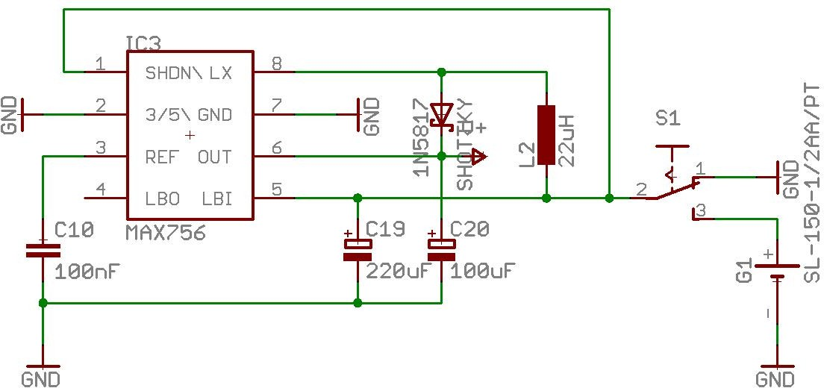
Selection of the construction units - Hardware
Introduction
The Hardware is an important component of this project. It is divided in three mean parts: Microcontroller, Sensor, Speech part. Each mean part needs other parts and components for the correct functionality.
Power supply
A 3 Volt Battery is used for the power supply. The Microcontroller and the Speech Chip needs 5 Volt, so the 3 Volt is not enough. The MAX756 is a step up converter which converts an input voltage between 1.7 Volt to 5 Volt up to 3 Volt or to 5 Volt. This Chip detects also when the battery is low. With 5 Volt output voltage it is possible to get an output current up to 200 mA.
Figure:5.1 Power supply
The picture shows the Layout of the step up converter.
c) Sensor
The Sensor consists of a Red LED, Green LED, Blue LED, two Photo Diodes, and a Monitor Diode. There is also a connected ground and a reference Voltage for the Photo Diodes.
The Red LED needs a voltage around 1.91 Volt and a current of 14mA, so the resister between microcontroller and the LED must be 22K. The blue LED needs a voltage of
3.75 Volt and a current of 7mA so the resister must be 180Ohms. The Green LED takes 5 Volt and a current of 32mA, but the microcontroller has an output current of a maximum of 25mA. So the current is given by a transistor. The basis of this transistor is connected to the microcontroller and the emitter is connected to the green LED. If
16

Slide 23
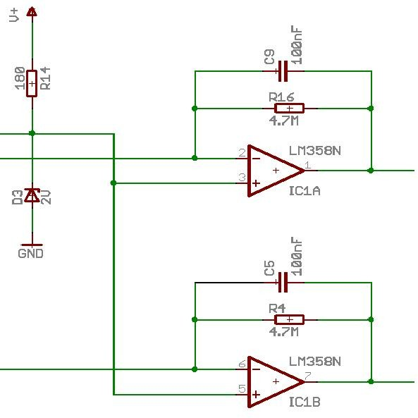
the output port of the microcontroller is set low the transistor locks. If the output port is high the green LED gets the current.
The Photo Diodes are used for detecting the light intensity. The resistor or the conductivity of the Photo Diodes is changing when the light intensity is changing.
The Monitor Diode is used for detecting the temperature in the sensor. It is also changing the resistor when the temperature is changing.
d) The Amplifier
An amplifier is used to amplify the signal of the Photodiodes. The amplifier is an inverting amplifier. It consists of an OPV LM358 a resistor and a capacitor. If the resistor of the Photo Diodes is changing the output voltage of the OPV is also changing. The capacitor is used to stable the voltage.
Figure:5.2 Amplifier
e) Microcontroller
We use the PIC18F2455 from microchip. More information about the microcontroller please visit the datasheet (http://www.microchip.com/downloads/en/DeviceDoc/39632c.pdf).
The Voltage of the Pin Diode1 is connected with the Pin 2 (Port A0), and the Pin Diode 2 is connected with Pin 3 (Port A1). On the Pin3 we find the Monitor Diode. On the Pins 11, 12, 13 are connected the Leds (Blue, Red, Green). It is possible to detect the low battery with the Port RC5 (Pin16). On Pin 18 (Port RC7) is the bush bottom to start a measurement. The Pins 21, 22, 23, 24, 25 (Port B0…B4) are the address lines for the Speech Chip. With Pin 27 (Port B6) we can detect when a played message is finish. To start playing a message we give the signal on Pin 28 (Port B7).
17

Slide 24
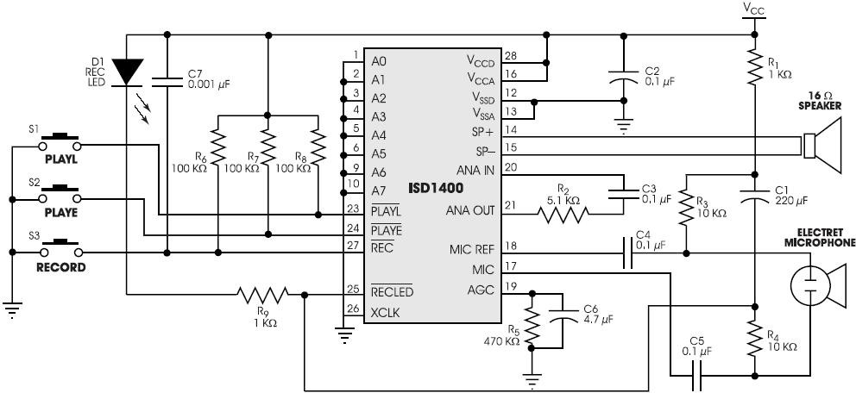
f) Speech chip
We are using the speech chip to give out the name of the color by a speaker. After researches we have decided to use an ISD chip, because it was the only chip which is able to give out an analog signal.
For us it was important because the digital output of a voice is very hard to understand.
We are using the ISD 1420, which can store 20 seconds. The following graph shows the protective circuit.
Figure:5.3 Speech chip
This circuit was important to record the different messages (color names). The addresses A0-A7 we are using to select the position of the message with a binary code. The buttons PLAYL / PLAYE / REC are to play or store the messages. The AGC input is for amplify of the input signal. The input signal can be transmitted by two different ways. The first way we are using is a Microphone and the second way we set the output “ANA OUT” after the capacitor at Ground. Then we connect an analog signal (PC/ MP3-player …) on the “ANA IN”.
For the output we are using an 8 Ohm speaker.
18

Slide 25
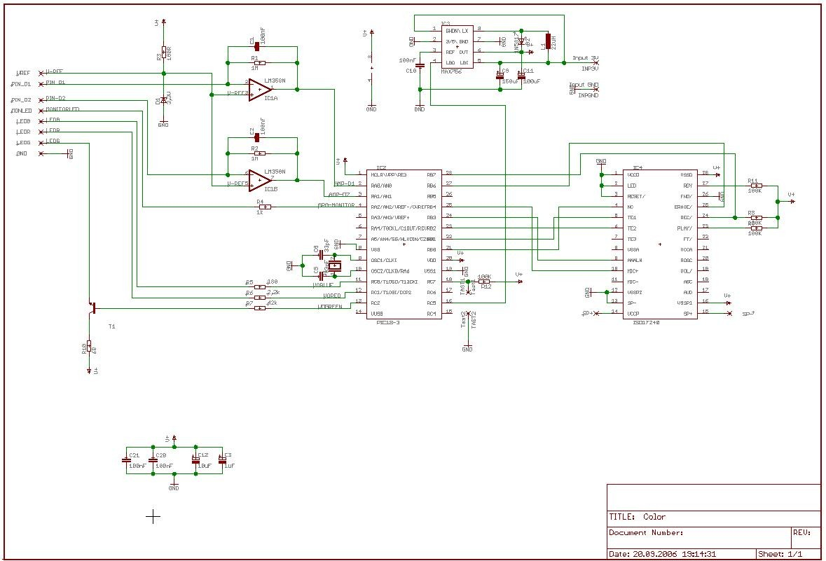
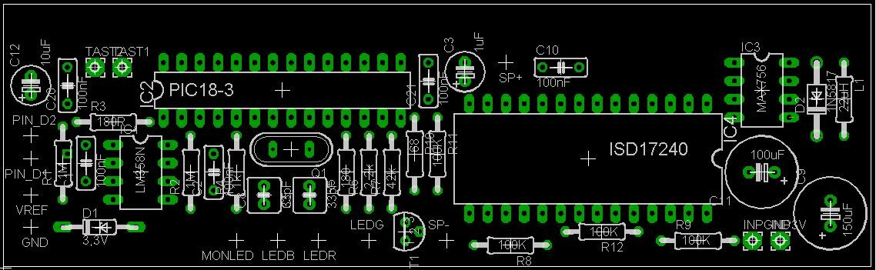
g) Schematic
Figure:5.4 Schematic
h) Board
Figure:5.5 Amplifier
19

Slide 26
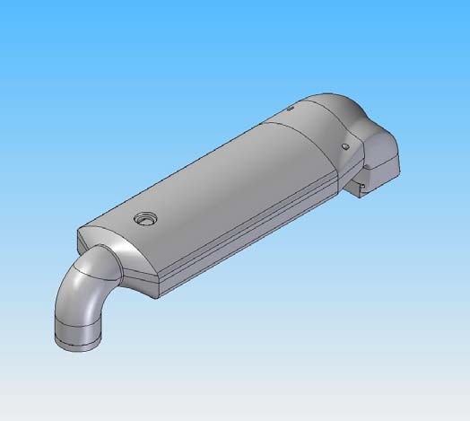
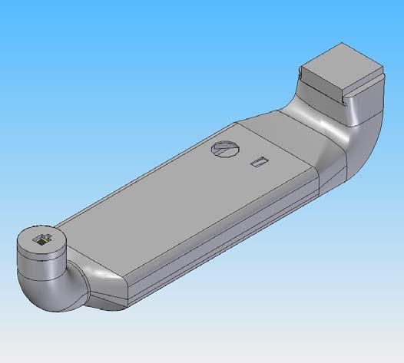
6. The design
Figure:6.1 The design
20

Slide 27
7. Introduction of Software Development
The purpose of this report is to develop microcontroller software to improve the embedded color detection system system. The basic idea of ​​the software is to connect two embedded system sensor modules and a speech chip.
First, the port configuration is done with a microcontroller. It then turns on each LED sensor in its sequence and when the Led light shines, the Pin diodes are sensed to measure the Led light reflection and simply by calling the analog to digital function (ADC).
Then other mathematical functions enter the image, which is used in the ADC result to compare the standard RGB values ​​(stored in the system).
The next step is to compare these estimated RGB values ​​with universal RGB values ​​and here, the software finds a small distance between the estimated RGB and global values.
Finally, after receiving a small distance it is ready to send the 5-bit address to the speech chip where the colors are stored and after receiving this message speech chip is responsible for speaking the same color.
The microcontroller used was a PIC18F2455 from a microchip. The editor tools were MPLAB and PICSTART Plus from Microchip. All system upgrades are performed on ANSI C using a Microchip C18 compiler.
For more information a complete software implementation is included.
21

Slide 28
a) The Program
import cv2
import numpy as np
import pandas as pd
import argparse
#Creating argument parser to take image path from command line
ap = argparse.ArgumentParser()
ap.add_argument('-i', '--image', required=True, help="Image Path")
args = vars(ap.parse_args())
img_path = args['image']
#Reading the image with opencv
img = cv2.imread(img_path)
#declaring global variables (are used later on)
clicked = False
r = g = b = xpos = ypos = 0
#Reading csv file with pandas and giving names to each column
index=["color","color_name","hex","R","G","B"]
csv = pd.read_csv('colors.csv', names=index, header=None)
#function to calculate minimum distance from all colors and get the most matching color
def getColorName(R,G,B):
minimum = 10000
for i in range(len(csv)):
d = abs(R- int(csv.loc[i,"R"])) + abs(G- int(csv.loc[i,"G"]))+ abs(B- int(csv.loc[i,"B"]))
if(d<=minimum):
minimum = d
cname = csv.loc[i,"color_name"]
return cname
More
22

