Slide 1

Executive Advisors
Client guidelines example
Name of client: Executive Advisors

Slide 2
Problem solving precautions
Clarify the issue –
Ensure everyone understands the problem.
Check data quality –
Use reliable, up-to-date information.
Analyse root causes –
Don’t confuse symptoms with causes.
Explore alternatives –
Avoid settling on the first idea.
Assess feasibility –
Time, cost, resources, constraints.
Challenge biases –
Stay objective and evidence-based.
Prototype or test –
Reduce risks before full execution.
Measure outcomes –
Track progress and adjust quickly.
Reflect & record –
Capture insights for future cases.
Brush-ups

Slide 3
Financing Pros and Cons
Pros Of Financing
Cons Of Financing
Immediate Access
Cash Flow Management
Leverage for Growth
Predictable Payments
Builds Credit
Tax Benefits (in some cases)
Interest Costs
Debt Obligation
Risk of Default
Approval Requirements
Reduced Financial Flexibility
Variable Rates Risk
Visual Enhancement

Slide 4
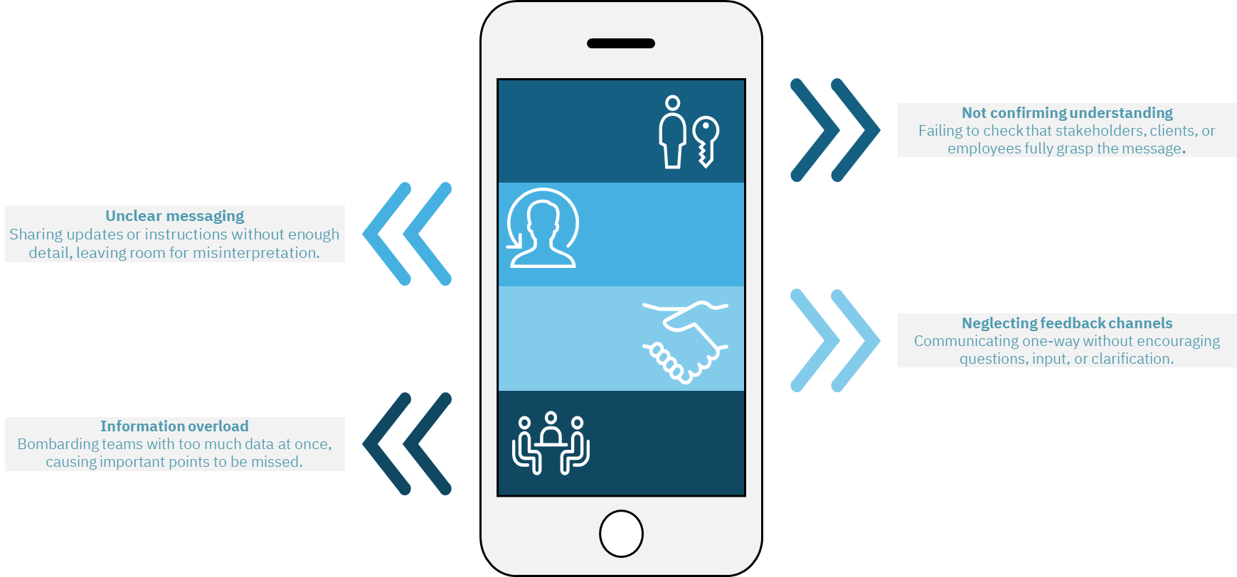
Common Communication Pitfalls
Icons

Slide 5

Targeting Excellence
Alignment

