Slide 1
Beyond Chunk Size
MINI PROJECT REVIEW · RESULTS AND ADVISOR
A multi-domain study of chunking, embedding and retrieval strategies for RAG
Team 2: Vinayak Kalal · Samvit Nandakishore · Sabbir Mondal · Rahul Shenoy
Prompt Engineering and Optimization for Generative AI (UE24AM343AB5)

Slide 2
Retrieval quality decides RAG quality
WHY THIS MATTERS
1
2
3
The problem
The gap
Our angle
A RAG answer is only as good as the text it retrieves. Chunk size, splitting method and embedding model change recall, noise and cost, yet they are often chosen by habit.
In the studies we reviewed, comparisons use one generic corpus and one retrieval setup. Few test how document type, embedder and reranker interact, or what compression costs.
Compare chunking × embedding × retrieval with chunk-size-independent metrics mapped to ITU-T F.748.52, then build a decision matrix and advisor app.

Slide 3
LITERATURE SURVEY (1 of 3)
Theme | Work | What it contributes
Foundations | Lewis et al. [1] | Generator plus retrieval memory; basis of our pipeline
Foundations | Gao et al. [3] | Naive, advanced and modular RAG; frames our pipeline
Foundations | Barnett et al. [4] | Seven failure points, several in retrieval
Chunking | Qu et al. [7] | Semantic chunking gains not consistent enough for its cost
Chunking | Chen et al. [8] | Proposition units can improve retrieval and QA
Chunking | Yepes et al. [9] | Structure-aware chunking helped on financial reports
Chunking | Finardi et al. [10] | Retriever, chunk and generator choices interact
Chunking | Günther et al. [11] | Late chunking: embed long text first, then pool chunks
Chunking | Anthropic [12] | Contextual Retrieval: prepend LLM-written context
Embeddings | Reimers and Gurevych [13] | Sentence-BERT: bi-encoder sentence embeddings
Key takeaway: retrieval quality bounds answer quality, and the best chunking method depends on the document.

Slide 4
LITERATURE SURVEY (2 of 3)
Theme | Work | What it contributes
Embeddings | Wang et al. [14] | E5: weakly-supervised contrastive pre-training
Embeddings | Xiao et al. [15] | BGE: open general-purpose embedding family
Embeddings | Kusupati et al. [20] | Matryoshka: leading dimensions stay useful when truncated
Embeddings | Shakir et al. [21] | Binary and scalar quantization keep much of the quality
Pipeline | Robertson and Zaragoza [22] | BM25: strong sparse baseline for exact terms
Pipeline | Cormack et al. [23] | Reciprocal Rank Fusion: training-free rank merging
Pipeline | Nogueira and Cho [24] | Cross-encoder reranking improves ordering
Pipeline | Wang et al. [25] | Recommends balanced RAG component combinations
Evaluation | Es et al. [27] | RAGAS: reference-free RAG metrics with an LLM judge
Evaluation | Zheng et al. [28] | LLM judges agree with humans but show known biases
Evaluation | ITU-T F.748.52 [29] | Standard of requirements and evaluation methods for RAG
Key takeaway: embedding, pipeline and evaluation choices interact with chunking and should be tested together.

Slide 5
Key takeaways
LITERATURE SURVEY (3 OF 3)
1
Foundations. Retrieval quality bounds answer quality, so we measure recall, precision and noise together, not recall alone.
2
Chunking. The best method depends on document structure and task; semantic chunking is disputed and structure-aware methods are tested on one domain only.
3
Embeddings. Leaderboard ranks may not transfer to a corpus, so truncation and quantization must be tested together with chunking.
4
Retrieval pipeline. Hybrid search and reranking may reduce how much chunking matters, but this was untested across chunkers (our H2).
5
Evaluation. We need chunk-size-independent metrics, a cautious LLM judge and a mapping to ITU-T F.748.52 so results are comparable.

Slide 6
What is still missing
RESEARCH GAP
1
Limited document diversity. Most studies use one generic or single-domain corpus.
2
Components studied in isolation. Chunking, embedder and reranker are rarely varied together.
3
Metrics tied to chunk boundaries. Chunkers of different sizes are hard to compare fairly.
4
Efficiency studied separately. Truncation and quantization are seldom combined with chunking.
5
No practitioner-ready output. Few decision aids map document type and priorities to a setup.
6
No link to standards. Results are rarely reported against ITU-T F.748.52.

Slide 7
Three hypotheses, three verdicts
WHAT WE FOUND
H1
H2
H3
Structure beats size
Reranking narrows the gap
Compression is cheap
Not supported. Structure-aware chunking ranks 2nd on health and 4th on legal; no clear win.
Partly supported. 256 dimensions keep 95 to 98% of quality; binary codes keep 79 to 91%.
Supported. With a reranker the spread falls to 0.07 (health) and 0.06 (legal).
Not supported
Supported (descriptive)
Partly supported

Slide 8
A staged experiment
METHOD
1
2
3
4
Corpora
Chunking
Embeddings
Retrieval
→
→
→
Health and legal text, with LLM-drafted questions and evidence spans
Fixed, sentence, semantic, structure-aware and parent-child (hierarchical)
BGE, E5, GTE and MiniLM, with optional Gemini and OpenAI embeddings
Dense (FAISS), hybrid with BM25, and hybrid plus cross-encoder reranker
Staged runs keep the grid small: all chunkers first, then top chunkers × embedders, then retrieval variants, then efficiency tests. Results are reported with ITU-T F.748.52 measures.

Slide 9
Corpus and question set
DATA
2
4,796
58
main corpora, 2 documents each
words of text
questions with evidence spans
Questions per corpus
Why these corpora
Health
36
Short public documents in two domains, to test whether chunking advice transfers. Python docs were dropped (gold documents missing).
Legal
22
AI pilot
4

Slide 10
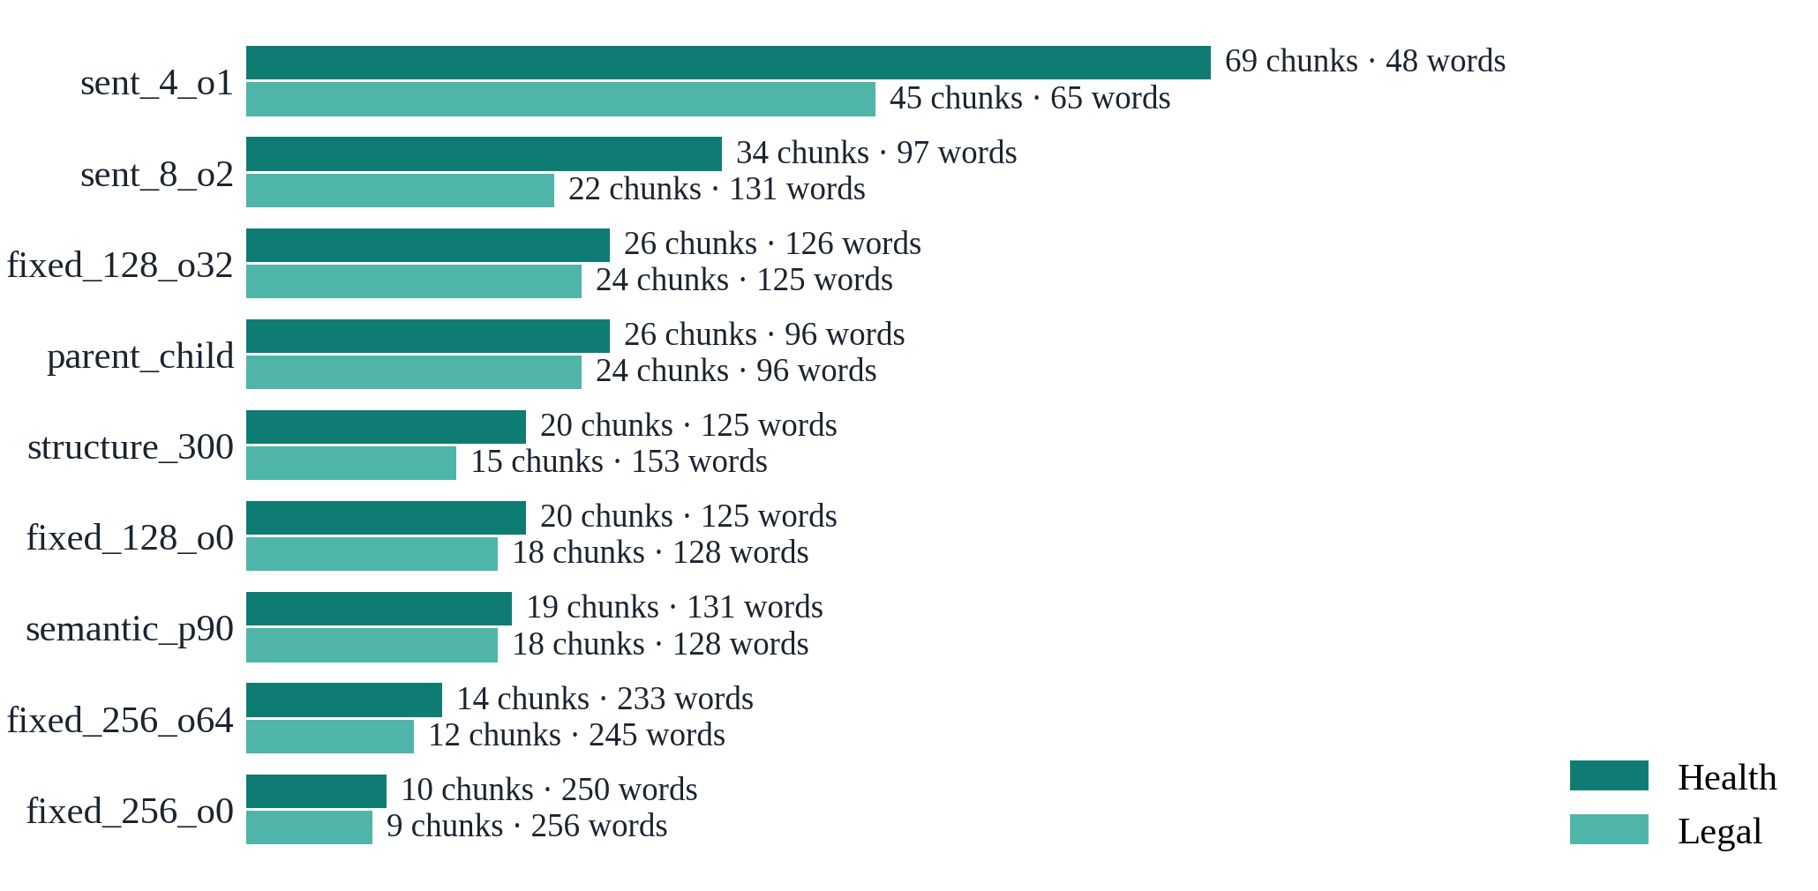
Chunking strategies prepared
CHUNKING
Same text, different chunk sets
●
Health 2,495 words, legal 2,301 words
●
9 to 69 chunks per strategy
●
Average length 48 to 256 words
●
parent_child embeds small chunks and returns the larger parent

Slide 11
Models and retrieval modes
MODELS AND RETRIEVAL
Model | Hugging Face id | Dimensions | Notes
bge-small | BAAI/bge-small-en-v1.5 | 384 | Query instruction prefix
e5-small | intfloat/e5-small-v2 | 384 | Query and passage prefixes
gte-small | thenlper/gte-small | 384 | General text embeddings
MiniLM | all-MiniLM-L6-v2 | 384 | Also splits text for semantic chunking
1
2
3
Dense
Hybrid
Hybrid + rerank
FAISS vector search
BM25 + dense, merged by reciprocal rank fusion
Cross-encoder re-scores the top candidates

Slide 12
Testing each hypothesis
TEST DESIGN AND RESULTS
Hypothesis | How we tested it | Result
H1 · structure-aware chunking wins | All chunkers across embedders; paired bootstrap on f_ctx, 95% CI | Not supported (paired CIs include zero)
H2 · reranking narrows the gap | All chunkers × dense, hybrid, hybrid + rerank; spread per mode | Supported: spread falls to 0.07 and 0.06
H3 · compression is cheap | 256, 128, 64 dimensions and binary codes; f_ctx vs full vectors | Partly supported: 256-d keeps 95 to 98%
Outputs: heatmaps, pipeline-effect charts, the decision matrix and ITU-T F.748.52 tables.

Slide 13
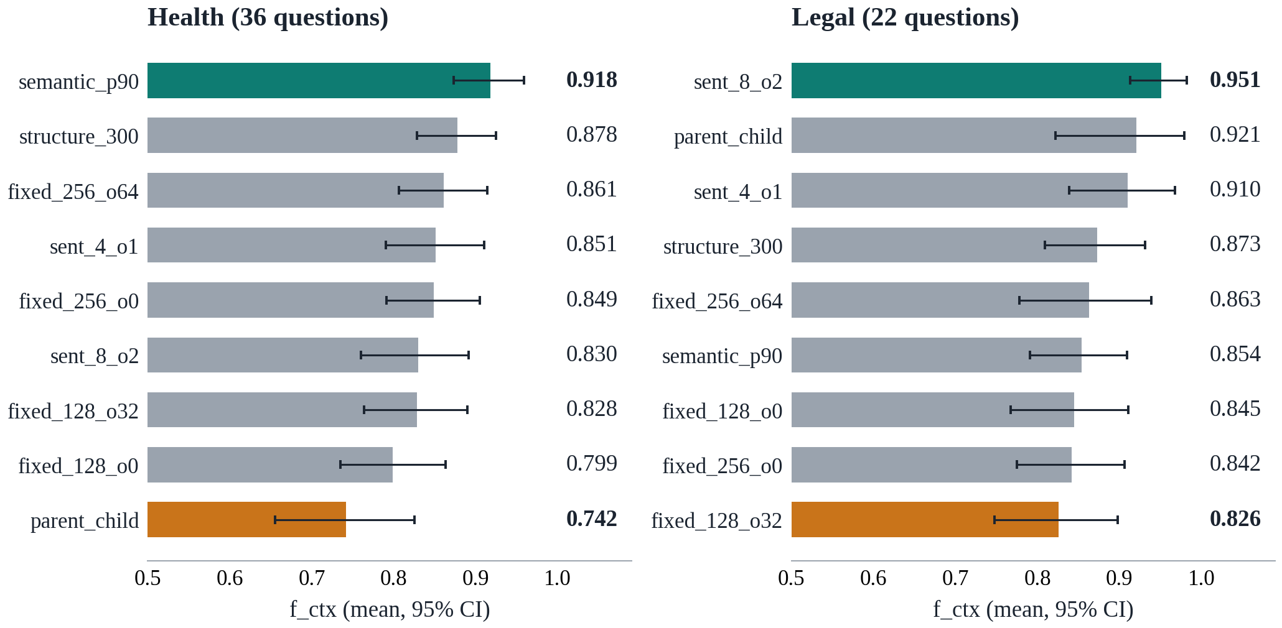
Best chunker depends on the document
RESULTS
Two domains, two rankings
●
Health: semantic chunking leads (0.918)
●
Legal: eight-sentence groups lead (0.951)
●
Rank correlation across domains: −0.02
●
Best embedder: e5-small (health), bge-small (legal)

Slide 14
Pipeline and compression
RESULTS
17 of 18
27–36×
95–98%
chunker pairs helped by hybrid
reranker time vs hybrid
quality kept at 256 dimensions
Mean f_ctx by retrieval mode (health | legal)
Decision matrix winners
Dense
0.848 | 0.876
Health: semantic_p90 + e5-small + hybrid. Legal: fixed_256_o64 + bge-small + hybrid.
Hybrid
0.878 | 0.941
Hybrid + rerank
0.909 | 0.954

Slide 15
ITU-T F.748.52 evaluation
STANDARD
11 of 20
5
4
clauses implemented
clauses partly implemented
out of scope or not implemented
Best MAP@5 per domain (clause 8.1.2)
Aligned, not conformant
Health
0.936
Full conformance would need image and video support, distributed storage and a security system.
Legal
0.966

Slide 16
Next steps and plan
NEXT STEPS
Done: survey, pipeline, results and app
Now: verify questions and re-run
Final demo and IEEE report
Before the final review
Suggested team split
○
Fix the Python-docs corpus and re-run
●
Data and chunking pipeline
○
Human-verify the gold questions
●
Embeddings and efficiency
○
Add larger corpora with unanswerable questions
●
Evaluation set and metrics
○
Fill human rating sheets; second-provider judge
●
Retrieval, reranking and advisor app
○
Demo the Config Advisor app

Slide 17
Thank you

