Slide 1
Task-2
Report

Slide 2
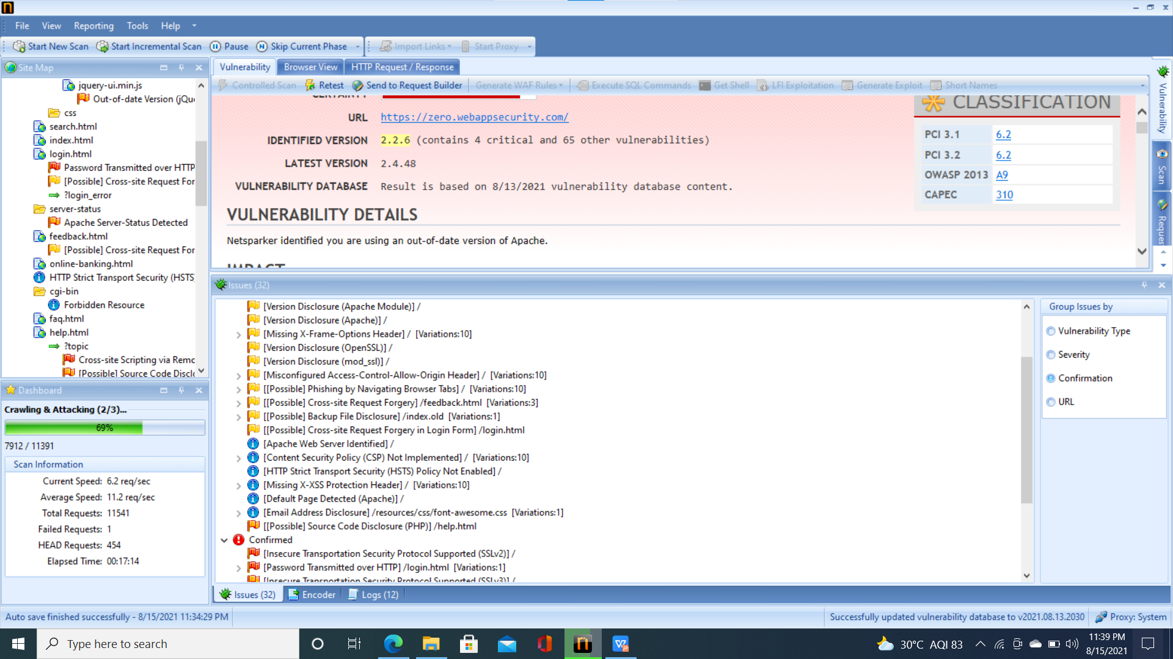
Vunerabilities

Slide 3
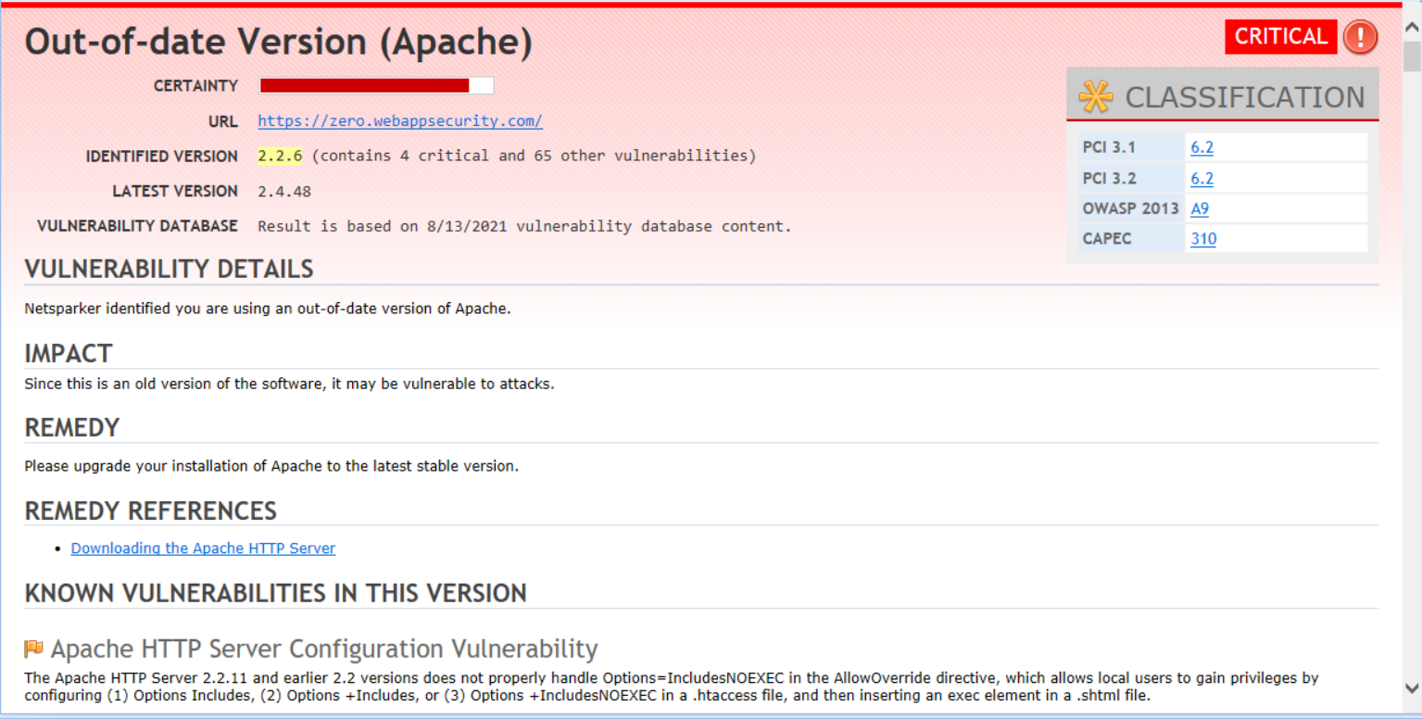
Report generated by Netsparker

Slide 4
Vunerability: Out of date version of apache used
Domain: webappsecurity.com
Subdomain: zero.webappsecurity.com
URL: http://zero.webappsecurity.com/
Type of vulnerability: critical
version used: 2.2.6
Details:
Application is using an outdate version of apache, which is suseptible to some attacks.

Slide 5
Impact:
As this is an old version of apache server, it is vulnerable to some attacks which hacker might do and security of the concerned application may be compromised.
Remedy:
Latest version of Apache should be installed(used) on the hosting side.

