Slide 1
Task-3
Report

Slide 2
Report
Vulnerability: Cross site scripting
Summary:
Cross-site scripting (also known as XSS) is a web security vulnerability that allows an attacker to compromise the interactions that users have with a vulnerable application. It allows an attacker to circumvent the same origin policy, which is designed to segregate different websites from each other.
Cross-site scripting works by manipulating a vulnerable web site so that it returns malicious JavaScript to users. When the malicious code executes inside a victim's browser, the attacker can fully compromise their interaction with the application.

Slide 3
Details
domain: vulnweb.com
Subdomain: testasp.vulnweb.com
URL: http://testasp.vulnweb.com/
Steps to reproduce:
Prepare a Javascript payload. Following has been used in this particular attack.
<img src/onerror=prompt(8)>
2. Just type the above code in the search text field and it will promt for user input and confirmation.

Slide 4
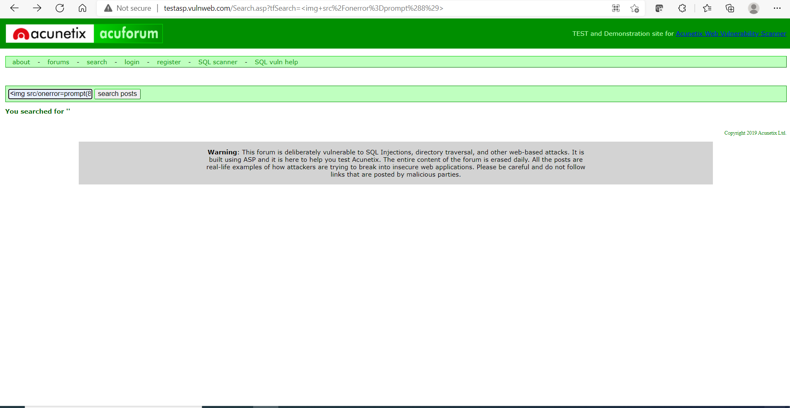
Injection demonstration

Slide 5
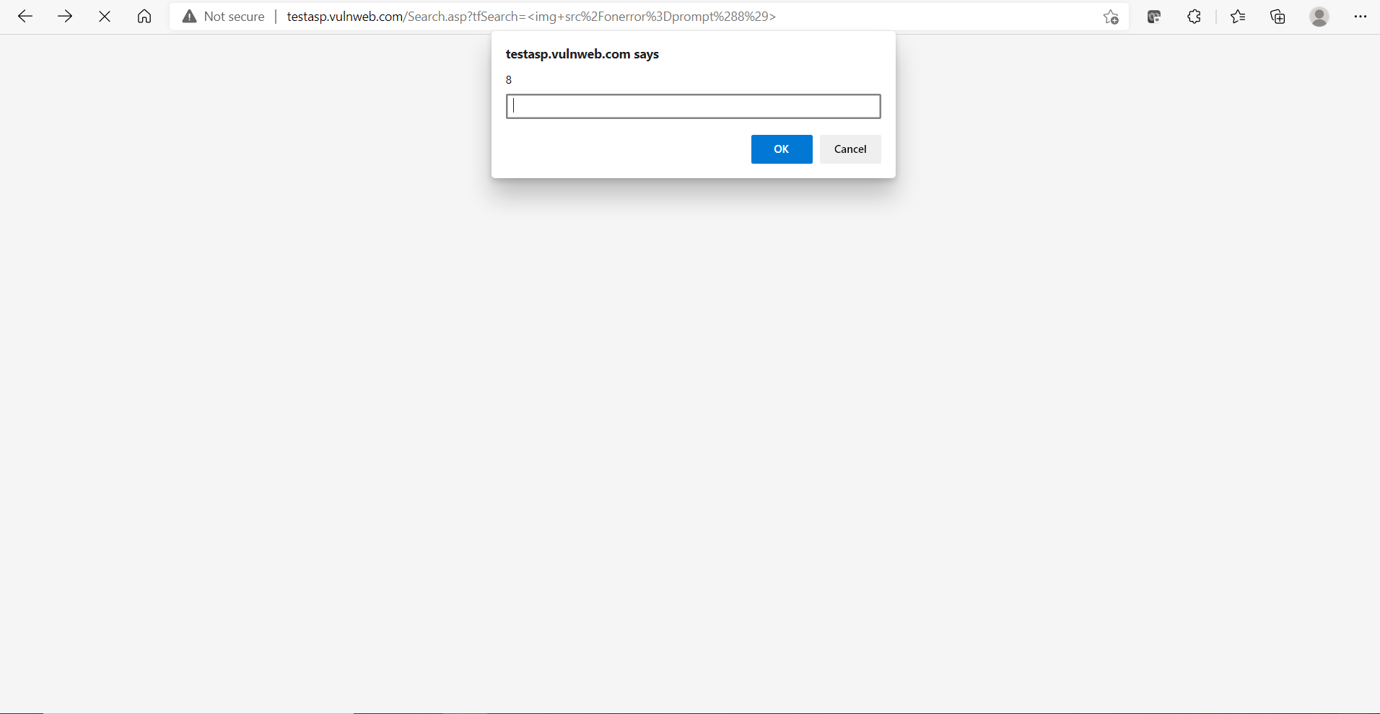

Slide 6
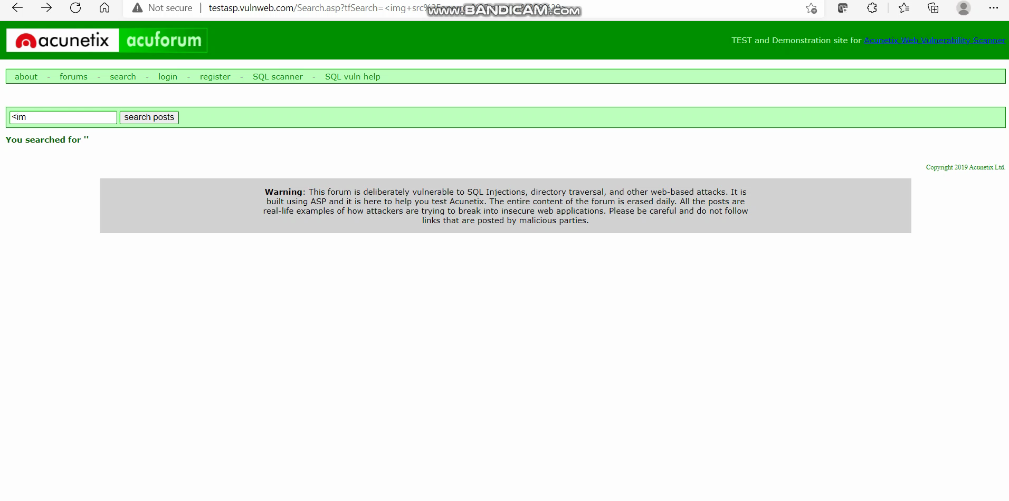
Video Demo

Slide 7
Impact
XSS allows attackers to execute scripts in the victim’s browser which can hijack their session, deface content, or redirect them to a malicious website.
Cross-site scripting vulnerabilities occur when a parameter under the user’s control is either reflected (Type-2) to the user, stored (Type-1) and returned at a later time, or executed as a result of modifying the DOM environment (Type-0).
User accounts can be hijacked, credentials could be stolen, sensitive data could be exfiltrated, and lastly, access to your client computers can be obtained.

Slide 8
Remedy
Below 2 can be used to mitigate XSS
Input Validation: It is recommended that the user’s input is sanitized by removing special characters <,>,’,”,&,/ and JavaScript onEvent actions.
Output Encoding: If special characters are required in the affected parameters, output encoding should be used to replace special characters with their HTML equivalent. (e.g., < becomes <)

