Slide 1
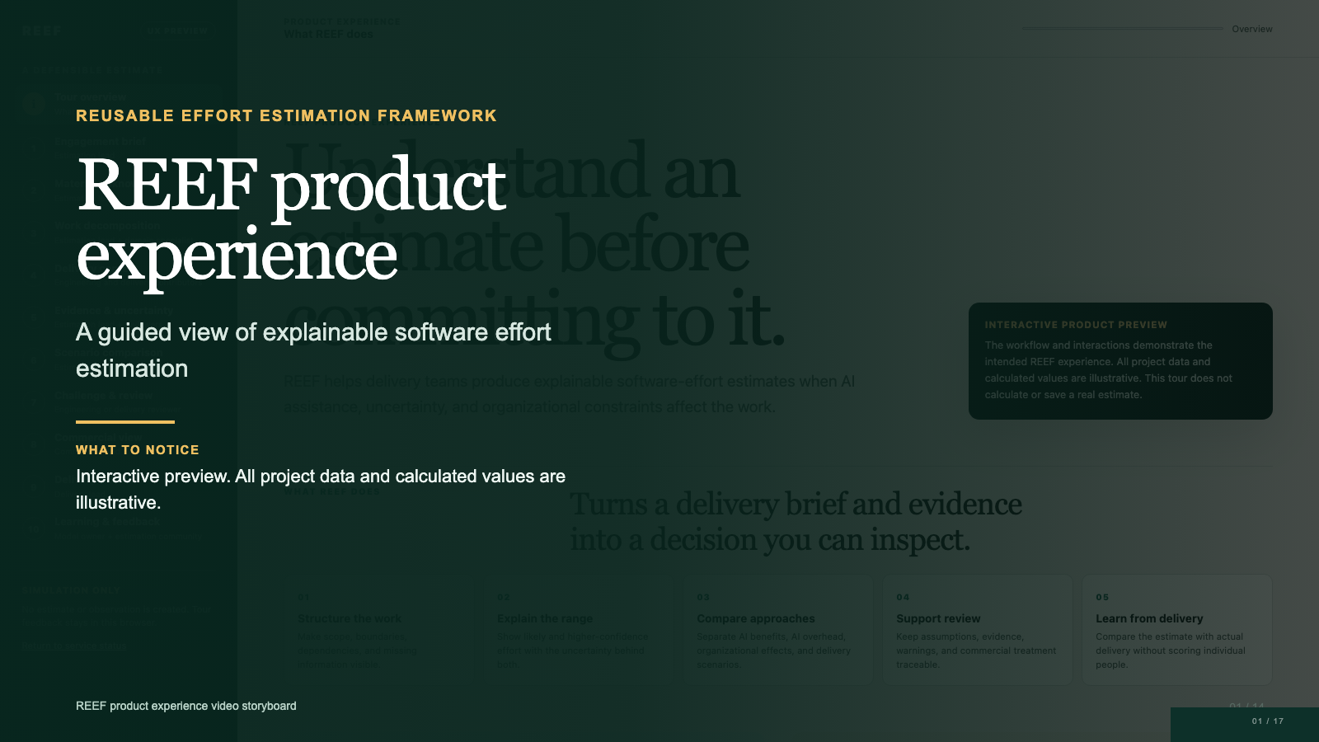
Notes:
REEF stands for Reusable Effort Estimation Framework. It helps delivery teams create software effort estimates that people can inspect, challenge, and explain. This walkthrough follows one fictional modernization project from its initial brief through estimation, review, commercial planning, delivery actuals, and learning. The current product experience is an interactive preview. It demonstrates the intended workflow, vocabulary, roles, and decisions. It does not calculate or save a real estimate, and every value shown in the tour is illustrative. By the end of this video, you should understand what REEF needs, what it produces, where people make decisions, and how the estimate remains traceable throughout delivery.

Slide 2
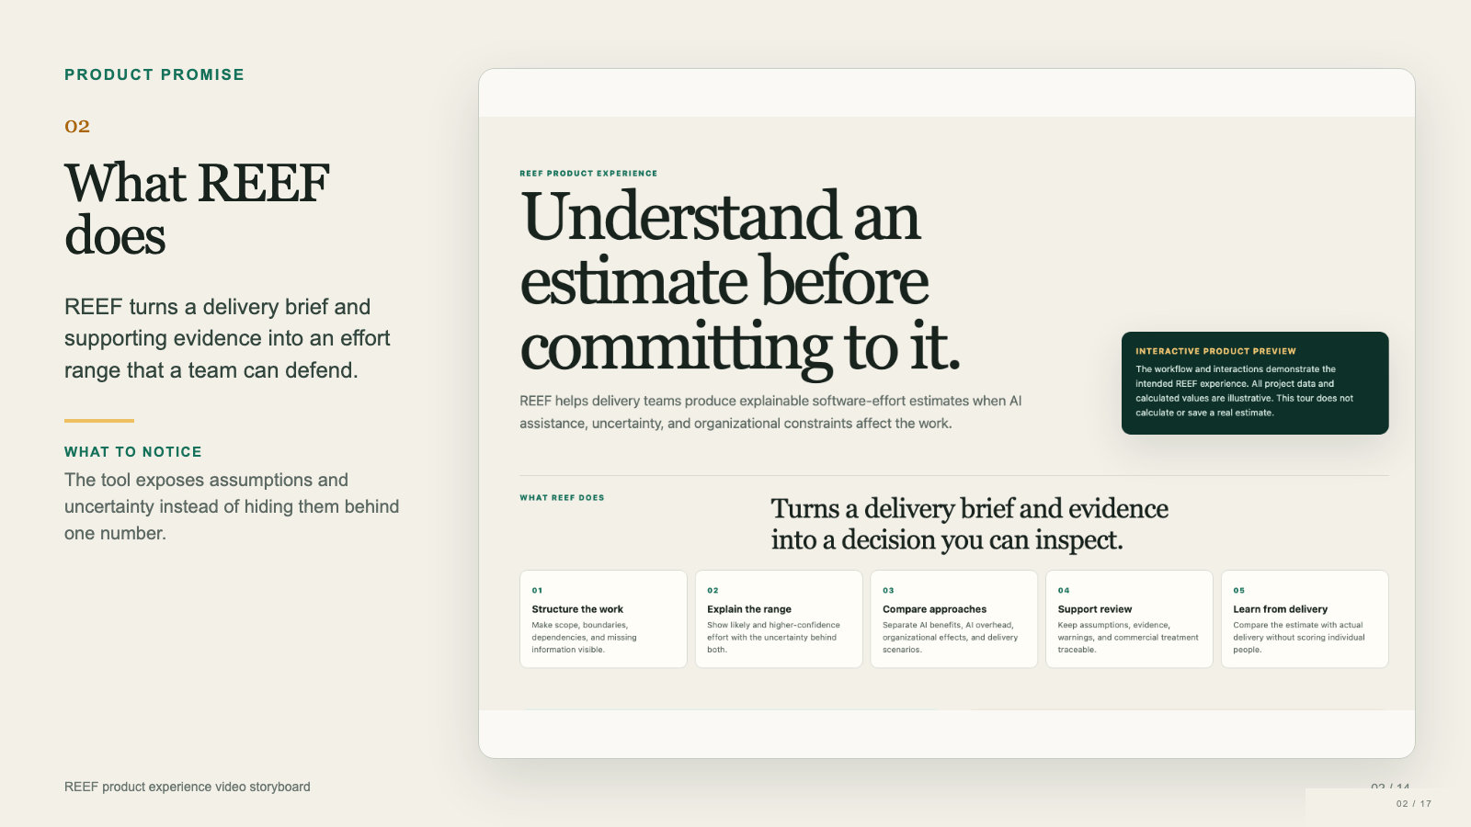
Notes:
REEF begins with a delivery brief and the evidence available at estimation time. It structures the work, identifies missing information, and represents the delivery context that can change effort or elapsed time. It then presents likely and higher confidence effort ranges, compares delivery approaches, and keeps the causes of each adjustment visible. Reviewers can challenge weak evidence before accepting an exact estimate version. Commercial teams can apply different commercial arrangements without rewriting the engineering baseline. During delivery, teams can compare the estimate with actual effort and elapsed time. REEF supports professional judgment. It does not replace the people accountable for scope, assumptions, review, or commitment.

Slide 3
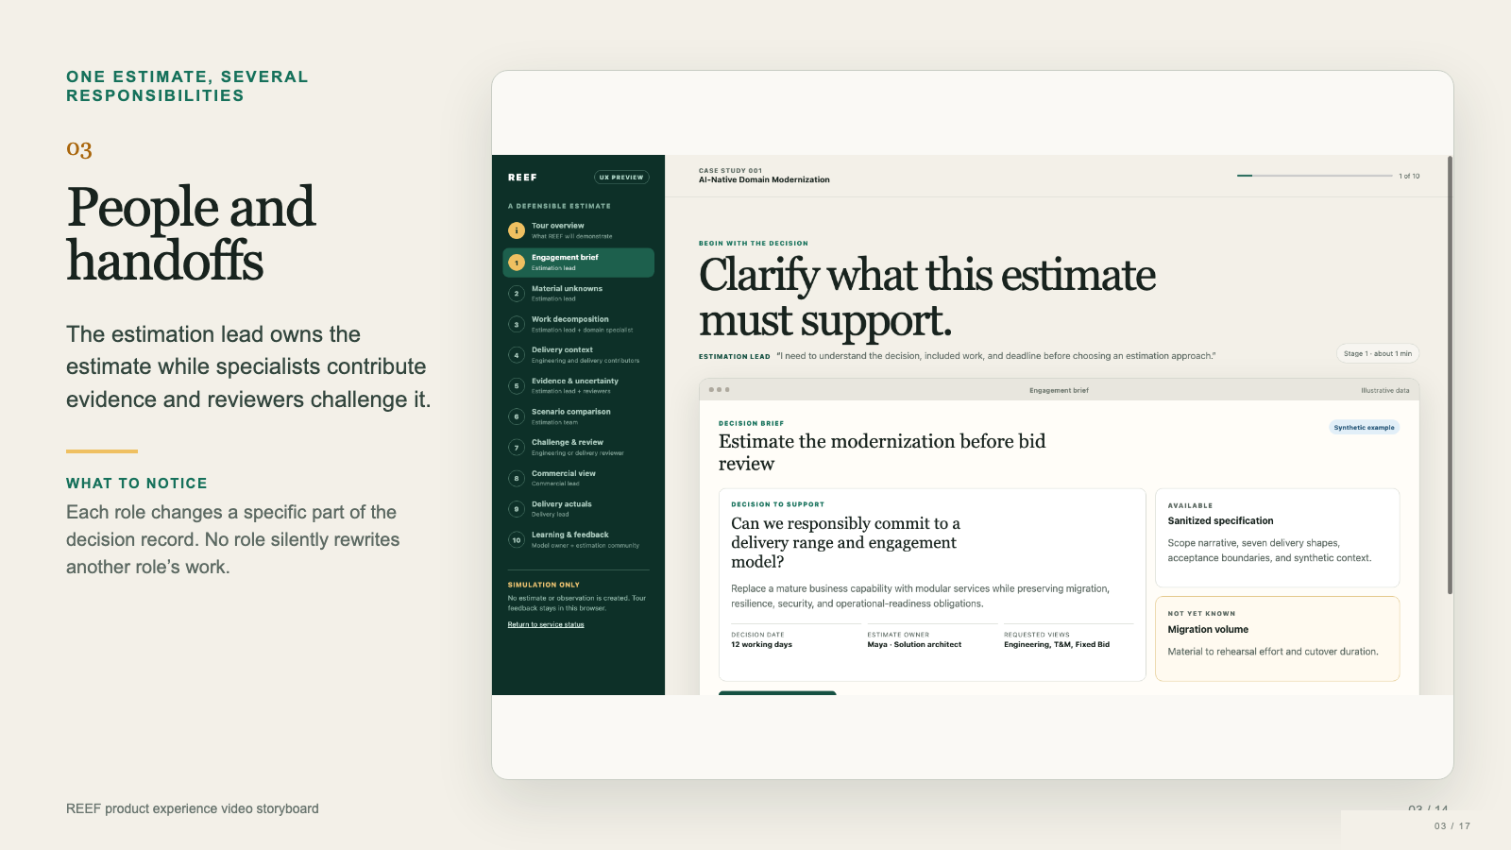
Notes:
REEF supports a workflow rather than one generic user. The estimation lead, often a solution architect or accountable delivery lead, owns the accepted scope, assumptions, evidence, and warnings. Engineering and delivery contributors describe how the work will happen, including AI participation, dependencies, and organizational constraints. A reviewer challenges scope, feasibility, evidence quality, and uncertainty. The commercial lead converts the accepted engineering estimate into a time and materials, fixed bid, or managed service view. The delivery lead records what actually happened. Finally, the estimation method owner evaluates whether later evidence should improve a future method version. Historical estimates stay bound to the decisions they originally supported.

Slide 4
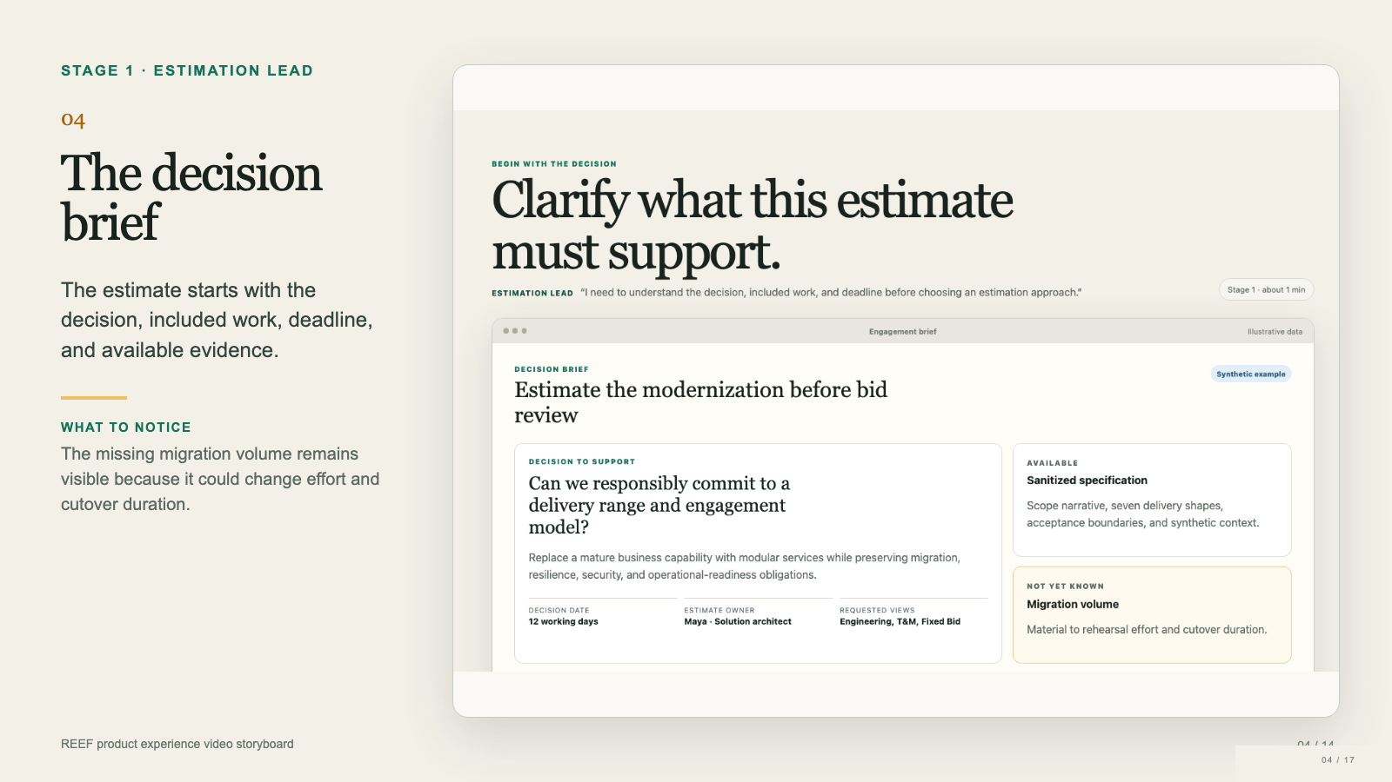
Notes:
The first workflow stage clarifies what the estimate must support. In this fictional case, the team must decide whether it can responsibly commit to a delivery range before bid review. The brief records the modernization boundary, the decision date, the estimate owner, and the views that stakeholders need. It also records what evidence is available and what remains unknown. Notice that REEF asks the user to choose an estimation approach, not an AI model. A commercial arrangement is a separate concept that appears later. The estimation lead remains responsible for confirming that the brief describes the real decision before any effort range can be trusted.

Slide 5
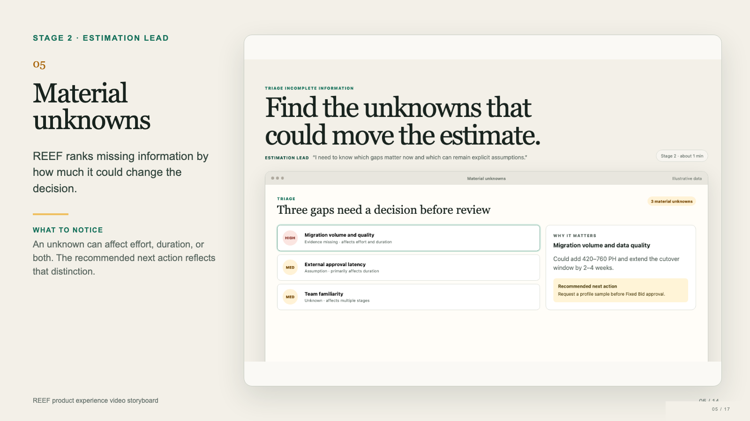
Notes:
Most early estimates contain missing information. REEF does not treat every gap as equally urgent and does not silently replace important unknowns with confident defaults. Here, migration volume and data quality could add hundreds of person hours and extend the cutover window, so REEF recommends obtaining a profile sample before approving a fixed bid. External approval latency may extend elapsed duration without adding the same amount of engineering effort. Team familiarity may affect ramp up effort, review intensity, and parallel work. The estimation lead can decide which evidence to gather now and which uncertainty to retain as an explicit assumption. That tradeoff remains visible to later reviewers.

Slide 6
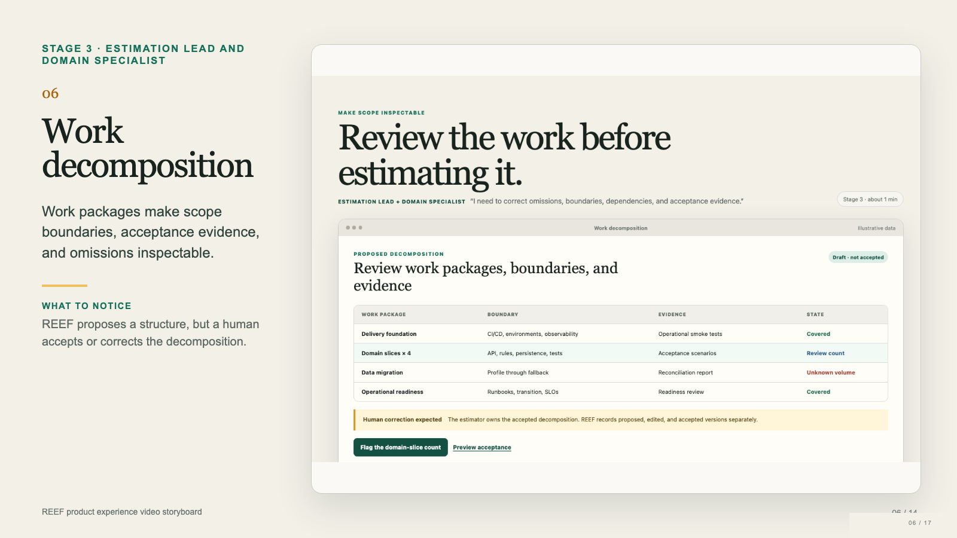
Notes:
REEF next turns the brief into a proposed work decomposition. Each work package shows its boundary, the evidence that would demonstrate completion, and its current review state. The example separates delivery foundations, domain slices, data migration, and operational readiness. This prevents important work such as observability, runbooks, or migration fallback from disappearing inside a broad implementation label. The domain specialist can correct missing packages, counts, dependencies, or acceptance conditions. REEF records the proposed, edited, and accepted versions separately. The decomposition is evidence for estimation, not an authoritative plan generated by AI. The estimation lead owns the version that moves forward.

Slide 7
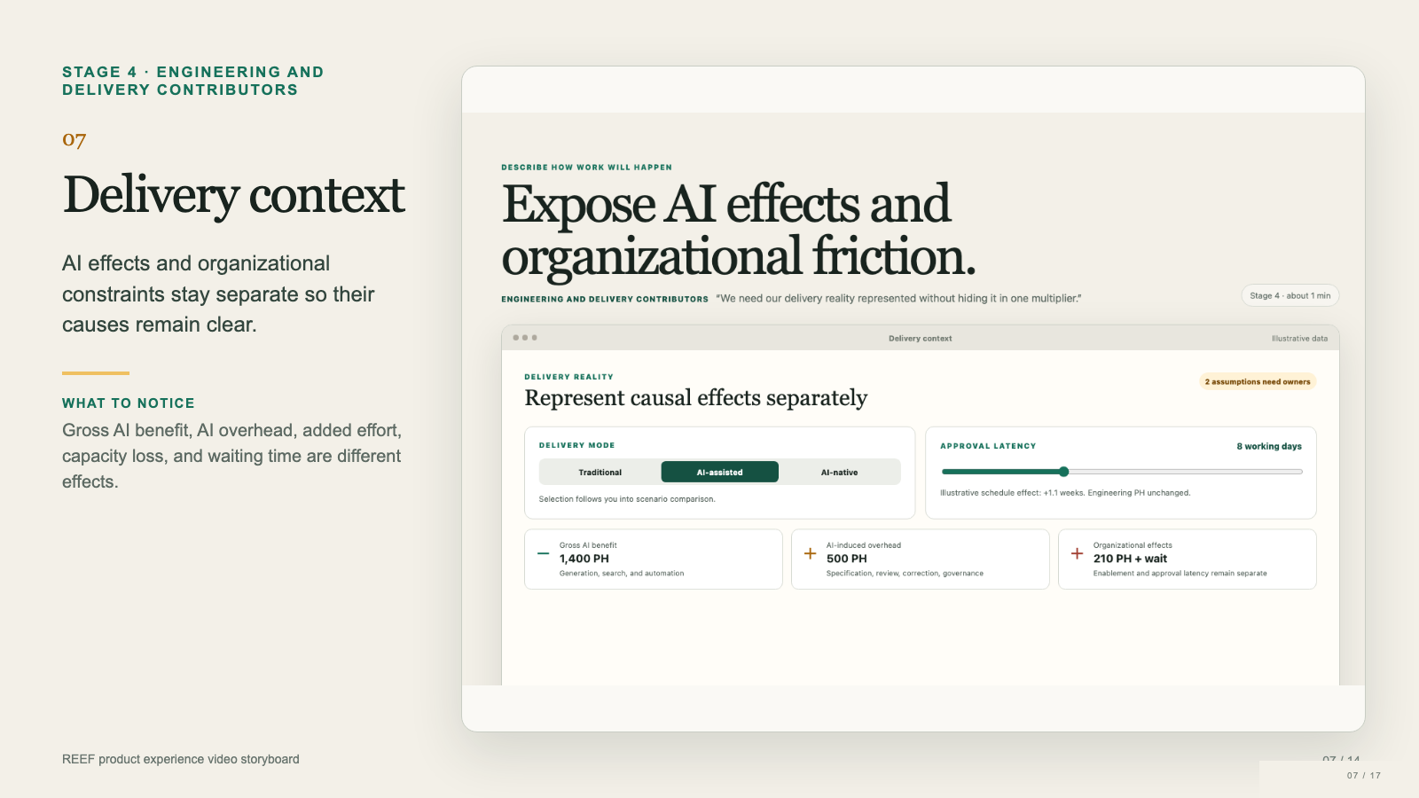
Notes:
The delivery context describes how the work will happen. The team can compare traditional, AI assisted, and AI native delivery approaches. REEF keeps gross AI benefit separate from AI induced overhead. Gross benefit covers work reduced through generation, search, or automation. AI overhead covers specification effort, review, correction, and governance needed to use those capabilities responsibly. Organizational effects also remain explicit. Enablement may add person hours, while approval latency may extend the schedule without changing engineering effort by the same amount. In the interface, PH means person hours. Keeping these effects separate makes the estimate easier to explain and prevents one unexplained multiplier from hiding several different causes.

Slide 8

Notes:
This stage shows why the team should trust some parts of the estimate more than others. The evidence register distinguishes reference evidence, parameter distributions, explicit assumptions, and unresolved unknowns. Strong evidence might come from comparable work with acceptance results. Medium evidence may use an experimental range that includes correction overhead. Weak evidence may remain a placeholder until the team obtains a data profile. REEF also highlights correlation. Migration complexity and external approval latency could compound cutover risk, so treating them as independent would understate the upper range. The result is a transparent confidence assessment rather than a precise looking number that hides uncertainty. Reviewers can see exactly where more evidence would matter.

Slide 9
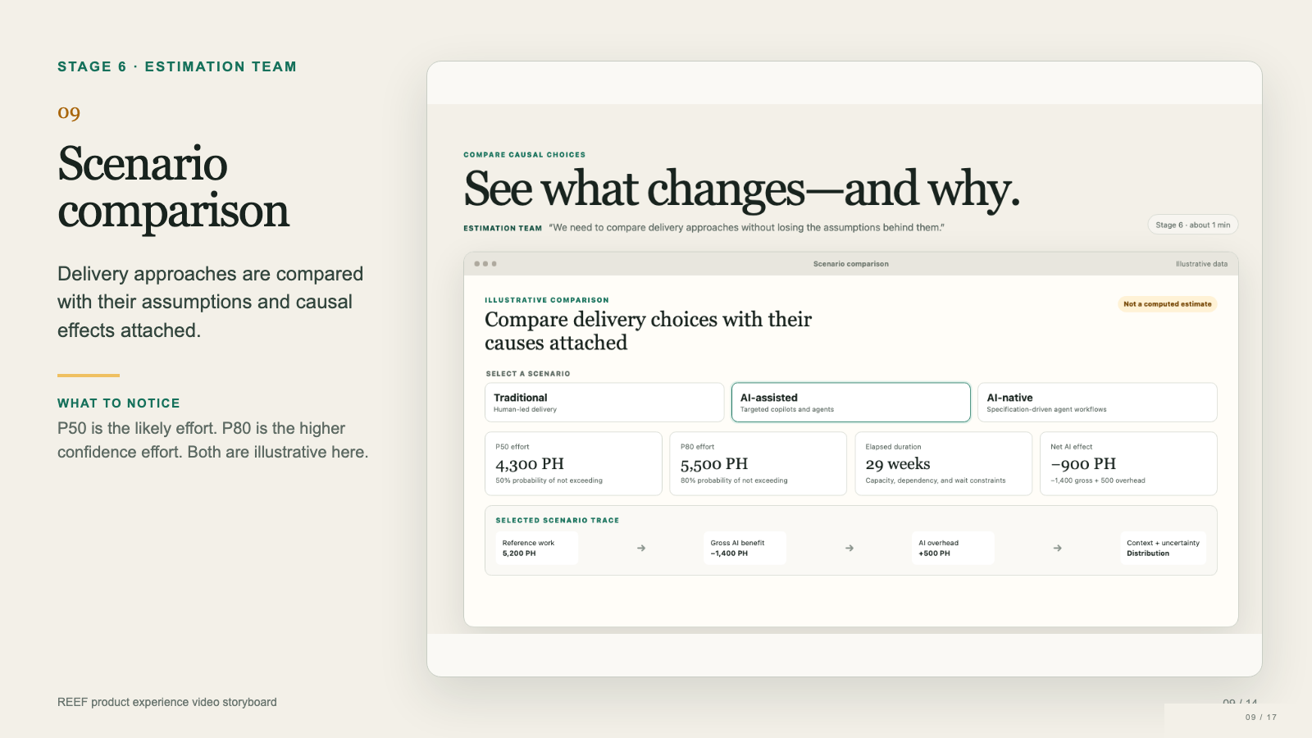
Notes:
The estimation team can now compare delivery approaches. The traditional, AI assisted, and AI native scenarios change effort, duration, benefit, and overhead together. P50 means there is a fifty percent probability that actual effort will not exceed the displayed value, given the stated assumptions. P80 means an eighty percent probability of not exceeding the displayed value. Teams often use P50 for likely effort and P80 when they need a higher confidence planning view. The selected AI assisted example shows four thousand three hundred person hours at P50 and five thousand five hundred at P80. Its net AI effect combines gross benefit with explicit overhead. These values demonstrate the experience only. REEF has not computed or validated them.

Slide 10
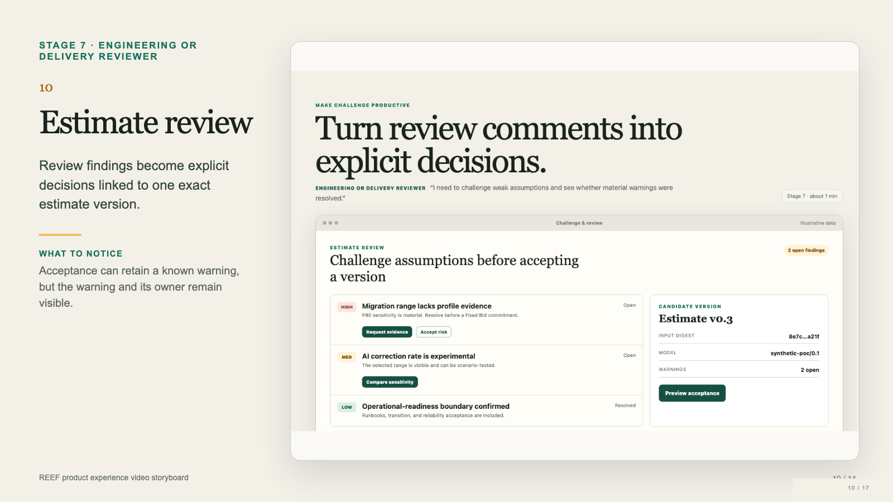
Notes:
Review turns informal comments into traceable findings. The reviewer can request evidence, compare sensitivity, resolve a concern, or explicitly accept a known risk. In this example, migration evidence remains material before a fixed bid commitment, while the AI correction rate needs a sensitivity comparison. The candidate estimate has a version, an estimate identifier, an estimation method version, and a visible warning count. Acceptance means that accountable people accept this exact combination of inputs, assumptions, evidence, and unresolved warnings. It does not endorse hidden logic or erase uncertainty. Once accepted, the version becomes the historical record for the decision. Later observations can inform future work without silently rewriting this estimate.

Slide 11
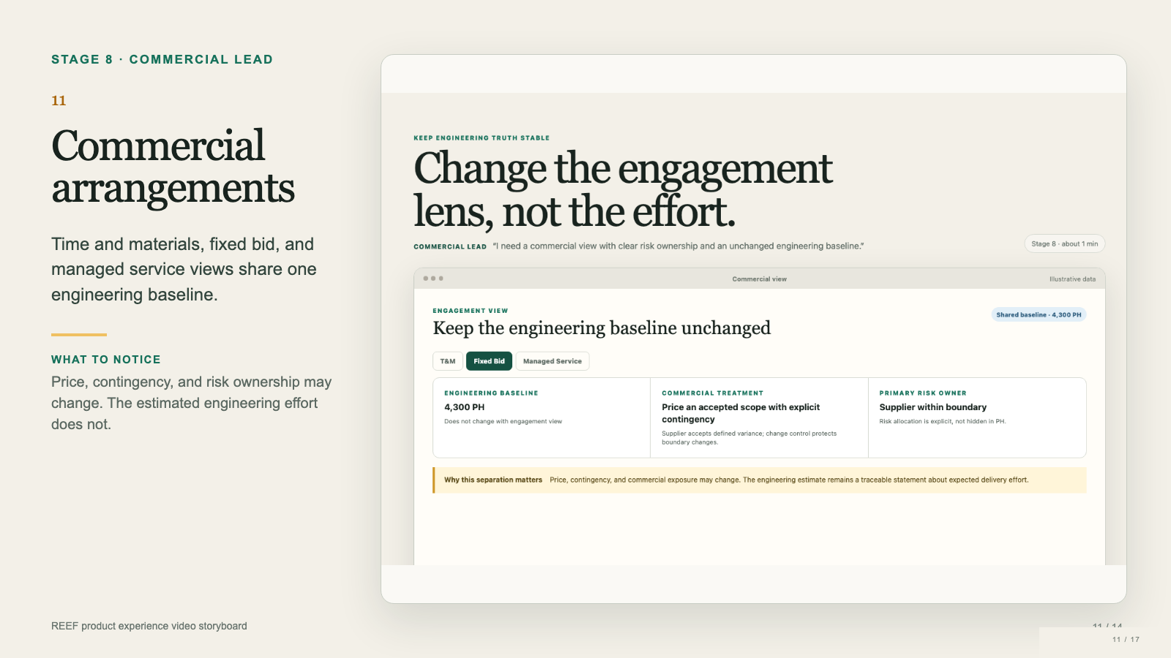
Notes:
Commercial planning uses the engineering estimate without redefining it. The example keeps the baseline at four thousand three hundred person hours while the commercial lead switches among time and materials, fixed bid, and managed service arrangements. A time and materials view bills observed effort and leaves more volume and productivity variance with the client. A fixed bid prices an accepted scope with explicit contingency and assigns defined variance to the supplier within the agreed boundary. A managed service separates transition from steady state service and uses service levels and demand bands. The commercial treatment, price, contingency, and risk owner can change. The underlying engineering baseline remains the same traceable statement about expected delivery effort.

Slide 12
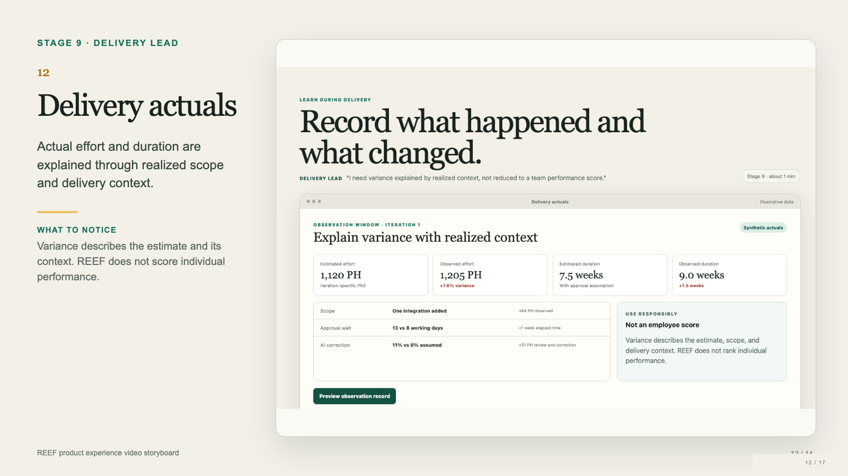
Notes:
During delivery, REEF compares the estimate with observed effort and elapsed duration. The example shows an iteration that used more person hours and took longer than planned. The explanation separates an added integration, a longer approval wait, and a higher AI correction rate. This matters because effort and duration can diverge for different reasons. A waiting period may delay completion without consuming equivalent engineering effort. A scope addition changes the work itself. Higher correction effort tests an AI assumption. REEF treats this variance as evidence about scope, context, and the estimation method. It does not rank people or turn the difference into an employee performance score. The delivery lead records what happened so future estimates can learn from comparable conditions.

Slide 13
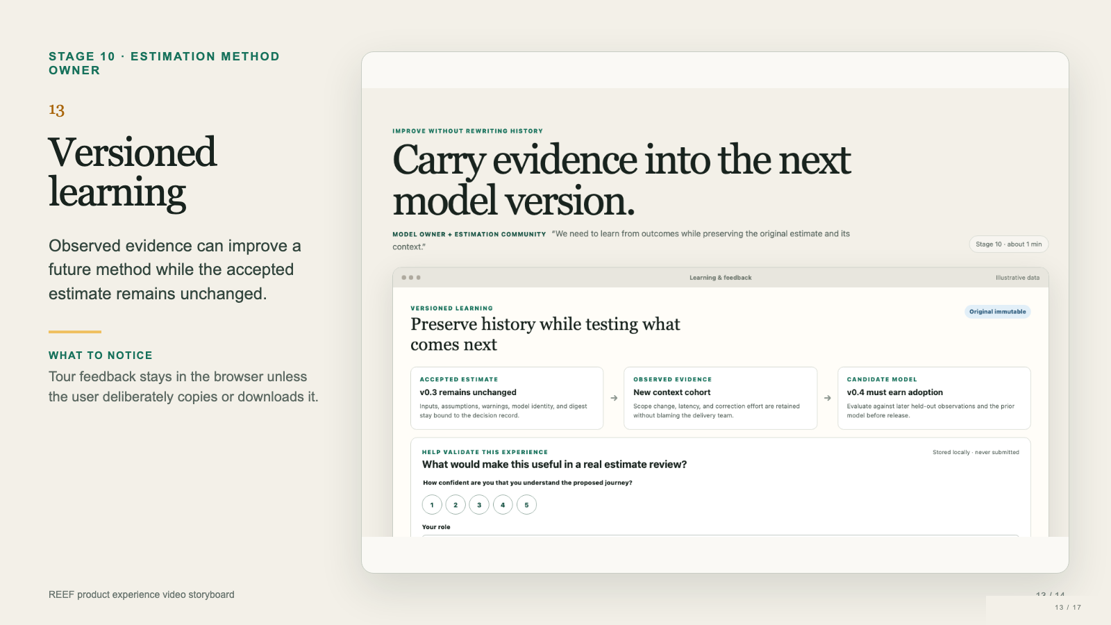
Notes:
The final stage preserves history while preparing future learning. The accepted estimate keeps the inputs, assumptions, warnings, estimation method identity, and estimate identifier that supported the original decision. Actual scope changes, approval latency, and AI correction effort become new observed evidence. The estimation method owner can place comparable observations into a cohort and evaluate a candidate method version against later held out data and the previous version. A candidate must earn adoption. It never rewrites historical estimates. The tour also asks users to assess whether the experience is understandable and useful. That feedback remains only in local browser storage. Nothing is submitted to a server. Users can copy, download, or clear their local response.

Slide 14
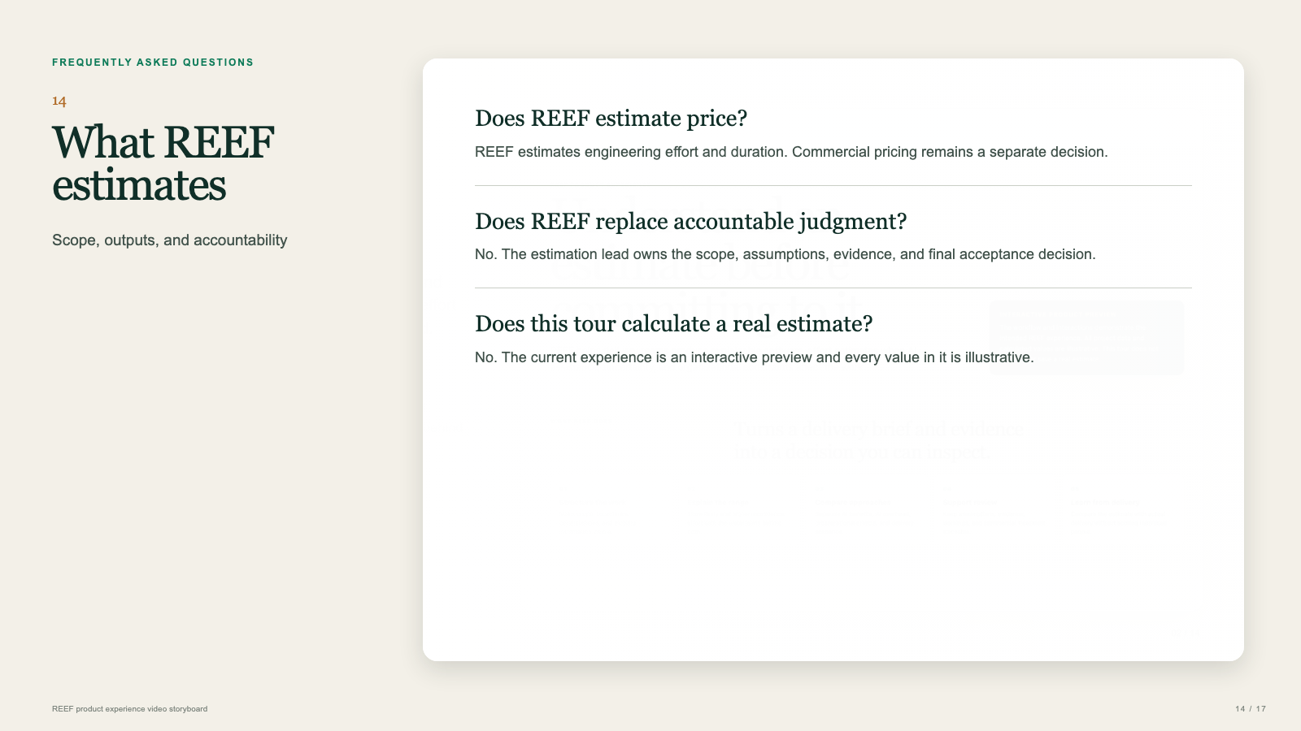
Notes:
Three boundaries matter before a team uses REEF. First, REEF produces an engineering estimate. It does not set a price or choose a contract. Second, REEF structures evidence and makes judgment visible, but the accountable estimation lead still accepts the result. Third, this product tour demonstrates the intended workflow and terminology. It does not calculate or save a production estimate. These boundaries prevent a polished interface from creating false confidence. In a live implementation, teams would connect the workflow to approved data sources, review controls, and versioned estimate records.

Slide 15
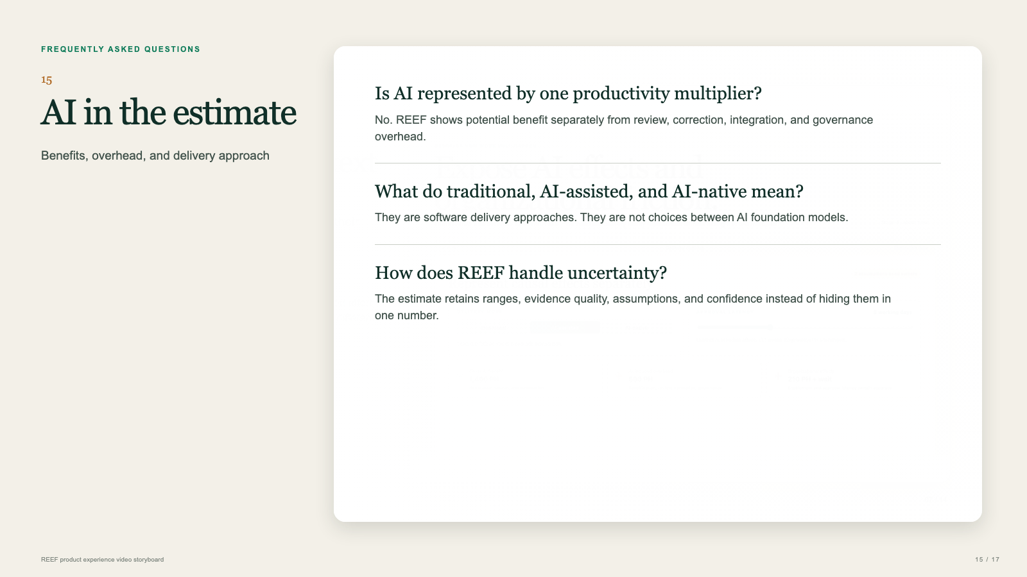
Notes:
REEF treats AI as part of the delivery method, not as a magic discount. Potential productivity gains appear separately from the work required to review output, correct errors, integrate changes, and meet governance requirements. The terms traditional, AI-assisted, and AI-native describe delivery approaches. They do not ask the user to select an AI foundation model. Teams compare the approaches using the same scope and evidence, then explain why effort changes. This makes the impact of AI inspectable and keeps uncertainty visible in the resulting range.

Slide 16
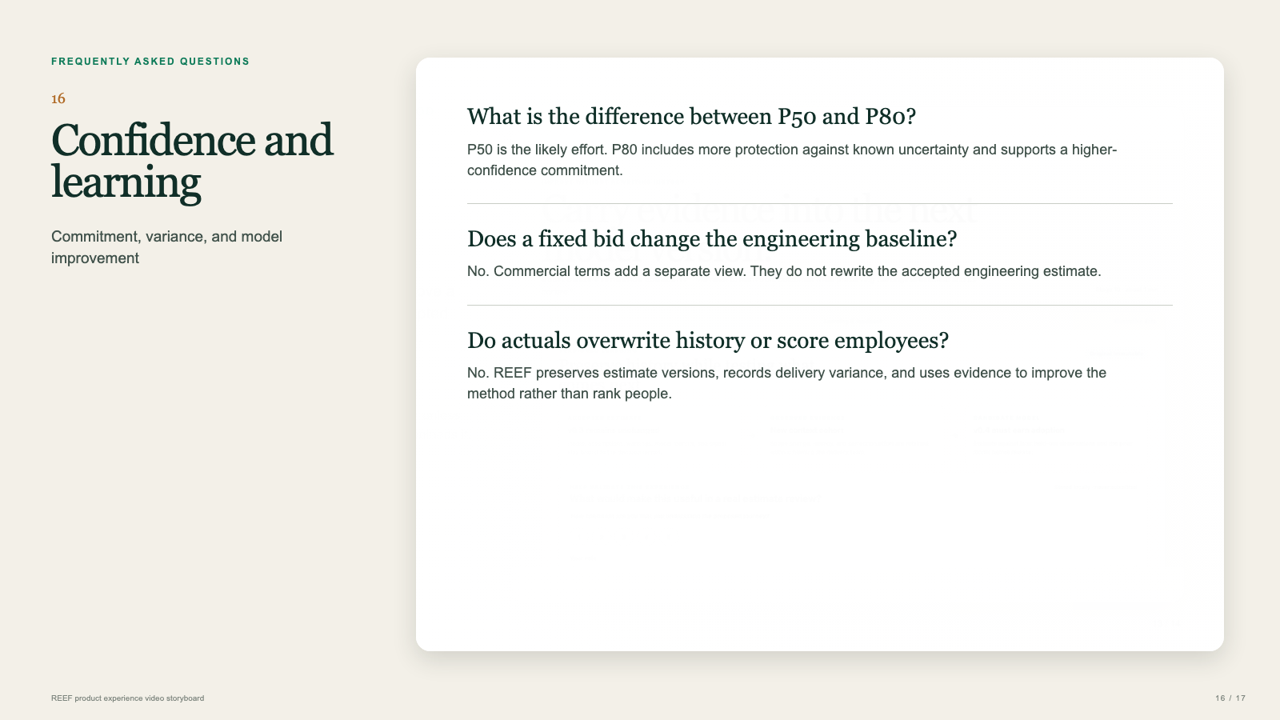
Notes:
Confidence levels help people use the estimate for different decisions. P50 represents the likely effort, while P80 provides more protection against known uncertainty. Commercial choices such as a fixed bid do not change the engineering baseline. They add a separate risk and pricing view. During delivery, actual effort and scope changes are recorded against the accepted version instead of overwriting it. REEF uses that variance as evidence for future model improvement. The learning loop evaluates the estimation method and its assumptions. It is not an employee scoring system.

Slide 17

Notes:
You have now followed the complete intended REEF journey. REEF needs a clear decision, a scope boundary, delivery evidence, and explicit assumptions. It structures the work, ranks material unknowns, and keeps AI effects and organizational constraints separate. It produces likely and higher confidence effort ranges with the causes and evidence attached. Reviewers challenge an exact version before acceptance. Commercial teams can change the arrangement without changing engineering truth. Delivery teams record actual effort, elapsed time, scope change, and realized context without scoring individuals. Future estimation method versions can learn from those observations while preserving history. The current product experience demonstrates these capabilities with fictional data. It does not yet calculate, accept, or persist a real estimate.

