Slide 1

Building High-Performance Data Pipelines with Go and Kubernetes
A Developer’s Practical Approach
Rahul Sid Patil

Slide 2


About Me
Rahul Sid Patil
Lead Software Engineer @ EPAM Systems
Head of Golang Community, EPAM India
12+ years of experience in backend engineering
Specialized in Golang, Kubernetes, Kafka, and cloud-native systems
Author of upcoming book 'Let Us Go Vol. 1'
Tech Speaker | Mentor | Open Source Contributor
LinkedIn: www.linkedin.com/in/rahulsidpatil
Contact: golangda@gmail.com

Slide 3
Why High-Performance Data Pipelines?
Data volumes are growing exponentially
Real-time analytics & responsive systems demand scalable pipelines
Traditional stack limitations → need for modern tooling

Slide 4
Tech Stack Overview
Go → Fast, lightweight, concurrency-friendly
Kafka → Distributed, durable event streaming
MongoDB → Flexible document database
Kubernetes → orchestration and Autoscaling(Optional)

Slide 5
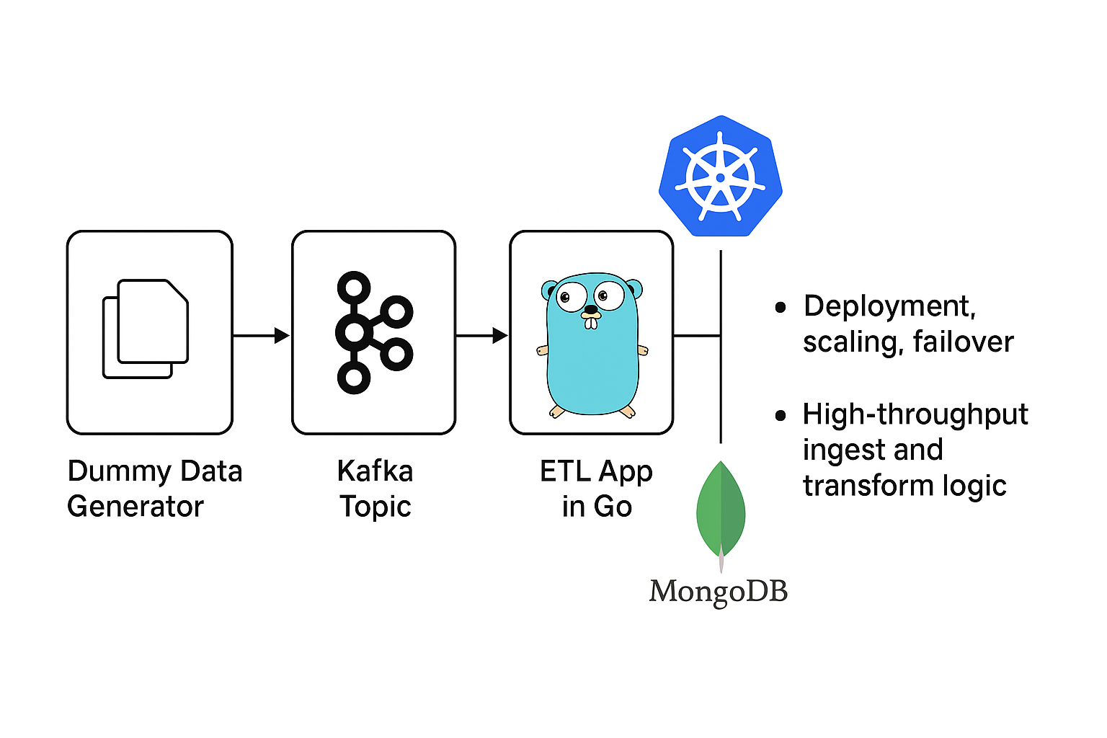
Pipeline Architecture

Slide 6
Step-by-Step Plan (Overview)
1. Minikube Setup
2. Kafka Cluster Deployment
3. Data Generator (Kafka Producer)
4. ETL Application (Go Kafka Consumer + MongoDB Upsert)
5. MongoDB Deployment
6. HPA Autoscaler
(optional)
7. Benchmarking

Slide 7
Setting Up Minikube (K8s)
Install & start Minikube
Basic kubectl commands
Cluster up and running locally

Slide 8
Modern Kafka (KRaft Mode) on Kubernetes
Using Bitnami Helm chart with kraft.enabled=true
Simpler, faster, and production-ready deployment
helm install kafka bitnami/kafka --set kraft.enabled=true

Slide 9
Dummy Data Generator (Go)
Kafka producer in Go
Sends JSON messages to dummy-data topic
Tunable message rate (via sleep interval)

Slide 10
ETL Application in Go
Kafka consumer
Transforms message into MongoDB bson.M
Inserts into MongoDB etl_db.data collection
Production-ready concurrency possible

Slide 11

MongoDB Deployment
Single pod setup
YAML deployment
Exposed service for internal cluster access

Slide 12

Autoscaling ETL App(WIP)
Kubernetes HPA
kubectl autoscale based on CPU usage
Minimum 1, maximum 5 pods
Responsive to workload spikes

Slide 13
Benchmarking and Monitoring
Load simulation using k6
Metrics: Kafka lag, MongoDB throughput
Optional tools: Prometheus, Grafana

Slide 14
Live Demo (5 mins)
Show running pipeline in Minikube
Kafka producing/consuming messages
MongoDB insert verification
HPA in action with kubectl top pods (optional)

Slide 15
Step 1: Start Minikube

Slide 16
Step 2: Verify Minikube

Slide 17
Step 3: Verify Minikube k8s cluster

Slide 18
Step 4: Launch Minikube k8s Dashboard

Slide 19
Step 5: Install & Test Kafkak cluster in kraft mode

Slide 20
Step 6: Install mongo-db and initialize DB

Slide 21
Step 6: Install & initialize mongo-db

Slide 22
Step 7: Build, Deploy & Verify Dummy Data Generator

Slide 23
Step 7: Build, Deploy & Verify Dummy etl-consumer

Slide 24
Sample Benchmark Results
Pod | CPU (m) | Memory (MiB)
dummy-producer | 120 | 70
etl-consumer | 160 | 95
kafka-controller-0 | 300 | 250
mongodb | 110 | 130
Producer → Kafka Throughput
Messages Sent: 1000
Average Rate: ~950 msgs/sec
Duration: ~1.1 sec
Kafka → MongoDB ETL
Consumer Lag: 0 (fully consumed)
Inserted Docs: 1000
Insertion Time: ~1.5 sec
Observations
End-to-end latency ≈ 30–50ms under burst load.
No message drops observed.
MongoDB write throughput consistent with producer rate.

Slide 25
Key Takeaways
✅ Fully working data pipeline
✅ Simple, scalable Go components
✅ Real-time ingestion and autoscaling(WIP)
✅ Extensible for real-world systems

Slide 26
What's Next?
Add observability and alerting
Cloud-native version (GKE/EKS/Azure AKS)
Integrate with real data sources
GitHub repo and Docker images (coming soon)

Slide 27
Useful Material
- GitHub Repo: https://github.com/rahulsidpatil/go-k8s-data-pipeline
- Kafka on KRaft: https://kafka.apache.org/documentation/#kraft
- Kubernetes Docs: https://kubernetes.io/docs/
- Go Concurrency: https://go.dev/doc/effective_go#concurrency
- MongoDB on K8s: https://www.mongodb.com/docs/kubernetes-operator/current/

Slide 28
Frequently Asked Questions (FAQ)
1. Why use Go for ETL instead of Python or Java?
→ Go offers better performance, concurrency, and lightweight deployment.
2. Why MongoDB for storage? Why not SQL?
→ MongoDB provides flexible document storage, making it easier to ingest unstructured/semistructured data commonly seen in real-world pipelines.

Slide 29
Frequently Asked Questions (FAQ)
3. Why is Kubernetes essential for this setup?
→ Kubernetes provides scalability, self-healing, rolling updates, and resource efficiency for managing distributed components like Kafka, MongoDB, and microservices.
4. What are the resource requirements for running this pipeline locally?
→ Ideally, a machine with 16GB RAM, 4-core CPU, and Docker + Minikube installed.

Slide 30
Frequently Asked Questions (FAQ)
5. Is this pipeline production-ready?
→ The architecture is extendable to production, but for real-world use, you'd need to add logging, error handling, authentication, CI/CD, and observability layers.
6. Can I run this pipeline on a public cloud?
-> Yes. You can easily deploy this setup on AWS, GCP, or Azure using managed Kubernetes (like EKS/GKE/AKS) and integrate with managed Kafka and MongoDB services.

Slide 31
Frequently Asked Questions (FAQ)
7. What kind of data is being used in the demo?
→ A dummy data generator in Go simulates event streams that mimic real-world sensor data or logs for ETL processing.
8. How do I scale the ETL application dynamically?
-> Kubernetes Horizontal Pod Autoscaler (HPA) is used based on CPU/memory usage or custom metrics from Prometheus.

Slide 32

Q&A
Thank You!!

