Slide 1
Image (and Video) Coding and Processing
Lecture 1: Class Overview
Wade Trappe

Slide 2
Course Basics
ECE 332:529 (Image and Video Processing) is a graduate course that builds upon basic digital signal processing (e.g. the Rutgers DSF course).
Prerequisites:
  An introductory graduate course in signal processing (DSF)
  Stochastic Signals and Systems is highly recommended
  Notes:
    The course description webpage states 332:550 is a prerequisite. No one has seen 550 in eons…
    The course description also says that 332:535 (multidimensional signal processing) is recommended. This is not true. 535 is rarely offered and will be contained in this class.

Slide 3
Course Basics, pg. 2
A core graduate DSP curriculum consists of:
  An advanced course on digital signal filters
  A class on multirate signals and systems
  A class on image and video signal processing
  A class on adaptive and optimal signal processing
At Rutgers, the DSF course is required
The other 3 classes are essential to being able to say you “know signal processing” by the time you graduate.
Students interested in DSP are encouraged to take as many of these “core” courses as possible.
Additionally, there are several other advanced signal processing classes that are worth looking into:
  E.g.: Computer Vision, Speech Processing, Signal Recovery

Slide 4
So, what is this class?
Image and Video Coding and Processing will cover:
  Multidimensional sampling and filtering
  Models for the Human Visual System
  Color Modeling and Representation of Images
  Denoising
  Pattern recognition
  Image and Video Compression
  Watermarking

Slide 5
Course Resources
Required Textbook:
  Y. Wang, J. Ostermann, Y-Q. Zhang: Digital Video Processing and Communications, Prentice-Hall, 2001.
Reference Textbook:
  A.Bovik & J.Gibson: Handbook Of Image & Video Processing, Academic Press, 2000.
The textbook will not be sufficient for this class (especially early on).
  I will assign paper readings to supplement the text
  More often than not, these papers will come from IEEE or ACM
  Most likely, I will make the papers available on the course website
Other useful resource: MATLAB’s Image Processing Toolbox
  Goto www.mathworks.com

Slide 6
The Dirty Work…
This class is not a “cake-walk” graduate course:
  It should not be assumed that I will give out automatic A’s.
  In fact, just like other “Core” courses, there could be C’s in this class.
Image and Video Processing requires a lot of work to understand:
  Programming in MATLAB is a must
  Programming in C/C++ is highly desirable (Matlab is just too slow for the massive optimizations you will need later)
  Seeing is believing in Image and Video Processing…
    Telling me that the MSE/PSNR is good is nice, but I still want to see the image!
    Seeing images and videos play is half the fun!

Slide 7
Introduction to Image and Video Processing
Thanks to Min Wu (UMD) for providing many of the slides that follow.

Slide 8
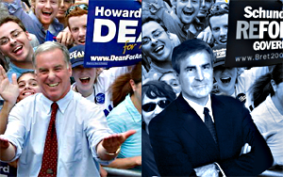

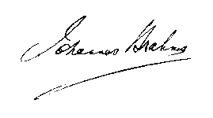
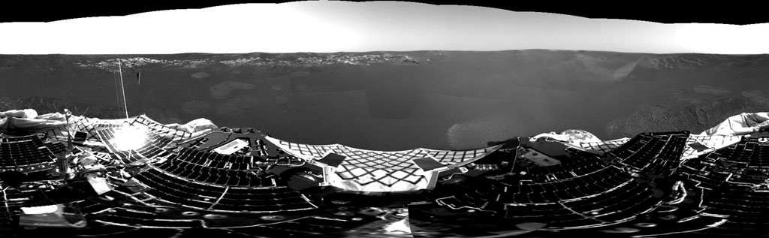
Images and Videos are Efficient and Effective
Sonar Image
Signature of Joseph Brahms
A doctored political ad
http://marsrovers.jpl.nasa.gov/gallery/press/opportunity/20040125a.html
JPL Mars’ Panorama captured by the Opportunity
Visual representations are often the most efficient way to represent information
Images are used in many scenarios:
  Politics, advertisements, scientific research, military, etc…
Video signals can effectively tell a temporally evolving story
  Arise in cinema (motion pictures)
  Arise in surveillance
  Arise in medical applications

Slide 9
Why Do We Process Images?
Enhancement and restoration
  Remove artifacts and scratches from an old photo/movie
  Improve contrast and correct blurred images
Transmission and storage
  Images and Video can be more effectively transmitted and stored
Information analysis and automated recognition
  Recognizing terrorists
Evidence
  Careful image manipulation can reveal information not present
  Detect image tampering
Security and rights protection
  Encryption and watermarking preventing illegal content manipulation

Slide 10
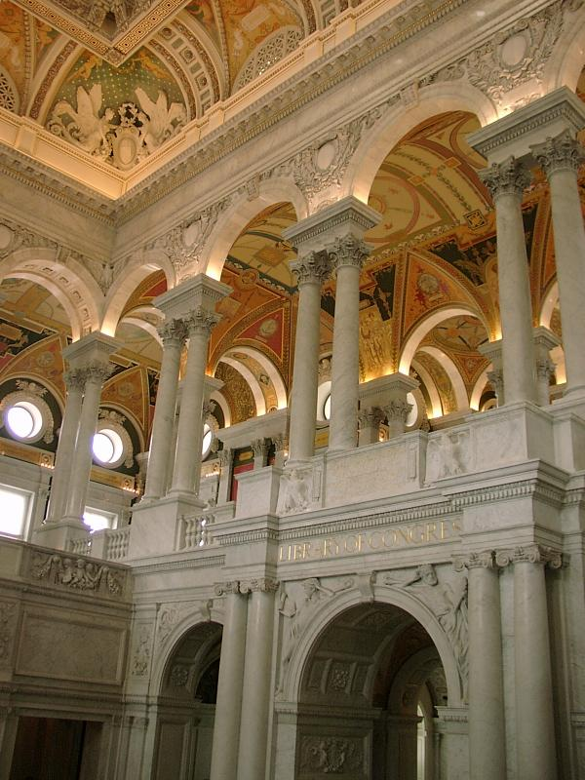
Compression
Color image of 600x800 pixels
  Without compression
    600*800 * 24 bits/pixel
    = 11.52K bits = 1.44M bytes
  After JPEG compression (popularly used on web)
    only 89K bytes
    compression ratio ~ 16:1
Movie
  720x480 per frame, 30 frames/sec, 24 bits/pixel
  Raw video ~ 243M bits/sec
  DVD ~ about 5M bits/sec
  Compression ratio ~ 48:1
“Library of Congress” by M.Wu (600x800)

Slide 11
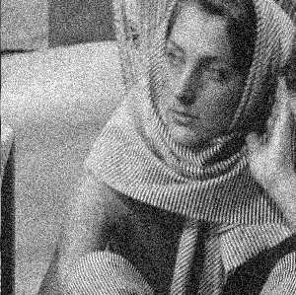
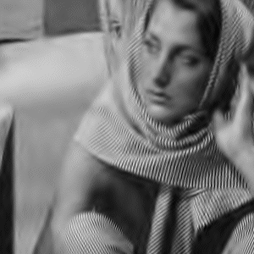
Denoising
From X.Li http://www.ee.princeton.edu/~lixin/denoising.htm

Slide 12
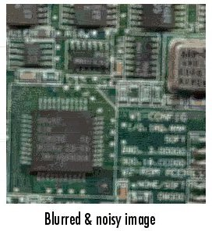
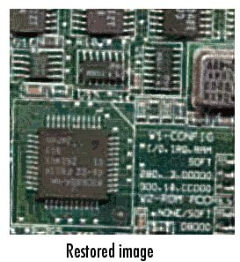
Deblurring
From Mathworks

Slide 13
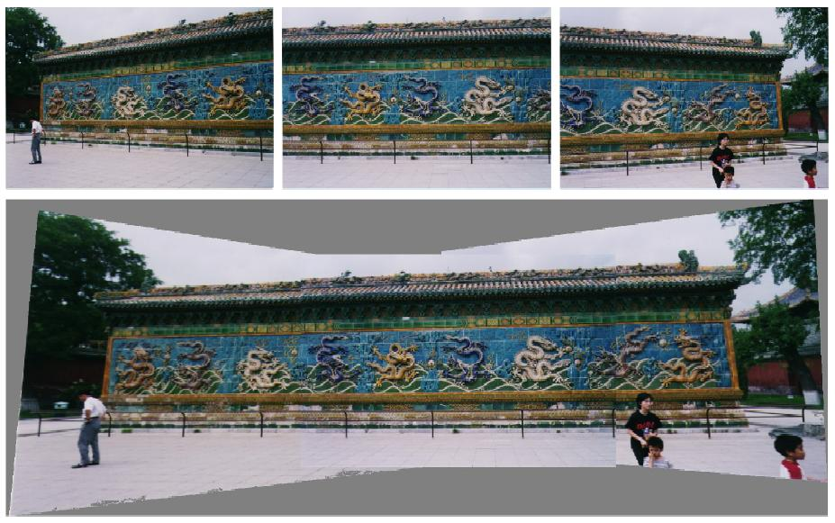
Visual Mosaicing
  Stitch photos together without thread or scotch tape
R.Radke – IEEE PRMI journal paper draft 5/01

Slide 14
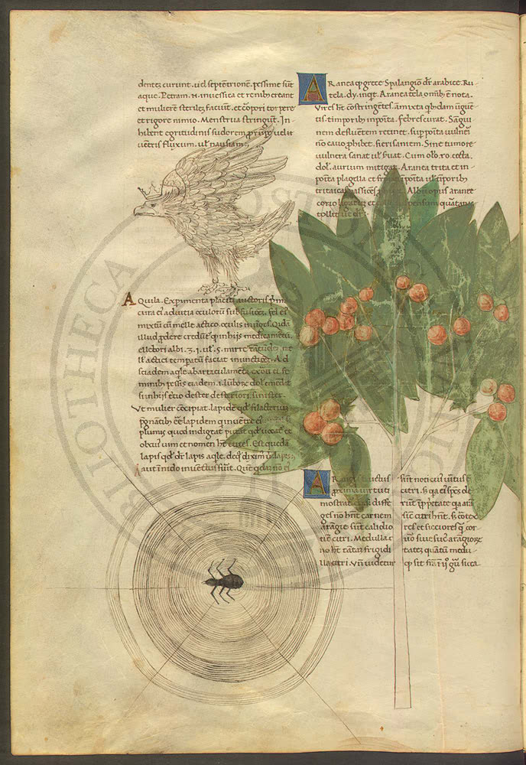
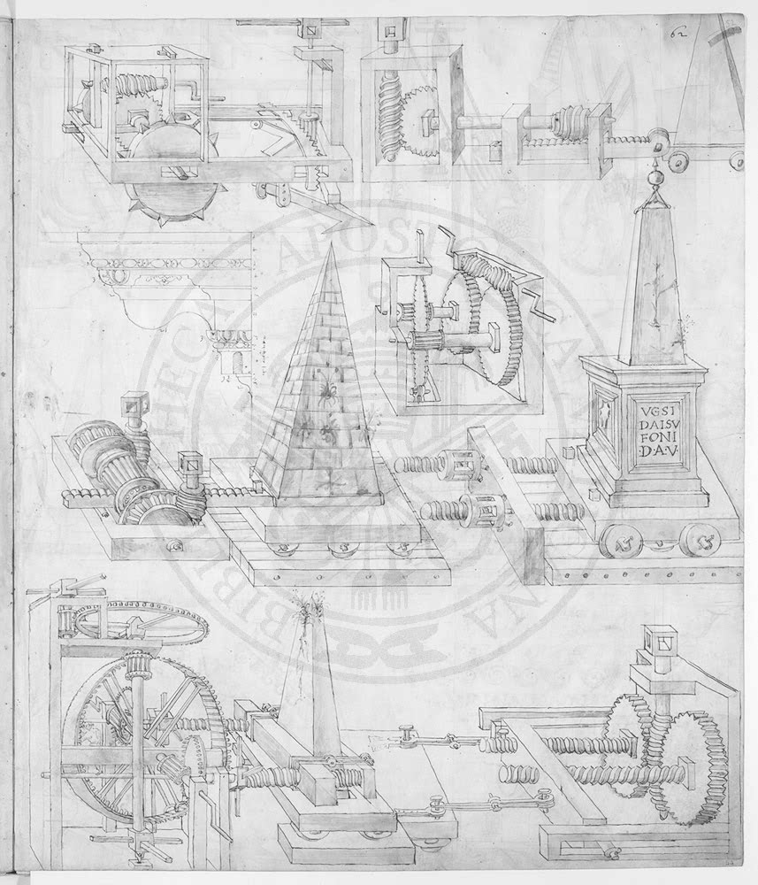
Visible Digital Watermarks
from IBM Watson web page
“Vatican Digital Library”

Slide 15

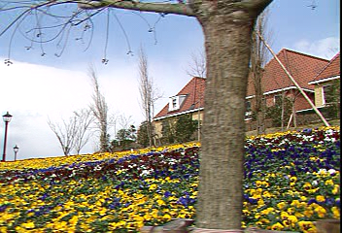

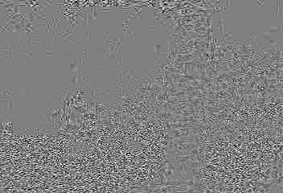
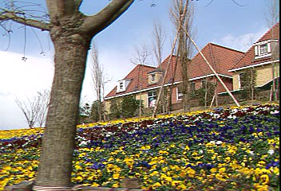

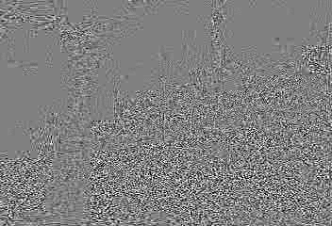
Invisible Watermark
  1st & 30th Mpeg4.5Mbps frame of original, marked, and their luminance difference
  human visual model for imperceptibility: protect smooth areas and sharp edges

Slide 16
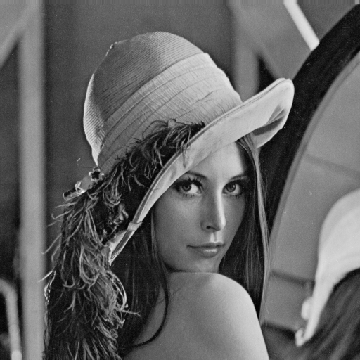
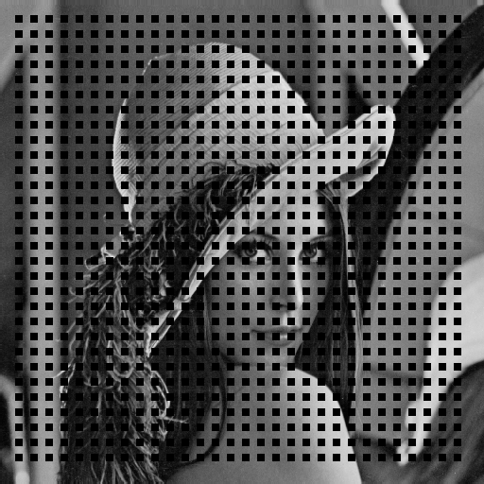

Error Concealment
(a) original lenna image
(b) corrupted lenna image
(c) concealed lenna image
25% blocks in a checkerboard pattern are corrupted
corrupted blocks are concealed via edge-directed interpolation
Examples were generated using the source codes provided by W.Zeng.

Slide 17
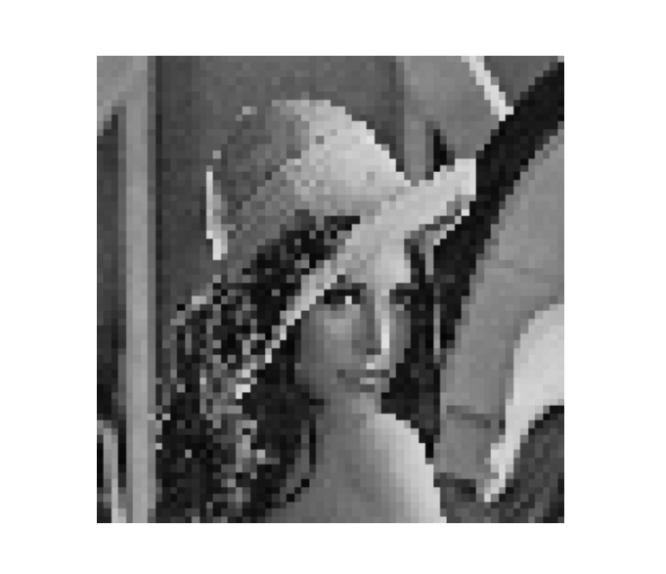
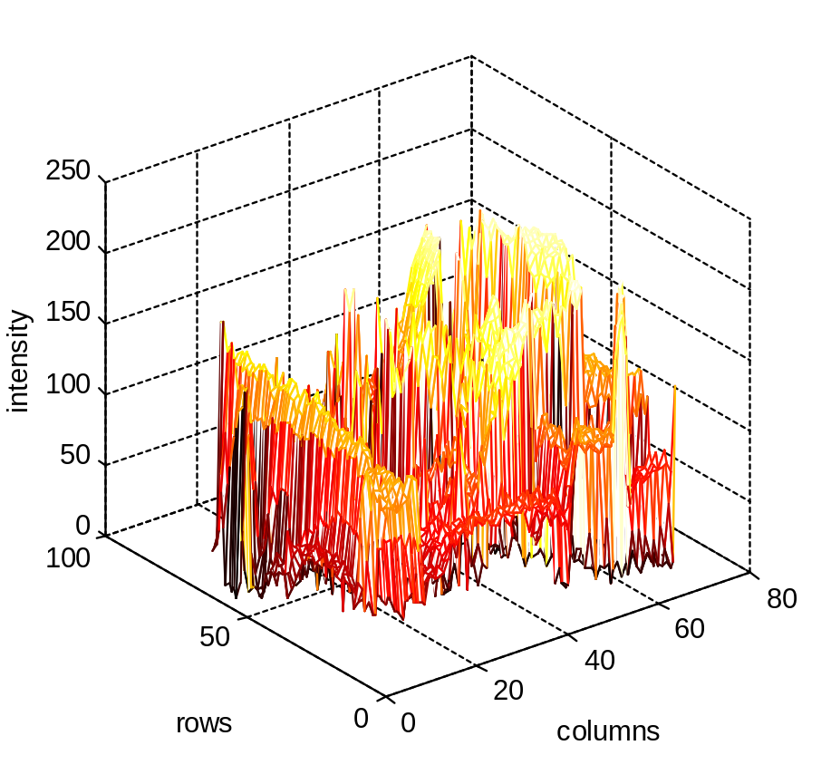
What is An Image?
y
Grayscale image
  A grayscale image is a function
  I(x,y) of the two spatial coordinates
  of the image plane.
  I(x,y) is the intensity of the image at the point (x,y) on the image plane.
    I(x,y) takes non-negative values
    assume the image is bounded by a rectangle [0,a]×[0,b]
  I: [0, a] × [0, b] → [0, inf )
x
I(x,y)
Color image
  Can be represented by three functions, R(x,y) for red, G(x,y) for green, and B(x,y) for blue.
y
x

Slide 18
Sampling and Quantization
Computer handles “discrete” data.
Sampling
  Sample the value of the image at the nodes of a regular grid on the image plane.
  A pixel (picture element) at (i, j) is the image intensity value at grid point indexed by the integer coordinate (i, j).
Quantization
  Is a process of transforming a real valued sampled image to one taking only a finite number of distinct values.
  Each sampled value in a 256-level grayscale image is represented by 8 bits.
255 (white)
0 (black)

Slide 19



Examples of Sampling
256x256
64x64
16x16

Slide 20

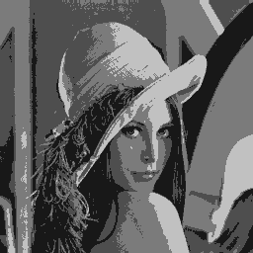
Examples of Quantizaion
8 bits / pixel
4 bits / pixel
2 bits / pixel

Slide 21
Looking Forward
Today’s lecture gave an overview of some of the applications of image and video signal processing.
We will cover some of these applications
  Some will be left for you to explore on your own (just not enough time for everything)
Looking forward:
  We will start by reviewing sampling theory, and developing the basics of multidimensional sampling
  Following that, we will move to lattices and multidimensional multirate systems
  Then, we will move into the human visual system, and how that HVS guides us in our choice of sampling

