Slide 1

RecoveryLens
AI-assisted data-recovery intelligence for damaged storage
Recover what exists. Infer relationships carefully. Never invent evidence.
Project review for the judges · Working prototype · Status as of 25 September 2026
Notes:
Introduce RecoveryLens: a working prototype that takes a damaged storage image or a damaged file and explains what can be recovered, how trustworthy each result is, and what to look at first. The tagline is the design rule for the whole project: we never fabricate data.

Slide 2




The problem
Classic recovery tools hand back files. They do not say whether those files can be trusted.
Fragmented data
Silent damage
No triage
Evidence risk
Deleted files are split across the disk. Tools guess which pieces belong together and rarely show why.
Partly overwritten files are returned as if they were complete. The user finds out only when the file will not open.
An investigator gets hundreds of files with nothing to say which ones matter or should be checked first.
In forensics, results must trace back to the original bytes and the evidence must stay unchanged.
2
Notes:
Four gaps in existing tools. Fragmentation, silent damage, no prioritisation, and weak evidence handling. RecoveryLens is designed around each one.

Slide 3



Our approach: understand before recovering
We add seven steps between "find" and "recover", and every step leaves evidence behind.
Traditional
Find
Recover
RecoveryLens
Find
Understand
Relate
Reconstruct
Validate
Measure
Classify
Prioritize
Explain
Orange = machine-learning step. All other steps are deterministic parsers and rules.
Recover what exists
Infer carefully
Never invent evidence
Only bytes actually read from the evidence are used. Missing ranges are reported with exact offsets.
Fragment links are probabilities with their reasons shown. Rejected alternatives are kept for review.
No generative filling. Explanations are built only from recorded checks, never from an LLM.
3
Notes:
Traditional tools do find and recover. We do nine steps. Only the Relate step uses machine learning; everything that decides whether bytes are valid is a real parser. This keeps the output reproducible and defensible.

Slide 4
System architecture
A Python analysis engine behind a REST API, with a React web interface on top.
Evidence intake
Cluster scanner
Fragments
File structure
Relationship model
Read-only copy, SHA-256 hash, input-type detection
Entropy, signatures, headers, FAT/VFAT entries per 4 KiB
Split into runs of the same content family
xref, ZIP directory, SQLite b-tree; EXIF and names
Logistic model over 9 explainable features
Explain & report
Classify & rank
Four scores
Validation
Reconstruction
Evidence-based text, JSON report, audit trail
Status and user-configurable priority
Integrity · reconstruction · link · content
Real parsers: libjpeg, CRC-32, sqlite3, PDF walk
PDF · DOCX/ZIP · SQLite · JPEG · text/logs
Backend Python · FastAPI · NumPy · Pillow · PyMuPDF · SQLite
Frontend React · TypeScript · Vite · Tailwind · React Flow · Recharts
4
Notes:
The engine is a ten-stage pipeline. The top row finds and groups data, the bottom row rebuilds, checks and explains it. Only the relationship model (orange) is learned. The API exposes every stage so the UI can show the evidence behind each number.

Slide 5


Where AI is used, and where it is not
Facts come from parsers. AI only scores relationships, and it always shows its reasons.
Deterministic (facts)
AI / ML (inference)
File signatures, headers and cluster classification
Placement via container indexes (PDF xref, ZIP offsets + CRC-32, SQLite b-tree)
Validation with real parsers (libjpeg, zipfile, sqlite3, MuPDF)
Explanations: templates filled from recorded checks, no LLM
Fragment-relationship model: logistic regression over 9 features (seams, entropy, timestamps, vocabulary…)
Anomaly scan of JPEG rows (advisory only)
TF-IDF content similarity between recovered texts
0.999
1.00
0.81
test AUC
recall
precision
5
Notes:
Trained on 14 generated images and tested on 5 held-out images. A JPEG join is accepted only at 70% or more; joins between 50 and 70% become leads for the analyst instead of being silently accepted.

Slide 6
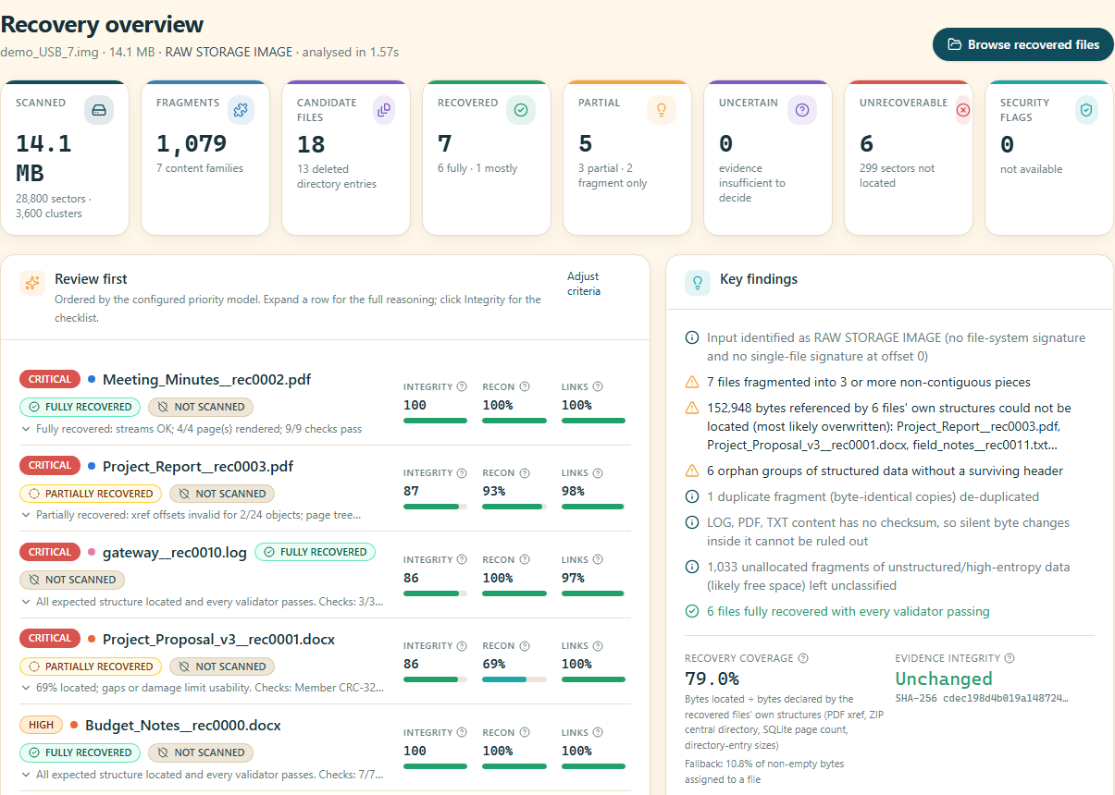
Live demo: a corrupted 14 MB USB image
13 deleted files, fragmented into up to 8 pieces, partly overwritten and bit-rotted.
1,079
fragments found
18
candidate files
7
recovered (6 fully)
5
partial
6
honestly unrecoverable
Evidence SHA-256 verified unchanged
6
Notes:
Overview page. KPIs at the top, a "Review first" list ordered by priority, and key findings that name the exact problems. Every demo screen is marked SIMULATED EVIDENCE.

Slide 7
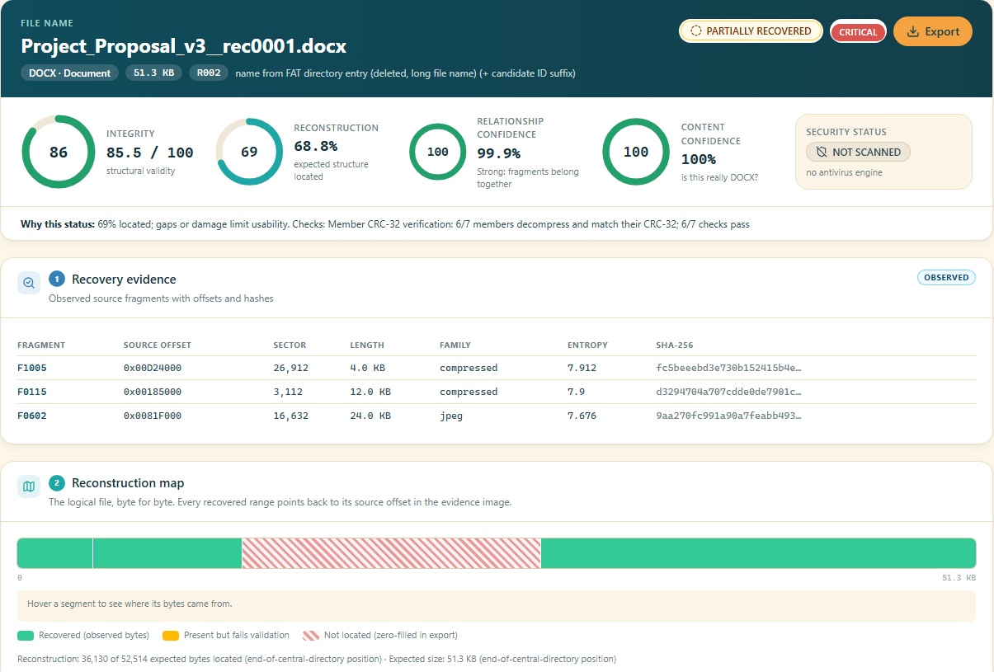


Every number is explained
File view for Project_Proposal_v3.docx: partly overwritten, but the document text is fully verified.
Four separate scores
Integrity 85.5, reconstruction 68.8%, link 99.9%, content 100%. They are never merged into one number.
"Why this status"
Names the deciding checks: 6/7 ZIP members pass their CRC-32.
Byte-level map
Every range points to its source offset. Missing bytes are hatched and declared.
7
Notes:
68.8% of the bytes are located, yet integrity is 85.5 because the missing 16 KB belong to an embedded image; the document text itself passes CRC-32. This is the kind of nuance a normal undelete tool cannot show.

Slide 8
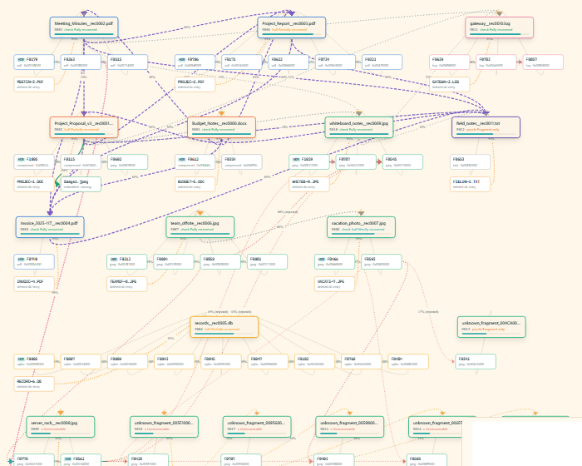
Relationship graph: how fragments were joined
77 nodes and 125 relationships in the USB demo. Edges are labelled as inferred, not as facts.
Fragments → files
Links come from structure, metadata, content similarity and timestamps.
Rejected alternatives
Shown in red with their scores, so a reviewer can challenge a join.
Click any edge
Shows the evidence and each feature's contribution to the model score.
Deleted directory entries
Deleted long file names are rebuilt, including the lost first character.
8
Notes:
The graph makes the machine-learning step auditable. Nothing is hidden: rejected joins stay visible.

Slide 9

Latest work: single-file validation and repair
Same damaged PDF (corrupted_demo_report.pdf, 1.7 KB) before and after this round of development.
 | Before | Now
Input type | UPLOADED IMAGE (wrong) | UPLOADED FILE – PDF
Status | Uncertain, no reason | Fragment only, with the deciding checks listed
Integrity | 58 (generic guess) | 39 from 9 weighted PDF checks
Links / Recon | 97% / "—" | 43% of references resolve / 100% contiguous
Coverage | "—" | N/A with the reason stated
Output | recovered_00000000.pdf | Named copy + repaired copy (xref rebuilt)
Why the score went down
The file really is broken: 800 bytes were overwritten and the page cannot be displayed. The old 58 was too generous. The tool now shows exactly what is missing instead of guessing.
9
Notes:
This is the most recent development round. We added input-type detection, a nine-check PDF validator, a reason for every status, a repaired copy, and N/A-with-reason instead of blank metrics. A lower score here is a more honest score.

Slide 10
Measured accuracy against hidden ground truth
The demo generator records where every cluster really belongs. The engine never reads that record.
100%
88.4%
100%
0 / 6
placement precision
cluster recall
link accuracy (26 links)
bit flips detected
10
Notes:
Per-file comparison from the USB demo run. Where the engine cannot verify bytes, it reports less than truly survives, never more: it is conservative by design. Bit flips in formats without checksums cannot be detected, and we report that openly.

Slide 11



Built for forensic trust
The evidence is never modified, and every export is checked byte for byte.
Evidence handling
Export integrity
Security scanning
Read-only copy, SHA-256 before and after analysis
Full provenance: fragments, offsets, hashes, model version
Every result labelled observed, derived, inferred, reconstructed or unverified
Three export classes: validated file, partially validated, forensic byte artifact
Exports re-hashed on the server and again in the browser
Missing ranges declared, never silently passed off as recovered
ClamAV interface plus YARA-style rules and static checks
No scanner means "NOT SCANNED", never "CLEAN"
Detected malware is quarantined and never opened
11
Notes:
Uploads require an explicit "authorised to analyse" confirmation. Every action, including a change of priority criteria, is written to the audit trail.

Slide 12
How far we have developed
A working end-to-end prototype. Everything below runs today.
8,300+
2,900+
Evidence intake, hashing, input-type detection | Done
Scanner, fragment extraction, FAT deleted-entry recovery | Done
ML relationship model + graph | Done
Reconstruction: PDF, DOCX/ZIP, SQLite, JPEG, text/logs | Done
Validation (8 formats), scoring, priority, explanations | Done
Single-file PDF validation + repair | Done
Web UI, JSON report, audit trail, ground-truth check | Done
Malware scanning (needs ClamAV installed) | Partial
NTFS / ext4 parsers, MP4 / PNG rebuild, E01 images | Planned
lines of Python engine
lines of TypeScript UI
53 / 53
20
automated tests passing
REST API endpoints
13
9
UI screens
demo datasets
12
Notes:
Code size and test counts measured on 25 September 2026: 49 backend unit tests and 4 frontend tests, all passing. The core pipeline is complete; the remaining work is broader file-system support and production hardening.

Slide 13
Honest limitations and next steps
Current limitations
Next steps
Demo images are synthetic; accuracy on real media is not yet measured
Assumes 4 KiB clusters and files starting on cluster boundaries
Silent corruption in formats without checksums (PDF text, logs) cannot be detected
Compressed PDF streams and progressive JPEGs are validated, not rebuilt
File-system parsers: FAT, NTFS and ext4 allocation tables
More formats: MP4 reconstruction, PNG/GIF assembly
Validate on real (authorised) damaged media
Analyst feedback: confirmed or rejected links retrain the model
Production: job queue and PostgreSQL
13
Notes:
We state the limits openly, in the app and in the report. The next milestone is testing on real damaged media.

Slide 14
Thank you
Recover what exists. Infer relationships carefully. Never invent evidence.
Questions and live demo
Run locally: setup.cmd, then start-dev.cmd → http://localhost:5173
Notes:
Offer the live demo: New analysis → Corrupted USB image, then open Project_Proposal_v3.docx and the relationship graph.

