Slide 1

SMART INDIA HACKATHON 2026
TITLE PAGE
Problem Statement ID - SIH26162
Problem Statement Title- AI-Based Detection and Classification of Industrial Fires and Persistent Thermal Sources Using NASA FIRMS, OSM & Satellite Data
Theme- Disaster Management
PS Category- Software
Team ID-
Team Name (Registered on portal) - Fire Orbit
Organisation: National Technical Research Organisation (NTRO)

Slide 2

IDEA TITLE: ThermalSentinel
Fire Orbit
Proposed Solution (Describe your Idea/Solution/Prototype)
Detailed explanation of the proposed solution
How it addresses the problem
Innovation and uniqueness of the solution
• NASA FIRMS publishes every VIIRS and MODIS thermal anomaly within about three hours, but only as a hot pixel with no meaning.
• ThermalSentinel groups detections into thermal sources, tracks each source for 90 days, and adds context from OpenStreetMap.
• A hybrid classifier labels every detection as industrial fire, gas flare, mining or coal-seam fire, agricultural burn, wildfire or other.
• An alert is raised only when a known source burns far above its own baseline.
• Industrial fires are segregated from forest fires and other natural fires, which is the core ask of the problem statement.
• Results are stored in a spatial database and shown as a map overlay, with GeoJSON export for QGIS and ArcGIS.
• Only 138 of 22,179 detections reach an operator, so a control room reviews the events that matter.
• Every label carries plain reasons, so an analyst can confirm or override it.
• Classification of the source over 90 days instead of a single pixel.
• Alerts measured against each site's own normal level, not a fixed threshold.
• Fusion of OpenStreetMap infrastructure and land cover with the thermal signal.
• Persistent heat with no mapped facility is itself reported as a finding.
• Built only on free and open data, and already running as a public prototype.
22,179
114
138
6
99.9 %
detections classified
persistent sources
incident alerts
thermal classes
accuracy on the labelled archive
Working prototype: the whole 90-day archive is classified in about seven seconds on a laptop, and the dashboard, the GeoJSON API and the QGIS export are already public. One environment variable switches the same pipeline to live NASA FIRMS data.
Prototype GIS dashboard, live at rahulskandagal.github.io/thermal-sentinel/

Slide 3
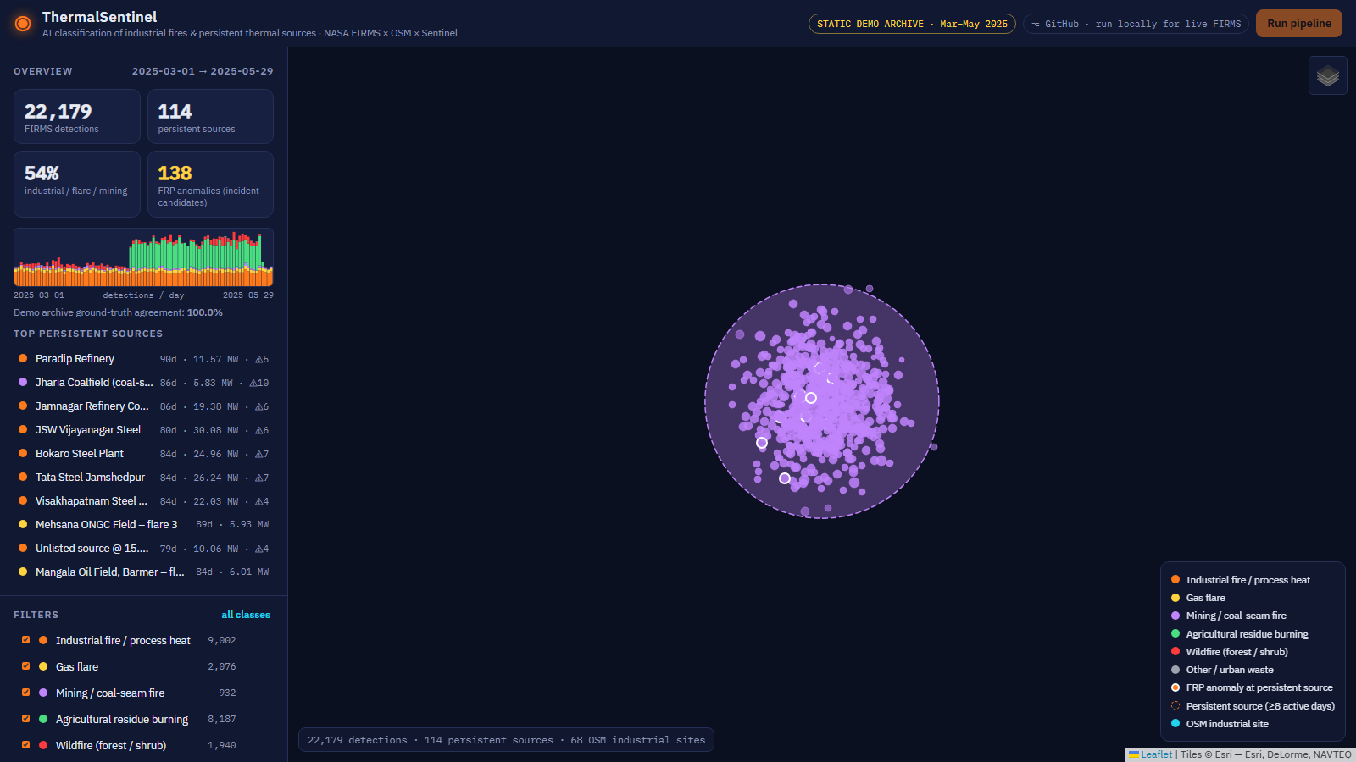
TECHNICAL APPROACH
Fire Orbit
Technologies to be used (e.g. programming languages, frameworks, hardware)
Methodology and process for implementation (Flow Charts/Images/ working prototype)
Data
NASA FIRMS Area API (VIIRS 375 m, MODIS 1 km), OpenStreetMap Overpass, Copernicus Sentinel-2, NASA Worldview
1
Ingest
FIRMS VIIRS and MODIS pulled in 10-day chunks, both sensors normalised, overlapping passes removed
AI and ML
Python, scikit-learn (haversine DBSCAN, HistGradientBoosting), rule engine, shapely STRtree
2
Cluster
Backend
FastAPI REST serving GeoJSON, SQLite with a PostGIS-ready schema, OGC-standard exports
Haversine DBSCAN at 750 m turns pixel-jittered detections into thermal sources (22,179 into 4,419)
Frontend
React 18 with Vite, Leaflet canvas renderer for 40,000 points, QGIS and ArcGIS export
3
Track
90-day history per source: active days, span, night fraction, FRP mean, variation and z-score
Hardware
None. Software only: a laptop for the demo, a single Linux VM, NIC cloud or an air-gapped server
4
Contextualise
OpenStreetMap facility type and distance, plus land cover by point-in-polygon lookup
Core of the model: 34 features covering radiometry, persistence, OpenStreetMap context, land cover and Indian burn-season priors. Rules give auditable priors, the gradient-boosted model resolves the ambiguous cases, and agreement between them raises confidence. Training and testing use a source-aware split so no thermal source appears on both sides.
5
Classify
Explainable rules and gradient-boosted trees vote over 34 features and return reasons
6
Alert and serve
FRP at 2.5 times the source mean raises an incident; results served as GeoJSON to the GIS dashboard
Prototype and source code
Live demo: https://rahulskandagal.github.io/thermal-sentinel/
Code: https://github.com/rahulskandagal/thermal-sentinel
Prototype: all-India classification, and a persistent coal-seam source at Jharia with its 90-day history.

Slide 4
FEASIBILITY AND VIABILITY
Fire Orbit
Analysis of the feasibility of the idea
Potential challenges and risks
Strategies for overcoming these challenges
• Data is available: the FIRMS key is issued instantly and OpenStreetMap and Copernicus are open, so there is no procurement.
• It already runs: the full 90-day archive of 22,179 detections is classified in about seven seconds on a laptop.
• Light to deploy: FastAPI, SQLite and React run on a single VM, NIC cloud or an air-gapped server.
• Live in one step: a single environment variable moves the same pipeline to near-real-time FIRMS data.
• Thermal is not fire: steady process heat and flares look like fires in the raw feed.
• Incomplete mapping: OpenStreetMap misses many small Indian industrial units.
• Data gaps: cloud cover and pixel jitter break single-pass observations.
• Few labelled events: confirmed incident records for supervised learning are scarce.
• Trust: agencies will not act on a label they cannot question.
• Persistence and context: 90-day behaviour plus facility and land-cover context separate routine heat from fire.
• Baseline alerts: each site is compared with its own normal, so flares stay silent until they spike.
• Multi-satellite window: three VIIRS satellites and a 90-day window absorb cloud gaps and jitter.
• Feedback loop: analyst confirmations become labels and retrain the model.
• Explainability: every decision lists its reasons and can be overridden.
Viability: what it costs and how it scales
Rs 0
Rs 3,000 - 5,000
7 seconds
India-wide
GeoJSON
data licensing, all sources open
per month for one cloud VM
to classify a 90-day national archive
OSM queried only around hotspot cells
plugs into Bhuvan, NDEM, QGIS
Roadmap: the idea and the prototype are done and public. The next four weeks add live FIRMS ingestion for all India and validation against documented incidents, followed by alerting and a Sentinel-2 verification model, and then integration with agency GIS systems.

Slide 5
IMPACT AND BENEFITS
Fire Orbit
Potential impact on the target audience
Benefits of the solution (social, economic, environmental, etc.)
1
Disaster management (NDMA, SDMAs, fire services)
Social
Alerts only on abnormal industrial heat, with the facility name and the evidence, so response reaches the right plant sooner.
Communities living beside refineries, steel plants and chemical complexes are warned earlier, and fire services are used where they are needed.
2
NTRO and geospatial analysts
Economic
A national registry of persistent thermal sources with 90 days of activity history, including sites that are not on any map.
No data licensing cost and a single VM to run. Early detection reduces losses, and the open stack avoids paid geospatial platforms.
3
CPCB, MoEFCC and state boards
Environmental
Fires attributed to stubble burning, flaring or industry, district by district, for air-quality action.
Agricultural burning is separated from industrial emissions, and flaring and coal-seam fires are inventoried for climate reporting.
4
Industry and insurers
Operational
A verifiable incident timeline for any site, with satellite imagery links for claims and compliance.
A control room reviews 138 events instead of 22,179, and every decision is explainable and auditable.
Measured on the labelled 90-day archive
99 %
22,179
114
138
6
fewer hotspots to triage
detections classified
persistent sources registered
incident candidates
classes separated
Example alerts found: Bhilai Steel at 414 MW against a 32 MW baseline, Jamnagar Refinery at 207 MW against 19 MW, Tata Steel at 101 MW against 26 MW.

Slide 6
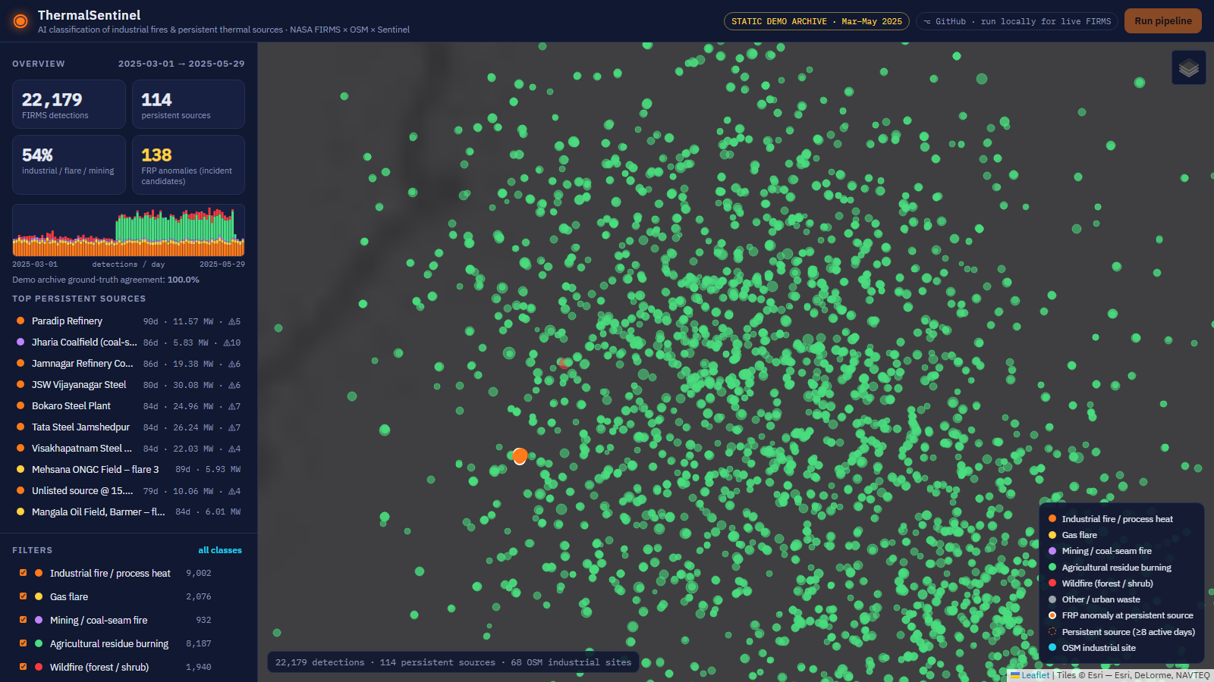
RESEARCH AND REFERENCES
Fire Orbit
Details / Links of the reference and research work
1
Problem statement
6
Context data
NTRO, PS SIH26162, Smart India Hackathon 2026: segregate industrial fires from forest and other natural fires, with GIS storage and map-overlay visualisation.
OpenStreetMap Overpass API and tagging: industrial, man_made=flare or works, power=plant, landuse=quarry, farmland or forest.
https://sih.gov.in
https://wiki.openstreetmap.org/wiki/Overpass_API
2
Hotspot data
7
Verification
NASA FIRMS Area API: VIIRS 375 m (Suomi-NPP, NOAA-20, NOAA-21) and MODIS 1 km active-fire products, near real time and archive.
Copernicus Data Space, Sentinel-2 SWIR bands B11 and B12 for visual confirmation, and ESA WorldCover 10 m land cover.
https://firms.modaps.eosdis.nasa.gov/api/area/
https://dataspace.copernicus.eu
3
Sensor science
8
Seasonal priors
Schroeder, W. et al. (2014). The new VIIRS 375 m active fire detection data product. Remote Sensing of Environment, 143, 85-96.
ICAR-IARI CREAMS and CPCB crop-residue burning bulletins, used as the October-November and April-May seasonality prior.
https://doi.org/10.1016/j.rse.2013.12.008
https://creams.iari.res.in
4
Flare signatures
9
Methods
Elvidge, C. D. et al. (2013). VIIRS Nightfire: satellite pyrometry at night. Remote Sensing, 5(9), 4423-4449.
Ester, M. et al. (1996). DBSCAN, KDD-96, used for source grouping; scikit-learn HistGradientBoostingClassifier documentation.
https://doi.org/10.3390/rs5094423
https://scikit-learn.org
5
Industrial heat
Liu, Y. et al. (2018). Identifying industrial heat sources using time series of the VIIRS Nightfire product. Remote Sensing of Environment, 204.
https://www.sciencedirect.com/journal/remote-sensing-of-environment
Our own work
Working prototype: https://rahulskandagal.github.io/thermal-sentinel/
Source code and documentation: https://github.com/rahulskandagal/thermal-sentinel
Prototype: all-India view and the Punjab crop-burn season

