Slide 1


SMART INDIA HACKATHON 2026
Problem Statement ID – SIH26162
Problem Statement Title- AI-Based Detection and Classification of Industrial Fires and Persistent Thermal Sources Using NASA FIRMS, OSM & Satellite Data
Theme- Disaster Management
PS Category- Software
Team ID-
Team Name (Registered on portal) - Fire Orbit
1

Slide 2

Fire Orbit
ThermalSentinel: AI That Knows What Is Burning —
and Whether It Should Be
Real-world issue: NASA FIRMS reports thousands of hot pixels over India every day — a refinery flare, a steel plant, a coal-seam fire, a stubble burn and a forest fire all look identical.
Risk
v
Solution
🔥
Identical hotspots, no meaning
6-class AI: industrial · flare · mine · crop · wildfire
CORE INNOVATION
Real fires hidden in routine heat
Alert only when FRP ≫ the site's own baseline
Why important: A genuine plant fire hides among routine industrial heat; responders cannot prioritise, and no registry of persistent thermal sources exists for security agencies.
🔔 Baseline-relative incident alerts
FRP ≥ 2.5× site normal & z ≥ 3
No memory of persistent sources
90-day source tracking & registry
PRIMARY FUNCTIONS
🤖 6-class AI classification | 📒 Persistent-source registry (90-day)
Solution: AI classifies every hotspot into 6 classes, tracks each source for 90 days and alerts only when a known site burns far above its own normal.
Black-box AI mistrusted
Every label carries plain reasons
CONTEXT & EVIDENCE
🏭 OSM facilities · 🌾 Land cover · 🛰️ Sentinel-2 verification · 📅 India burn seasons
Prototype
Live Demo
GitHub
MONITORING & OUTPUT
🗺️ GIS dashboard · 🔗 GeoJSON API · 🔔 Webhook / SMS alerts · 👤 Analyst loop · 📤 QGIS export
working today — click to open
real prototype — GIS dashboard
@SIH Idea submission- Template
2

Slide 3
Fire Orbit
TECHNICAL APPROACH
METHODOLOGY & PROCESS OF
IMPLEMENTATION
TECHNOLOGIES USED
🛰️
📥
⚙️
🗺️
🛰️
Data
Ingest
VIIRS 375 m
MODIS 1 km
NASA FIRMS API
≤ 3 h latency
ThermalSentinel
engine
GIS · registry
⚠ alerts
NASA FIRMS (VIIRS 375 m, MODIS), OpenStreetMap Overpass, Copernicus Sentinel-2, NASA Worldview
FIRMS data
🛰️
AI core: 34 features · haversine DBSCAN 750 m · per-source FRP μ/σ · OSM facility type + distance · land cover · India burn-season priors → explainable rules + gradient-boosted trees; anomaly when FRP ≥ 2.5 μ and z ≥ 3.
🤖
AI / ML
Serve
📡
🔗
Cluster
Python · scikit-learn (DBSCAN, HistGradientBoosting) · rule engine · shapely STRtree
GIS · alerts
🔥
DBSCAN sources
🤖
⏱️
🗄️
Backend
Classify
Persist
FastAPI REST (GeoJSON) · SQLite → PostGIS · OGC-standard exports
rules + GBM
90-day baseline
🗺️
🗺️
Frontend
Context
React 18 + Vite · Leaflet canvas renderer (40 k+ points) · deep-link views
OSM + land use
Report
GitHub
Detailed
Report
☁️
Deployment
Working prototype: 22,179 detections · 114 persistent sources · 138 alerts · GeoJSON export
GitHub Pages demo · one Linux VM / NIC cloud / air-gapped server · Docker-ready
@SIH Idea submission- Template
3

Slide 4
Fire Orbit
FEASIBILITY AND VIABILITY
FEASIBILITY ANALYSIS
VIABILITY
BUSINESS & DEPLOYMENT
★★★★½
✔
💼
Working prototype: 22 k detections classified in 7 s on a laptop; public demo live on GitHub Pages.
Proven signals: persistence + OSM context + physics separate the classes — 99.9 % hybrid / 98.4 % rules on the labelled 90-day archive.
Government: SDMA control rooms, NTRO source registry, CPCB fire attribution — ≈ ₹3–5 k / month per deployment.
Open data only: FIRMS key issued instantly, OSM Overpass, Copernicus — ₹0 licences, no procurement.
Trusted by design: every label shows reasons; analysts confirm or override and their labels retrain the model.
Industry & insurers: site-monitoring subscriptions and verified incident evidence for claims and compliance.
Light footprint: FastAPI + SQLite + React on one VM, NIC cloud or an air-gapped NTRO server.
Scales: OSM queried only around hotspot cells; PostGIS + tiles path for national, multi-year archives.
Integration: GeoJSON layers for Bhuvan / NDEM, QGIS, ArcGIS — no new GIS needed.
Live in one switch: one env variable moves the same pipeline from archive to near-real-time FIRMS.
Risks handled: OSM gaps → curated list + WorldCover; clouds → 90-day, 3-satellite window; false alarms → baseline-relative thresholds.
Roadmap: 4-week live pilot + validation on real incidents → finale: alerts, Sentinel-2 chip CNN → agency SOP.
✔ Idea + prototype
Next 4 weeks
Grand finale
Deployment
🛰️
done · live demo
live FIRMS pilot · validation
PostGIS · alerts · Sentinel-2 CNN
Bhuvan / NDEM · SDMA SOP
@SIH Idea submission- Template
4

Slide 5
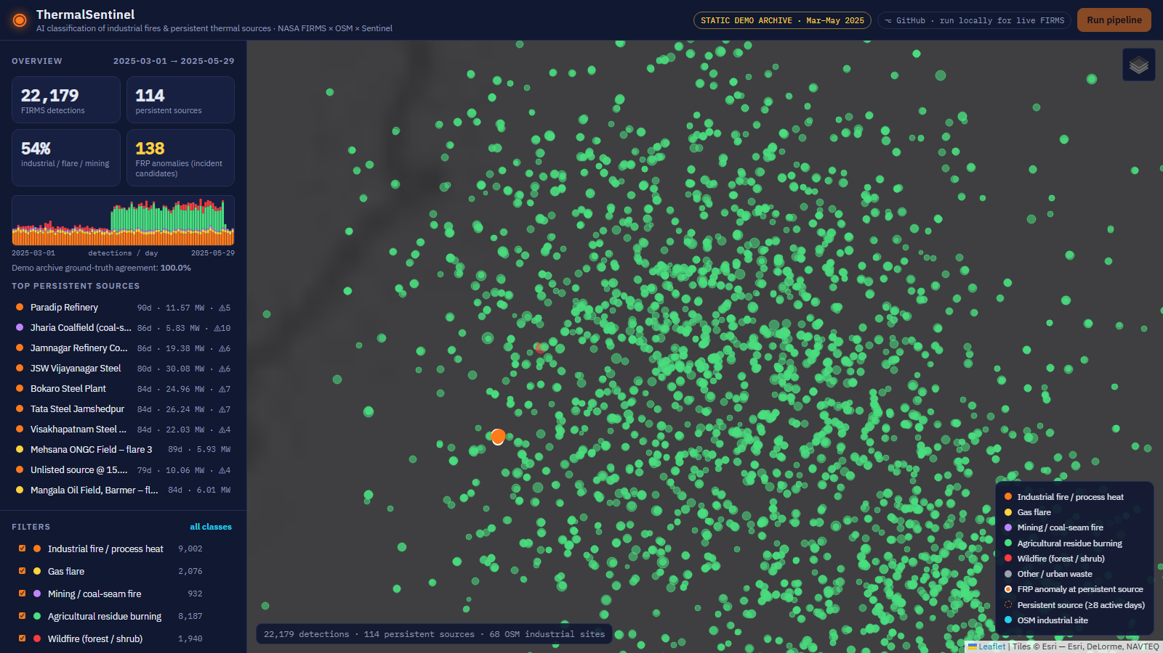
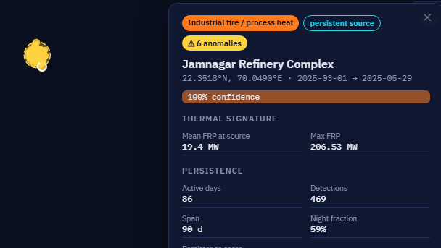
Fire Orbit
IMPACT AND BENEFITS
Control-room workload — FIRMS today vs with ThermalSentinel
Faster response
1
1
Safety
Alerts only on abnormal industrial heat — the right plant, sooner.
Communities near refineries, steel & chemical plants warned earlier.
99 % less triage
2
2
Economic
Only 138 of 22,179 detections reach an operator.
₹0 data, one VM; losses cut by early detection.
IMPACTS
BENEFITS
National registry
3
3
Environmental
Measured on the labelled 90-day archive (22,179 detections).
Persistent thermal sources with 90-day history for NTRO.
Stubble burning vs industry attribution; flaring & coal-fire inventories.
From hot pixels to actionable alerts →
Standing watch
4
4
Strategic
Coal-seam fires & gas flares (Jharia, Barmer) monitored daily.
Explainable, sovereign, Bhuvan / NDEM-ready.
crop-burn season, Punjab (green = agri)
Jamnagar: 86 active days · ⚠ 207 MW spike
@SIH Idea submission- Template
5

Slide 6
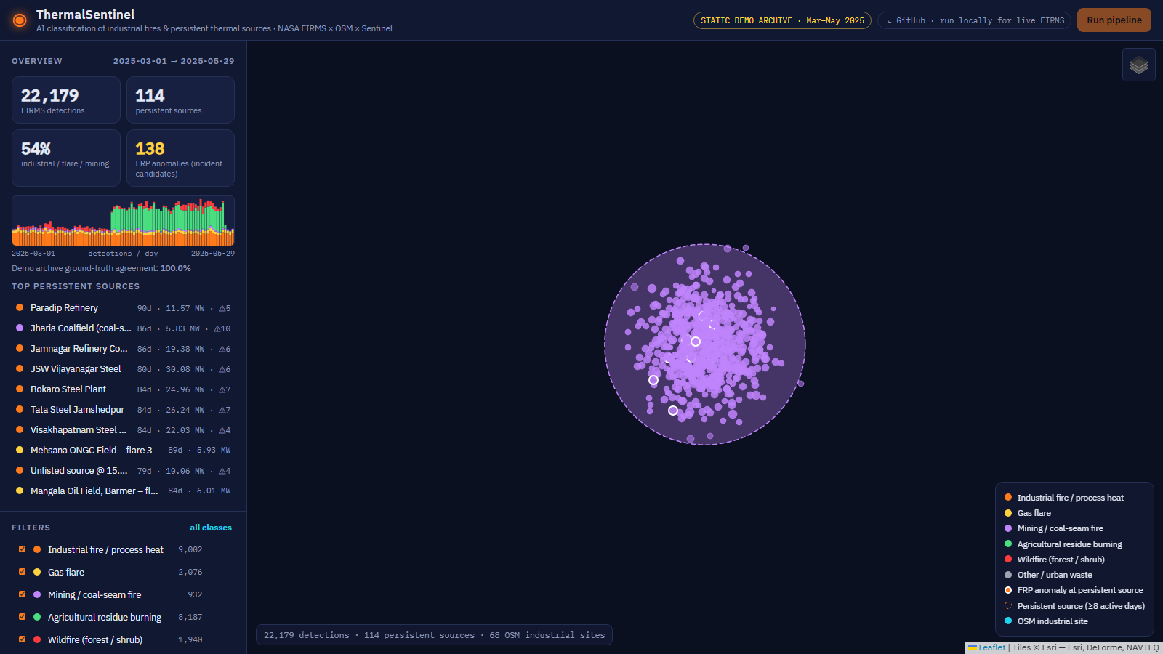
Fire Orbit
RESEARCH AND REFERENCES
hotspot data source
375 m sensor science
flare signatures
industrial heat
context data
visual verification
seasonal priors
NASA FIRMS:
Active-fire
Area API
Schroeder 2014:
VIIRS 375 m
fire product
Elvidge 2013:
VIIRS
Nightfire
Liu 2018:
Industrial heat
sources (RSE)
OpenStreetMap:
Overpass API
& tags
Copernicus:
Sentinel-2 SWIR
WorldCover
ICAR-CREAMS /
CPCB: residue
burning
LINK
LINK
LINK
LINK
LINK
LINK
LINK
UI / UX — working prototype (live link below)
all-India classification · Punjab crop-burn season · Jharia coal-seam fires
Working prototype: https://rahulskandagal.github.io/thermal-sentinel/ Source code: https://github.com/rahulskandagal/thermal-sentinel
@SIH Idea submission- Template
6

