Slide 1


SMART INDIA HACKATHON 2026
Problem Statement ID - SIH26162
Problem Statement Title- AI-Based Detection and Classification of Industrial Fires and Persistent Thermal Sources Using NASA FIRMS, OSM & Satellite Data
Theme- Disaster Management
PS Category- Software
Team ID-
Team Name (Registered on portal) - Fire Orbit
Organisation: National Technical Research Organisation (NTRO)
1

Slide 2

Fire Orbit
ThermalSentinel: Classifying Every Satellite Hotspot
and Alerting Only on Abnormal Industrial Heat
Real-world issue: NASA FIRMS reports thousands of hot pixels over India every day. A refinery flare, a steel plant, a coal-seam fire, a stubble burn and a forest fire all look identical in that feed.
Risk
vs
Solution
Identical hotspots carry no meaning
Six-class AI: industrial, flare, mine, crop, wildfire
CORE INNOVATION
Real fires hidden in routine heat
Alert only when FRP exceeds the site baseline
Why it matters: A genuine plant fire hides among routine industrial heat, so responders cannot prioritise, and no registry of persistent thermal sources exists for security agencies.
Baseline-relative incident alerts: FRP at least 2.5 times the site normal and z-score at least 3
No memory of persistent sources
90-day source tracking and registry
PRIMARY FUNCTIONS
Six-class AI classification and a 90-day persistent-source registry
Our solution: Classify every hotspot into 6 classes, track each source for 90 days, and raise an alert only when a known site burns far above its own normal level.
Black-box AI is not trusted
Every label carries plain reasons
CONTEXT AND EVIDENCE
OSM facilities, land cover, Sentinel-2 verification, Indian burn-season priors
Prototype
Live Demo
GitHub
MONITORING AND OUTPUT
GIS dashboard, GeoJSON API, webhook and SMS alerts, analyst loop, QGIS export
running today, click to open
Prototype GIS dashboard
2

Slide 3
Fire Orbit
TECHNICAL APPROACH
METHODOLOGY AND PROCESS OF
IMPLEMENTATION
TECHNOLOGIES USED
1
2
3
4
1
Data
Ingest
VIIRS 375 m,
MODIS 1 km
NASA FIRMS API,
under 3 h latency
ThermalSentinel
engine
GIS, registry,
alerts
NASA FIRMS (VIIRS 375 m, MODIS), OpenStreetMap Overpass, Copernicus Sentinel-2, NASA Worldview
FIRMS data
1
AI core: 34 features, haversine DBSCAN at 750 m, per-source FRP mean and standard deviation, OSM facility type and distance, land cover, Indian burn-season priors. Explainable rules vote with gradient-boosted trees; an anomaly is raised when FRP reaches 2.5 times the source mean and z-score 3.
2
AI and ML
Serve
6
2
Cluster
Python, scikit-learn (DBSCAN, HistGradientBoosting), rule engine, shapely STRtree
GIS and alerts
DBSCAN sources
5
3
3
Backend
Classify
Persist
FastAPI REST with GeoJSON, SQLite moving to PostGIS, OGC-standard exports
rules and GBM
90-day baseline
4
4
Frontend
Context
React 18 with Vite, Leaflet canvas renderer for 40,000+ points, deep-link views
OSM and land use
Report
GitHub
Detailed
Report
Deployment
5
Prototype: 22,179 detections classified, 114 persistent sources, 138 incident alerts, GeoJSON export
GitHub Pages demo, single Linux VM, NIC cloud or air-gapped server, Docker-ready
3

Slide 4
Fire Orbit
FEASIBILITY AND VIABILITY
FEASIBILITY ANALYSIS
VIABILITY
BUSINESS AND DEPLOYMENT
Working prototype: the full 90-day archive of 22,179 detections is classified in about 7 seconds on a laptop, and the demo is public.
Signals that work: persistence, OSM context and physical signature separate the classes. Accuracy on the labelled 90-day archive is 99.9 % hybrid and 98.4 % rules-only.
Government: SDMA control rooms, an NTRO source registry and CPCB fire attribution, at roughly Rs 3,000 to 5,000 per month per deployment.
Open data only: the FIRMS key is issued instantly, OSM Overpass and Copernicus are free. No licences, no procurement.
Designed for trust: every label shows its reasons. Analysts confirm or override, and their labels retrain the model.
Industry and insurers: site-monitoring subscriptions and verified incident evidence for claims and compliance.
Light footprint: FastAPI, SQLite and React run on a single VM, NIC cloud or an air-gapped NTRO server.
Scales: OSM is queried only around hotspot cells, with a PostGIS and tile path for national, multi-year archives.
Integration: GeoJSON layers for Bhuvan, NDEM, QGIS and ArcGIS. No new GIS is required.
One switch to live: a single environment variable moves the same pipeline from the archive to near-real-time FIRMS.
Risks handled: OSM gaps use a curated list and WorldCover, clouds are covered by a 90-day window across 3 satellites, false alarms by baseline-relative thresholds.
Roadmap: a 4-week live pilot with validation on real incidents, then alerting and a Sentinel-2 chip classifier, then an agency SOP.
Idea and prototype
Next 4 weeks
Grand finale
Deployment
done, public demo live
live FIRMS pilot, validation
alerting, Sentinel-2 classifier
Bhuvan and NDEM, SDMA SOP
4

Slide 5
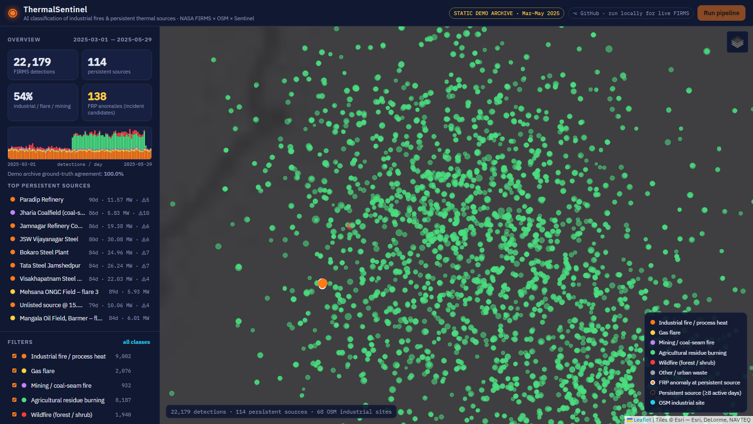
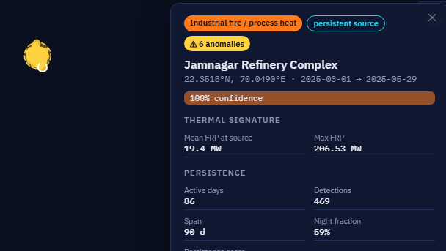
Fire Orbit
IMPACT AND BENEFITS
Control-room workload: FIRMS today versus ThermalSentinel
Faster response
1
1
Safety
Alerts only on abnormal industrial heat.
Communities near refineries and chemical plants warned earlier.
99 % less triage
2
2
Economic
Only 138 of 22,179 reach an operator.
No data cost, one VM, losses cut by early detection.
IMPACTS
BENEFITS
Source registry
3
3
Environmental
Measured on the labelled 90-day archive of 22,179 detections.
90 days of activity history per site.
Stubble burning separated from industrial emissions and flaring.
From hot pixels to actionable alerts
Standing watch
4
4
Strategic
Jharia and Barmer watched daily.
Explainable, sovereign, ready for Bhuvan or NDEM.
crop-burn season, Punjab
Jamnagar: 86 active days, 207 MW spike
5

Slide 6
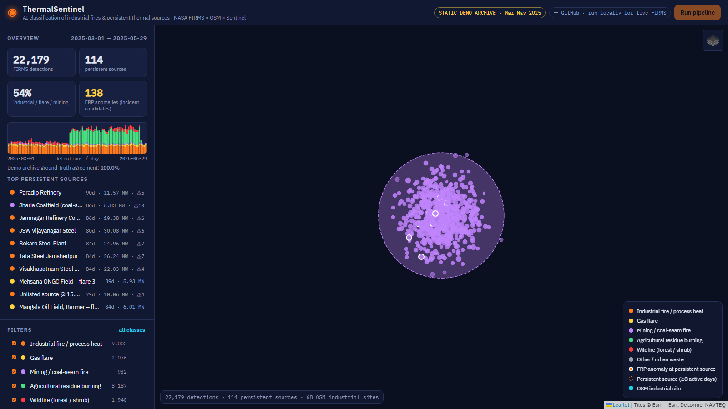
Fire Orbit
RESEARCH AND REFERENCES
policy and problem
hotspot data source
sensor science
flare signatures
industrial heat
context data
verification
NTRO
PS SIH26162
SIH 2026
NASA FIRMS
Active-fire
Area API
Schroeder 2014
VIIRS 375 m
fire product
Elvidge 2013
VIIRS
Nightfire
Liu 2018
Industrial heat
sources (RSE)
OpenStreetMap
Overpass API
and tags
Copernicus
Sentinel-2 SWIR
WorldCover
LINK
LINK
LINK
LINK
LINK
LINK
LINK
Working prototype screens
all-India classification, Punjab crop-burn season, Jharia coal-seam fires
Working prototype: https://rahulskandagal.github.io/thermal-sentinel/ Source code: https://github.com/rahulskandagal/thermal-sentinel
6

