Slide 1

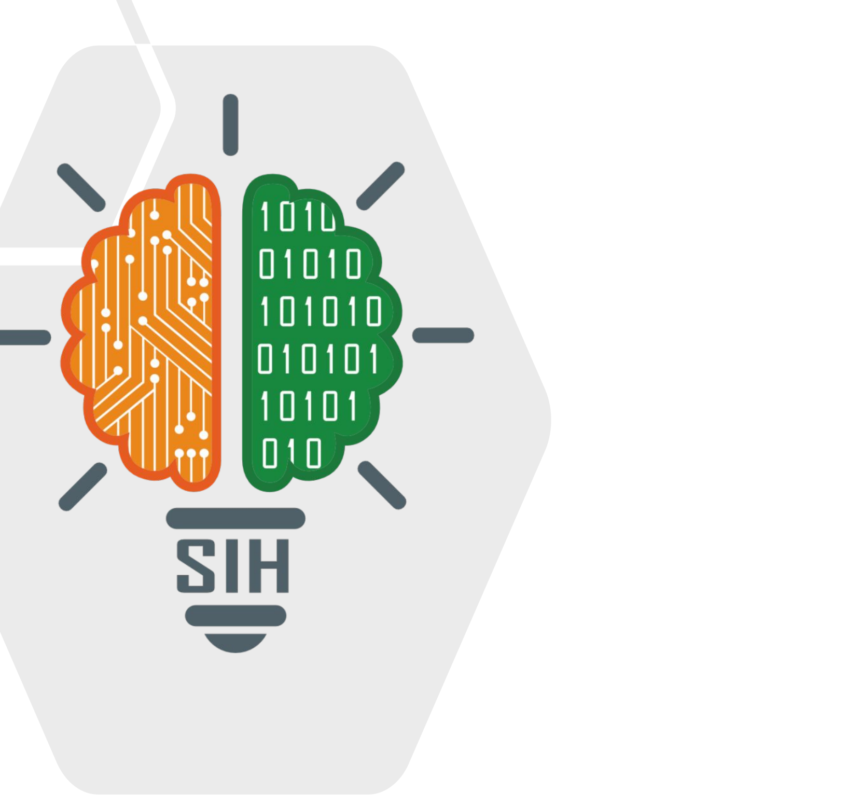
SMART INDIA HACKATHON 2026
Problem Statement ID – SIH26229
Problem Statement Title- Kabadiwala Connect – Bringing the Informal Collector into the Formal Recycling Chain
Theme- Clean & Green Technology
PS Category- Software
Team ID-
Team Name (Registered on portal) - Fire Orbit
Organisation: Ministry of Mines · Dept: JNARDDC, Nagpur
1

Slide 2
Fire Orbit
Kabadiwala Connect: Fair Price · Formal Chain · Full Traceability
for Every Scrap Collector
Real-world issue: India generates ≈ 4 million tonnes of e-waste a year and over 90 % moves through kabadiwalas and waste-pickers who sit outside the formal EPR chain — ending in open-air cable burning and acid leaching.
Risk
v
Solution
♻️
Collector does not know the fair price
Photo → AI category → live ₹/kg band + trend
CORE INNOVATION
No link to authorized recyclers
Matching + pooled pickup in one tap
Why important: Collectors do not know fair prices, authorized recyclers or compliant handover; recyclers cannot source traceable feedstock; India loses lithium, cobalt, neodymium, tantalum, gallium, indium — and workers lose their health.
📷 Snap-to-Value on-device AI + 🧾 tamper-evident GPS handover ledger — fair price and traceability in one tap
No proof of formal handover
GPS-verified handover, QR trace ID, cash / UPI receipt
PRIMARY FUNCTIONS
💰 Price discovery & 30-day trends | ♻️ Authorized-recycler matching & pooled pickup
Solution: A Hindi / Marathi, voice-first, offline-capable Android app: photo → instant AI price → audio price board → authorized recycler → GPS-verified handover → cash or UPI, logged in an earnings ledger → EPR record.
Low literacy, weak network
Voice-first Hindi / Marathi; works offline
INCLUSION & TRUST
🗣️ Hindi / Marathi voice UI · 🔊 audio price board · 📴 offline-first · 💵 cash or UPI with OTP receipt · 📒 earnings ledger · 🛡️ safety guidance
✔ Covers all 12 PS requirements
Prototype
✔ Photo → AI valuation
✔ Price history dataset
Live App
GitHub
PLATFORM & DATA
✔ End-to-end traceability
✔ Recycler directory + matching
🖥️ Recycler console · 📊 MoM / CPCB dashboard · 🔗 open price dataset & API · 📄 EPR / Form-6 records · 📍 hotspot map
✔ Audio price boards
✔ GPS handover records
installable PWA — open the link
on any Android phone
✔ Earnings ledger / history
✔ Safety guidance built in
✔ Hindi & Marathi
✔ Offline-first
✔ Entry-level Android
✔ Cash transactions
@SIH Idea submission- Template
2

Slide 3
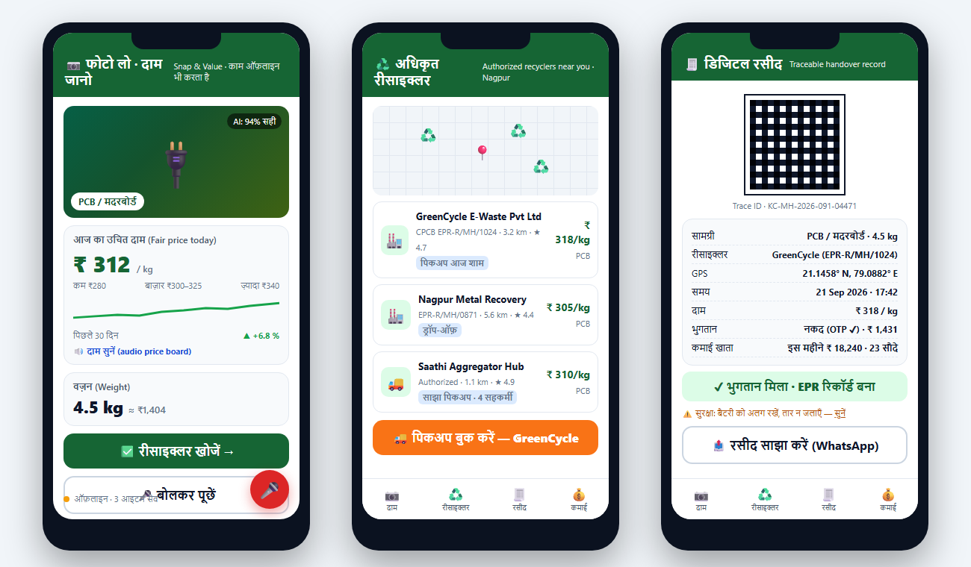
Fire Orbit
TECHNICAL APPROACH
METHODOLOGY & PROCESS OF
IMPLEMENTATION
TECHNOLOGIES USED
📱
☁️
🏭
🏛️
📱
Mobile
Snap
Collector app
offline queue
Sync · price engine
· matching
Recycler console
quotes · pickups
MoM / CPCB
dashboard · EPR
Flutter (Android 8+, 1 GB RAM), SQLite + WorkManager offline sync, TensorFlow Lite on-device vision
on-device AI
📷
AI & data core: on-device TFLite MobileNet classifier (12 e-waste categories, ~4 MB) · price engine = recycler quotes + LME/MCX Cu/Al indices + verified transactions, median & 30-day trend · matching = distance × price × capacity × rating · handover records SHA-256 hash-chained → tamper-evident EPR trail.
🗣️
Vernacular & safety
Ledger
📒
💰
Price
Bhashini ASR / TTS (Hindi, Marathi), audio price boards, icon-first UI, built-in hazardous-handling guidance, SMS / IVR fallback
earnings · EPR
♻️
fair ₹/kg band
💵
♻️
🗄️
Backend
Pay
Match
FastAPI + PostgreSQL / PostGIS · price engine · matching service · hash-chained handover ledger
cash or UPI + receipt
authorized recycler
🧾
💵
Payments & ledger
Handover
Cash or UPI (NPCI) — both logged with OTP-confirmed receipt; per-collector earnings ledger builds a financial history
GPS · QR · weight
Live App
Code
Works on a
₹6–8 k phone
🖥️
Consoles & data
Collector app: Snap & Value + audio price board → authorized recyclers → GPS handover receipt (cash / UPI) with earnings ledger & safety tip
React dashboards (recycler, MoM / CPCB), open price-dataset API, EPR / Form-6 export
@SIH Idea submission- Template
3

Slide 4
Fire Orbit
FEASIBILITY AND VIABILITY
FEASIBILITY ANALYSIS
VIABILITY
BUSINESS & SCALE
★★★★½
✔
💼
Tech is ready: on-device image AI, offline sync, UPI and Bhashini are proven, free / open building blocks — no research risk.
Incentives align: collector earns more (fair price, no middleman cut); recycler gets traceable feedstock; MoM gets data.
Revenue: 1–2 % platform fee on recycler payouts; EPR compliance reports for PROs / producers; price-index data services.
Data exists: CPCB list of EPR-registered recyclers; MCX / LME metal indices; recycler quotes seed the price dataset.
Unit economics: PCB informal ≈ ₹250/kg vs formal ₹310 + ₹15 incentive → ≈ +30 % per kg (pilot target, to be measured).
Policy fit: E-Waste (Management) Rules 2022 EPR framework; automated Form-6; Mission LiFE & Swachh Bharat alignment.
Low-end friendly: APK < 15 MB, Android 8+, works on ₹6–8 k phones and 2G; SMS / IVR fallback.
Trust by design: cash stays possible (OTP receipt), visible price band, dispute button; only a phone number — no sensitive personal data.
Scale path: Nagpur → Maharashtra (Marathi) → Hindi belt; extend to plastics & metals; ULB and PRO partnerships.
Field-first: PS asks for ≥ 2 real collectors — we plan 50 collectors + 3 authorized recyclers in Nagpur (JNARDDC's city); the PWA is live today for the usability demo.
Risks handled: recycler adoption → onboarding kit + EPR credits; price gaming → multi-source median; connectivity → offline queue + SMS.
Roadmap: 4-week MVP + pilot → finale: 500 collectors, price API, CPCB integration → national roll-out with PROs.
✔ Idea + mockups
Next 4 weeks
Grand finale
Deployment
♻️
architecture · field-survey plan
MVP app · 50-collector Nagpur pilot
recycler console · price API · unit economics
CPCB EPR portal · PRO partners
@SIH Idea submission- Template
4

Slide 5
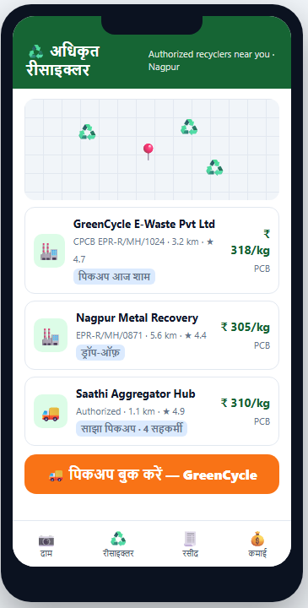
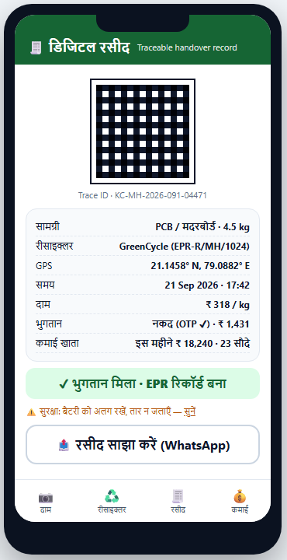
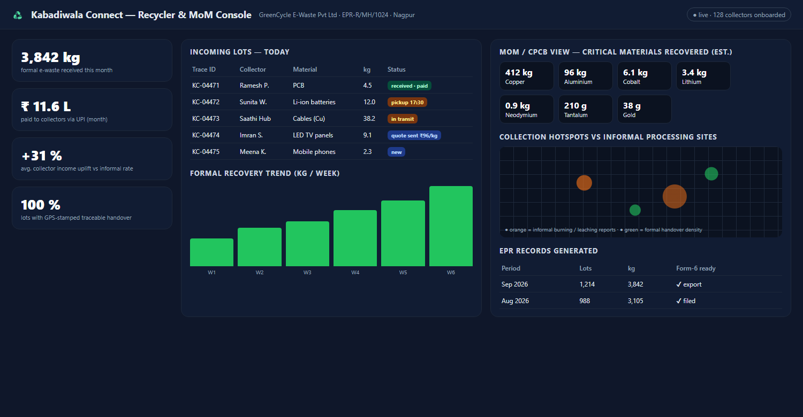
Fire Orbit
IMPACT AND BENEFITS
Collector earnings ₹ / kg — informal today vs Kabadiwala Connect
Higher income
1
1
Social
≈ +25–35 % per kg via fair prices; earnings ledger builds a financial history for credit.
Dignity, digital identity and records for lakhs of informal workers.
Formalisation
2
2
Economic
Every lot enters the EPR chain with a GPS-stamped, traceable record.
Recyclers get compliant feedstock; producers earn EPR credits.
IMPACTS
BENEFITS
Safer work
3
3
Environmental
Illustrative pilot model (fair price + incentive, pooled pickup) — to be validated in the Nagpur field study.
Pickup + training replace open burning and acid leaching.
Less toxic burning / leaching; higher material recovery rates.
From backyard burning to a traceable, fairly-paid chain
Critical minerals
4
4
Governance
Li, Co, Nd, Ta, Ga, In recovered instead of lost to backyard processing.
MoM / CPCB see real-time flows, prices and hotspots.
recycler match · digital receipt · recycler / MoM console (mockups)
@SIH Idea submission- Template
5

Slide 6
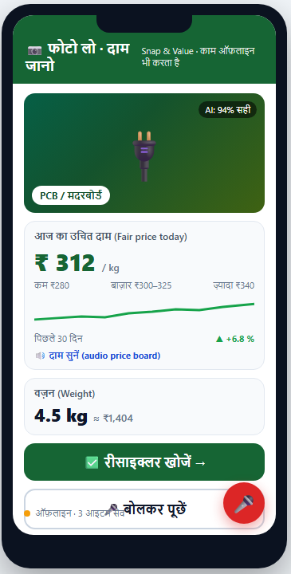
Fire Orbit
RESEARCH AND REFERENCES
policy framework
recycler database
scale of problem
domain partner
vernacular AI
payments
on-device AI
E-Waste (Mgmt)
Rules 2022
MoEFCC / CPCB
CPCB EPR
e-waste portal:
registered recyclers
Global E-waste
Monitor 2024
UNITAR / ITU
JNARDDC,
Ministry of Mines
Nagpur
Bhashini:
Hindi / Marathi
ASR & TTS
NPCI UPI:
instant payouts
& receipts
TensorFlow Lite
& critical-minerals
list (MoM 2023)
LINK
LINK
LINK
LINK
LINK
LINK
LINK
UI / UX — working collector app (Hindi) and recycler / MoM console
Snap & Value · authorized recyclers · digital handover receipt · console
Working prototype (PWA): https://rahulskandagal.github.io/kabadiwala-connect/ Source code: https://github.com/rahulskandagal/kabadiwala-connect
@SIH Idea submission- Template
6

