Slide 1

Synergetic Communication, Inc. (Syncom)

Slide 2
Who is Syncom?
Syncom is Synergetic Communication, Inc.
Syncom was Founded in 1996 by Michael Orlando
25th Anniversary February 2021
Syncom Is A Debt-Free Corporation- Insuring Financial Security.
Syncom Recovers Debts in the Full Spectrum of Collection Stages and Industries.
Syncom specializes in Deficiency Balance Collections, Late Stage Strategies “LA$ER”, Collateral Locate and Repossession.
Syncom Has Increased Small-Medium Balance Programs over Past 24 Months
Telecom, Medical-Self Pay, DDA, Credit Card
Accounts for 60% of Active Accounts
Syncom has Three Centers throughout the US:
Houston, TX (Corporate Head Quarters & Collections)
Hayden, ID (Support Services Center)
Minneapolis, MN (Collateral Recovery)
Dedicated Office 11 Years Old
Syncom is 80 FTE strong and growing
Syncom has unlimited growth capacity

Slide 3
Syncom Differentiators
Cradle to Grave Collection Products
Primes, Seconds, Late Stage Collection Programs and Collateral Recovery Division
Executive Team has 90 Years of Experience in the Third Party Collection Arena Among 4 Executives
Executive Management Maintains “Hands On” Strategy and Oversight
Syncom Believes in a Flat Organizational Structure
80% of Clients have Awarded Syncom Multiple Projects Due to Wide Range of Experience and Capabilities and Ability to Achieve a High Level of Service

Slide 4
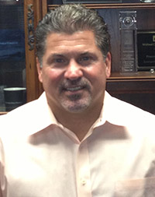

Management Team
Michael Orlando President/CEO, 1996 – Present Mr. Orlando has over 30 years of Collection Agency Management experience. Mike started Syncom with previous Clients following from some of the largest Manufactured Housing and Automobile Finance companies in the industry. He has served the last 24 years as President and CEO of Syncom.

Slide 5
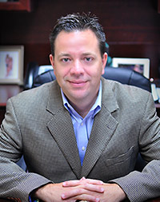
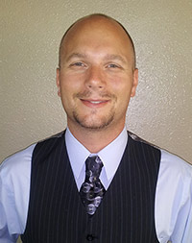
Management Team
Ken Walsh Director of Operations-Houston 2012 – Present Mr. Walsh has over 19 years of experience in the collection industry. Ken, prior to joining Syncom, spent 7 years running the operations of a 50 person collection agency in Houston. He oversaw all aspects of the business. Ken has worked and managed across the full range of industries in the collection space.
Patrick Green Director of Support Services 2006 – Present Mr. Green has a long track record of overseeing processes that are directly related to customer service having run a region of offices for a major pay day loan company. Since joining Syncom he has held various positions throughout the company which makes him perfectly suited to oversee all the processes that support Syncom’s operations.

Slide 6
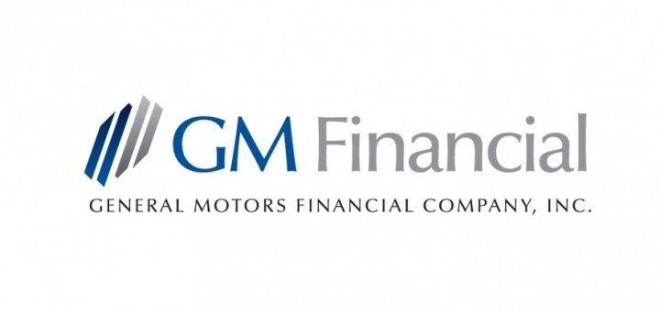











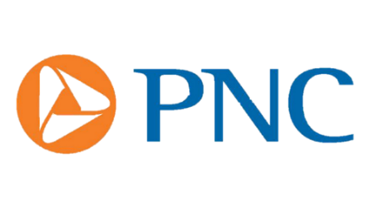

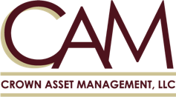
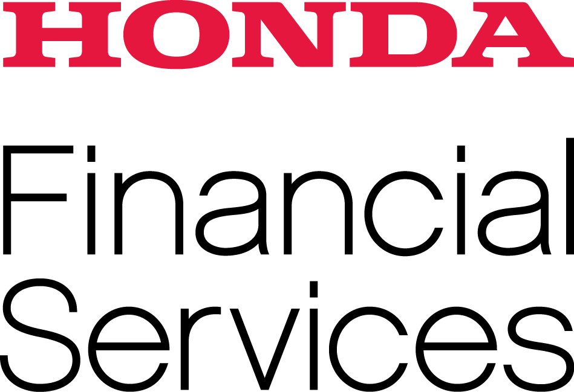



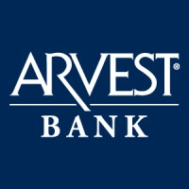






Who Believes in Syncom?

Slide 7
Client Longevity-Direct Lender
American Honda Finance- 11 years
6 Projects (Primes, Laser, 4 Tiers in Collateral Recovery)
Harley Davidson- 4 years
1 Project (Primes)
Hyundai/Kia- 7 years
1 Project (Seconds)
Laser to Begin 2nd Qtr 2020
GM Financial-2 years
2 Projects (Quads, Dormant Judgments)
Nissan Motor Acceptance- 9 years
2 Projects (Laser, Collateral Recovery)
TD Bank- 16 years
2 Projects (Primes, Tertiary)
Toyota Financial Services- 8 years
5 Projects (Primes, Tertiary, 4ths, 5ths and 6ths)
Arch (formally) United Guaranty- 6 years
2 Projects (Seconds-Mortgage, Seconds Student Loans)
Toyota South East (World Omni)- 4 years
6 Projects (Primes, Seconds, Tertiary, Quad, Laser, Collateral Recovery)

Slide 8

Debt Buyer/Servicer Vertical
Jefferson Capital- 4 years
3 Projects (Auto, Telecom, Private Label card)
Crown Asset Management- 2 years
3 Projects (Auto, Credit Card, Consumer Loan)
Also Working accounts they service from Second Round
Boston Portfolio Advisors- 4 years
Career Education College- 3 Tiers (3rds, Quads, Laser)
PNC Bank- 3 Tiers (3rds, Quads, Laser
US Asset (EOS)- 4 years
4 Projects (3 Telecom and Medical)
Cascade Receivables- 3 year
3 Projects (Auto, 2 Medical Projects)
Diversified Funding Associates-New 2021
1 Project (credit card, DDA, retail loans)
National Debt Holdings-New 2021
1 Project (retail loan, credit card)
InvestiNet- 2 years
3 Projects ( Seconds, Quads and Fifths)
Joined RMA International-late 2019
Certified Receivables Company 6-2020
Projects are Predominately late stage both Out of Statute and Near Statute but have begun to work forward flow fresh charge off portfolios
Current Total Inventory is:
2.1 Million Accounts
$ 3.4 Billion Dollars

Slide 9
Laser - Near and Out of Statute Recovery Program
Late Stage “warehouse” Triggers Based Collection Strategy
2-6 Years From Charge Off to Out of Statute (Post Bureau)
Over 23 current Projects Across Most Collection Industries
Currently 2.7 Million Accounts for $5.6 Billion
Focuses on Scoring and Working High Propensity to Pay Accounts Up Front at Placement With Daily Monitoring For Positive Life-Style Improvements Through Credit Activity
Annuitized Returns as Different Portions of the Portfolio “Pop” each Day
Program Works Across all Industries and Balance Ranges
Highly Focused State by State Compliance
Letters and State Regulations
ACA Attorney Review Monthly
Fast Facts-ACA
Executive Management 20 Years Experience in Late Stages of Collections

Slide 10



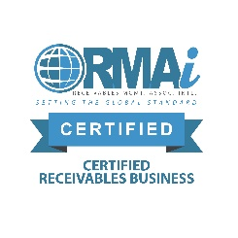

Compliance Centric
Compliance Management System
Predictable and Repeatable
All Calls Recorded and Manually Dialed
Score all numbers to mitigate risk
No Number Dialed in Excess of 3 Times per Day
Training Focused
Ongoing training for All Employees
All Training Includes Testing for Knowledge & Retention
All Collectors are Certified for Clients they Work
Strong Auditing and Documentation to Resolution
Complaint Process, C&D
Quality Monitoring Program Compliance Focused
Bonuses are Dependent on Successful Score
Manager’s Bonus is Tied to Their Team’s Score
ACE calls Award Bonus Points to Quality Score
Organizational Structure
Compliance Independent of Operations
Cyber Security-Technology, Policies & Practices
TECHLOCK Certified
Refresh and Expansion 2019
Secure Online Payment Option
Enhanced Virtual Negotiation 2020
RMAi member late 2019
Certified Receivable Business June 2020

Slide 11
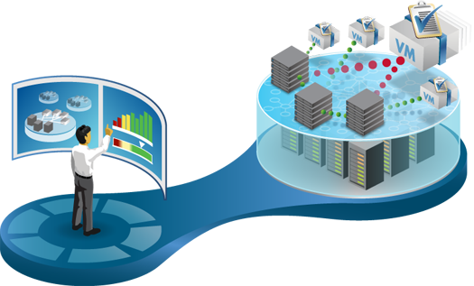
Syncom IT Infrastructure
Ontario Systems-
TCS 2012
Extensive Customized Programming
Virtual Environment Utilizing Thin Clients
Vmware Virtual Platform
Monthly Penetration Testing through Tenable Appliance
Dial Connection Dialing System “Mobile Comply”
All Calls are Manual
Compliance State and Client Appliance to Assure Dialing Complies
IT Support Outsourced to Local IT Servicer
Uprite Services-24 Hour/365 day Support
Extensive Hardware Infrastructure Refresh 2019

Slide 12
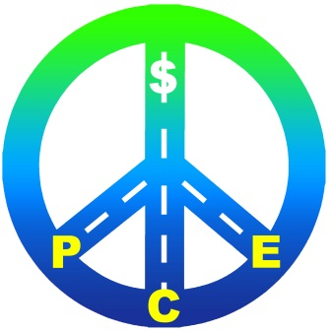
Positive Consumer Experience (PCE) Initiative
Assume Positive Intent
Gather Enough Information to Assure Consultative Collection Result
Arrangements That Are in The Best Interest of Client, Consumer and Syncom
Monitoring for Tone, Direction and Compliance
Not Just Legal and Productive Monitoring
Include Monitoring and PCE on Monthly Report Card
Scores Impact Compensation
Created Director of Compliance Position
Primary position Is to Assure We Deploy a Collection Technique that Promotes Positive Consumer Culture
Creating Productive and Compliant Environment
All Collectors are Certified for Clients They Treat
Collector “Ace” Calls Are Rewarded

Slide 13
