Slide 1



MARKETING · UNIQUE SELLING PROPOSITION
APPLE
vs
SAMSUNG
One connected ecosystem, or endless innovation and choice?
Eight speakers. Four criteria. One winning USP.
PRESENTED BY Isha · Yashvi · Nishita · Aarya · Venesa · Simran · Mann · Gouraksh
Notes:
Welcome. Today we compare two of the biggest names in consumer electronics — Apple and Samsung — and judge which brand owns the stronger Unique Selling Proposition.

Slide 2
RUNNING ORDER
The line-up
Eight speakers, one argument — building from definition to verdict to jingle.
01
Isha
02
Yashvi
Introduction — what a USP is and what we will evaluate
Apple’s USP — the seamless ecosystem
03
Nishita
04
Aarya
Apple from the consumer’s point of view
Samsung’s USP — innovation, smart tech and choice
05
Venesa
06
Simran
Samsung from the consumer’s point of view
Head-to-head comparison and the winner
07
Mann
08
Gouraksh
Deeper analysis of the winning USP
Jingle, audio advertisement and conclusion
Apple vs Samsung · USP Analysis
02
Notes:
Quick roadmap so the audience knows who speaks when and what each section adds.

Slide 3




INTRODUCTION
01 ISHA
What exactly is a USP?
WHY IT MATTERS FOR ELECTRONICS BRANDS
Every phone looks similar on paper
A Unique Selling Proposition is the one clear reason a customer should choose your product over every other option on the shelf.
Screen, chip and camera specs have converged. Specs alone no longer decide the sale.
People buy an experience, not a spec sheet
The feeling of using the product is what gets remembered and recommended.
A USP is NOT…
A slogan or a logo
A list of specifications
A discount or an offer
Something a rival can copy by tomorrow
A strong USP protects the price
It gives a brand a reason to charge more instead of competing only on discounts.
Apple vs Samsung · USP Analysis
03
Notes:
Define the USP, clear away the common confusions, then explain why it matters so much in a category where the hardware looks alike.

Slide 4
INTRODUCTION
01 ISHA
The two contenders
Both sell premium smartphones. Each argues for them in a completely different way.
APPLE
Sells a connected experience
Sells innovation and choice
WHAT WE ARE COMPARING
WHAT WE ARE COMPARING
iPhone, Mac and iPad working as one
AirPods and Apple Watch as companions
iCloud holding it all together
One Apple ID across every device
Galaxy S series — the flagship line
Galaxy A series — the value line
Galaxy Z Fold and Z Flip — foldables
Galaxy AI features across the range
In one line: buy one, and the next one works better.
In one line: whatever you want, there is a Galaxy for it.
Apple vs Samsung · USP Analysis
04
Notes:
Introduce both brands and name the exact products we will judge, so the comparison later is fair and like-for-like.

Slide 5



INTRODUCTION
01 ISHA
How we will judge the two USPs
Four criteria. Every later section feeds back into these — and Simran scores them on slide 16.
01
02
03
04
Uniqueness
Customer value
Memorability
Differentiation
Can a rival copy it quickly, or is it hard to imitate?
Does it solve a real problem the buyer feels daily?
Can someone repeat it in one sentence after hearing it once?
Does it clearly separate the brand from everyone else?
THE TEST
THE TEST
THE TEST
THE TEST
Could a rival launch this next year?
Does it help on an ordinary Tuesday?
Can you repeat it without notes?
Swap the logo — would you still believe it?
Note: the scoring on slide 16 is our team’s own assessment of these four criteria — it is a judgement, not market research data.
Apple vs Samsung · USP Analysis
05
Notes:
Set the rules of the contest before either brand is argued for, so the verdict later feels earned rather than opinionated.

Slide 6

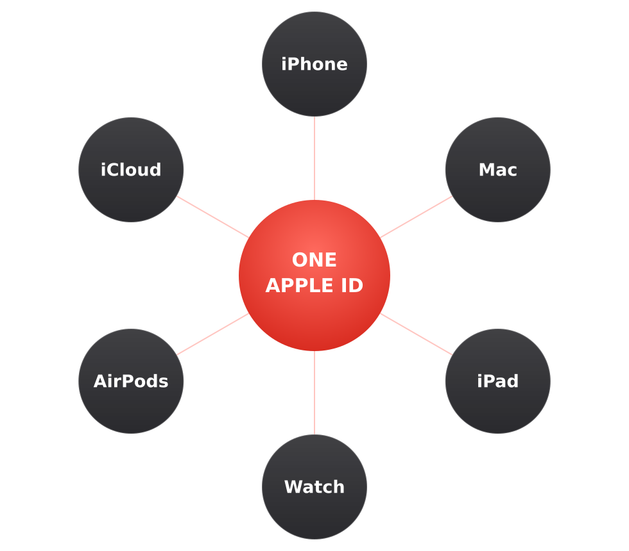

02 YASHVI
BRAND 1 · APPLE
Seamless
Ecosystem
One connected ecosystem where Apple devices work together effortlessly.
The USP is not any single device — it is what happens when you own two of them.
Every device signs in with one Apple ID — that is what makes the hand-offs feel automatic.
Apple vs Samsung · USP Analysis
06
Notes:
Apple’s USP in three words: the seamless ecosystem. The centre of the diagram is one Apple ID — that single sign-in is the mechanism that makes everything else work.

Slide 7






BRAND 1 · APPLE
02 YASHVI
The five proof points
iPhone + Mac + iPad
AirDrop
Continue tasks across devices with Handoff — start on one, finish on another.
Instantly share photos, files and content between nearby Apple devices.
iCloud
AirPods
Keeps photos, files and data synced, so every device shows the same thing.
Seamless connection that switches between Apple devices automatically.
Apple Watch
What makes it unique?
Stay connected without constantly reaching for your phone.
Apple sells an integrated experience — not just individual devices.
Apple vs Samsung · USP Analysis
07
Notes:
Five concrete proof points. Each one is small on its own; together they are the reason people stay.

Slide 8



BRAND 1 · APPLE
02 YASHVI
In the product and in the branding
IN THE PRODUCT
IN THE BRANDING
Devices set each other up — sign in once, everything follows
The same apps, layout and gestures on every screen
Files, messages and photos appear on all devices without being sent
Accessories pair themselves instead of being paired
Adverts show devices being used together, not spec sheets
One design language across the whole family of products
Stores are laid out as one connected table of products
Every launch is framed as an addition to the ecosystem
REAL-WORLD EXAMPLES
Start an email on iPhone, finish it on Mac
AirDrop holiday photos to a friend in seconds
Answer a call on your Watch with the phone in your bag
Apple vs Samsung · USP Analysis
08
Notes:
The USP is not only engineered into the product — it also decides how Apple advertises and how its stores are laid out.

Slide 9


BRAND 1 · CONSUMER PERSPECTIVE
03 NISHITA
Why the ecosystem appeals to buyers
It removes small, daily frustrations
No cables, no transfers, no re-typing passwords. The annoyance simply disappears.
"It just works."
It is easy for non-technical users
Nothing has to be set up. Convenience arrives by default, not by configuration.
This is the promise the ecosystem makes — and the reason customers accept a higher price for it.
Value grows with every extra device
The second and third Apple product make the first one better — so buying again feels logical.
THE BUYER IT SUITS
Someone who values simplicity, consistency and time saved more than customisation or a lower price.
It builds trust and habit
Once the routine works, switching feels like a risk rather than an upgrade.
Apple vs Samsung · USP Analysis
09
Notes:
The appeal is emotional as much as functional — it is about the friction that never happens.

Slide 10


BRAND 1 · CONSUMER PERSPECTIVE
03 NISHITA
Strengths, weaknesses, verdict
STRENGTHS
WEAKNESSES
Genuinely hard for a rival to copy — it needs the whole product family
Convenience is felt every single day, not just at purchase
Supports a premium price without discounting
Turns one purchase into repeat purchases
The benefit only appears once you own more than one Apple device
Higher entry price than many rival options
Less customisation and fewer form-factor choices
Leaving the ecosystem later feels costly — some buyers resent that
DIFFERENTIATION VERDICT
Very effective. Rivals can match a camera or a chip in one product cycle — they cannot quickly build a whole family of devices that already talk to each other.
Apple vs Samsung · USP Analysis
10
Notes:
Be honest about the weaknesses — the lock-in that is a strength for Apple is exactly what some buyers dislike.

Slide 11

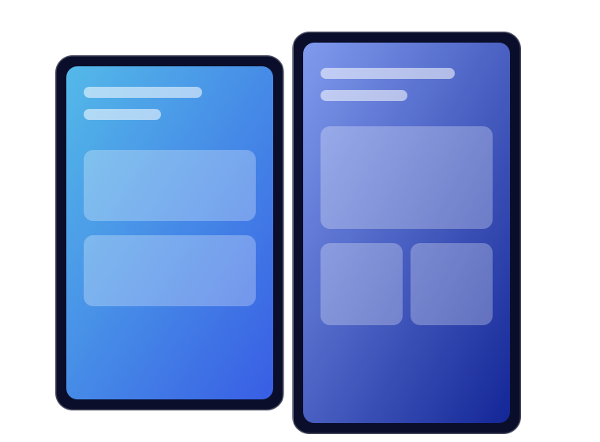

04 AARYA
BRAND 2 · SAMSUNG
Innovation,
Smart Tech
& Choice
Samsung differentiates itself by combining innovative technology, intelligent features and a wide range of product choices.
Where Apple narrows the choice, Samsung widens it.
The Galaxy Z Fold and Z Flip: hardware that changes shape — the clearest signal of Samsung’s innovation claim.
Apple vs Samsung · USP Analysis
11
Notes:
Samsung’s USP has three parts working together — innovation, smart technology and choice. Nothing is locked to a single price point.

Slide 12


BRAND 2 · SAMSUNG
04 AARYA
Three pillars, one proposition
Innovation
Smart Technology
Wide Choice
Samsung introduces new and unique smartphone designs.
Galaxy AI makes everyday tasks easier and more convenient.
Smartphones in different designs, features and price ranges.
EXAMPLES
EXAMPLES
EXAMPLES
Galaxy Z Fold — a phone that opens into a tablet
Galaxy Z Flip — a flagship that folds in half
New form factors before the rest of the market
Photo Assist — edit images instantly
Writing Assist — rewrite and summarise
Interpreter — live translation
Now Brief — a daily summary
Galaxy S series — flagship performance
Galaxy A series — accessible pricing
Galaxy Z series — foldable form factors
Apple vs Samsung · USP Analysis
12
Notes:
Each pillar has its own evidence. Innovation is the hardware, smart technology is Galaxy AI, and choice is the three-series line-up.

Slide 13
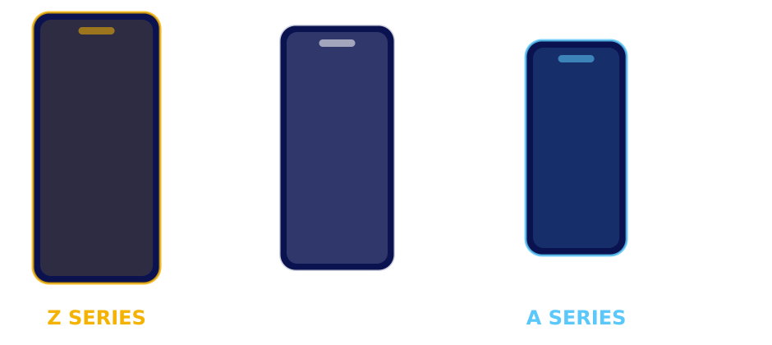
BRAND 2 · SAMSUNG
04 AARYA
In the product and in the branding
IN THE PRODUCT
IN THE BRANDING
Foldable screens that change what a phone can be
Galaxy AI features built into the everyday apps
A model at almost every price point and screen size
Launch events lead with the newest form factor
Advertising demonstrates AI features in real situations
Campaigns run across every tier, not only the flagship
ONE USP, THREE PRICE TIERS
The same promise — new technology, your choice of shape and budget — is repeated at every level of the range. A student and a flagship buyer are both being sold "choice".
Apple vs Samsung · USP Analysis
13
Notes:
Samsung repeats one message across three price tiers — that is how the choice pillar becomes visible in marketing.

Slide 14

BRAND 2 · CONSUMER PERSPECTIVE
05 VENESA
Why Samsung’s USP appeals to buyers
A phone at every budget
From the value A series to the flagship S series — consumers are not forced into one price.
More options,
more new ideas.
Genuinely new hardware
Foldable phones give buyers something they simply cannot get from a conventional slab phone.
Samsung appeals through innovation, variety and advanced features — and offers phones across price ranges, giving consumers more choice than Apple.
AI that helps with real tasks
Photo Assist, Writing Assist, Interpreter and Now Brief make everyday jobs quicker.
THE BUYER IT SUITS
Someone who wants the newest technology, room to customise, and a phone that fits their budget.
Freedom to customise
Displays, cameras and software settings can be tailored to how the owner actually uses the phone.
Apple vs Samsung · USP Analysis
14
Notes:
Samsung’s appeal is about breadth — features people want to try, at a price they can reach.

Slide 15
BRAND 2 · CONSUMER PERSPECTIVE
05 VENESA
Strengths, weaknesses, verdict
STRENGTHS
WEAKNESSES
More variety across designs and price points
Innovative features and foldable form factors
Wider price range reaches far more buyers
Greater customisation for the owner
So many models that choosing becomes confusing
Features vary between models — the promise is inconsistent
A three-part USP is harder to remember than a single idea
Rivals can copy an individual feature quickly
HOW SAMSUNG DIFFERENTIATES ITSELF FROM APPLE
Apple focuses on a premium, simple, closely connected ecosystem. Samsung gives consumers more device options, more customisation and more experimental technology — variety and novelty instead of integration.
Apple vs Samsung · USP Analysis
15
Notes:
Overall: Samsung suits buyers who want variety, customisation and the latest features; Apple suits buyers who value premium experience, simplicity and integration.

Slide 16
USP COMPARISON
06 SIMRAN
Head to head, on our four criteria
Scored out of five. This is our team’s assessment of the two propositions — a judgement, not market research data.
CRITERION
APPLE · SEAMLESS ECOSYSTEM
SAMSUNG · INNOVATION & CHOICE
Uniqueness
4/5
5/5
Structurally hard to copy, but the idea itself is well known
Foldable hardware is the most visibly new thing in the category
Customer value
5/5
4/5
Saves time and effort every single day
Great when a feature is used — but not every buyer uses them
Memorability
5/5
3/5
One idea, one sentence: everything works together
Three ideas at once are harder to repeat back
Differentiation
5/5
3/5
Nobody else owns a whole connected device family
Individual features get matched by rivals within a cycle
TOTAL
19 / 20
15 / 20
Apple vs Samsung · USP Analysis
16
Notes:
Samsung actually wins uniqueness — foldables are the newest thing on a shop shelf. Apple wins everything else, and wins memorability and differentiation decisively.

Slide 17





06 SIMRAN
THE VERDICT
It is one idea, not three
"Everything works together" survives one hearing. "Innovation, smart technology and choice" does not.
The stronger USP:
Apple’s Seamless Ecosystem
It compounds instead of resetting
Each new Apple device makes the existing ones more useful. A new Samsung feature starts the argument again.
Samsung out-innovates Apple on hardware. But a USP is judged on whether customers can name it, feel it and fail to find it elsewhere.
It cannot be matched feature by feature
A rival can build a foldable in one cycle. Building a family of devices that already trust each other takes years.
TEAM SCORECARD (SLIDE 16)
Apple 19/20 · Samsung 15/20
Apple vs Samsung · USP Analysis
17
Notes:
State the winner plainly and give three reasons. Credit Samsung for uniqueness so the verdict does not sound like fandom.

Slide 18



DEEPER ANALYSIS · THE WINNING USP
07 MANN
Why the ecosystem keeps winning
The value compounds
It raises the cost of leaving
It sells a feeling, not a feature
One device is a good product. Two devices become a system. Each purchase increases the value of the ones already owned — so the advantage grows over time instead of resetting each launch.
Switching away does not mean losing one phone — it means losing the hand-offs, the shared files and the habits built around them. That keeps customers without needing a discount.
Specifications are compared; experiences are remembered. "It just works" is the kind of claim customers repeat to each other, which turns owners into advocates.
THE EVIDENCE, IN EVERYDAY TERMS
Handoff: the task follows you between devices
AirDrop: sharing needs no app, account or cable
iCloud: the same photo is already on every screen
Apple vs Samsung · USP Analysis
18
Notes:
Three mechanisms, then the everyday evidence. The point: this advantage is structural, not a marketing line.

Slide 19


DEEPER ANALYSIS · BRIDGE TO THE ADVERTISING
07 MANN
How this USP should be communicated
What the ad must SAY
What the ad must MAKE YOU FEEL
Everything you own works together — with nothing to set up.
Relief. The small daily frictions simply are not there any more.
What the ad must PROVE
Why AUDIO suits this USP
Show a hand-off happening: one action, two devices, no explanation needed.
The idea is a sequence of moments, so it can be sung. Sound can travel between devices in a way a still image cannot.
Over to Gouraksh — who turns this brief into a fifteen-second jingle.
Apple vs Samsung · USP Analysis
19
Notes:
This slide is the handover: it converts the analysis into a creative brief the next speaker can act on.

Slide 20







08 GOURAKSH
AUDIO ADVERTISEMENT
"One Tap Away"
A fifteen-second jingle. Each line is one device picking up where the last one left off — the music never stops, and neither does the task.
Line 1 = Handoff
THE LYRICS
The task moves between devices without stopping.
Line 2 = AirDrop
Phone to laptop — tap, it’s there,
Photos flying through the air.
Watch on wrist, buds in your ear,
Everything you love stays near.
Apple. One world, one tap away.
Sharing sounds effortless because it is described as flying.
Line 3 = Watch + AirPods
The companion devices join the same sentence.
Line 4 = the payoff
"Stays near" is the emotional promise of the ecosystem.
PERFORM OR PLAY THE JINGLE HERE
Apple vs Samsung · USP Analysis
20
Notes:
Introduce the idea, explain the structure, then perform or play the jingle. Afterwards, point out that every line maps to one ecosystem feature.

Slide 21

CONCLUSION
Samsung sells you
more products.
Apple sells you
one experience.
OUR TAGLINE
"One world.
One tap away."
That is why the seamless ecosystem is the stronger Unique Selling Proposition.
THANK YOU · QUESTIONS WELCOME
Isha · Yashvi · Nishita · Aarya · Venesa · Simran · Mann · Gouraksh
Notes:
Close on the contrast in one sentence, land the tagline, thank the audience and open for questions.

