Slide 1
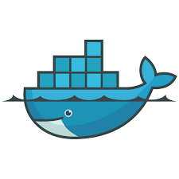
Docker
Topics to be covered:
Virtualization vs Containerization
Introduction to Docker
Why Docker?
Docker Architecture
Advantages of Docker
Docker Statistics & Facts
Use Cases
Sample Demo

Slide 2
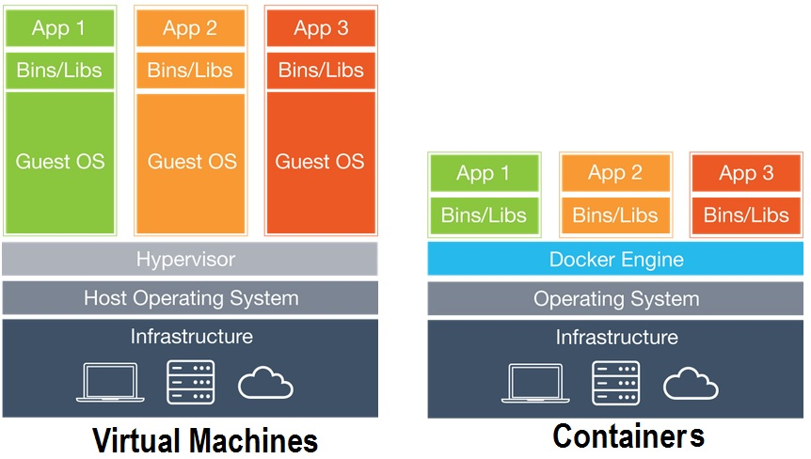
Virtualization vs Containerization

Slide 3
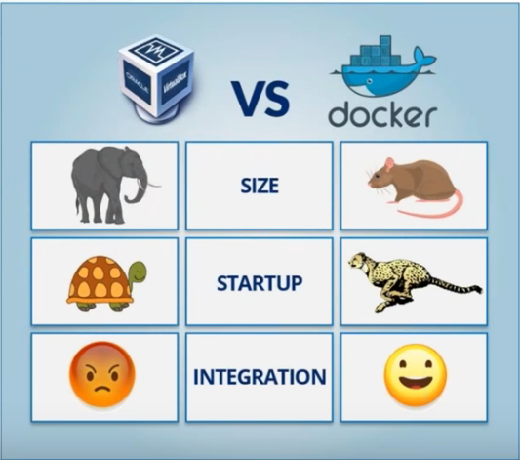
Docker vs Virtual System

Slide 4
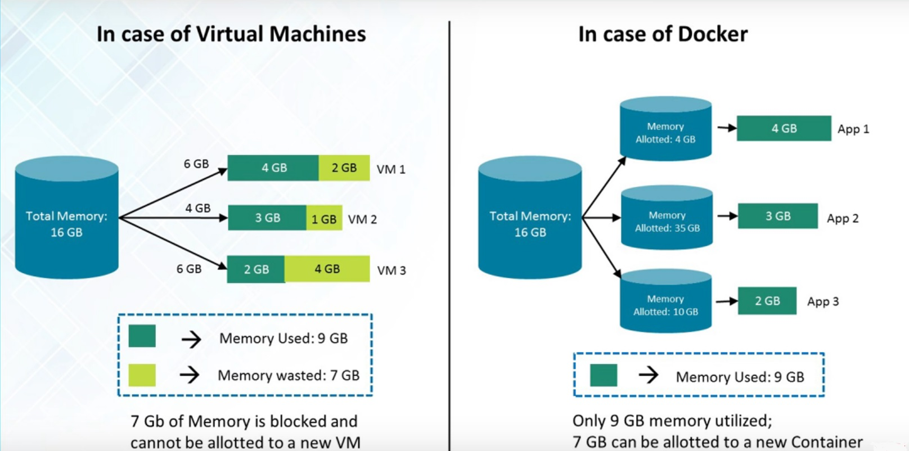
Docker vs Virtual System

Slide 5
Docker vs Virtual System
Docker | VM
Containers on the same OS kernel are lighter and smaller | Running multiple Virtual Machines leads to unstable performance
Better resource utilization compared to VMs | Hypervisors are not as efficient as the host operating system
Boot-up process is short and takes few seconds | Boot-up process is long and takes time

Slide 6
Introduction to Docker
Docker is a Containerization platform which packages your application and all its dependencies together in the form of Containers so as to ensure that your application works seamlessly in any environment be it Development or Test or Production.
Docker is an open-source project that automates the deployment of applications inside software containers, by providing an additional layer of abstraction and automation of operating system–level virtualization on Linux.
Docker is a tool that can package an application and its dependencies in a virtual container that can run on any Linux server. This helps enable flexibility and portability on where the application can run, whether on premises, public cloud, private cloud, bare metal, etc.

Slide 7
Why Docker?
Low Cost:
Provide a simple model for implementing complex enterprise integration solutions.
Facilitate asynchronous, message-driven behavior within a Spring-based application.
Promote intuitive, incremental adoption for existing Spring users.
Resource Utilization:
Components should be loosely coupled for modularity and testability.
The framework should enforce separation of concerns between business logic and integration logic.

Slide 8
Why Docker?
Deploy everything:
Webapps
Backends
SQL, NoSQL
Big Data
Message queues and more…
Deploy almost everywhere:
Linux servers
VMs or bare metal
Kernel 3.8 (or RHEL 2.6.32).

Slide 9
Why Docker?
Deploy reliably & consistently:
If it works locally, it will work on the server
With exactly the same behavior
Regardless of versions
Regardless of dependencies

Slide 10
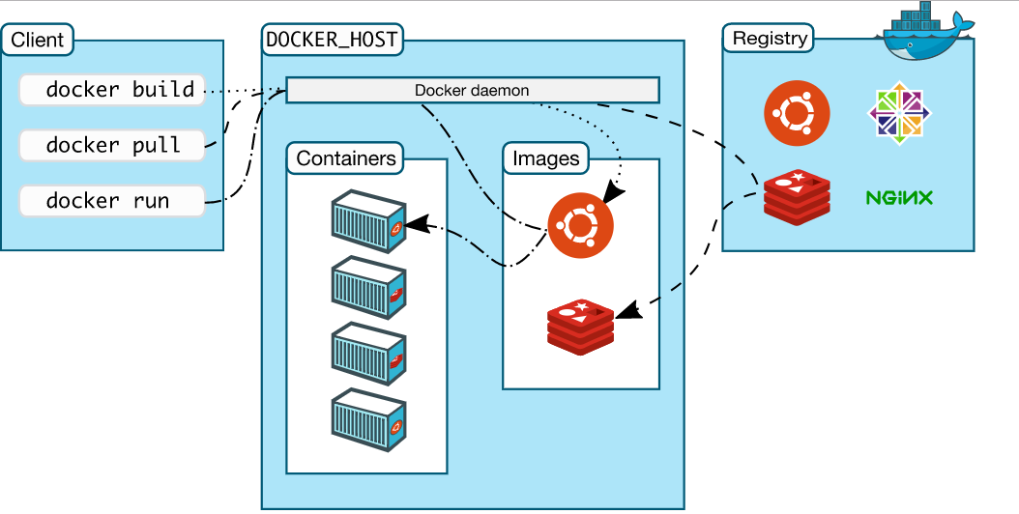
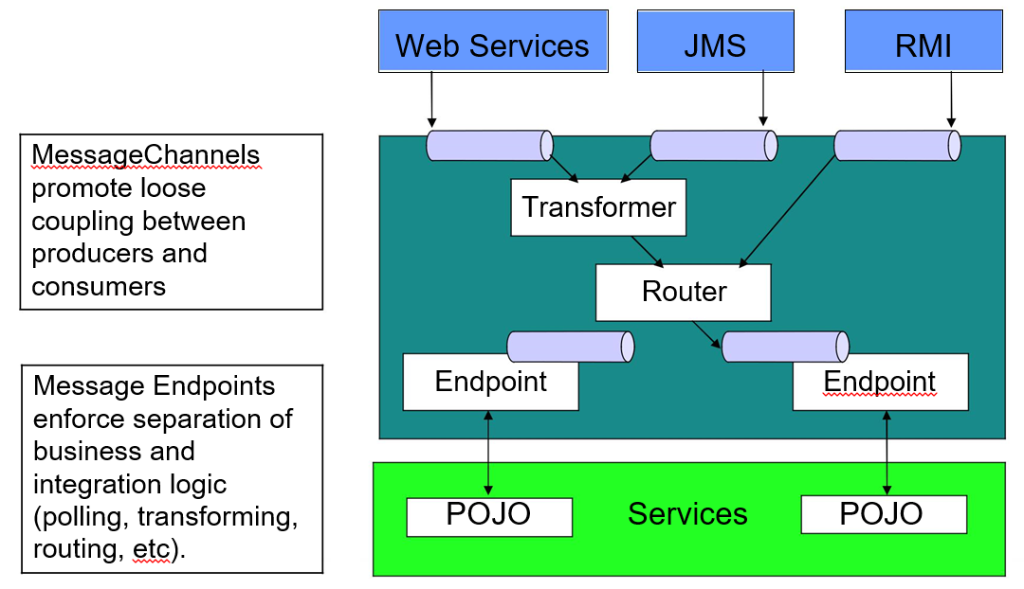
Docker Architecture

Slide 11
Docker Architecture
The underlying technology of Docker is written in Go and takes advantage of several features of the Linux kernel to deliver its functionality.
Docker uses a technology called namespaces to provide the isolated workspace called the container. When you run a container, Docker creates a set of namespaces for that container.

Slide 12
Docker Engine
Docker engine is the layer on which Docker runs. It’s a lightweight runtime and tooling that manages containers, images, builds, and more. It runs natively on Linux systems and is made up of:
A Docker Daemon that runs in the host computer.
A Docker Client communicates with the Docker Daemon to execute commands.
A REST API for interacting with the Docker Daemon remotely.

Slide 13
Docker Daemon
The Docker daemon is what actually executes commands sent to the Docker Client — like building, running, and distributing your containers.
The Docker Daemon runs on the host machine, but as a user, you never communicate directly with the Daemon.
The Docker Client can run on a different machine and communicate with the Docker Daemon that’s running on the host machine.

Slide 14
Docker Image
Images are read-only templates that you build from a set of instructions written in your Dockerfile. Images define both what you want your packaged application and its dependencies to look like *and* what processes to run when it’s launched.
The Docker image is built using a Dockerfile. Each instruction in the Dockerfile adds a new “layer” to the image, with layers representing a portion of the images file system that either adds to or replaces the layer below it. Layers are key to Docker’s lightweight yet powerful structure. Docker uses a Union File System to achieve this.

Slide 15
Dockerfile
A Dockerfile is where you write the instructions to build a Docker image. These instructions can be:
FROM - Specifies the base image that the Dockerfile will use to build a new image. For this post, we are using phusion/baseimage as our base image because it is a minimal Ubuntu-based image modified for Docker friendliness.
MAINTAINER - Specifies the Dockerfile Author Name and his/her email.
RUN - Runs any UNIX command to build the image.
ENV - Sets the environment variables. For this post, JAVA_HOME is the variable that is set.
CMD - Provides the facility to run commands at the start of container. This can be overridden upon executing the docker run command.
ADD - This instruction copies the new files, directories into the Docker container file system at specified destination.
EXPOSE - This instruction exposes specified port to the host machine.

Slide 16
Docker Containers
A Docker container wraps an application’s software into an invisible box with everything the application needs to run.
That includes the operating system, application code, runtime, system tools, system libraries, and etc. Docker containers are built off Docker images. Since images are read-only, Docker adds a read-write file system over the read-only file system of the image to create a container.
Docker Container
OS
Code
Run-time
System Tools
System Libs

Slide 17
Advantages of Docker
Continuous Deployment and Testing
Multi-Cloud Platforms
Environment Standardization and Version Control
Isolation
Portability across machines
Lightweight footprint and minimal overhead – Docker images are typically very small, which facilitates rapid delivery and reduces the time to deploy new application containers.

Slide 18
Docker commands
Runnable instance of an image
docker ps: List all running containers
docker ps –a: List all containers (incl. stopped)
docker start <container id>: Start a stopped container
docker stop < container id>: Stop a running container
docker pause: Pause all processes within a container
docker rm <continer id>: Delete a container
docker rmi <image id>: Remove the inactive image

Slide 19
Docker Statistics & Facts
2/3 of companies that try using Docker, adopt it. Most companies who will adopt have already done so within 30 days of initial production usage, and almost all the remaining adopters convert within 60 days.
At the beginning of March 2016, 13.6 percent of Datadog's customers had adopted Docker. One year later that number has grown to 18.8 percent. That's almost 40 percent market-share growth in 12 months.
Adopters multiply their containers by five. Docker adopters approximately quintuple the average number of running containers they have in production between their first and tenth month of usage.
PHP, Ruby, Java, and Node are the main programming frameworks used in containers.

Slide 20
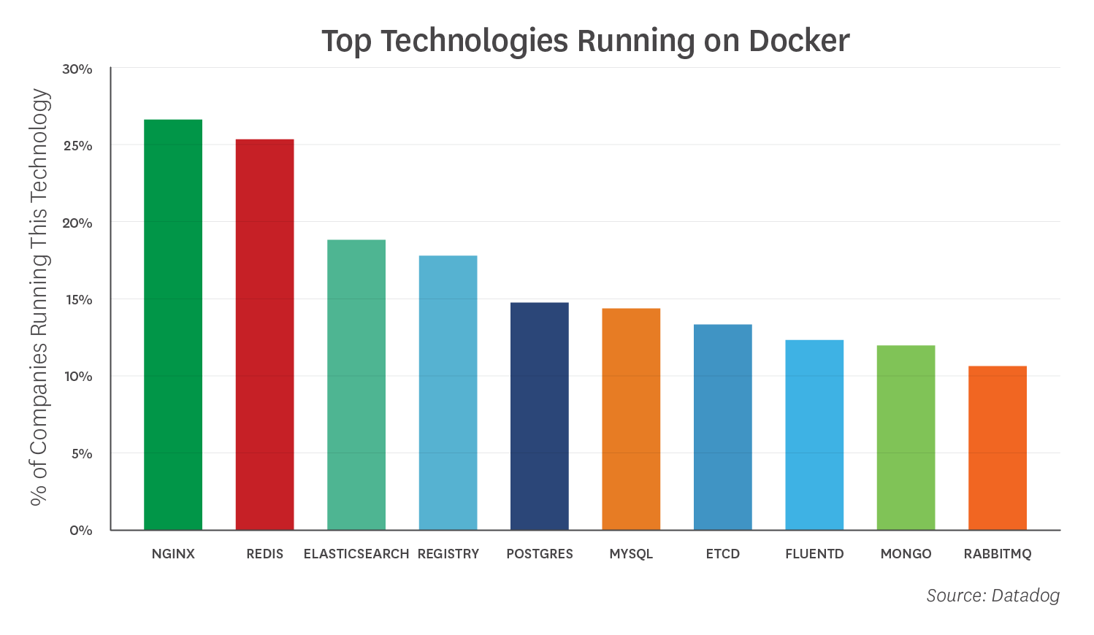
Top Technologies Running on Docker

Slide 21
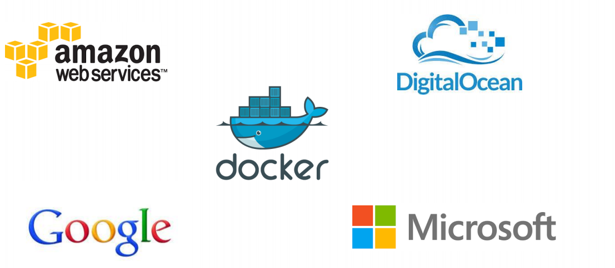
Docker supported in many Cloud platforms

Slide 22
Docker use cases
Simplifying Configuration
Code Pipeline Management
Developer Productivity
App Isolation
Server Consolidation
Debugging Capabilities

Slide 23
Thankyou

