Slide 1
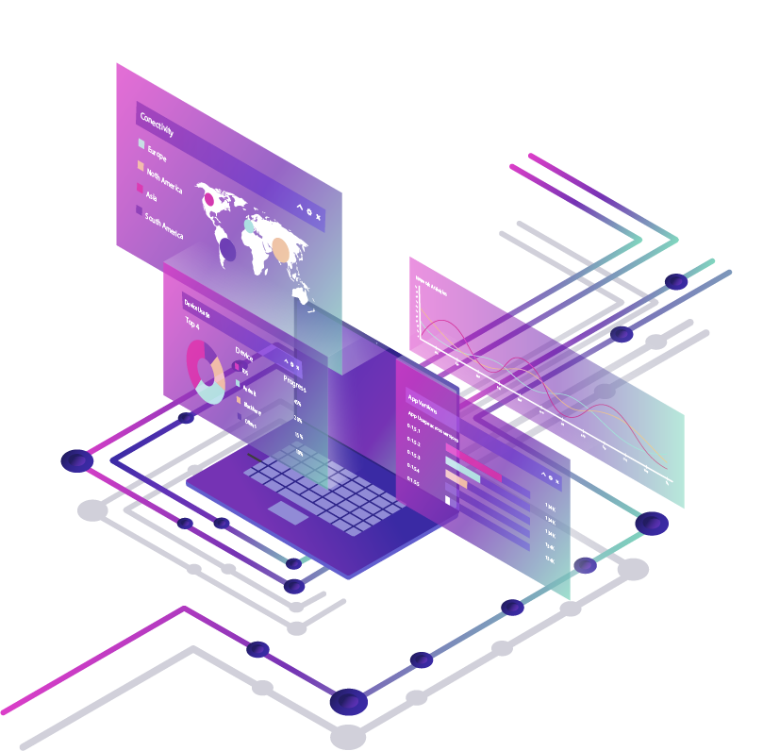
FOOD DELIVERY SYSTEM
Safety. Quality. Reliability.
IEEE Coders Week
Blockchain

Slide 2
IDEA
A food warehousing and delivery system to provide quality food which the users can rely on.
A blockchain which will contain information about every food item stored and delivered by a warehouse. As the food is brought to the warehouse an entry is made to the blockchain with information related to its shelf life, quality, the date of procurement, etc.

Slide 3
HOW BLOCKCHAIN STORES THE DATA
Each raw material brought is grouped and assigned an unique batch id.
Each batch is made into a transaction with it’s details.
Transactions of each day is made into a block for uploading to the chain.
The users will be able to retrieve the data using the batch id of the product they purchased.

Slide 4

SCALABILITY
The data can be used to train a ML model to predict it’s demand to maximise the profit and eliminate the wastage of raw materials due to the prolonged storage.

Slide 5


THANKS
—RAHUL SUNIL
I would like to thank IEEE coders week for giving me a solid introduction into blockchain.

