Slide 1
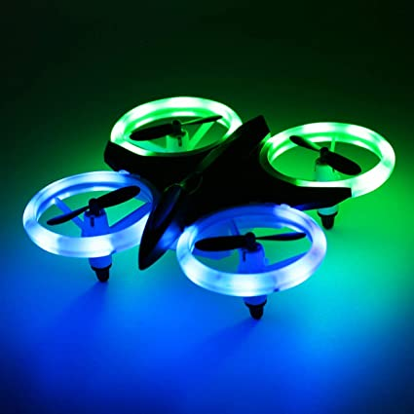
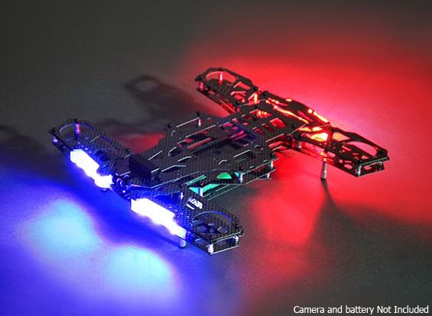


Hybrid-X Frame
More optimal arm placement
01
Easy maneuvering
02
More Lift -> More pay Load
03
X-FRAME
H-FRAME
HX FRAME

Slide 2


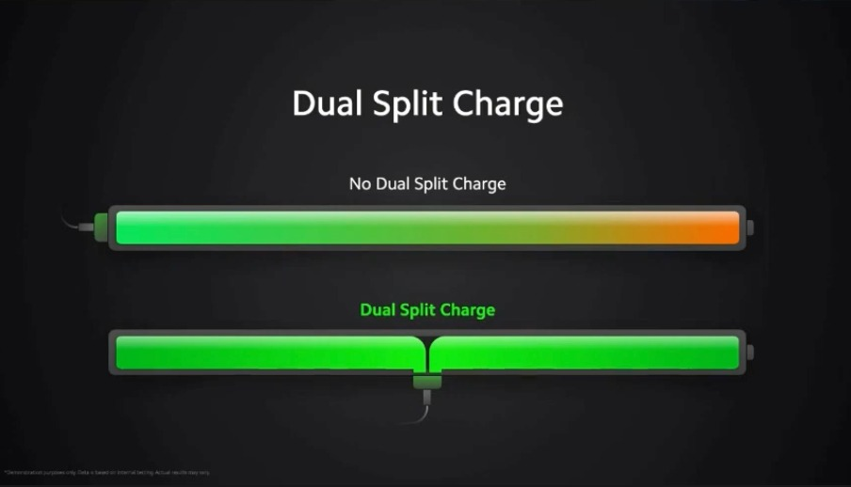

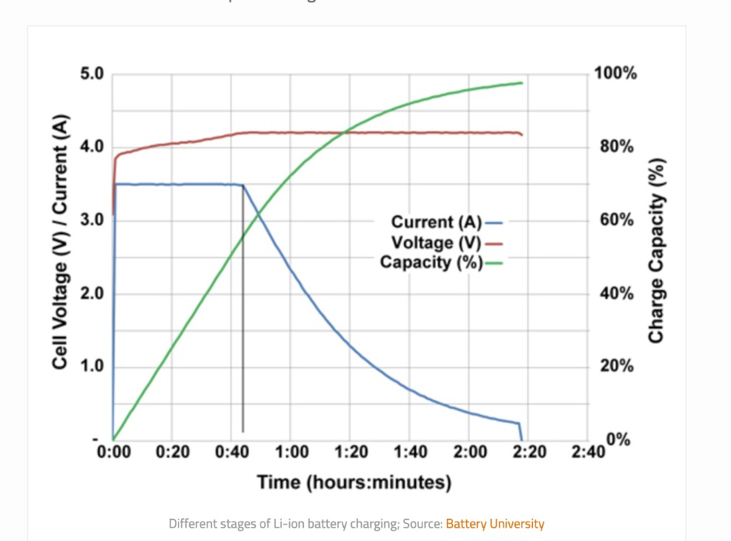
Dual battery
Reduces the weight
Fast charging
Increased current capacity

Slide 3


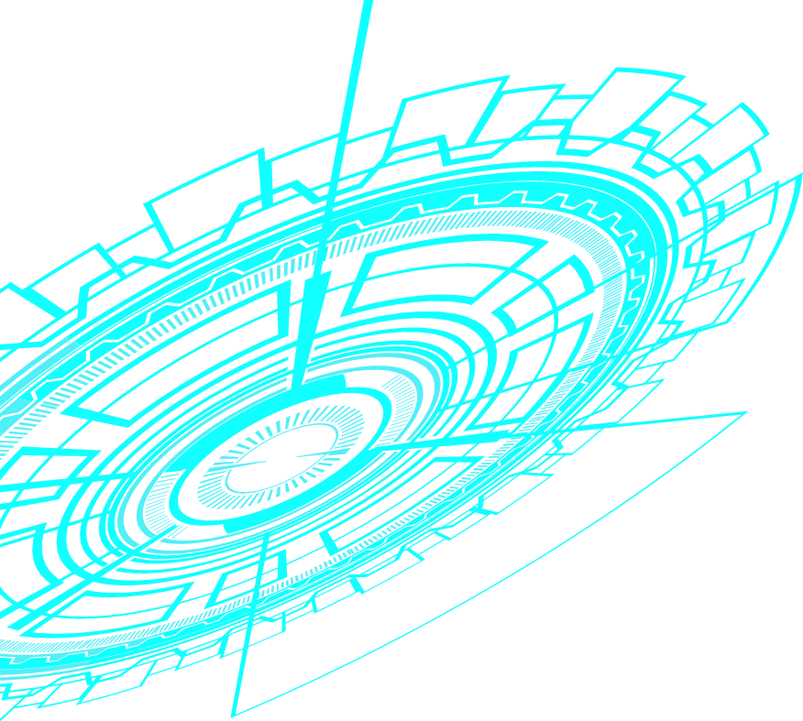
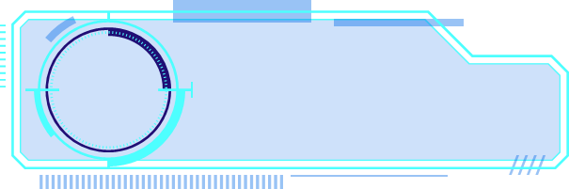



Derminal-denticles
Reduces the drag

