Slide 1
Introduction of SQL DML Commands & VIEW
BY GURUNATH DML
BY RAHUL VIEW
BY Preshita VIEW
Notes:
1

Slide 2
DML Commands
SELECT
INSERT
UPDATE
DELETE
Notes:
2

Slide 3
Introduction
DML stands for ''data manipulation language. '' It's a set of SQL statements that act on the data within a table. Select, insert, update, and delete are elements of this language. You'd use these elements when you want to retrieve a portion of, add data to, change data within, or delete data from a table.
20XX
presentation title
3
Notes:
3

Slide 4
SELECT SELECT command or statement in SQL is used to fetch data records from the database table and present it in the form of a result set. It is usually considered a DQL command, but it can also be considered a DML. SELECT customerName, phone, city,state FROM customers;
Notes:
4

Slide 5
INSERT INSERT commands in SQL are used to insert data records or rows in a database table. In an INSERT statement, we specify both the column_names for which the entry has to be made along with the data value that has to be inserted. INSERT INTO table_name (column1, column2, column3, ...) VALUES (value1, value2, value3, ...);
20XX
presentation title
5
Notes:
5

Slide 6
UPDATE
UPDATE command or statement is used to modify the value of an existing column in a database table.
UPDATE table_name SET column1 = value1, column2 = value2, ... WHERE condition;
DELETE
DELETE statement in SQL is used to remove one or more rows from the database table. It does not delete the data records permanently. We can always perform a rollback operation to undo a DELETE command. With DELETE statements, we can use the WHERE clause for filtering specific rows.
DELETE FROM table_name WHERE condition;
20XX
presentation title
6
Notes:
6

Slide 7
View
A view is a database object that has no values. Its contents are based on the base table.
It contains rows and columns similar to the real table.
View is a virtual table created by a query by joining one or more tables.

Slide 8
Create view:
Syntax:
CREATE [OR REPLACE] VIEW view_name AS
SELECT columns
FROM tables
[WHERE conditions];

Slide 9
Updating a View
Unlike CREATE VIEW and DROP VIEW there is no direct statement to update the records of an existing view.
We can use the SQL UPDATE Statement to modify the existing records in a table or a view.
The SELECT clause may not contain the keyword DISTINCT.
The SELECT clause may not contain summary functions.
The SELECT clause may not contain set functions.
The SELECT clause may not contain set operators.
The SELECT clause may not contain an ORDER BY clause.
The FROM clause may not contain multiple tables.
The WHERE clause may not contain subqueries.
The query may not contain GROUP BY or HAVING.
Calculated columns may not be updated.
Syntax
UPDATE view_name
SET column1 = value1, column2 = value2...., columnN = valueN
WHERE [condition];

Slide 10
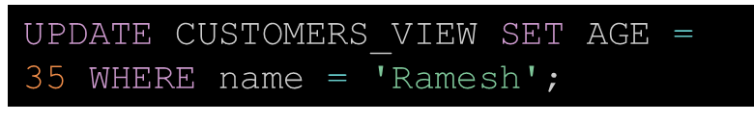
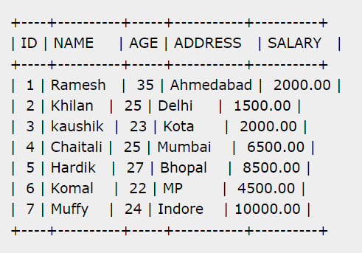
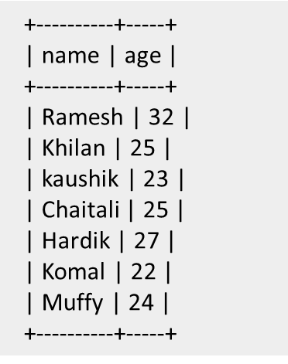
Updating a View

Slide 11

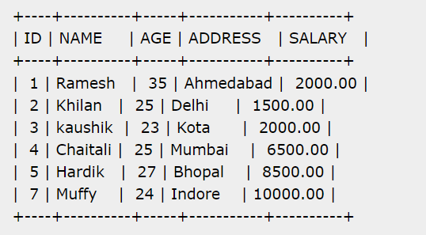
Deleting Rows into a View
Rows of data can be deleted from a view. The same rules that apply to the UPDATE and INSERT commands apply to the DELETE command.
DELETE FROM CUSTOMERS_VIEW WHERE age = 22;

Slide 12
Dropping Views
Obviously, where you have a view, you need a way to drop the view if it is no longer needed. The syntax is very simple and is given below −
DROP VIEW view_name;
DROP VIEW CUSTOMERS_VIEW;

Slide 13
Renaming a View
The RENAME TABLE statement in MySQL database is used to rename views.
You just have to make sure that the new name of the view does not overlap with the name of any existing views.
Syntax
RENAME TABLE old_view_name to new_view_name;

Slide 14
Thank You !!!

