Slide 1

Twitter Trend Analysis
By
Sankalp Nilekar
Sudeep Rawat
Rahul Verma
Under the Guidance Of
Prof. Pravin Rahate

Slide 2
oUTLINE
Twitter Trend analysis searches for the trends happening around the world and thus we can know about the things people are talking about or the things people are currently interested in talking.
What we do here in Twitter trend analysis is filter out the noise in the tweets and provide the user with the relevant information.
Twitter helps us to provide information instantaneously and thus it can be used to spread important information around the world without any delays and maximum coverage.
Using hashtags can help you reach an audience interested in a particular topic or in a particular location.
Twitter Trend Analysis helps us solve all these issues by filtering out the noise and displaying just the relevant information that is needed by the user.

Slide 3
iNTRODUCTION
Trends in social networks are of high significance and a major point of interest in both the industry and the research community.
Many applications on web and business can be immensely benefitted from knowing what is currently “trending”, which represents an answer to the age-old query what are people talking about.
From stock exchange making real-time decision to search engines delivering more updated, relevant search results. Twitter is one of the most popular social networking and micro-blogging service, which had more than 200 Million registered users by 2013, producing 400 Million tweets every day.
As a microblogging website it allows its users to create a short text message of 140 characters as their posts called “tweets”. There are also many different ways for users to update their tweets, including the mobile phone, web and text messaging tools and so on.
Twitter is also very real-time in nature. In pasts, several events were reported on twitter as news hours earlier than the mainstream media. Hence twitter is a very robust source for getting the real-time trends in the web.

Slide 4
Abstract
The community of users participating in social media tends to share about common interests at the same time, giving rise to what are known as social trends. A social trend reflects the voice of a large number of users which, for some reason, becomes popular in a specific moment.
Through social trends, users therefore suggest that some occurrence of wide interest is taking place and subsequently triggering the trend. In this work, we explore the types of triggers that spark trends on the microblogging site Twitter, and introduce a typology that includes the following four types: news, ongoing events, memes, and commemoratives.
The user will be allowed to search for the latest trends by inputting a keyword into search field. Based on user provided keyword, the system will search for similar keywords in database and summarize the total count to provide the trending tweets on twitter.
The trending tweets with hashtag (#) will be displayed first and then the rest words will be displayed. By clicking on every trending tweet, the user commented tweets will be displayed. User can view all the tweets from the searched keyword.

Slide 5
REVIEW OF LITERATURE
Paper Details | Methodology
Sensing Trending Topics in Twitter -Luca Maria Aiello -IEEE Transactions On Multimedia, Vol. 15, No. 6, October 2013. | Author compare six trend detection method and find that standard natural language processing technique perform well for social streams on particular topic.
Comparison of Machine Learning -Approaches on Twitter Trend Analysis -Altawaier -International Journal on Advanced Science, Engineering and Information Technology | The Authors have used one dataset with three algorithms and performance has been evaluated on the basis three different information retrieval metrics precision, recall, and f-measure.
Twitter Trending Topic Classification -Kathy Lee 2011 11th IEEE International Conference on Data Mining | Author proposed supervised learning techniques to classify twitter trending topic for that they use text based and network based classifier and conclude C5.0 gave best performance

Slide 6
Aim & objective
Creating a model to process real-time tweets feed to filter out the “noise” and output only relevant tweets.
Creating a system to store the social graph of twitter users such that it can be efficiently used as a data structure for answering various user queries and get relations for a given user.
To identify and get an insight on the popular trends trending on the social media.
To analyze and view tweets posted by the users on twitter.
To generate statistics for the data generated from the twitter.
To make use of the gathered data for reaching a larger audience and help improve company business.

Slide 7
PROPOSED SYSTEM
Using Twitter API to Collect Data
Input Data
Tweets
Extraction
Preprocess
Sorting of Data
Trend Detection

Slide 8
Dataset: Collect tweet data through twitter streaming API. Which download tweets in JSON format.
Pre-processing: Tweet pre-processing module having several stages. After downloading tweets we have to extract text data form that and discard video, audio, image etc. store English text which is retrieve form tweet.
Extraction: After pre-processing stage next module is Extraction which is done in two way through Term frequency calculation and pos tagging. We can view the Count, Strength etc. after the extraction of the data, which can therefore, be used to view tweets using similar hashtags from different users.
Trend Detection: We can determine trend by using TF-IDF calculation. And predict positive, negative, neutral mood tendency by applying machine learning algorithms. Show the graph for the given input by the user.

Slide 9
Enter Twitter Search
Twitter API
Export Data from Twitter
Processing of Tweet
Display the Tweet
View Tweet Statistics (eg. Count, Strength)
Generate Graph for tweet

Slide 10
The system comprises of 8 major modules with its description as follows:
Login: User need to login first using valid credentials to access the system.
Search for Latest Trends: After successful login, user can search for latest trending tweets by entering the keyword in the search column.
View Latest Trending Tweet: Based on user-inputted keyword, the search results will be displayed in form of trending tweets.
View Tweets: User can click on respective trending tweet to view the message twitted by other users.

Slide 11
View Location: We can check the locations from where the user has tweeted which can be further used to analyze the popularity of the hashtag at that particular location.
View Username: We can view the tweets as well as the username of the user who posted the tweet.
View Date and Time: The tweets are sorted according to the date and time which is in GMT(Greenwich Mean Time) by default.
View Top Trending Tweets in a particular Region: The Trends vary from region to region and it is required to display current trends in different regions. We can display the Top Trending Tweets from different Regions/Countries by entering the name of the desired country in the input box.

Slide 12
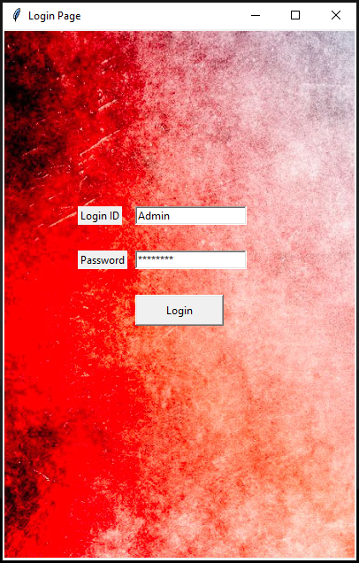
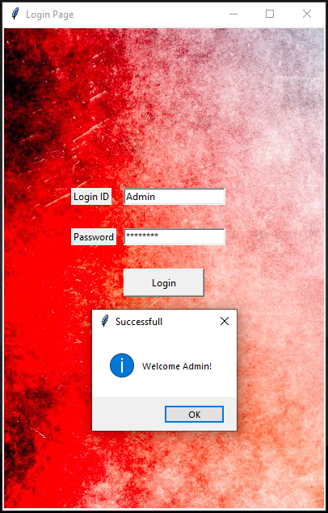
LOGIN PAGE:

Slide 13
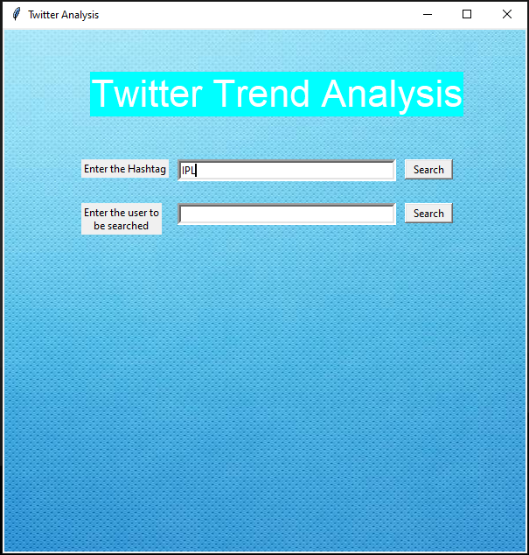
HASHTAG INPUT:

Slide 14
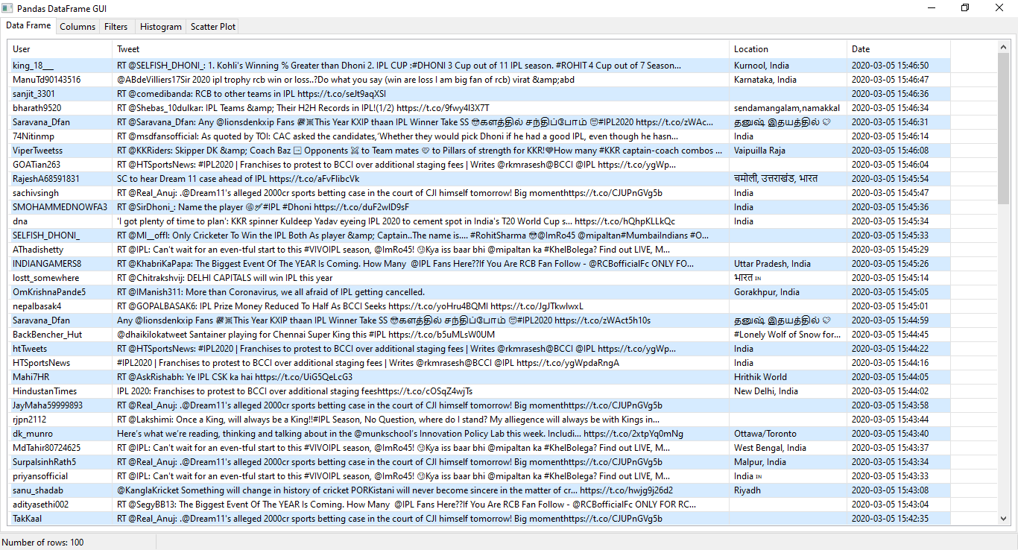

Slide 15
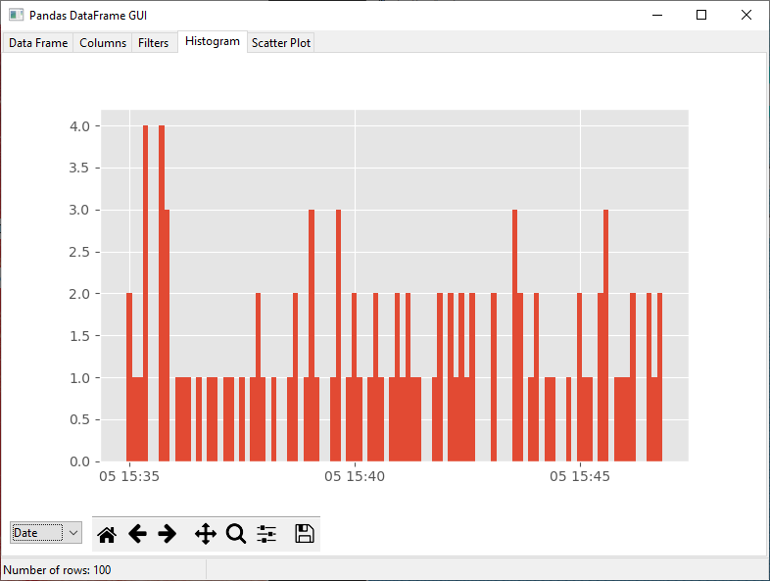
HISTOGRAM:

Slide 16
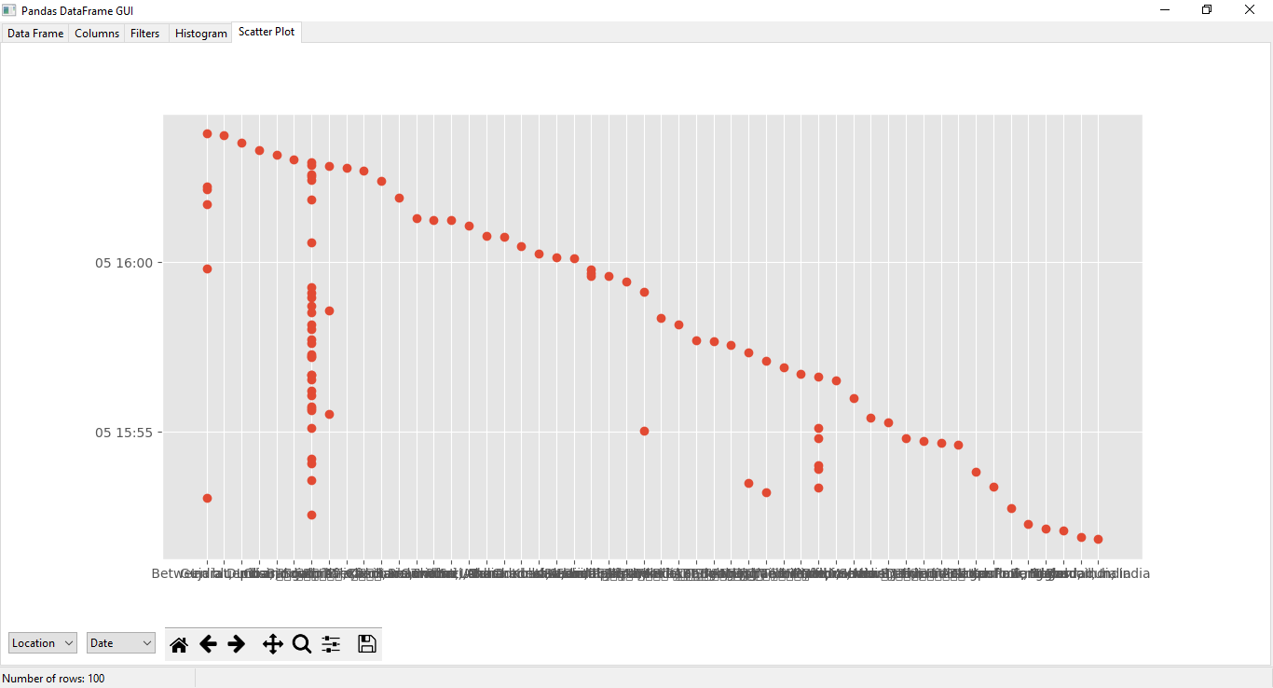
SCATTER PLOT:

Slide 17
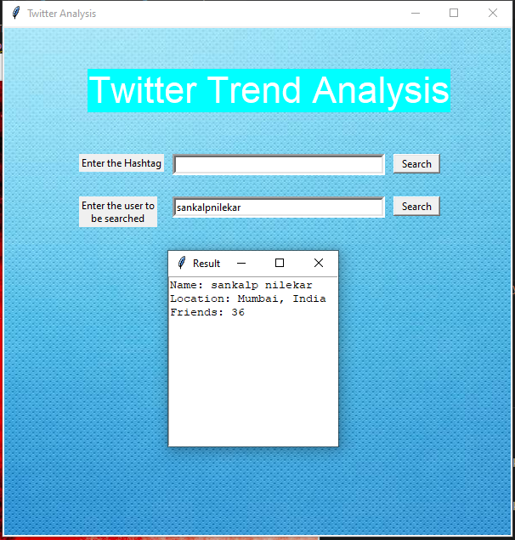
USER SEARCH:

Slide 18
Conclusion
The main contribution of this project report is to suggest a new unique way to analyze the trends in online social networks.
We have identified some of the features, which can help develop a model, which can be used to classify “trends” and “non-trends” in very early stages.
So, we will develop a highly scalable and efficient model to filter noise from tweets.
Also, this prediction model is generic enough to be applied to any social media network, which has a connection among users.
We will show that how by constructing evolving graphs for different topics and observing several topological properties of the graph we can distinguish “trend” from “non-trends” topics.

Slide 19
References
Luca Maria Aiello, Georgios Petkos, Carlos Martin, David Corney, Symeon Papadopoulos, Ryan Skraba, Ayse Göker, Ioannis Kompatsiaris, Senior Member “Sensing Trending Topics in Twitter” IEEE, and Alejandro Jaimes IEEE Transactions On Multimedia, Vol. 15, No. 6, October 2013.
Soyeon Caren Han, Hyunsuk Chung, Do Hyeong Kim, Sungyoung Lee, and Byeong Ho Kang “Twitter Trending Topics Meaning Disambiguation” Springer International Publishing Switzerland 2014.
Arkaitz Zubiaga, Damiano Spina, Raquel Mart´ınez, V´ıctor Fresno “Real-Time Classification of Twitter Trends” Journal of the American Society for Information Science and Technology copyright @ 2013.
Altawaier, M. M., & Tiun, S. (2016) “Comparison of Machine Learning Approaches on Arabic Twitter Sentiment Analysis” International Journal on Advanced Science, Engineering and Information Technology, 6(6), 1067-1073.
Rong Lu and Qing Yang, “Trend Analysis of News Topics on Twitter”, International Journal of Machine Learning and Computing Vol. 2, No. 3, June 2012

