Slide 1
PROJECT ON HOTEL MANAGEMENT USING C LANGUAGE
MADE BY:
RAHUL TEHRI [15CSU174]
RAHUL JINDAL [15CSU173]
RAJAN ARORA [15CSU175]

Slide 2
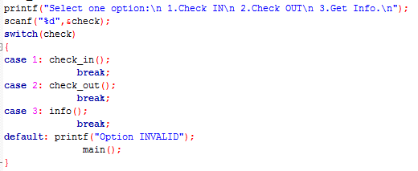
Features
It mainly allows the user to handle data related to the several clients/customers that check in to his/her hotel.
It consists of mainly three features:
Check In
Check Out
Display Information
It can further be enhanced to billing system.

Slide 3
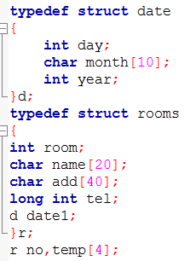
Concepts
It is mainly based on the concept of file handling in C Language.
All the data is being stored in or deleted from the file ‘hotel.txt’.
The data is being stored in the form of structure namely- rooms which consist elements of different data types as well as another structure- date as shown.
And then this structure( rooms ) is type defined using the keyword typedef as
typedef struct rooms
{
…………..
.………….
}r;

Slide 4
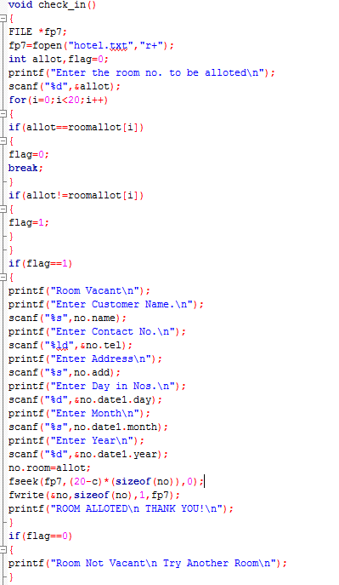
CHECK IN
This task is carried out using the function
void check_in();
It is the user defined function which performs the basic task of storing the information about the customer mainly:
Name
Address
Contact No.
Date
Room Alloted
It stores all the information in the file named ‘hotel.txt’ using fwrite function.

Slide 5
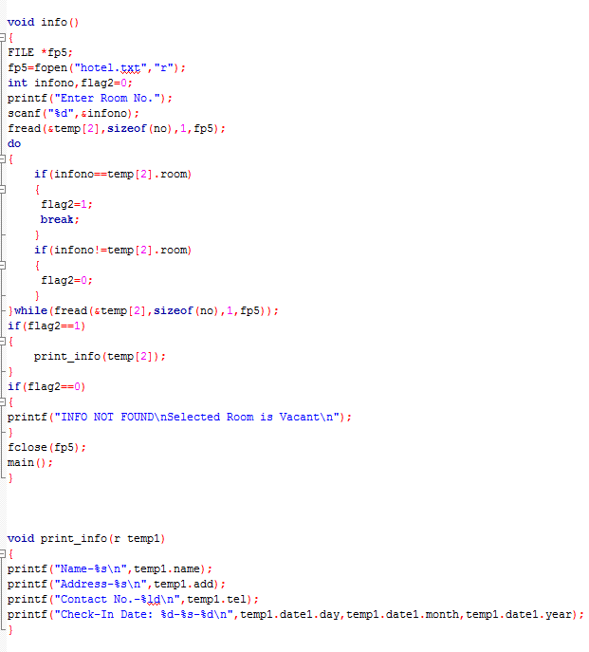
DISPLAY INFORMATION
This task is carried out using a user defined function
void get_info();
It carries out the task of displaying the information of a checked-in user.
It display all the information of the customer by scanning the ‘hotel.txt’ using fread function & displays the scanned information using function the user defined function
void print_info();
to display the information.

Slide 6
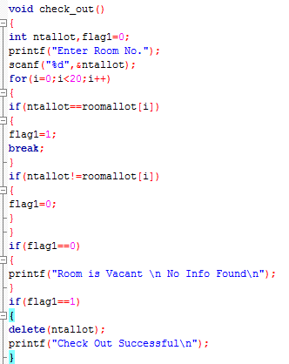
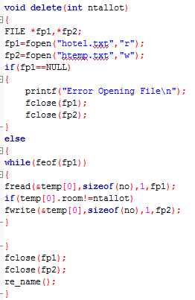
CHECK OUT
This task is carried out using another user defined fuction
void check_out();
It scans for the specific information which need to be deleted and perform this task using the function
void delete(int ntallot1);
where ntallot is the room no. of the customer whose information is to be deleted.

Slide 7
THANK YOU!
FOR NOT SLEEPIN’

