Slide 1
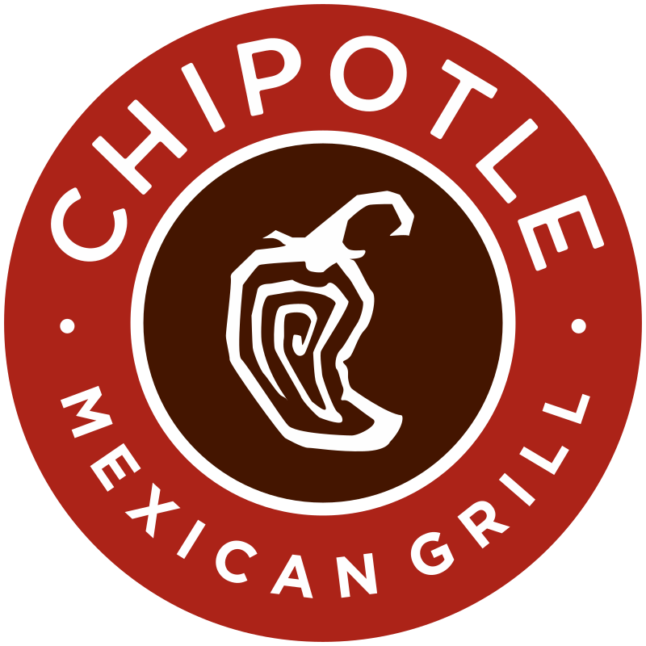
Chipotle’s Supply Chain
Management with RFID
-“Food with Integrity”
Sri Rayaleswar Mondrety
Rahul Teja Bolloju
Jaya Surya Thota

Slide 2
Introduction
Chipotle Mexican Grill, commonly known as Chipotle, is a popular American fast-food chain that specializes in Mexican cuisine.
Founded in 1993 by Steve Ells in Denver, Colorado.
Chipotle has been identified with a fresh and sustainable approach to fast food.

Slide 3
Overview
Focus: Evolution in response to "Food with Integrity."
Strategy: Local organic farmers -> controlled suppliers, digital tracking.
Challenges: Food safety, Brand reputation.
Adjustments: Safety training, Revised cooking procedures.
Technology: Digital tools for visibility and control.
Goal: Balance quality, Safety, and Ethical sourcing.
Notes:
In this presentation, we'll trace Chipotle's path from grassroots initiatives with local organic farmers to its current state, marked by collaboration with larger, controlled suppliers and the implementation of cutting-edge digital tools. We'll dive into the challenges faced—particularly in navigating food-borne illness risks—and the operational adjustments made, including intensified food safety training and technological integrations for enhanced supply chain visibility. Join us as we uncover the complexities, triumphs, and key takeaways from Chipotle's dynamic journey in supply chain management.

Slide 4
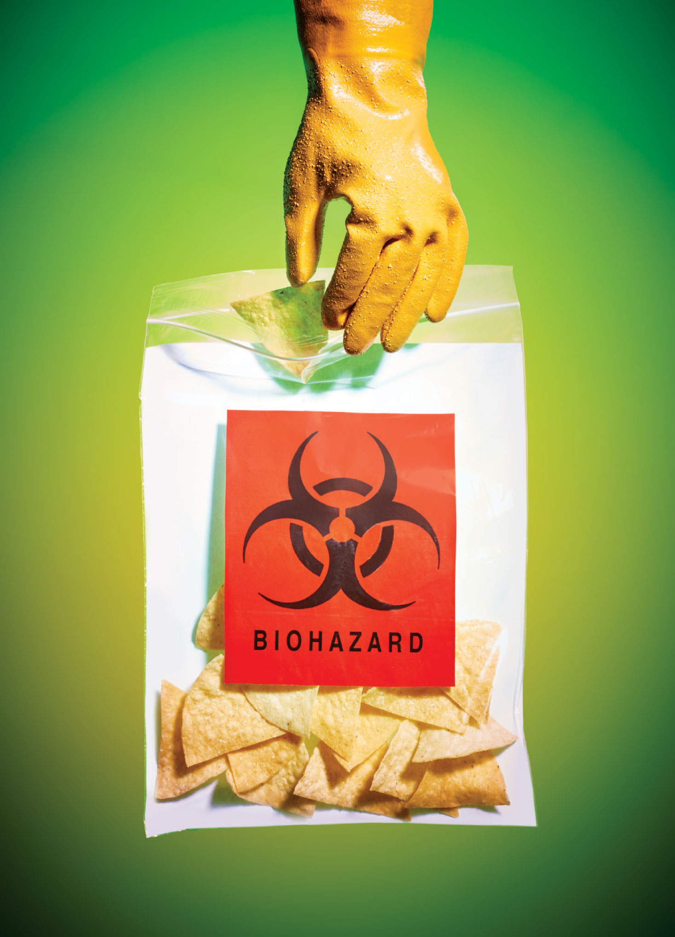
Crisis
In 2015, Chipotle experienced a series of foodborne illness outbreaks in various locations in the US.
The outbreaks involved cases of E. coli, norovirus, and other pathogens.
~700 cases were reported.
Chipotle responded by temporarily closing some stores and implementing rigorous new food safety measures.
Chipotle’s stock price tanked due to this incident.
These incidents received widespread media coverage, impacting Chipotle's reputation significantly.
Reasons for this outbreak was pinned on improper storage of food and lack of traceability of ingredients.
https://www.bloomberg.com/features/2015-chipotle-food-safety-crisis/

Slide 5
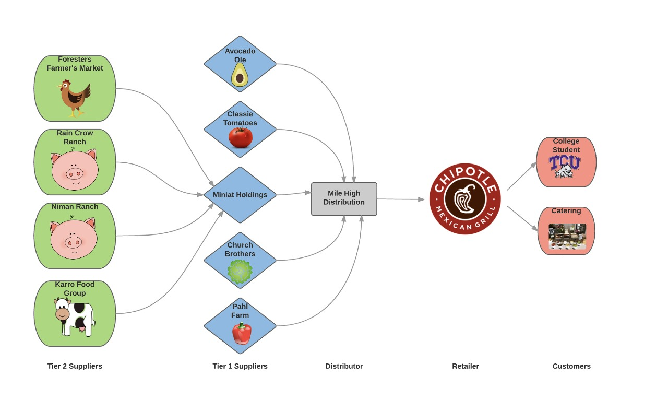
Generalized Old Supply Chain of Chipotle
Tier 2 Suppliers
Tier 1 Suppliers
Distributor
Retailer
Customers

Slide 6
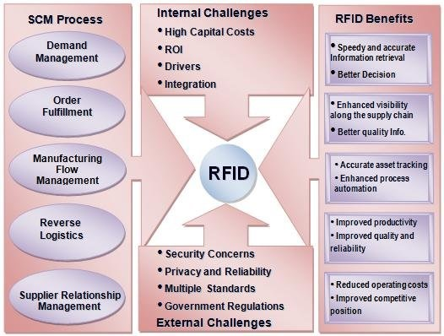
Embracing the Technology in Supply Chain : RFID
RFID, which functions similarly to smart bar codes, which automatically identify and track inventory, providing real-time snapshots across distribution centers and restaurants.
Since RFID technology works in conjunction with the current scanners in restaurants, integration costs are negligible.

Slide 7
Chipotle’s Implementation of RFID
Chipotle has a successful pilot program where it tested use of RFID technology to track ingredients in real time from suppliers to restaurants.
Chipotle tests ingredients with high-resolution DNA testing, surpassing state and federal requirements and industry standards.
This technology integration is enhancing employee experience at participating restaurants and benefiting our supply partners.
The RFID tags individually contain detailed information like origin, expiry date, time of ingestion into supply chain and handled by operators details.
Chipotle's use of RFID technology provides the company with a real-time view of its inventory throughout its distribution centers and restaurants. By leveraging Chipotle's RFID system, vendors can enhance their own inventory management processes and reduce the need for repetitive tasks.
https://medium.com/@AbhiXpert/in-air-gestures-recognition-using-rfid-tag-64a20749ecc8

Slide 8
Comparison
Old Supply Chain Management:
Local Sourcing:
Ingredients sourced from organic farmers within a 350-mile radius.
Close relationships with family-owned farms.
Challenges:
Faced risks of food-borne illnesses.
Unable to locate the source of the ingredients.
Forecasting demand was an issues and there were frequent items out of stock.
New Supply Chain Management:
Operational Changes:
Established a new supply chain team.
Made operational changes in response to food safety issues.
Safety Measures:
Increased food safety training frequency in restaurants.
Modified cooking and preparation procedures.
Efficiency Enhancements:
Introduced "Focus Prep" to minimize staff involved in food preparation.
Transitioned more preparation to a central kitchen, reducing in-store prep.
Technology Implementation:
Adopted digital supply chain tracking tools for better traceability.
Helped maintain Inventory better by automating the ordering process.
Supplier Shifts:
Moved away from exclusive reliance on small, local suppliers.
Focused on continuity, control, and animal welfare in supplier selection.

Slide 9
Research Question
Can integration of technologies like RFID into supply chains help companies better maintain their inventories and help them find root cause in case of an incident?

Slide 10
Conclusion
In the case of Chipotle after the food poisoning incident the implementation of RFID has helped the Chipotle maintain better inventory and had an additional benefits of traceability and now has the ability to hold any supplier accountable in case of an issue.

Slide 11
References
Inside Chipotle’s contamination crisis. (n.d.). Bloomberg.com. https://www.bloomberg.com/features/2015-chipotle-food-safety-crisis/
Expert Minds. (n.d.). Inside chipotle contamination crisis – article review assignment help. https://www.expertsminds.com/content/sample-paper/inside-chipotle-contamination-crisis-article-review-assignment-help-13335.html
Kline, D. B. (2018, July 10). Here's Everything Chipotle Has Done to Handle Its E. Coli Crisis; Is it Enough? The Motley Fool. https://www.fool.com/investing/general/2016/02/10/heres-everything-chipotle-has-done-to-handle-its-e.aspx
Littman, J. (2022, April 5). Chipotle tests RFID technology to improve food traceability. Supply Chain Dive. https://www.supplychaindive.com/news/chipotle-rfid-technology-food-traceability/621516/
Zimmerman, S. (2023, May 23). Chipotle prepares national rollout of RFID for food traceability. Supply Chain Dive. https://www.supplychaindive.com/news/chipotle-rfid-restaurant-inventory-tracking/650884/

