Slide 1
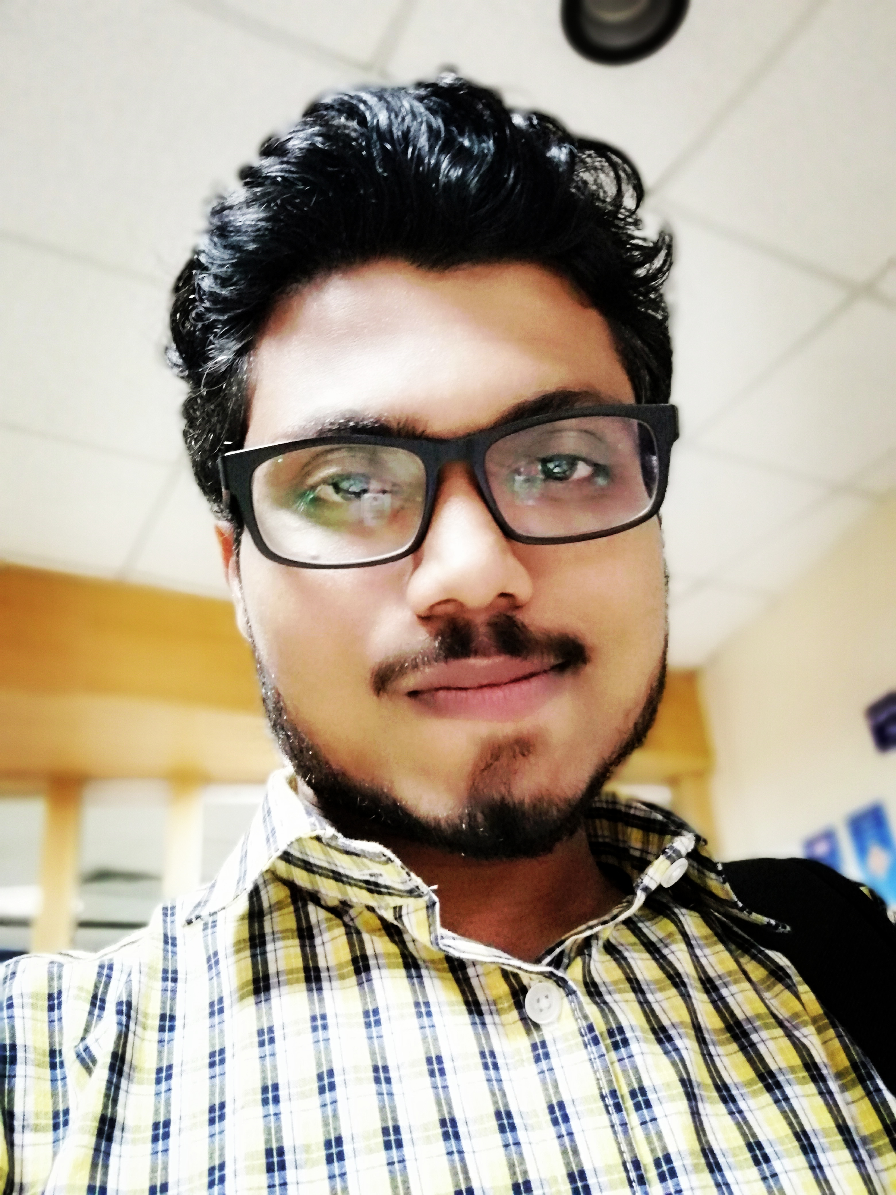
Rahul Digambar Thawri
Having 5 + years of comprehensive experience in Java/J2ee and web application development
Currently working with HCL Technologies Ltd. Pune as a Tech Lead
IT Experience in analysis, designing, implementation and maintenance of Software of Multi-tier enterprise level Web Applications using Java & J2EE related Technologies and Frameworks.
Hands on Experience in development of object-oriented business applications using Spring Framework, Spring Boot, Hibernate Configuration as well as Annotation Driven Approach.
Experience of developing Distributed Applications using SOAP (JAX-WS Apache-CXF) and Restful (JAX-RS RestEasy) based web services provider end in Enterprise Application Development.
Implementation Knowledge in Design Patterns like Strategy, Singleton, Factory Method
Experience in Log4j, Junit , SVN , Redmine , Maven , poi , iText , EH-Cache , Agile (Scrum).
B.E. (CE), Nagpur University, Nagpur, India, 2012
Programming Languages: Java J2ee Technologies: Spring and Spring Boot Distributed Technologies :- SOAP and Restful Front-end Technologies: JSP Devops tools: Jenkins Back-ends: Oracle and MongoDB Application Servers: Mobiliser, WebSphere and JBoss 7 Build and Packaging: Ant and Maven Project execution model: Agile Scrum and Waterfall Agile Tools: Jira and GIT ORM Technologies : Hibernate Project Management Tool :- Jira Version control :- Bit bucket, Gitlab

