Slide 1
AMBER Atom Type of any given PDB file

Slide 2
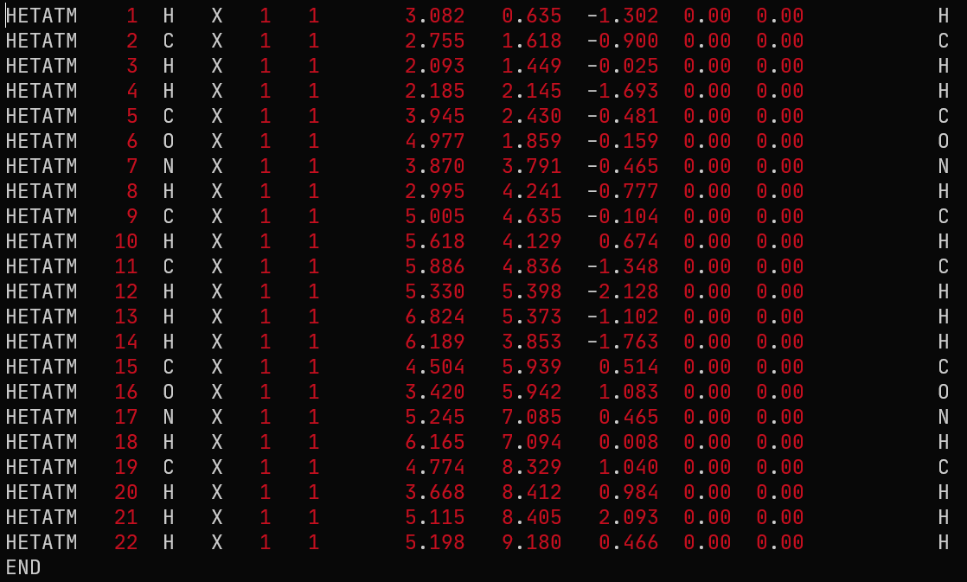
Two methods possible:
Gauss View
Amber ANTECHAMBER
Alanine Dipeptide PDB file

Slide 3
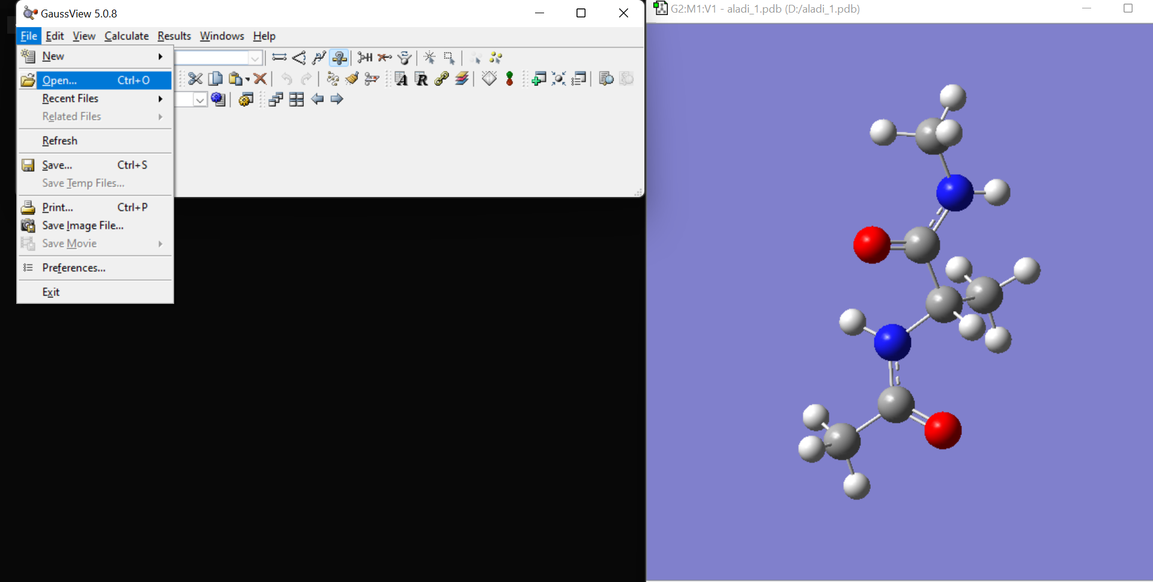
GaussView
Open PDB file

Slide 4
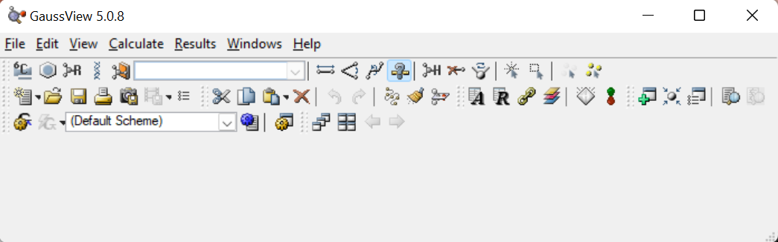
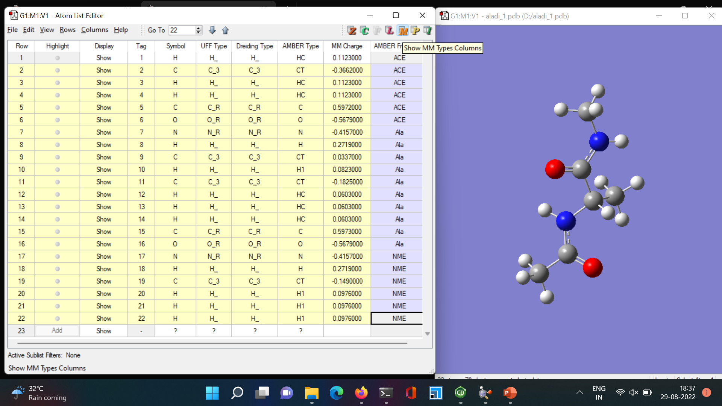
GaussView
Open Atom List Editor
Open Atom List Editor

Slide 5
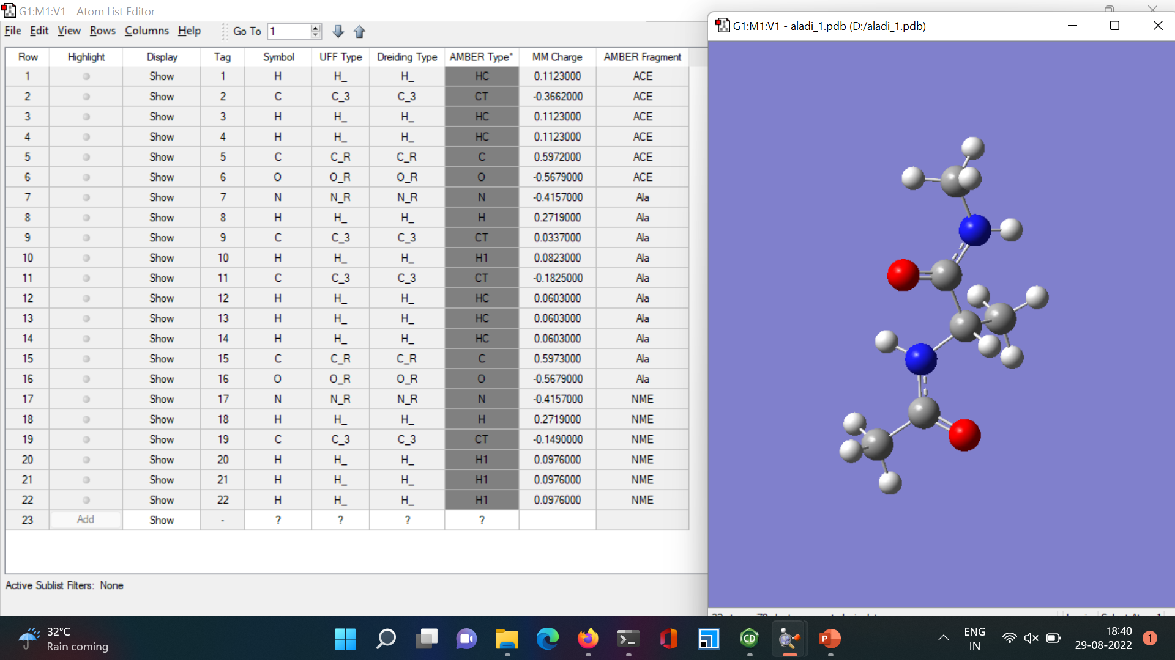
GaussView
AMBER atom type

Slide 6
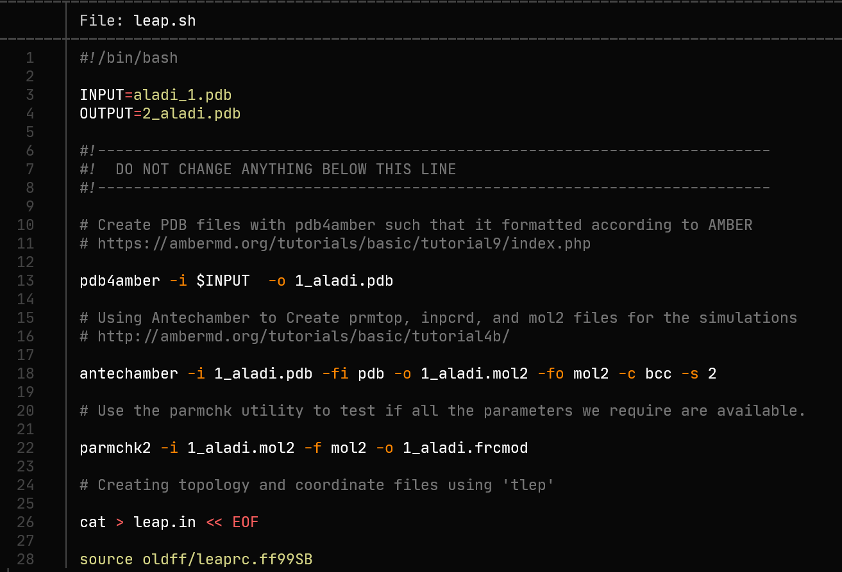
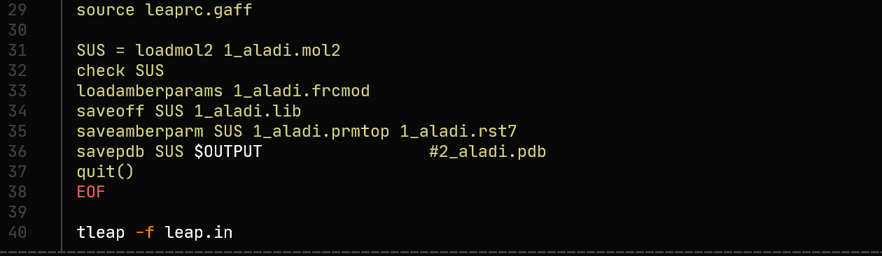
AMBER Antechamber Module
A ‘bash’ script file in given
Execute ‘leap.sh’ file as bash (chmod 755 leap.sh)
Make sure AMBER is sourced in the path.

Slide 7
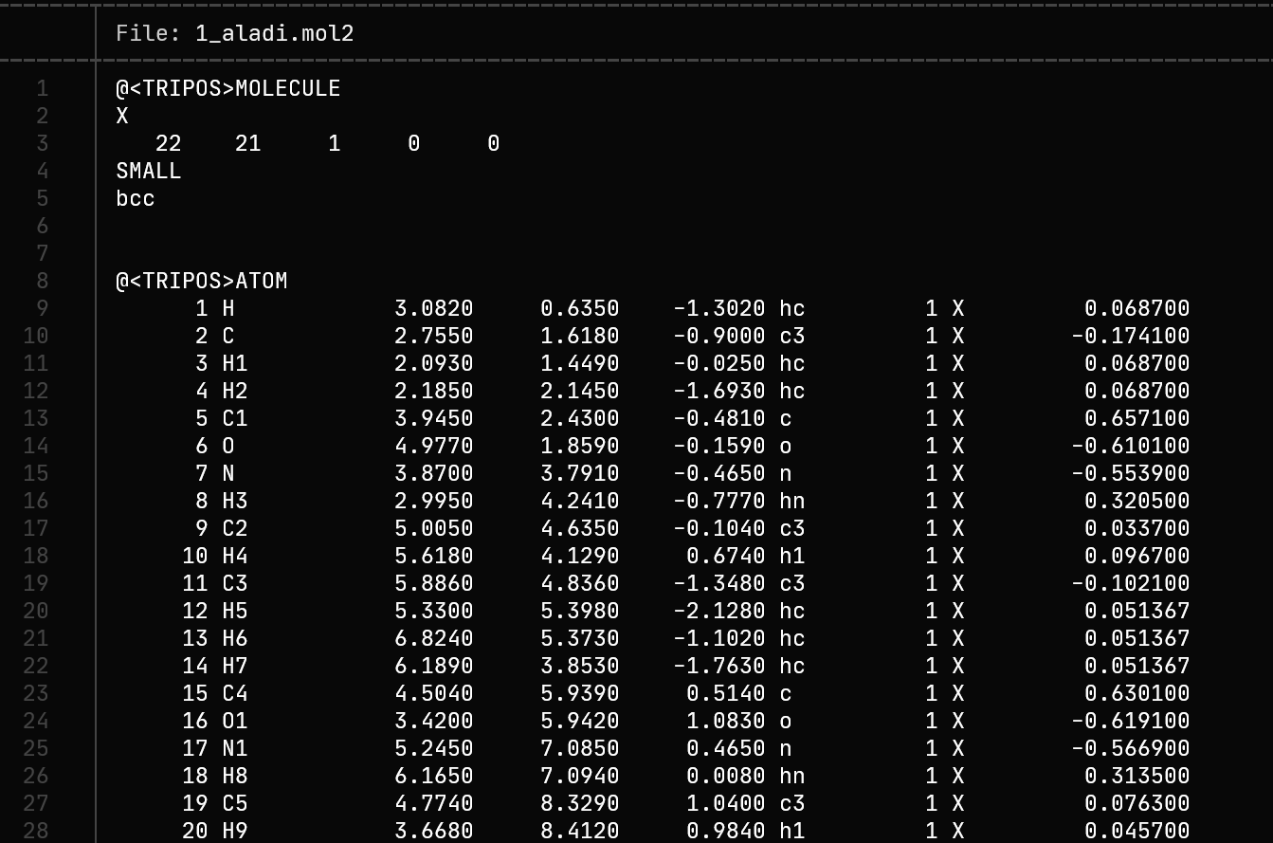
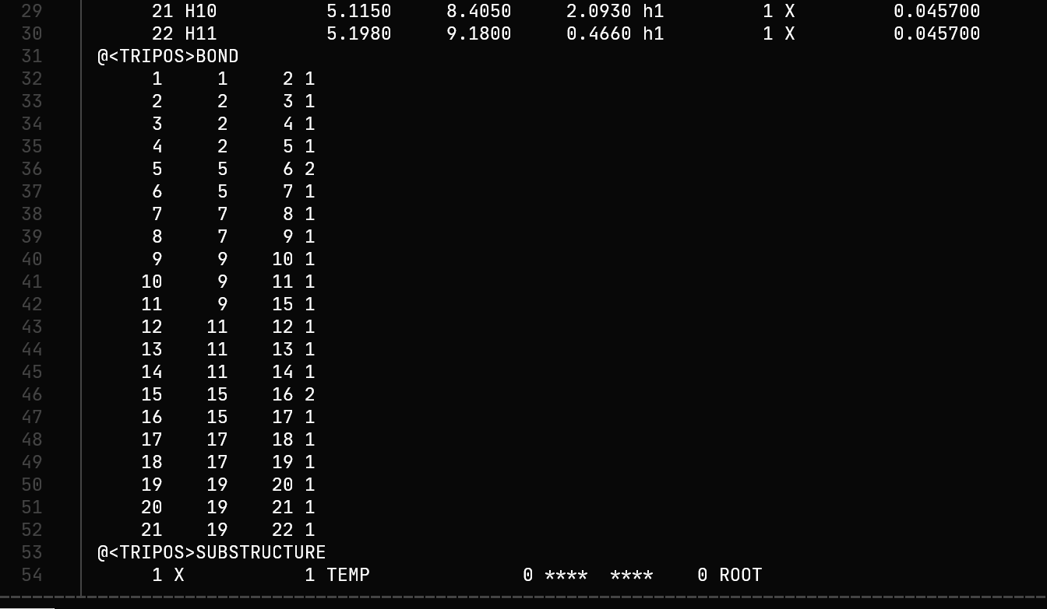
AMBER Antechamber Module
./leap.sh
A mol2 file will be created with atom type
information according to AMBER forcefield
This is just an idea to get the atom type from any given PDB file, in accordance to AMBER forcefield and both method works, but before running the calculations please re-check
AMBER atom type

