Slide 1
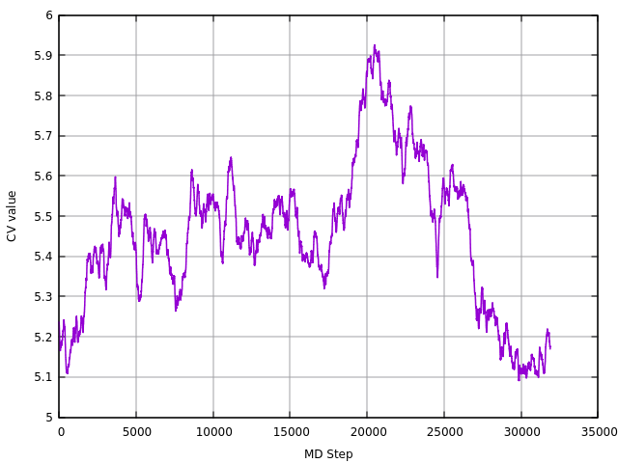
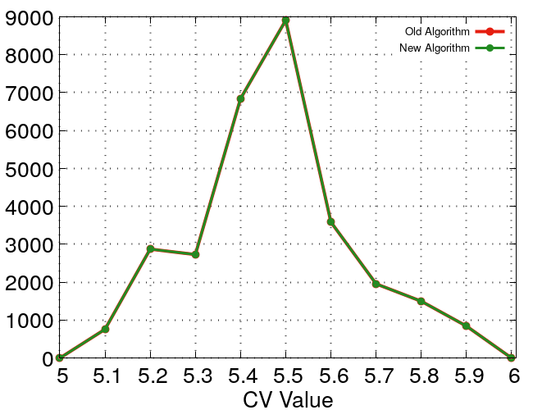
General Algorithm for Histogramming/Probability

Slide 2
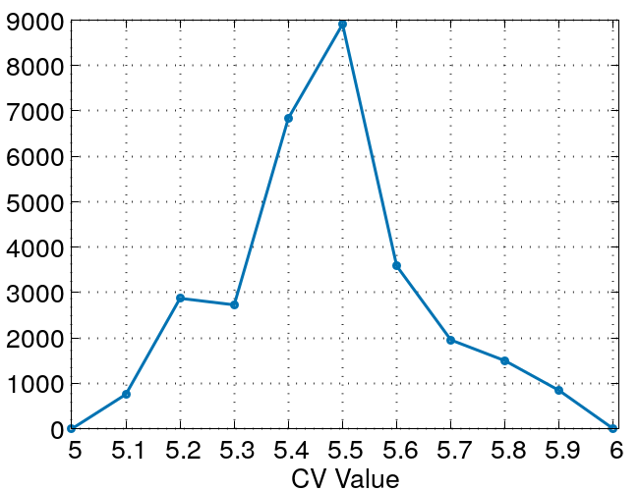
Old Algorithm for Histogramming/Probability
gridmin=5.0 ; gridmax=6.0 ; gridsize=0.1
Calculate Total Number of Bins :
nbin = NINT((gridmax - gridmin)/gridsize + 1
nbin = 11
Computing Histogram :
For each datat point finding the index at which cv lands,
index1 = NINT((cv(i) - gridmin)/gridsize) + 1
2
1
2
3
4
5
6
8
9
10
11
1
7
5.0
5.1
5.2
5.3
5.4
5.5
5.6
5.7
5.8
5.9
6.0

Slide 3
New Algorithm for Histogramming/Probability
gridmin=5.0 ; gridmax=6.0 ; gridsize=0.1
Calculate Total Number of Bins and store the bin positions in array:
pos(1) = 5.0 ; pos(2) = 5.1 ; pos(3) = 5.2 ; pos(4) = 5.3 ; pos(5) = 5.4 ; pos(6) = 5.5 ;
pos(7) = 5.6 ; pos(8) = 5.7 ; pos(9) = 5.8 ; pos(10) = 5.9 ; pos(11) = 6.0
nbin = 11
2
1
2
3
4
5
6
8
9
10
11
i
1
7
pos(i)
5.0
5.1
5.2
5.3
5.4
5.5
5.6
5.7
5.8
5.9
6.0
Computing Histogram :
Find the grid point (i) by checking the cv value and compare with each position (pos(i)).
1. First decide the range of positions for which we will accept the cv value.
2. Check if the cv values falls within that range
3. If YES then count the probablity

Slide 4
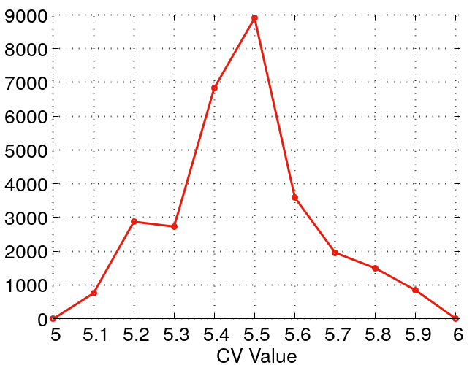
New Algorithm for Histogramming/Probability
2
1
2
3
4
5
6
8
9
10
11
i
1
7
pos(i)
5.0
5.1
5.2
5.3
5.4
5.5
5.6
5.7
5.8
5.9
6.0
5.05
5.15
Accepted Range for computing probability
Computing Histogram :
IF (i .gt. 1 .and. i .lt. nbin)THEN
a = (pos(i+1) - pos(i))/2.0
cut_min = pos(i) - a
cut_max = pos(i) + a
ELSEIF (i .eq. 1) THEN
cut_min = pos(1)
cut_max = pos(1) + a
ELSEIF (i .eq. nbin) THEN
cut_min = pos(nbin) - a
cut_max = pos(nbin)
ENDIF
IF (cv(i) .ge. cut_min .and. cv(i) .le. cut_max)THEN
index1 = i
ENDIF
ENDDO
Accepted Range
for computing probability
Checking the cv values which falls within the above computed range
then store the position to that index

Slide 5
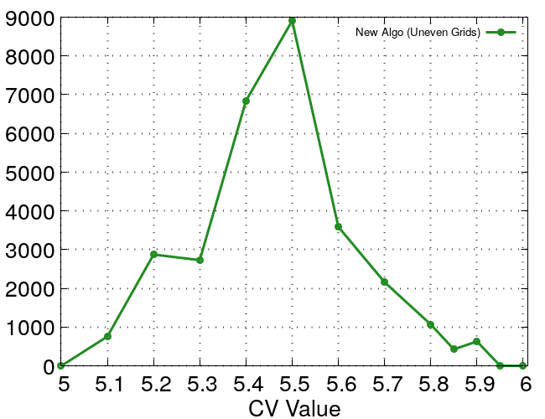
New Algorithm for Histogramming/Probability
2
11
1
2
3
4
5
6
8
9
13
i
1
7
10
12
pos(i)
5.0
5.1
5.2
5.3
5.4
5.5
5.6
5.7
5.8
5.9
6.0
5.05
5.15
5.85
5.95
Computing Histogram :
Accepted Range for computing probability
IF (i .gt. 1 .and. i .lt. nbin)THEN
a = (pos(i+1) - pos(i))/2.0
cut_min = pos(i) - a
cut_max = pos(i) + a
ELSEIF (i .eq. 1) THEN
cut_min = pos(1)
cut_max = pos(1) + a
ELSEIF (i .eq. nbin) THEN
cut_min = pos(nbin) - a
cut_max = pos(nbin)
ENDIF
IF (cv(i) .ge. cut_min .and. cv(i) .le. cut_max)THEN
index1 = i
ENDIF
ENDDO
Accepted Range
for computing probability
Checking the cv values which falls within the above computed range
then store the position to that index

