Slide 1
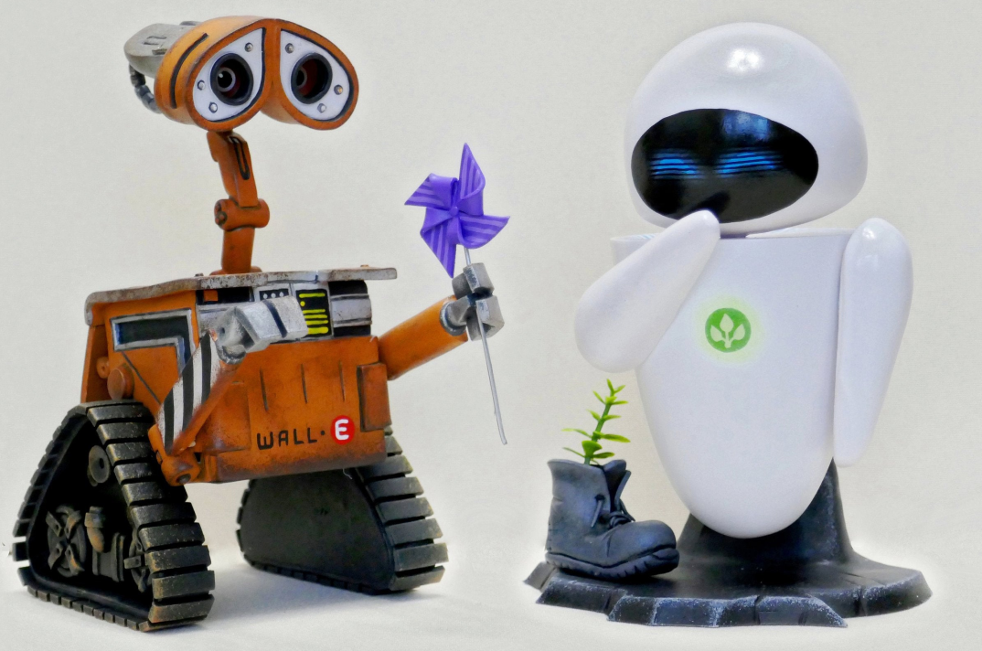
Artificial Intelligence
Dr. Piyush Joshi

Slide 2
KNOWLEDGE REPRESENTATION AND REASONING
Knowledge is awareness or familiarity gained by experiences of facts, data, and situations.

Slide 3
Knowledge-based agents
An intelligent agent needs knowledge about the real world for taking decisions and reasoning to act efficiently.
Maintaining an internal state of knowledge
reason over that knowledge,
update their knowledge after observations and take actions.
These agents can represent the world with some formal representation and act intelligently.

Slide 4
Knowledge-based agents
Knowledge-based agents are composed of two main parts: Knowledge-base and Inference system.
A knowledge-based agent must able to do the following:
An agent should be able to represent states, actions, etc.
An agent Should be able to incorporate new percepts
An agent can update the internal representation of the world
An agent can deduce the internal representation of the world
An agent can deduce appropriate actions.

Slide 5
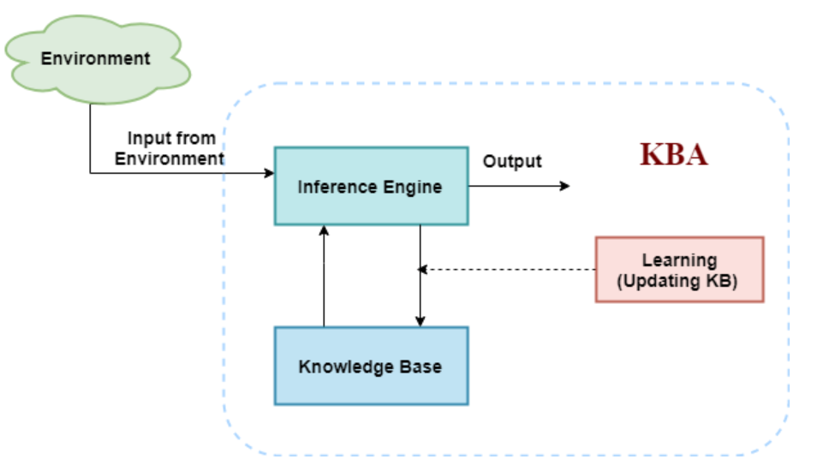
The architecture of knowledge-based agent
Knowledge-base is required for updating knowledge for an agent to learn with experiences and act as per the knowledge.

Slide 6
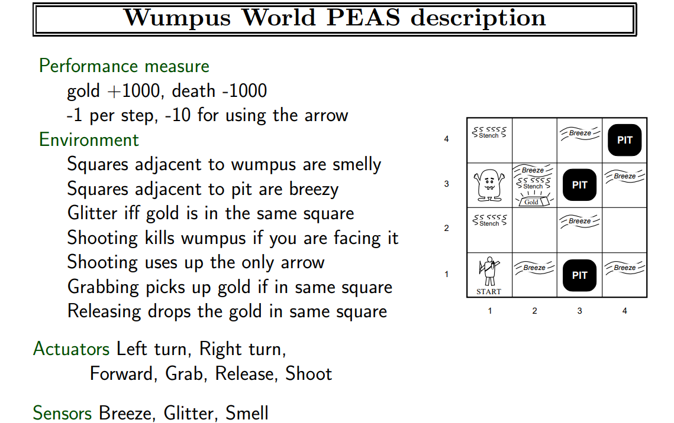

Slide 7
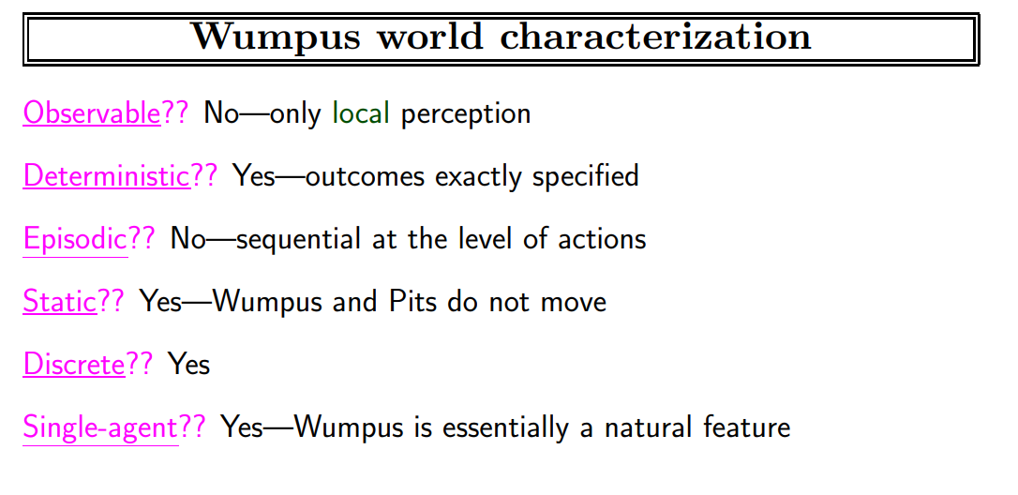

Slide 8
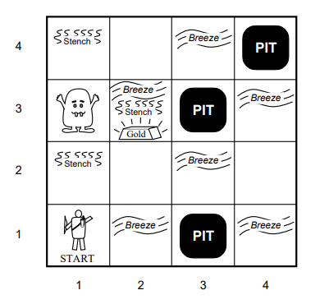
Wumpus world

Slide 9
Inference system
Inference means deriving new sentences from old.
Inference system allows us to add a new sentence to the knowledge base.
A sentence is a proposition about the world.
Inference system applies logical rules to the KB to deduce new information.

Slide 10
Inference system
Inference system generates new facts so that an agent can update the KB.
An inference system works mainly in two rules which are given as:
Forward chaining Backward chaining

Slide 11
Operations Performed by KBA
Following are three operations which are performed by KBA in order to show the intelligent behavior:
TELL: This operation tells the knowledge base what it perceives from the environment.
ASK: This operation asks the knowledge base what action it should perform.
Perform: It performs the selected action.

Slide 12
Various levels of knowledge-based agent:
A knowledge-based agent can be viewed at different levels which are given below:
1. Knowledge level: Knowledge level is the first level of knowledge-based agent, and in this level, we need to specify what the agent knows, and what the agent goals are.
With these specifications, we can fix its behavior.
For example, suppose an automated taxi agent needs to go from a station A to station B, and he knows the way from A to B, so this comes at the knowledge level.

Slide 13
Various levels of knowledge-based agent:
2. Logical level: At this level, we understand that how the knowledge representation of knowledge is stored.
At this level, sentences are encoded into different logics.
At the logical level, an encoding of knowledge into logical sentences occurs.
At the logical level we can expect to the automated taxi agent to reach to the destination B.

Slide 14
Various levels of knowledge-based agent:
3. Implementation level: This is the physical representation of logic and knowledge.
At the implementation level agent perform actions as per logical and knowledge level.
At this level, an automated taxi agent actually implement his knowledge and logic so that he can reach to the destination.

Slide 15
Knowledge Representation
Humans are best at understanding, reasoning, and interpreting knowledge.
Human knows things, which is knowledge and as per their knowledge they perform various actions in the real world.
But how machines do all these things comes under knowledge representation and reasoning.

Slide 16
Knowledge Representation
KR is responsible for representing information about the real world so that a computer can understand and can utilize this knowledge to solve the complex real world problems.
Knowledge representation is not just storing data into some database, but it also enables an intelligent machine to learn from that knowledge and experiences so that it can behave intelligently like a human.

Slide 17
Techniques of Knowledge Representation
Logical Representation
Semantic Network
KR Techniques
Production Rule
Frame Representation

Slide 18
Logical Representation
Logical representation is a language with some concrete rules which deals with propositions and has no ambiguity in representation.
Logical representation means drawing a conclusion based on various conditions.
It consists of precisely defined syntax and semantics which supports the sound inference.
Each sentence can be translated into logics using syntax and semantics.

Slide 19
Logical Representation
Syntaxes are the rules which decide how we can construct legal sentences in the logic.
It determines which symbol we can use in knowledge representation.
How to write those symbols.
Semantics are the rules by which we can interpret the sentence in the logic.
Semantic also involves assigning a meaning to each sentence.

Slide 20
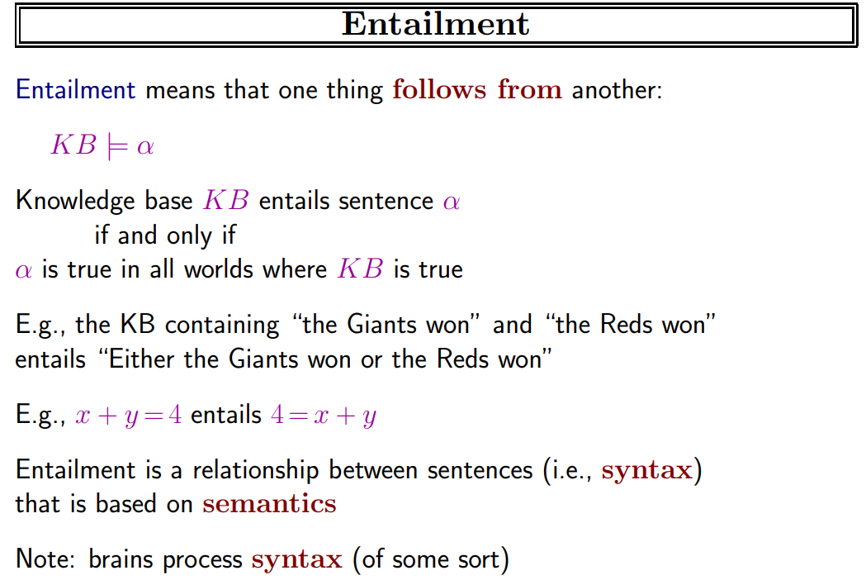

Slide 21
Logical Representation
Logical representation can be categorized into mainly two logics:
Propositional Logics
Predicate logics

Slide 22
Propositional logic
Propositional logic (PL) is the simplest form of logic where all the statements are made by propositions.
A proposition is a declarative statement which is either true or false.
It is a technique of knowledge representation in logical and mathematical form.

Slide 23
Propositional logic: Some basics
Propositional logic is also called Boolean logic as it works on 0 and 1.
In propositional logic, we use symbolic variables to represent the logic, and we can use any symbol for a representing a proposition, such A, B, C, P, Q, R, etc.
Propositions can be either true or false, but it cannot be both.

Slide 24
Propositional logic: Some basics
Propositions can be either true or false, but it cannot be both.
A proposition formula which is always true is called tautology, and it is also called a valid sentence.
A proposition formula which is always false is called Contradiction.
Statements which are questions, commands, or opinions are not propositions such as "Where is Ashu", "How are you", "What is your name", are not propositions.

Slide 25
Propositional Logic : Syntax
The syntax of propositional logic defines the allowable sentences for the knowledge representation.
There are two types of Propositions:
Atomic Propositions
Compound propositions
Atomic Proposition: Atomic propositions are the simple propositions.
It consists of a single proposition symbol.
These are the sentences which must be either true or false.

Slide 26
Propositional Logic : Syntax
Compound proposition: Compound propositions are constructed by combining simpler or atomic propositions, using parenthesis and logical connectives.
Logical connectives are used to connect two simpler propositions or representing a sentence logically.
We can create compound propositions with the help of logical connectives.

Slide 27
Propositional Logic : Logical connectives
There are five connectives in common use:
Negation ￢
Disjunction ∨
Conjunction ∧
Implication (if-then) ⇒
Biconditional (if and only if) ⇔

Slide 28
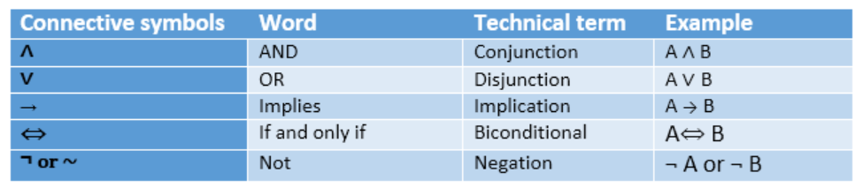
Propositional Logic : Logical connectives

Slide 29
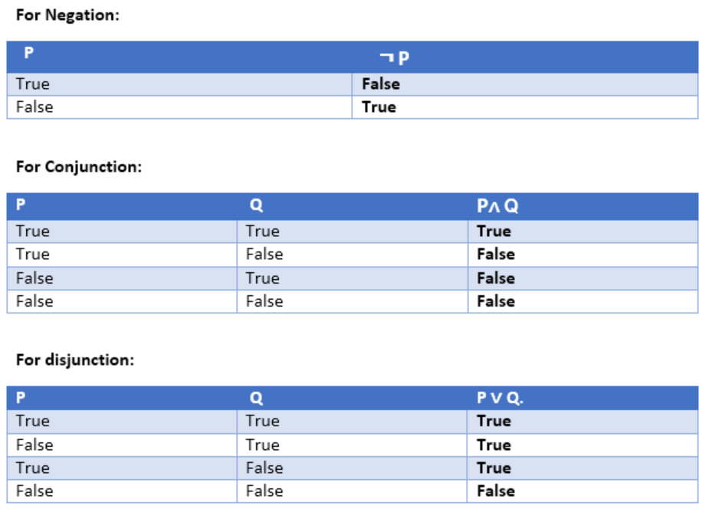
Propositional Logic : Truth Table

Slide 30
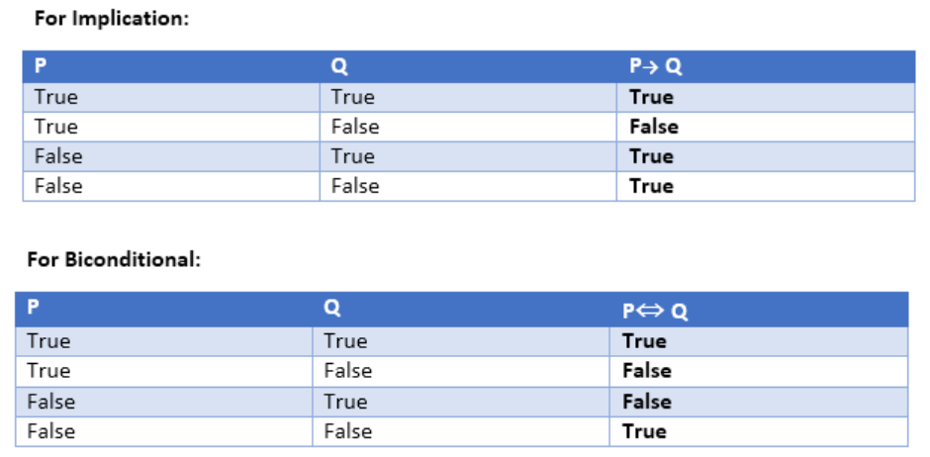
Propositional Logic : Truth Table

Slide 31
Precedence of connectives
Precedence | Operators
First Precedence | Parenthesis
Second Precedence | Negation
Third Precedence | Conjunction(AND)
Fourth Precedence | Disjunction(OR)
Fifth Precedence | Implication
Six Precedence | Biconditional

Slide 32
Example
You can go to mess only if you are iiits student or you are faculty

Slide 33
Properties of operators
Commutativity:
P∧ Q= Q ∧ P, or
P ∨ Q = Q ∨ P.
Associativity:
(P ∧ Q) ∧ R= P ∧ (Q ∧ R),
(P ∨ Q) ∨ R= P ∨ (Q ∨ R)
Identity element:
P ∧ True = P,
P ∨ True= True.

Slide 34
Properties of operators
Distributive:
P∧ (Q ∨ R) = (P ∧ Q) ∨ (P ∧ R).
P ∨ (Q ∧ R) = (P ∨ Q) ∧ (P ∨ R).
DE Morgan's Law:
¬ (P ∧ Q) = (¬P) ∨ (¬Q)
¬ (P ∨ Q) = (¬ P) ∧ (¬Q).
Double-negation elimination:
¬ (¬P) = P.

Slide 35
Limitations of PL
We cannot represent relations like ALL, some, or none with propositional logic.
Example: All students are intelligent. Some mangos are sweet.
Propositional logic has limited expressive power. In propositional logic, we cannot describe statements in terms of their properties or logical relationships.

Slide 36
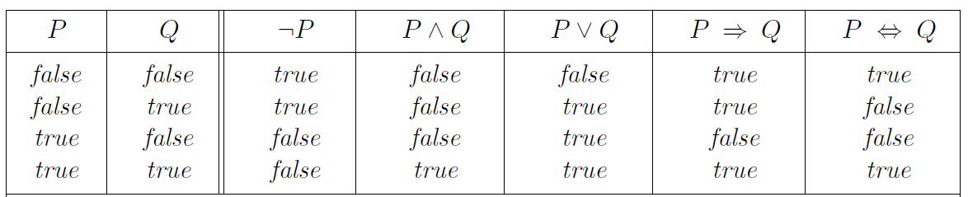
Propositional Logic : Semantics
The semantics defines the rules for determining the truth of a sentence with respect to a particular model.
The semantics for propositional logic must specify how to compute the truth value of any sentence.

Slide 37
Rules of Inference in Artificial intelligence
In artificial intelligence, we need intelligent computers which can create new logic from old logic or by evidence.
So generating the conclusions from evidence and facts is termed as Inference.
Inference rules are the templates for generating valid arguments.
Inference rules are applied to derive proofs in artificial intelligence, and the proof is a sequence of the conclusion that leads to the desired goal.

Slide 38
Rules of Inference in Artificial intelligence
In inference rules, the implication among all the connectives plays an important role. Following are some terminologies related to inference rules:
Implication: It is one of the logical connectives which can be represented as P → Q. It is a Boolean expression.
Converse: The converse of implication, which means the right-hand side proposition goes to the left-hand side and vice-versa. It can be written as Q → P.
Contrapositive: The negation of converse is termed as contrapositive, and it can be represented as ¬ Q → ¬ P.
Inverse: The negation of implication is called inverse. It can be represented as ¬ P → ¬ Q.

Slide 39
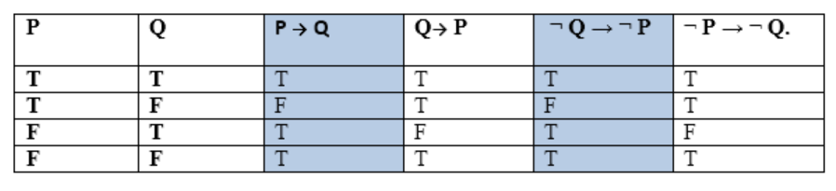
Rules of Inference in Artificial intelligence
we can prove that P → Q is equivalent to ¬ Q → ¬ P, and Q→ P is equivalent to ¬ P → ¬ Q.

Slide 40

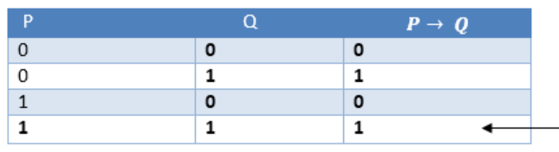
Types of Inference rules
1. Modus Ponens:
The Modus Ponens rule is one of the most important rules of inference, and it states that if P and P → Q is true, then we can infer that Q will be true. It can be represented as:

Slide 41

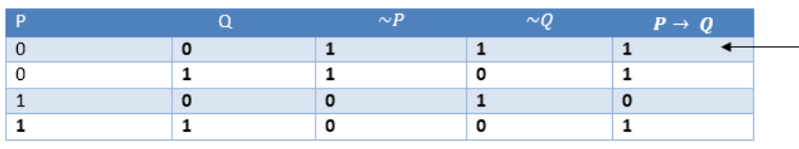
Types of Inference rules
2. Modus Tollens:
The Modus Tollens rule state that if P→ Q is true and ¬ Q is true, then ¬ P will also true. It can be represented as:

Slide 42
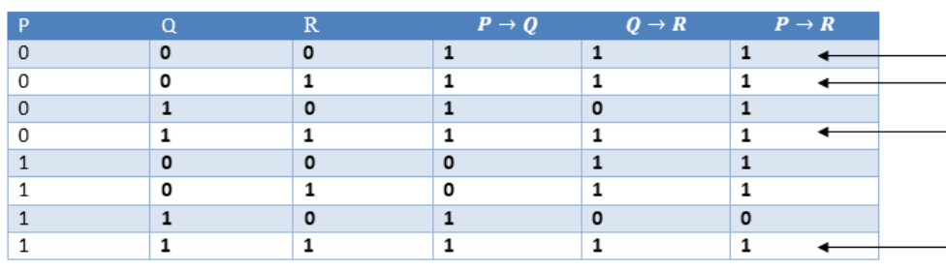
Types of Inference rules
3. Hypothetical Syllogism:
The Hypothetical Syllogism rule state that if P→R is true whenever P→Q is true, and Q→R is true. It can be represented as the following notation:

Slide 43

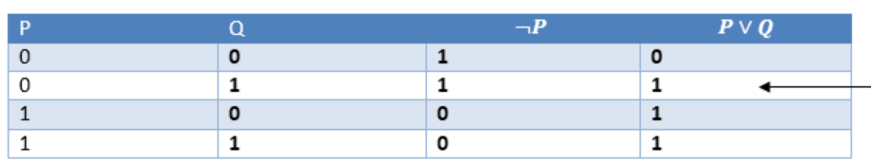
Types of Inference rules
4. Disjunctive Syllogism:
The Disjunctive syllogism rule state that if P∨Q is true, and ¬P is true, then Q will be true. It can be represented as:

Slide 44

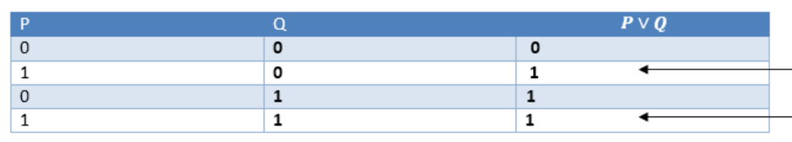
Types of Inference rules
5. Addition:
The Addition rule is one the common inference rule, and it states that If P is true, then P∨Q will be true.

Slide 45

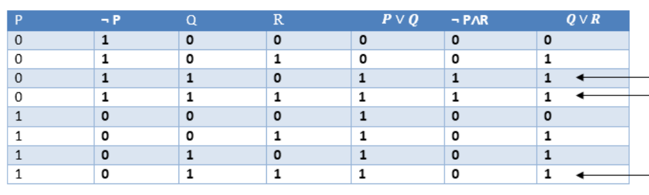
Types of Inference rules
6. Resolution:
The Resolution rule state that if P∨Q and ¬ P∧R is true, then Q∨R will also be true. It can be represented as

Slide 46
Inference system
Inference means deriving new sentences from old.
Inference system allows us to add a new sentence to the knowledge base.
A sentence is a proposition about the world.
Inference system applies logical rules to the KB to deduce new information.

Slide 47
Inference system
Inference system generates new facts so that an agent can update the KB.
An inference system works mainly in two rules which are given as:
Forward chaining Backward chaining

Slide 48
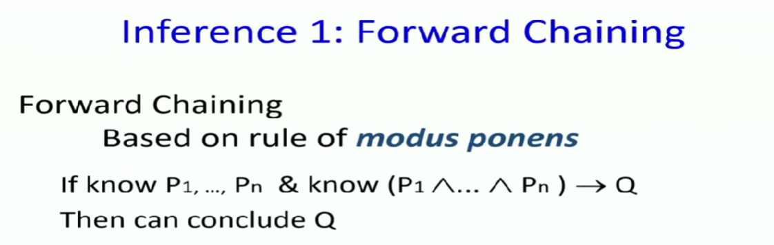
Forward and backward chaining

Slide 49
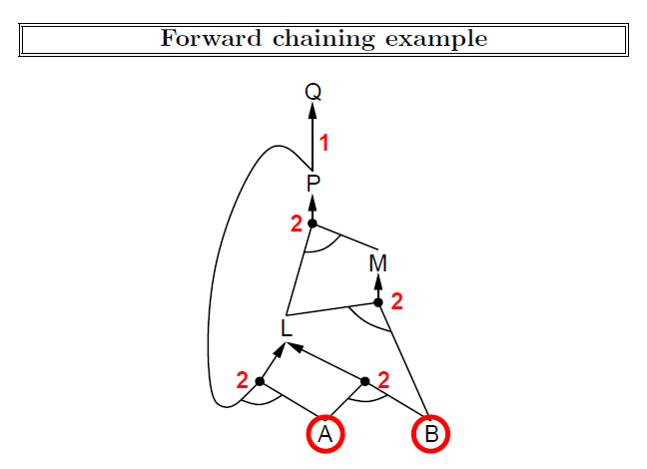
Artificial Intelligence: A Modern Approach, 4th US ed.
aima.cs.berkeley.edu by Stuart Russell

Slide 50
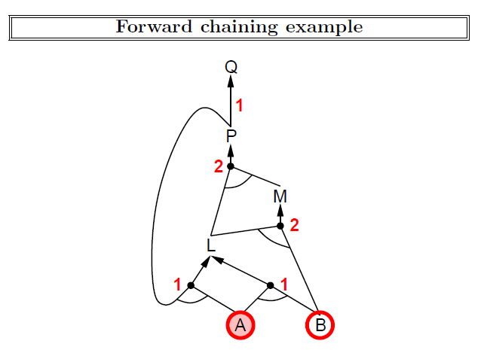
Artificial Intelligence: A Modern Approach, 4th US ed.
aima.cs.berkeley.edu by Stuart Russell

Slide 51
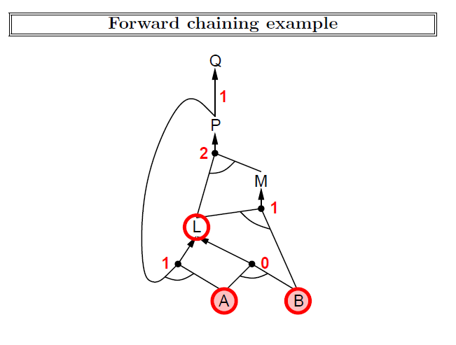
Artificial Intelligence: A Modern Approach, 4th US ed.
aima.cs.berkeley.edu by Stuart Russell

Slide 52
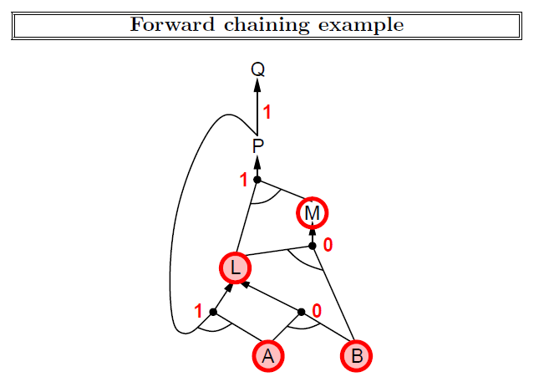
Artificial Intelligence: A Modern Approach, 4th US ed.
aima.cs.berkeley.edu by Stuart Russell

Slide 53
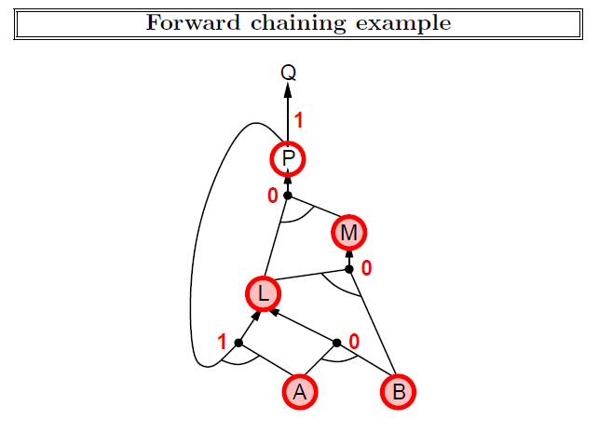
Artificial Intelligence: A Modern Approach, 4th US ed.
aima.cs.berkeley.edu by Stuart Russell

Slide 54
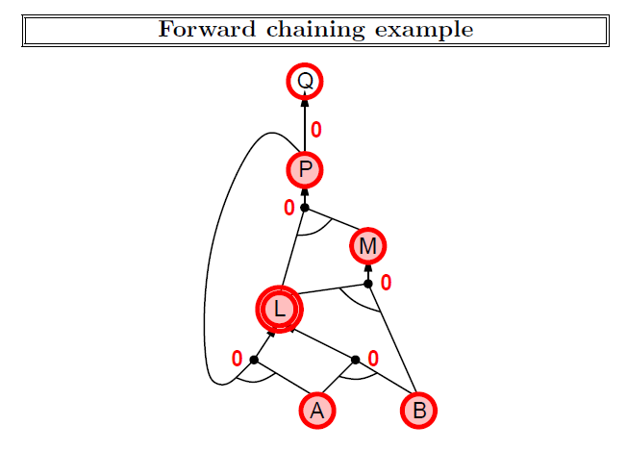
Artificial Intelligence: A Modern Approach, 4th US ed.
aima.cs.berkeley.edu by Stuart Russell

Slide 55
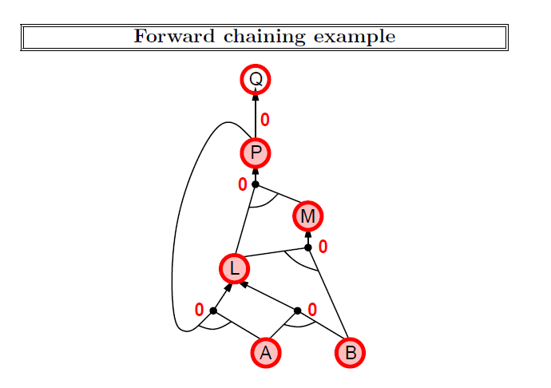
Artificial Intelligence: A Modern Approach, 4th US ed.
aima.cs.berkeley.edu by Stuart Russell

Slide 56
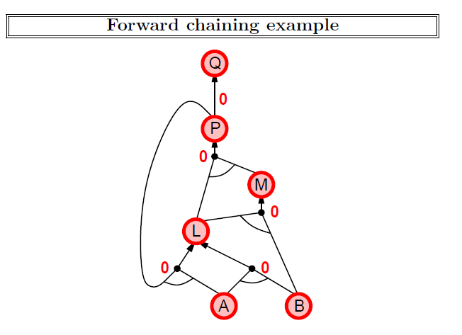
Artificial Intelligence: A Modern Approach, 4th US ed.
aima.cs.berkeley.edu by Stuart Russell

Slide 57

Conjunctive Normal Form
Conjunctive Normal Form
E.g., (A ∨ ¬B) ∧ (B ∨ ¬C ∨ ¬D)

Slide 58
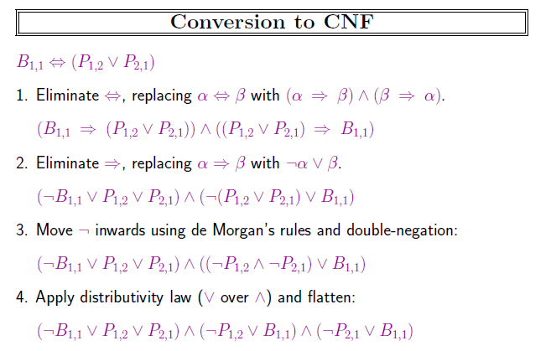
Artificial Intelligence: A Modern Approach, 4th US ed.
aima.cs.berkeley.edu by Stuart Russell

Slide 59
CNF Conversion
(A → B) → C
(P → (Q → R)) → (P → (R → Q))
(P → Q) → ((Q → R) → (P → R))

Slide 60
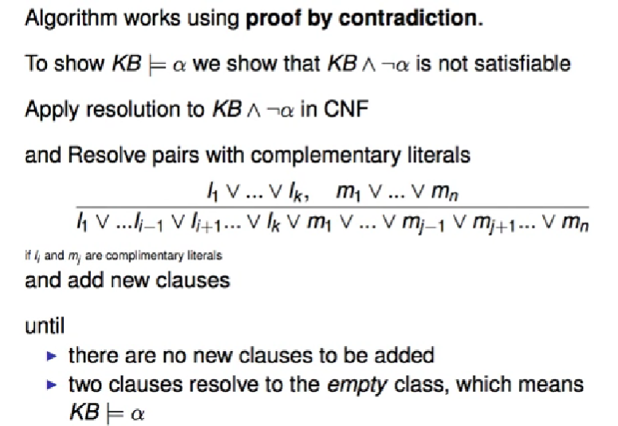
Resolution

Slide 61
Resolution example
If Ram is graduating then he will be happy.
If Ram is happy then he will smile.
Ram is graduating.
Ram is smiling

Slide 64
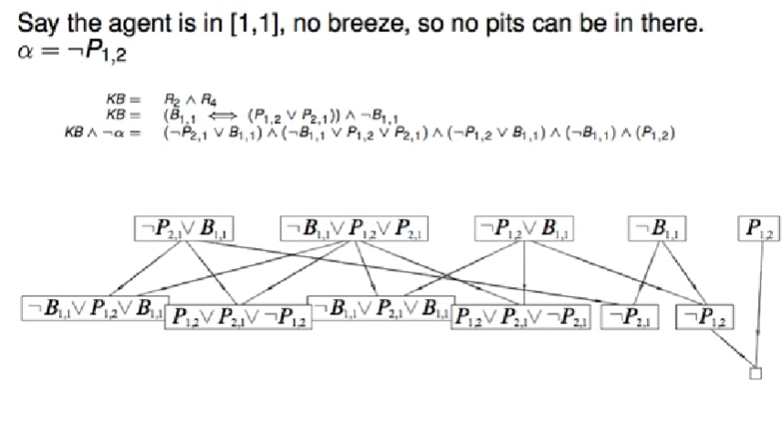

Slide 65
Limitations of PL
We cannot represent relations like ALL, some, or none with propositional logic.
Example: All students are intelligent. Some mangos are sweet.
Propositional logic has limited expressive power. In propositional logic, we cannot describe statements in terms of their properties or logical relationships.

Slide 66
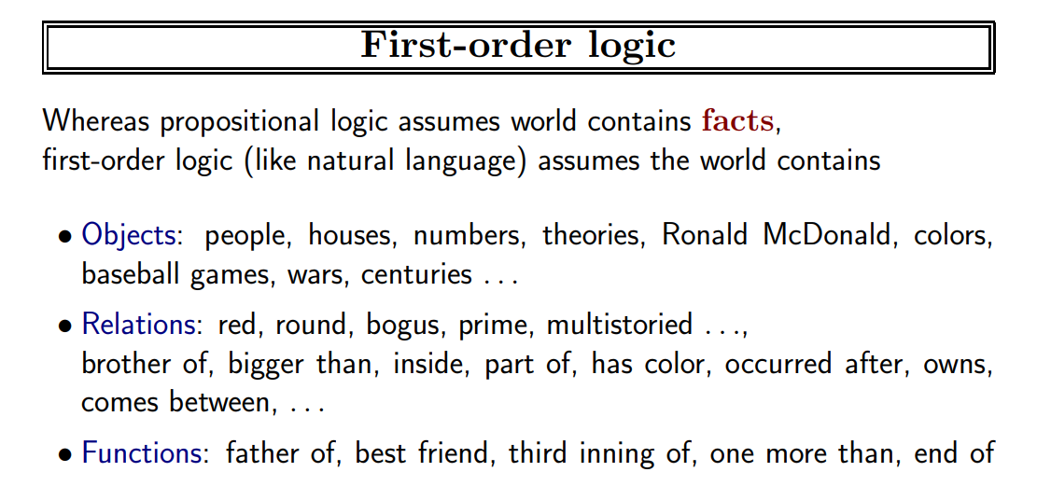

Slide 67
Quantifiers
Universal ∀x
Existential ∃x

Slide 68
Universal quantification
(∀x)P(x) means that P holds for all values of x in the domain associated with that variable
E.g., (∀x) dolphin(x) → mammal(x)
Existential quantification
(∃ x)P(x) means that P holds for some value of x in the domain associated with that variable
E.g., (∃ x) mammal(x) ∧ lays-eggs(x)
Permits one to make a statement about some object without naming it

Slide 69
Quantifiers
Universal quantifiers are often used with “implies” to form “rules”:
(∀x) student(x) → smart(x) means “All students are smart”
Universal quantification is rarely used to make blanket statements about every individual in the world:
(∀x)student(x)∧smart(x) means “Everyone in the world is a student and is smart”
Existential quantifiers are usually used with “and” to specify a list of properties about an individual:
(∃x) student(x) ∧ smart(x) means “There is a student who is smart”
A common mistake is to represent this English sentence as the FOL sentence:
(∃x) student(x) → smart(x)
But what happens when there is a person who is not a student?

Slide 70
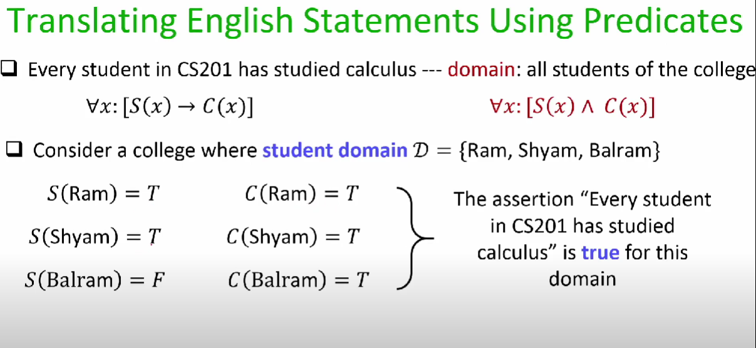

Slide 71
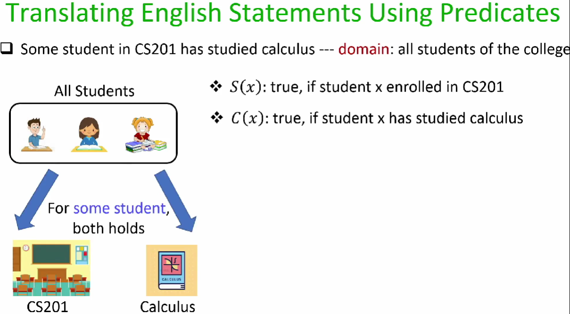

Slide 72
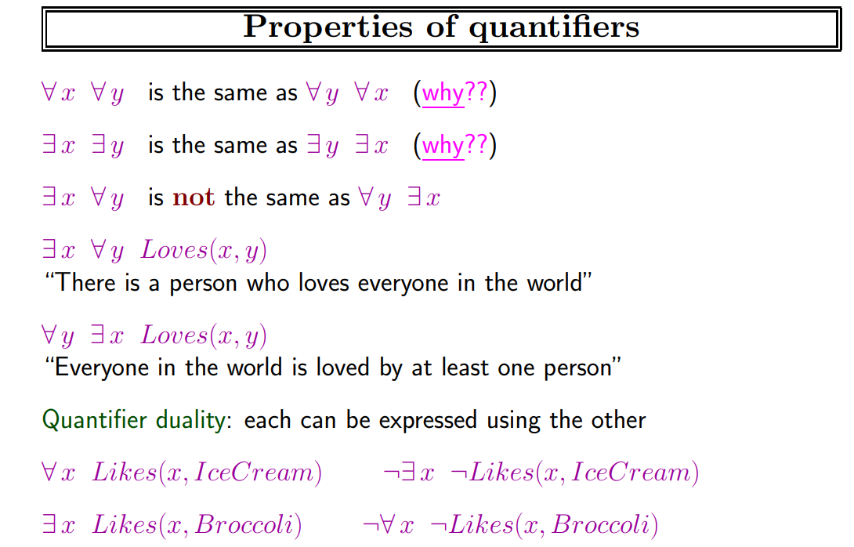

Slide 73
Examples
All boys like cricket.
Some boys like football.
Some girls hate football.

Slide 74
Examples
All girls love pink.
Every person who buys a policy is smart.
No person buys expensive policy.

