Slide 1
Constraint Satisfaction Problem

Slide 2
Constraint Satisfaction Problem (CSP)
A problem is solved when each variable has a value that satisfies all the constraints on the variable. A problem described this way is called a constraint satisfaction problem, or CSP.
The main idea is to eliminate large portions of the search space all at once by identifying variable/value combinations that violate the constraints.

Slide 3
Definition of CSP
Constraint satisfaction problem consists of three components, X, D, and C:
X is a set of variables, {X1,...,X,}.
D is a set of domains, {D,...,D,}, one for each variable.
C is a set of constraints that specify allowable combinations of values.
A domain, D, consists of a set of allowable values, {v1,..., vn}, for variable X;.
For example, a Boolean variable would have the domain {true,false}.
Each constraint C_{j} consists of a pair (scope, rel),
where scope is a tuple of variables that participate in the constraint
rel is a relation that defines the values that those variables can take on.

Slide 4
A relation can be represented as an explicit set of all tuples of values that satisfy the constraint, or as a function that can compute whether a tuple is a member of the relation.
For example, if X; and X, both have the domain {1,2,3}, then the constraint saying that X1; must be greater than X2 can be written as,
((X1,X2),{(3,1),(3,2),(2,1)}) or as ((X1, X2), X1 > X2).

Slide 5
CSPs deal with assignments of values to variables, {Xi = vi,Xj =vj,...}.
An assignment that does not violate any constraints is called a consistent or legal assignment.
A complete assignment is one in which every variable is assigned a value, and a solution to a CSP is a consistent, complete assignment.
A partial assignment is one that leaves some variables unassigned, and a partial solution is a partial assignment that is consistent.

Slide 6
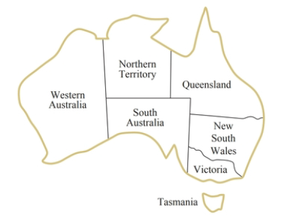
Example problem: Map coloring
A map of Australia showing each of its states and territories.
We are given the task of coloring each region either red, green, or blue in such a way that no two neighboring regions have the same color.

Slide 7
Example problem: Map coloring
We define the variables to be the regions:
X = {WA,NT,Q,NSW,V,SA,T}.
The domain of every variable is the set
Di = {red, green, blue}.
The constraints require neighboring regions to have distinct colors.
Since there are nine places where regions border, there are nine constraints:
C = {SA≠ WA, SA ≠ NT, SA ≠ Q, SA ≠ NSW, SA ≠ V,
WA ≠ NT, NT ≠ Q, Q ≠ NSW, NSW ≠ V}.

Slide 8
Example problem: Map coloring
Here we arc using abbreviations; SA ≠ WA is a shortcut for ((SA,WA),SA ≠ WA),
Where SA ≠ WA can be fully enumerated in turn as
{(red, green), (red. blue), (green, red), (green, blue), (blue, red), (blue, green) }.
Solutions to this problem?

Slide 9
Example problem: Map coloring
There are many possible solutions to this problem, such as
{WA =red, NT=green, Q= red, NSW = green, V = red, SA=blue, T = red }.

Slide 10
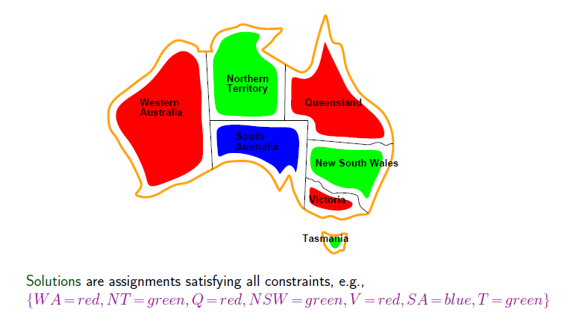

Slide 11
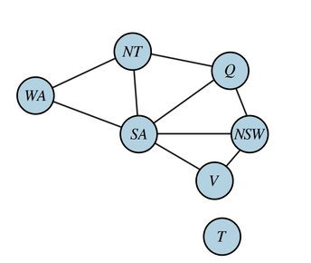
Example problem: Map coloring
It can be helpful to visualize a CSP as a constraint graph, as shown in Figure.
The nodes of the graph correspond to variables of the problem, and an edge connects any two variables that participate in a constraint.

