Slide 1

Artificial Intelligence
Dr. Piyush Joshi

Slide 2
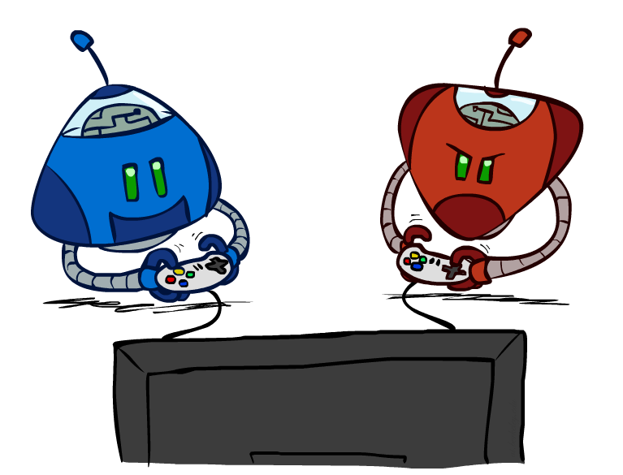
Artificial Intelligence
Game Playing
Notes:
Please retain proper attribution and the reference to ai.berkeley.edu. Thanks!

Slide 3
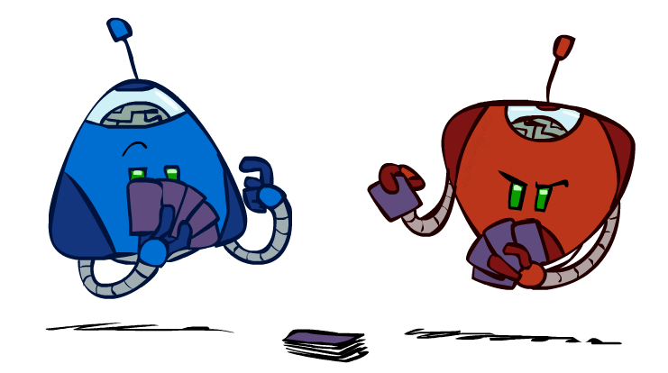
Types of Games
Game = task environment with > 1 agent
Axes:
Deterministic or stochastic?
Perfect information (fully observable)?
Two, three, or more players?
Teams or individuals?
Turn-taking or simultaneous?
Zero sum?
Want algorithms for calculating a contingent plan (a.k.a. strategy or policy) which recommends a move for every possible eventuality

Slide 4
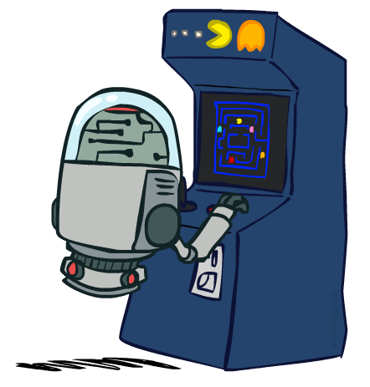
“Standard” Games
Standard games are deterministic, observable, two-player, turn-taking, zero-sum
Game formulation:
Initial state: s₀
Players: Player(s) indicates whose move it is
Actions: Actions(s) for player on move
Transition model: Result(s, a)
Terminal test: Terminal-Test(s)
Terminal values: Utility(s, p) for player p
Or just Utility(s) for player making the decision at root

Slide 5
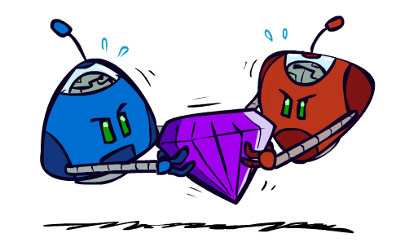
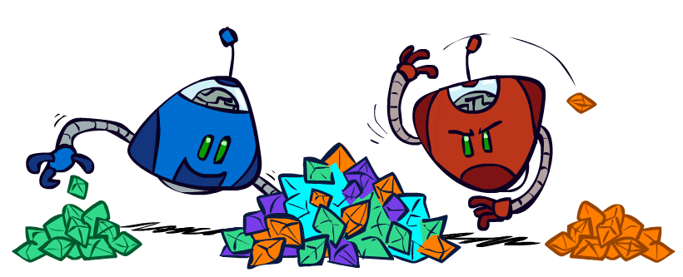
Zero-Sum Games
General-Sum Games
Agents have independent utilities
Cooperation, indifference, competition, shifting alliances, and more are all possible
Team Games
Common payoff for all team members
Zero-Sum Games
Agents have opposite utilities
Pure competition:
One maximizes, the other minimizes

Slide 6
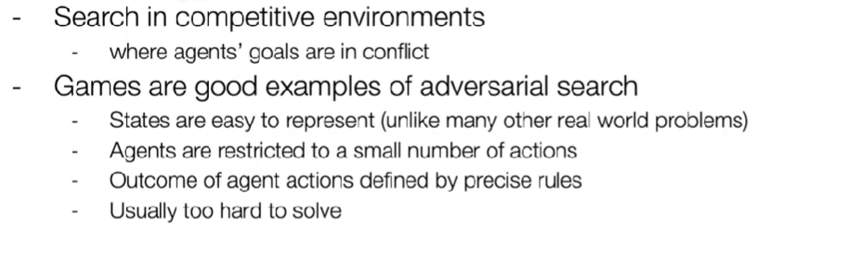
Adversarial search or Game playing

Slide 7
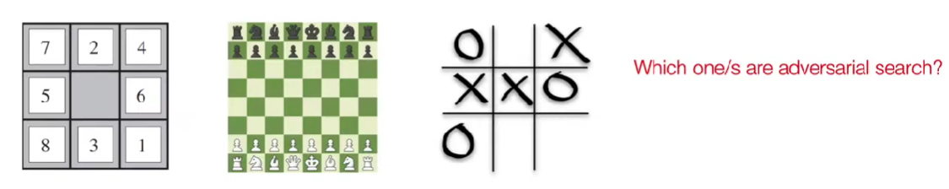
Adversarial search or Game playing

Slide 8
Adversarial search or Game playing
Adversarial search is a search, where we examine the problem which arises when we try to plan ahead of the world and other agents are planning against us.
Previously, we have studied the search strategies which are only associated with a single agent that aims to find the solution which often expressed in the form of a sequence of actions.
But, there might be some situations where more than one agent is searching for the solution in the same search space, and this situation usually occurs in game playing.

Slide 10
Adversarial search or Game playing
The environment with more than one agent is termed as multi-agent environment, in which each agent is an opponent of other agent and playing against each other. Each agent needs to consider the action of other agent and effect of that action on their performance.
Searches in which two or more players with conflicting goals are trying to explore the same search space for the solution, are called adversarial searches, often known as Games.
Games are modeled as a Search problem and heuristic evaluation function, and these are the two main factors which help to model and solve games in AI.

Slide 12
Adversarial search or Game playing
A game can be formally defined as a kind of search problem with the following elements:
S₀ : The initial state, which specifies how the game is set up at the start.
PLAYER(s): Defines which player has the move in a state.
ACTIONS(s): Returns the set of legal moves in a state.
RESULT(s, a): The transition model, which defines the result of a move.
TERMINAL-TEST(s): A terminal test, which is true when the game is over and false otherwise. States where the game has ended are called terminal states.
UTILITY(s, p): A utility function (also called an objective function or payoff function), defines the final numeric value for a game that ends in terminal state s for a player p.
For Chess, the outcomes are a win, loss, or draw and its payoff values are +1, 0, ½. And for tic-tac-toe, utility values are +1, -1, and 0.

Slide 13
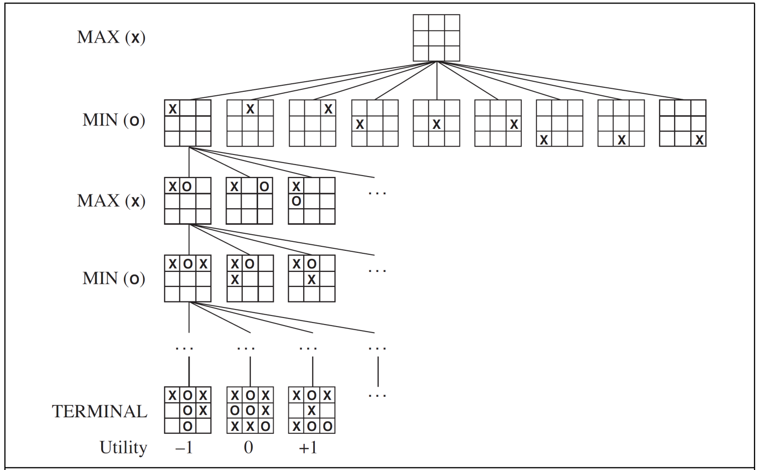
Game playing
Example: Tic-Tac-Toe game tree:
A (partial) game tree for the game of tic-tac-toe. The top node is the initial
state, and MAX moves first, placing an X in an empty square.
We show part of the tree, giving alternating moves by MIN (O) and MAX (X), until we eventually reach terminal states, which can be assigned utilities according to the rules of the game.

Slide 16
Game Tree
A game tree is a tree where nodes of the tree are the game states and Edges of the tree are the moves by players. Game tree involves initial state, actions function, and result Function.
From the initial state, MAX has 9 possible moves as he starts first. MAX place x and MIN place o, and both player plays alternatively until we reach a leaf node where one player has three in a row or all squares are filled.
In the game tree, we have a layer of Max, a layer of MIN, and each layer is called as Ply.

Slide 17
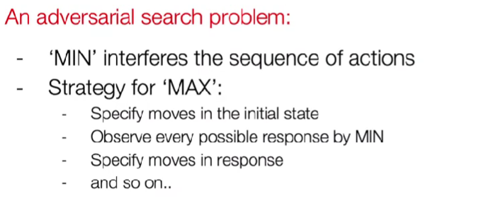

Slide 19
Min-Max Algorithm
Mini-max algorithm is a recursive or backtracking algorithm which is used in decision-making and game theory.
It provides an optimal move for the player assuming that opponent is also playing optimally.
Mini-Max algorithm uses recursion to search through the game-tree.
Min-Max algorithm is mostly used for game playing in AI.
Such as Chess, Checkers, tic-tac-toe, go, and various tow-players game. This Algorithm computes the minimax decision for the current state.

Slide 20
Min-Max Algorithm
In this algorithm two players play the game; one is called MAX and other is called MIN.
Both the players fight it as the opponent player gets the minimum benefit while they get the maximum benefit.
Both Players of the game are opponent of each other, where MAX will select the maximized value and MIN will select the minimized value.
The minimax algorithm performs a depth-first search algorithm for the exploration of the complete game tree.
The minimax algorithm proceeds all the way down to the terminal node of the tree, then backtrack the tree as the recursion.

Slide 21
Min-Max Algorithm
The minimax algorithm performs a complete depth-first exploration of the game tree.
It uses backtracking strategies.
This algorithm moves all the way down to the leaves of the tree (terminals), and then the minimax values are backed up through the tree to root.
MAX and MIN are two players.
MAX tries to maximize its utility.
MIN tries to minimize opponent utility.

Slide 22
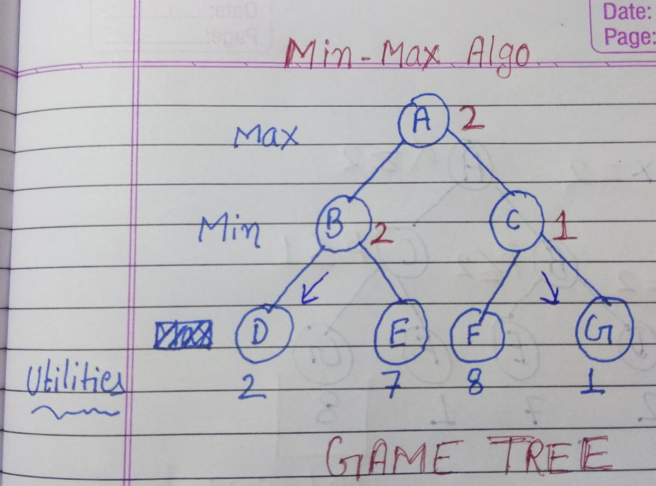
Min-Max Algorithm

Slide 23
Min-Max Algorithm

Slide 25
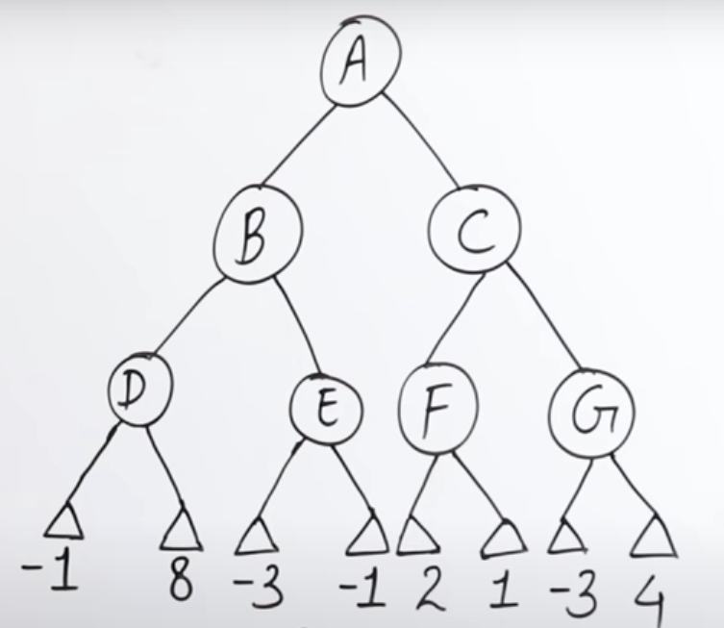
Min-Max Algorithm

Slide 27
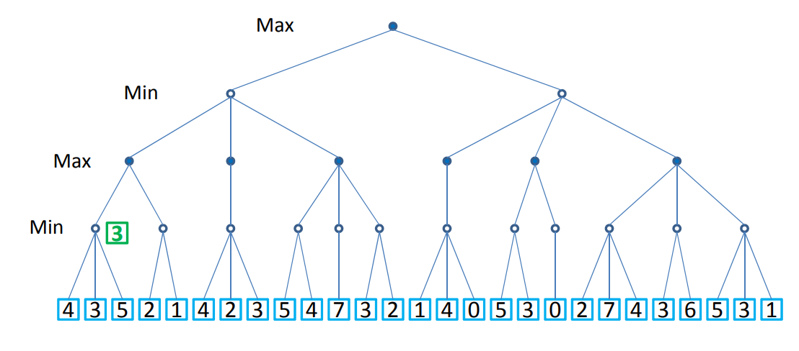
Min-Max Algorithm

Slide 28
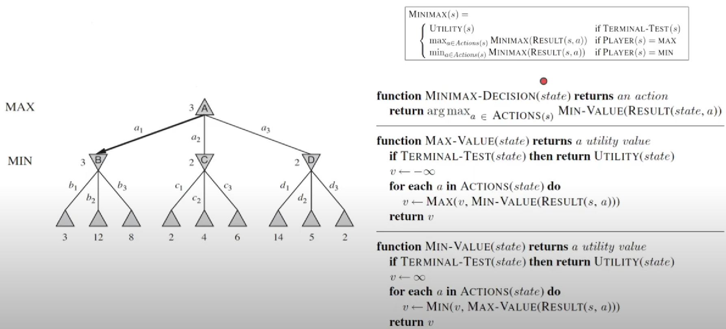

Slide 31
ALPHA–BETA pruning.
The problem with mini-max search is that the number of game states it has to examine is exponential in the depth of the tree.
Unfortunately, we can’t eliminate the exponent, but it turns out we can effectively cut it in half.
The trick is that it is possible to compute the correct mini-max decision without looking at every node in the game tree.
That means we cutoff some tree nodes to reduce time of the search.
It is an efficient version of Min-Max algorithm in terms of time.

Slide 32
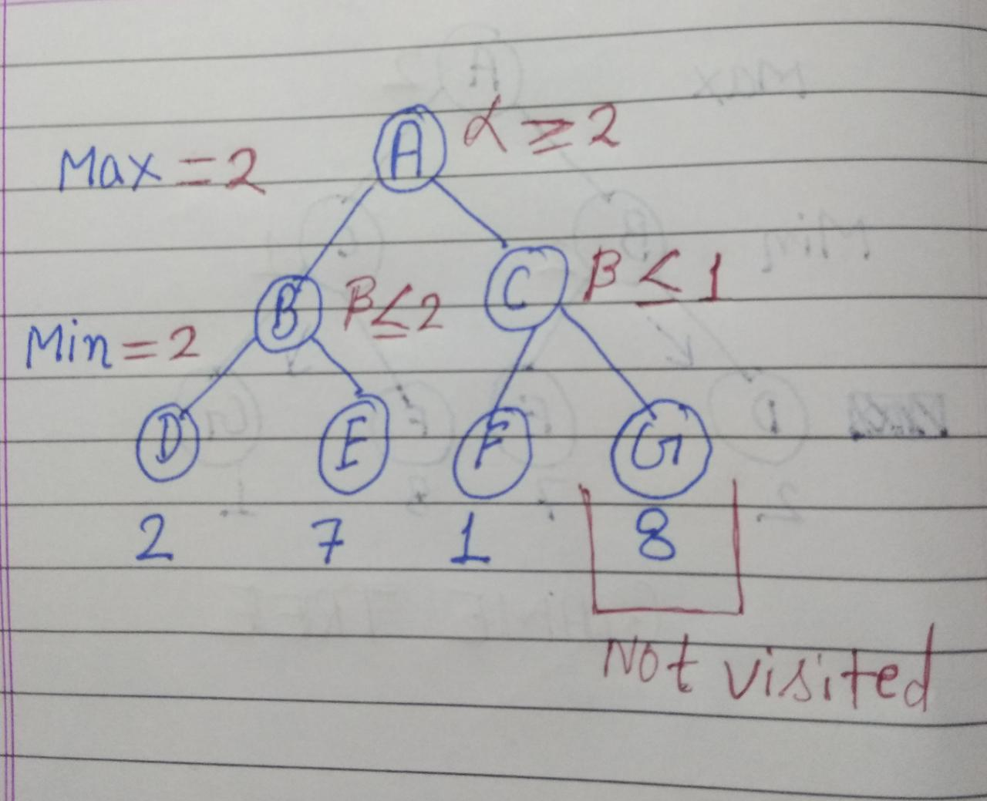
ALPHA–BETA pruning.

Slide 34
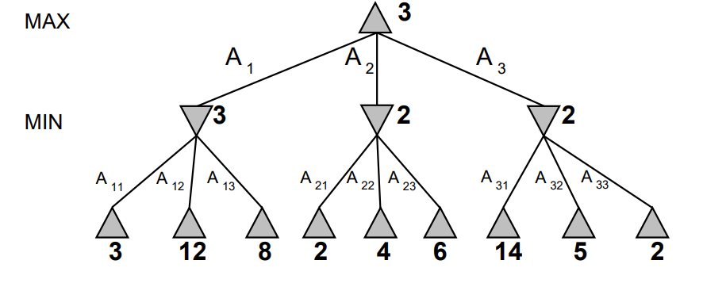

Slide 36
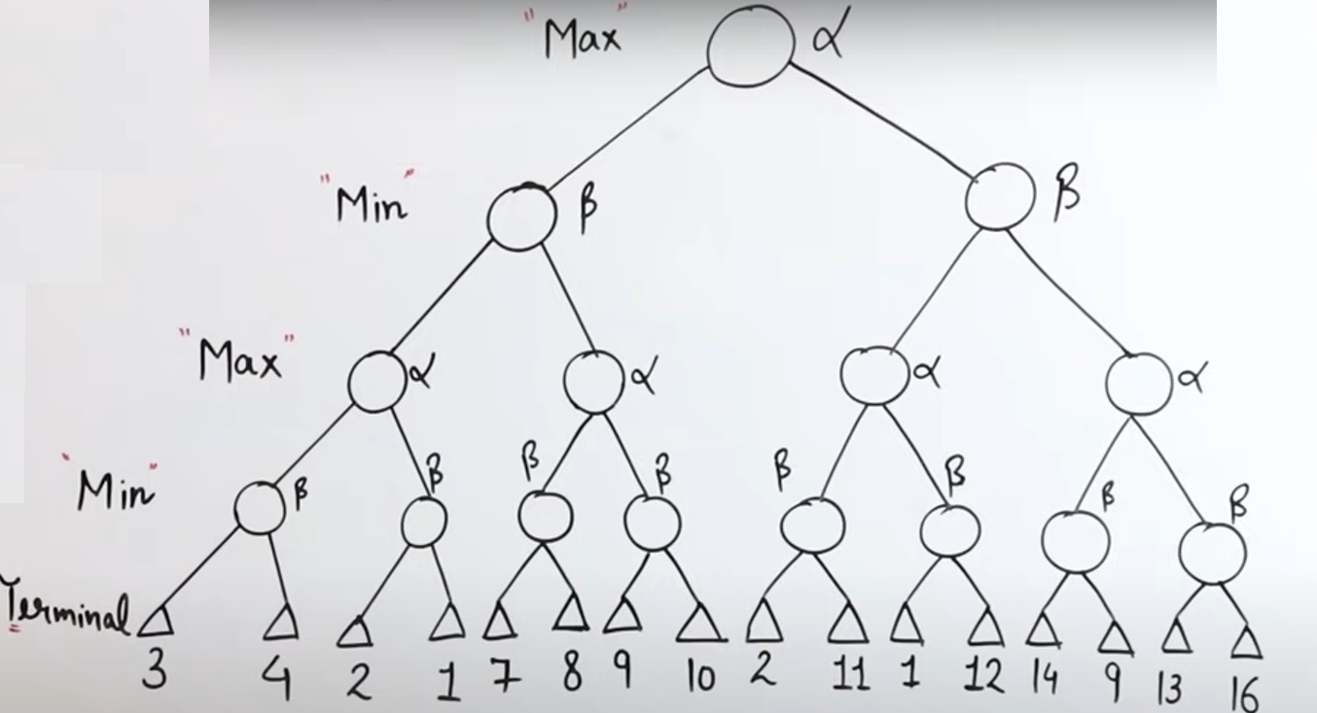
ALPHA–BETA pruning.

Slide 37
