Slide 1
First Order Logic
The wumpus world example

Slide 2
Assertions in FOL
A domain is just some part of the world about which we wish to express some knowledge.
Sentences are added to a knowledge base using TELL, exactly as in propositional logic. Such sentences are called assertions.
For example, we can assert that John is a king, Richard is a person, and all kings are persons:
TELL(KB, King(John)) .
TELL(KB, Person(Richard)).
TELL(KB, Vx King(x) = Person(x)).
We can ask questions of the knowledge base using ASK. For example,
ASK (KB, King(John)) returns true.
Questions asked with ASK are called queries or goals.

Slide 3
If we want to know what value of x makes the sentence true, we will need a different function, which we call ASKVARS,
ASKVARS(KB, Person(x))
and which yields a stream of answers.
In this case there will be two answers: {x/John} and {x/Richard}. Such an answer is called a substitution or binding list.

Slide 4
The wumpus world
Recall that wumpus world agent receives percepts.
The percepts will be given to the agent program in the form of a list of five symbols;
For example, if there is a stench and a breeze, but no glitter, bump, or scream, the agent program will get
Percept([Stench, Breeze, None, None, None]).
The corresponding first-order sentence stored in the knowledge base must include both the percept and the time at which it occurred.
Percept([Stench, Breeze, Glitter, None, None),5)
Percept is a binary predicate, and Stench and so on are constants placed in a list.

Slide 5
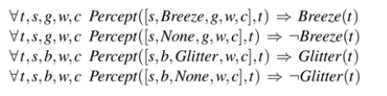
Actions: Turn(Right), Turn(Left), Forward, Shoot, Grab, Climb.
To determine which is best, the agent program executes the query
ASKVARS(KB, BestAction(a,5))
which returns a binding list such as {a/Grab}.
ꓯt Glitter(t) ⇒ BestAction(Grab,t).

Slide 6
Objects: squares, pits, and the wumpus.
We could name each square—Square1, 5 and so on, but adjacent would have to be an “extra” fact, and we would need one such fact for each pair of squares.
Adjacency of any two squares can be defined as,
ꓯ_{x,y,a,b} Adjacent([x,y],[a,b]=?

Slide 7
Objects: squares, pits, and the wumpus.
We could name each square—Square1, 5 and so on, but adjacent would have to be an “extra” fact, and we would need one such fact for each pair of squares.
Adjacency of any two squares can be defined as

Slide 8
It is simpler to use a unary predicate Pit that is true of squares containing pits.
Finally, since there is exactly one wumpus, a constant Wumpus is just as good as a unary predicate.
Agents Location: At(Agent,s,r) to mean that the agent is at square s at time 1.
We can fix the wumpus to a specific location forever with
ꓯt At(Wumpus, [1,3],t).

Slide 9
Given its current location, the agent can infer properties of the square from properties of its current percept.
For example, if the agent is at a square and perceives a breeze, then that square is breezy:
Consider the following statements:
What they infer in natural language?

Slide 10
Given its current location, the agent can infer properties of the square from properties of its current percept.
For example, if the agent is at a square and perceives a breeze, then that square is breezy:
Consider the following statements:
What they infer in natural language?:
A square is breezy if and only if there is a pit in a neighboring square.

Slide 11
Given its current location, the agent can infer properties of the square from properties of its current percept.
For example, if the agent is at a square and perceives a breeze, then that square is breezy:
Consider the following statements:
What they infer in natural language?
A square is breezy if and only if there is a pit in a neighboring square.
How do you represent the above sentence in FOL?

Slide 12
Given its current location, the agent can infer properties of the square from properties of its current percept.
For example, if the agent is at a square and perceives a breeze, then that square is breezy:
Consider the following statements:
What they infer in natural language?
A square is breezy if and only if there is a pit in a neighboring square.
How do you represent the above sentence in FOL?

Slide 13
The knowledge engineering process
Identify the questions.
Assemble the relevant knowledge.
Decide on a vocabulary of predicates, functions, and constants.
Encode general knowledge of the domain
Encode the specific problem instance
Pose queries to the inference procedure
Debug the knowledge base.

Slide 14
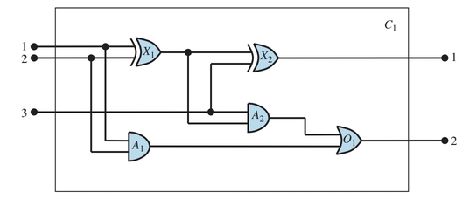
Example Problem: Full Adder Circuit

