Slide 1
Minimax and Alpha Beta Pruning

Slide 2
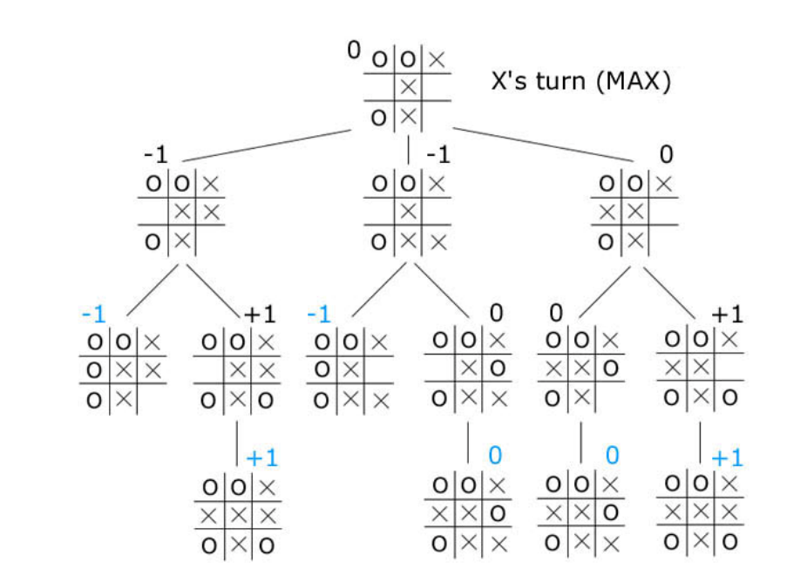
Game tree for Tic-Tac-Toe
Min
Max

Slide 3
Game tree for Tic-Tac-Toe
Min
Max

Slide 4
Minmax Algorithm
minimax(player,board)
if(game over in current board position)
return winner
children = all legal moves for player from this board
if(max's turn)
return maximal score of calling minimax on all the children
else (min's turn)
return minimal score of calling minimax on all the children

Slide 5
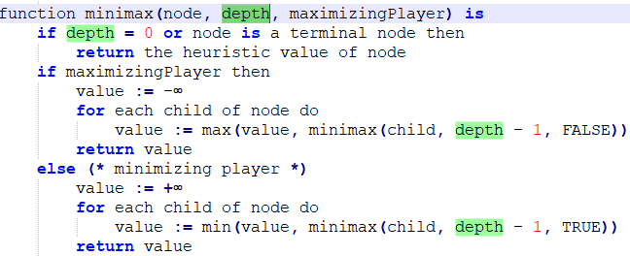
Depth-Limited Minmax Pseudocode

Slide 6
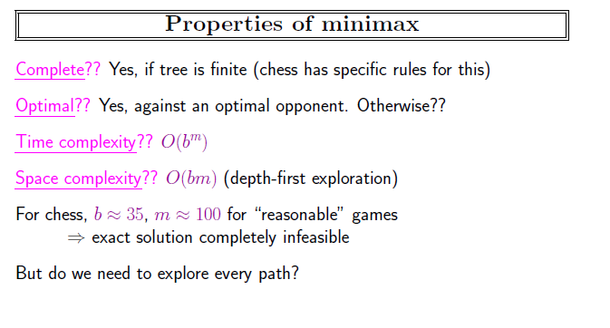
Credits: AIMA – S.J. Russel

Slide 7
Alpha-Beta Pruning
The number of game states is exponential in the depth of the tree.
No algorithm can completely eliminate the exponent.
But we can sometimes cut it in half, computing the correct minimax decision without examining every state by pruning large parts of the tree that make no difference to the outcome.

Slide 8
Alpha beta pruning
Children inherit parent’s alpha and beta values via passing them as arguments during recursive calls (not while returning).
Alpha can only be updated during max’s turn
Alpha = the value of the best (i.e., highest-value) choice we have found so far at any choice point along the path for MAX.
Think: alpha= “at least.”
Beta can only be updated during min’s turn
Beta= the value of the best (i.e., lowe: lue) choice we have found so far at any choice point along the path for MIN.
Think: Beta = “at most.”
When Alpha ‘is greater than equal to’ beta we don’t look into the remaining children (AKA pruning)

Slide 9
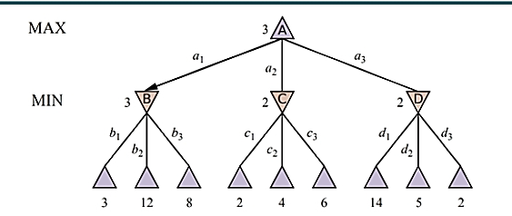
Credits: AIMA – S.J. Russel

Slide 11
A - Alpha
B – Beta
- Max
- Min
A = -∞
B =+∞
A = -∞
B =+∞
A = +∞
B =+∞
A =-∞
B =+∞
A = -∞
B =+∞
A = -∞
B =+∞
A =-∞
B =+∞
A = -∞
B =+∞
A = -∞
B =+∞
A =-∞
B =+∞
A = -∞
B =+∞
A = -∞
B =+∞
10
11
9
14
15
5
4
………

Slide 12
A - Alpha
B – Beta
- Max
- Min
A = -∞
B =+∞
A = -∞
B =+∞
A = +∞
B =+∞
A =-∞
B =+∞
A = -∞
B =+∞
A = -∞
B =+∞
A =-∞
B =10
A = -∞
B =+∞
A = -∞
B =+∞
A =-∞
B =+∞
A = -∞
B =+∞
A = -∞
B =+∞
10
11
9
14
15
5
4
………

Slide 13
A - Alpha
B – Beta
- Max
- Min
A = -∞
B =+∞
A = -∞
B =+∞
A = +∞
B =+∞
A =-∞
B =+∞
A = -∞
B =+∞
A = -∞
B =+∞
A =-∞
B =10
A = -∞
B =+∞
A = -∞
B =+∞
A =-∞
B =+∞
A = -∞
B =+∞
A = -∞
B =+∞
10
11
9
14
15
5
4
………

Slide 14
A - Alpha
B – Beta
- Max
- Min
A = -∞
B =+∞
A = -∞
B =+∞
A = +∞
B =+∞
A =-∞
B =+∞
A = -∞
B =+∞
A = -∞
B =+∞
A =-∞
B =10
A = -∞
B =+∞
A = -∞
B =+∞
A =-∞
B =+∞
A = -∞
B =+∞
A = -∞
B =+∞
10
10
11
9
14
15
5
4
………

Slide 15
A - Alpha
B – Beta
- Max
- Min
A = -∞
B =+∞
A = -∞
B =+∞
A = +∞
B =+∞
A =10
B =+∞
A = -∞
B =+∞
A = -∞
B =+∞
A =-∞
B =10
A = 10
B =9
A = -∞
B =+∞
A =-∞
B =+∞
A = -∞
B =+∞
A = -∞
B =+∞
10
10
11
9
14
15
5
4
………

Slide 16
A - Alpha
B – Beta
- Max
- Min
A = -∞
B =+∞
A = -∞
B =+∞
A = +∞
B =+∞
A =10
B =+∞
A = -∞
B =+∞
A = -∞
B =+∞
A =-∞
B =10
A = 10
B =+∞
A = -∞
B =+∞
A =-∞
B =+∞
A = -∞
B =+∞
A = -∞
B =+∞
10
10
11
9
14
15
5
4
………

Slide 17
A - Alpha
B – Beta
- Max
- Min
A = -∞
B =+∞
A = -∞
B =+∞
A = +∞
B =+∞
A =10
B =+∞
A = -∞
B =+∞
A = -∞
B =+∞
A =-∞
B =10
A = 10
B =9
A = -∞
B =+∞
A =-∞
B =+∞
A = -∞
B =+∞
A = -∞
B =+∞
10
10
11
9
14
15
5
4
………

Slide 18
A - Alpha
B – Beta
- Max
- Min
A = -∞
B =+∞
A = -∞
B =+∞
A = +∞
B =+∞
A =10
B =+∞
A = -∞
B =+∞
A = -∞
B =+∞
A =-∞
B =10
A = 10
B =9
A = -∞
B =+∞
A =-∞
B =+∞
A = -∞
B =+∞
A = -∞
B =+∞
10
9
10
11
9
14
15
5
4
………

Slide 19
A - Alpha
B – Beta
- Max
- Min
A = -∞
B =+∞
A = -∞
B =10
A = +∞
B =+∞
A =10
B =+∞
A = -∞
B =10
A = -∞
B =+∞
10
A =-∞
B =10
A = 10
B =9
A = -∞
B =10
A =-∞
B =10
A = -∞
B =+∞
A = -∞
B =+∞
10
9
10
11
9
14
15
5
4
………

Slide 20
A - Alpha
B – Beta
- Max
- Min
A = -∞
B =+∞
A = -∞
B =10
A = +∞
B =+∞
A =10
B =+∞
A = -∞
B =10
A = -∞
B =+∞
10
A =-∞
B =10
A = 10
B =9
A = -∞
B =10
A =-∞
B =10
A = -∞
B =+∞
A = -∞
B =+∞
10
9
10
11
9
14
15
5
4
………

Slide 21
A - Alpha
B – Beta
- Max
- Min
A = -∞
B =+∞
A = -∞
B =10
A = +∞
B =+∞
A =10
B =+∞
A = -∞
B =10
A = -∞
B =+∞
10
A =-∞
B =10
A = 10
B =9
A = -∞
B =10
A =-∞
B =10
A = -∞
B =+∞
A = -∞
B =+∞
10
9
14
10
11
9
14
15
5
4
………

Slide 22
A - Alpha
B – Beta
- Max
- Min
A = -∞
B =+∞
A = -∞
B =10
A = +∞
B =+∞
A =10
B =+∞
A = 14
B =10
A = -∞
B =+∞
10
A =-∞
B =10
A = 10
B =9
A = -∞
B =10
A =-∞
B =10
A = -∞
B =+∞
A = -∞
B =+∞
10
9
14
10
11
9
14
15
5
4
………

Slide 23
A - Alpha
B – Beta
- Max
- Min
A = -∞
B =+∞
A = -∞
B =10
A = +∞
B =+∞
A =10
B =+∞
A = 14
B =10
A = -∞
B =+∞
10
A =-∞
B =10
A = 10
B =9
A = -∞
B =10
A =-∞
B =10
A = -∞
B =+∞
A = -∞
B =+∞
10
9
14
10
11
9
14
15
5
4
………

Slide 24
A - Alpha
B – Beta
- Max
- Min
A = -∞
B =+∞
A = -∞
B =10
A = +∞
B =+∞
A =10
B =+∞
A = 14
B =10
A = -∞
B =+∞
10
14
A =-∞
B =10
A = 10
B =9
A = -∞
B =10
A =-∞
B =10
A = -∞
B =+∞
A = -∞
B =+∞
10
9
14
10
11
9
14
15
5
4
………

Slide 25
A - Alpha
B – Beta
- Max
- Min
A = -∞
B =+∞
A = -∞
B =10
10
A = +∞
B =+∞
A =10
B =+∞
A = 14
B =10
A = -∞
B =+∞
10
14
A =-∞
B =10
A = 10
B =9
A = -∞
B =10
A =-∞
B =10
A = -∞
B =+∞
A = -∞
B =+∞
10
9
14
10
11
9
14
15
5
4
………

Slide 26
A - Alpha
B – Beta
- Max
- Min
A = 10
B =+∞
A = -∞
B =10
10
A = 10
B =+∞
A =10
B =+∞
A = 14
B =10
A = 10
B =+∞
10
14
A =-∞
B =10
A = 10
B =9
A = -∞
B =10
A =-∞
B =10
A = 10
B =+∞
A = 10
B =+∞
10
9
14
10
11
9
14
15
5
4
………

Slide 27
A - Alpha
B – Beta
- Max
- Min
A = 10
B =+∞
A = -∞
B =10
10
A = 10
B =+∞
A =10
B =+∞
A = 14
B =10
A = 10
B =+∞
10
14
A =-∞
B =10
A = 10
B =9
A = -∞
B =10
A =-∞
B =10
A = 10
B =5
A = 10
B =+∞
10
9
14
10
11
9
14
15
5
4
………

Slide 28
A - Alpha
B – Beta
- Max
- Min
A = 10
B =+∞
A = -∞
B =10
10
A = 10
B =+∞
A =10
B =+∞
A = 14
B =10
A = 10
B =+∞
10
14
A =-∞
B =10
A = 10
B =9
A = -∞
B =10
A =-∞
B =10
A = 10
B =5
A = 10
B =+∞
10
9
14
10
11
9
14
15
5
4
………

Slide 29
A - Alpha
B – Beta
- Max
- Min
A = 10
B =+∞
A = -∞
B =10
10
A = 10
B =+∞
A =10
B =+∞
A = 14
B =10
A = 10
B =+∞
10
14
A =-∞
B =10
A = 10
B =9
A = -∞
B =10
A =-∞
B =10
A = 10
B =5
A = 10
B =+∞
10
9
14
5
10
11
9
14
15
5
4
………

Slide 30
A - Alpha
B – Beta
- Max
- Min
A = 10
B =+∞
A = -∞
B =10
10
A = 10
B =+∞
A =10
B =+∞
A = 14
B =10
A = 10
B =+∞
10
14
A =-∞
B =10
A = 10
B =9
A = -∞
B =10
A =-∞
B =10
A = 10
B =5
A = 10
B =+∞
10
9
14
5
10
11
9
14
15
5
4
………

Slide 31
A - Alpha
B – Beta
- Max
- Min
A = 10
B =+∞
A = -∞
B =10
10
A = 10
B =+∞
A =10
B =+∞
A = 14
B =10
A = 10
B =+∞
10
14
A =-∞
B =10
A = 10
B =9
A = -∞
B =10
A =-∞
B =10
A = 10
B =5
A = 10
B =4
10
9
14
5
10
11
9
14
15
5
4
………

Slide 32
A - Alpha
B – Beta
- Max
- Min
A = 10
B =+∞
A = -∞
B =10
10
A = 10
B =+∞
A =10
B =+∞
A = 14
B =10
A = 10
B =+∞
10
14
A =-∞
B =10
A = 10
B =9
A = -∞
B =10
A =-∞
B =10
A = 10
B =5
A = 10
B =4
10
9
14
5
10
11
9
14
15
5
4
………

Slide 33
A - Alpha
B – Beta
- Max
- Min
A = 10
B =+∞
A = -∞
B =10
10
A = 10
B =+∞
A =10
B =+∞
A = 14
B =10
A = 10
B =+∞
10
14
A =-∞
B =10
A = 10
B =9
A = -∞
B =10
A =-∞
B =10
A = 10
B =5
A = 10
B =4
10
9
14
5
4
10
11
9
14
15
5
4
………

Slide 34
A - Alpha
B – Beta
- Max
- Min
A = 10
B =+∞
A = -∞
B =10
10
A = 10
B =+∞
A =10
B =+∞
A = 14
B =10
A = 10
B =+∞
10
14
A =-∞
B =10
A = 10
B =9
A = -∞
B =10
A =-∞
B =10
A = 10
B =5
A = 10
B =4
10
9
14
5
4
10
11
9
14
15
5
4
………

Slide 35
A - Alpha
B – Beta
- Max
- Min
A = 10
B =+∞
A = -∞
B =10
10
A = 10
B =+∞
A =10
B =+∞
A = 14
B =10
A = 10
B =+∞
10
14
5
A =-∞
B =10
A = 10
B =9
A = -∞
B =10
A =-∞
B =10
A = 10
B =5
A = 10
B =4
10
9
14
5
4
10
11
9
14
15
5
4
………

Slide 36
A - Alpha
B – Beta
- Max
- Min
A = 10
B =+∞
A = -∞
B =10
10
A = 10
B =5
A =10
B =+∞
A = 14
B =10
A = 10
B =+∞
10
14
5
A =-∞
B =10
A = 10
B =9
A = -∞
B =10
A =-∞
B =10
A = 10
B =5
A = 10
B =4
10
9
14
5
4
10
11
9
14
15
5
4
………

Slide 37
A - Alpha
B – Beta
- Max
- Min
A = 10
B =+∞
A = -∞
B =10
10
A = 10
B =5
A =10
B =+∞
A = 14
B =10
A = 10
B =+∞
10
14
5
A =-∞
B =10
A = 10
B =9
A = -∞
B =10
A =-∞
B =10
A = 10
B =5
A = 10
B =4
10
9
14
5
4
10
11
9
14
15
5
4
………

Slide 38
A - Alpha
B – Beta
- Max
- Min
A = 10
B =+∞
A = -∞
B =10
10
A = 10
B =5
5
A =10
B =+∞
A = 14
B =10
A = 10
B =+∞
10
14
5
A =-∞
B =10
A = 10
B =9
A = -∞
B =10
A =-∞
B =10
A = 10
B =5
A = 10
B =4
10
9
14
5
4
10
11
9
14
15
5
4
………

Slide 39
A - Alpha
B – Beta
- Max
- Min
A = 10
B =+∞
A = -∞
B =10
10
A = 10
B =5
5
A =10
B =+∞
A = 14
B =10
A = 10
B =+∞
10
14
5
A =-∞
B =10
A = 10
B =9
A = -∞
B =10
A =-∞
B =10
A = 10
B =5
A = 10
B =4
10
9
14
5
4
10
11
9
14
15
5
4
………

Slide 40
A - Alpha
B – Beta
- Max
- Min
10
A = 10
B =+∞
A = -∞
B =10
10
A = 10
B =5
5
A =10
B =+∞
A = 14
B =10
A = 10
B =+∞
10
14
5
A =-∞
B =10
A = 10
B =9
A = -∞
B =10
A =-∞
B =10
A = 10
B =5
A = 10
B =4
10
9
14
5
4
10
11
9
14
15
5
4
………

Slide 41
A - Alpha
B – Beta
- Max
- Min
10
A = 10
B =+∞
A = -∞
B =10
10
A = 10
B =5
5
A =10
B =+∞
A = 14
B =10
A = 10
B =+∞
10
14
5
A =-∞
B =10
A = 10
B =9
A = -∞
B =10
A =-∞
B =10
A = 10
B =5
A = 10
B =4
10
9
14
5
4
10
11
9
14
15
5
4
………

Slide 42
A - Alpha
B – Beta
- Max
- Min
10
A = 10
B =+∞
Next Move
A = -∞
B =10
10
A = 10
B =5
5
Anticipated Moves
A =10
B =+∞
A = 14
B =10
A = 10
B =+∞
10
14
5
A =-∞
B =10
A = 10
B =9
A = -∞
B =10
A =-∞
B =10
A = 10
B =5
A = 10
B =4
10
9
14
5
4
10
11
9
14
15
5
4
………

Slide 43
A - Alpha
B – Beta
- Max
- Min
20
A = 20
B =+∞
A = -∞
B =20
20
A = 20
B =15
15
All the pruned branches
X
A =20
B =+∞
A = 24
B =20
A = 20
B =+∞
20
24
15
A =-∞
B =20
A = 20
B =5
A = -∞
B =20
X
A = 20
B =15
A = 20
B =12
20
5
24
15
12
X
X
X
20
40
5
1
24
50
2
3
15
4
12
5
6,7,8,9

Slide 44
Pseudocode for the alpha-beta algorithm
evaluate (node, alpha, beta)
if node is a leaf
return the heuristic value of node
if node is a minimizing node
for each child of node
beta = min (beta, evaluate (child, alpha, beta))
if beta <= alpha
return beta
return beta
if node is a maximizing node
for each child of node
alpha = max (alpha, evaluate (child, alpha, beta))
if beta <= alpha
return alpha
return alpha

