Slide 1
Xen Hypervisor – Case Study
Dr. Amit Praseed

Slide 2
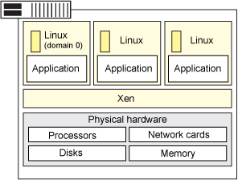
Overview of Xen
Xen is a type 1 hypervisor
Creates logical pools of system resources - many virtual machines can share the same physical resources.
Supports Full and Para virtualization.
Xen can run multiple guest OS, each in its on VM.

Slide 3
Domain 0
Xen can run several guest operating systems each running in its own virtual machine or domain.
When Xen is first installed, it automatically creates the first domain, Domain 0 (or dom0).
management domain
tasks like building additional domains, managing the virtual devices for each virtual machine, suspending virtual machines, resuming virtual machines, and migrating virtual machines.
Domain 0 runs a guest operating system and is responsible for the hardware devices.

Slide 4
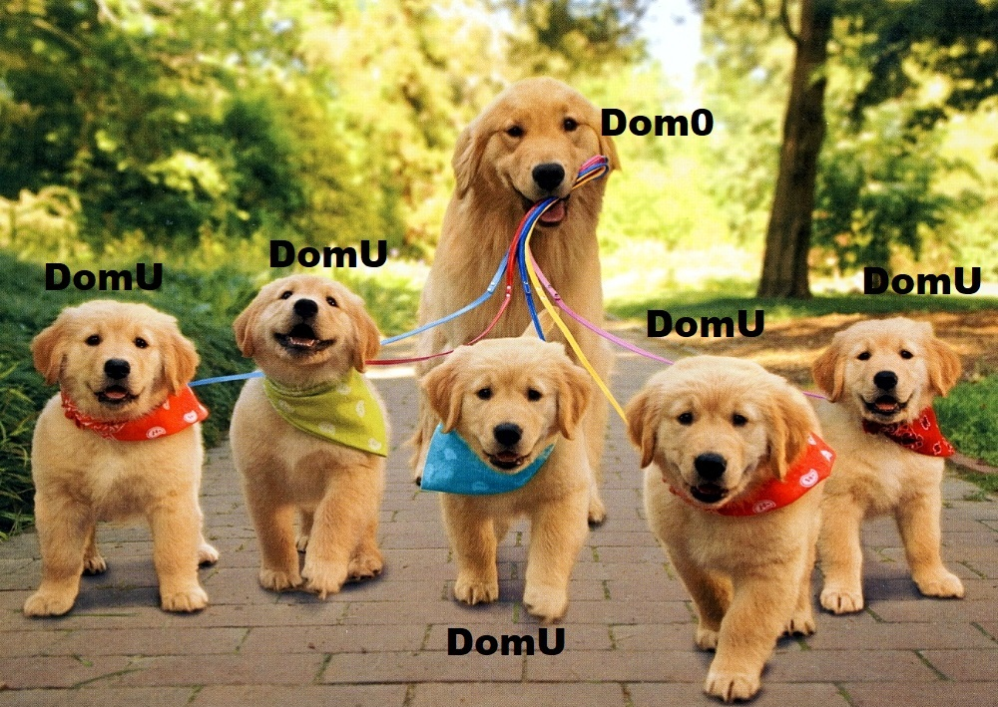

Slide 5
A Few Terminologies
Domain 0 is specially reserved for hypervisor operations
A general VM is represented as Domain U
Paravirtualized VM is represented as Domain U: PV Guests
Fully virtualized VM is represented by Domain U: HVM Guests

Slide 6
CPU Virtualization
Exceptions
each domain maintains its own unique and dedicated table of trap handlers - set_trap_table
System calls are carried out at near-native speeds without having to be executed in Ring-0.
Page Fault exceptions are carried out by Xen and the register values stored for retrieval by the guest in Ring-1.
Scheduling
Borrowed Virtual Time (BVT) scheduling scheme
Hybrid algorithm that is both work-conserving and has mechanisms for low-latency dispatch, or domain wake-up

Slide 7
Memory Virtualization
In a 32 bit architecture, Xen reserves the top 64 MB space for itself
Each domU has a maximum and current consumed physical memory allocation.
Balloon driver concept for each domain, that allows the operating system to adjust its current memory allocation
Allows “unused” allocation to be consumed in other areas
Shadow Page Tables for memory virtualization
Can use SLAT if hardware virtualization is enabled

Slide 8
I/O Virtualization
Xen follows a paravirtualization approach for I/O virtualization
installing device drivers that are coded to be Xen-aware and interact with the hypervisor APIs
Can be used by both modified/unmodified OS
Three components cooperate to allow for device virtualization in Xen
Device I/O Rings
Event Channels
Virtual I/O Devices and Split Device Drivers

Slide 9
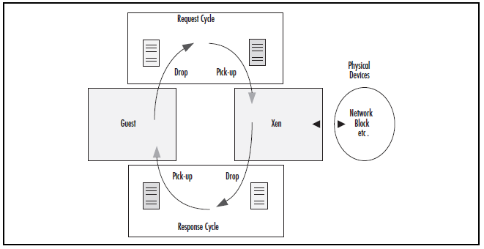
Device I/O Rings

Slide 10
Event Channels
Event channels are mediums through which events, the Xen equivalent of a hardware interrupt, are transmitted.
Event notifications are received via an upcall from Xen.

Slide 11
Split Device Drivers
When Xen boots and launches dom0, it exports a subset of the devices in the systems to the other domains
based on each domain’s configuration
Class devices, not as a specific hardware model
This architecture comprises two cooperating drivers:
the frontend driver in an unprivileged domU,
the backend driver, which runs in dom0

Slide 12
Split Device Drivers
The frontend driver appears to the domU guest operating system as a real device.
The guest can interact with it just as it would any other device for which it had the appropriate drivers installed.
It can receive I/O requests from its kernel, but since it does not have direct access to the hardware, it must pass those requests to the backend driver running in dom0.
The backend driver
receives the I/O requests,
validates them for safety and isolation
proxies them to the real device.
When the I/O operation completes, the backend driver notifies the frontend driver

