Slide 1
React
— Module III—
Dr. Chandra Mohan D
Assistant Professor
Computer Science and Engineering Group
Indian Institute of Information Technology, Sri City
React

Slide 2
Outline
Introduction to Advanced Front End Frameworks
  Front-end JavaScript Frameworks and Libraries Overview
  Introduction to React
  React APP Overview
React

Slide 3
React Introduction
React, sometimes referred to as a frontend JavaScript library created by Facebook
React is a JavaScript library for building user interfaces
React focus on User Interface (UI)
React is used to build single-page applications (SPA)
React allows us to create reusable UI components
React creates a VIRTUAL DOM in memory
The DOM represents the web page as a tree structure
Any piece of HTML that we write is added as a node, to this tree
With JavaScript, we can access any of these nodes (HTML elements) and update their styles, attributes, and so on
This means that the DOM enables JavaScript to access and modify the web page easily
React

Slide 4
How React Works
The root node is document
In React, we don't actually interact with the browser DOM
We interact with the virtual DOM, which is an exact copy of the browser DOM, but in memory
Any React component that we write is inserted as a child to the virtual DOM
The virtual DOM is the reason React renders so quickly and efficiently
React only changes what needs to be changed!
  React, updates in the virtual DOM first
  Then, the browser DOM and virtual DOM are compared to see if there are any updates made to virtual DOM that must be updated in the browser DOM
  React can be used to control parts of HTML page or entire pages
React

Slide 5
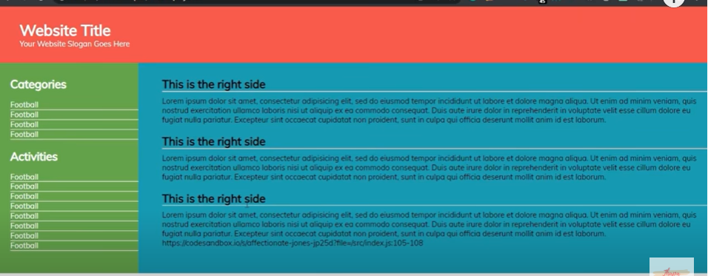
React: Component based approach
A component is one of the core building blocks of React
In other words, in every application you will develop in React will be made of pieces called components
Components make the task of building UI much easier
Declarative programming (DP) is a paradigm that expresses the logic of a computation without describing the control flow
DP is just like asking your friend to draw a landscape
You don’t care how they draw it, that is up to them
React

Slide 6
Advantages of React
Advantages of React
Code Maintainability, because we can now reuse components and break complex logic into smaller parts
Fast and Performant, because only part of the browser DOM is updated instead of the whole thing
One way Data Flow, which means that data flow is possible only from the parent component to child components
That is, components are nested, with the top most component being App
This keeps everything modular
Easy to learn and use, development time is less and learning curve is small
React

Slide 7
Why React ?
Created and maintained by Facebook which is long term player in the market
It has a huge community on GitHub (for support)
High demand due to high speed
Mobile app development with React-Native
Component based Architecture
React is used to develop single page application (SPA)
  Means complete website in single page (reactjs.org)
React Pre-Requisites
HTML, CSS and Javascript
EC6 (ECMAScript 2015 or ECMAScript 6) understanding will make you comfortable with ReactJS
React

Slide 8
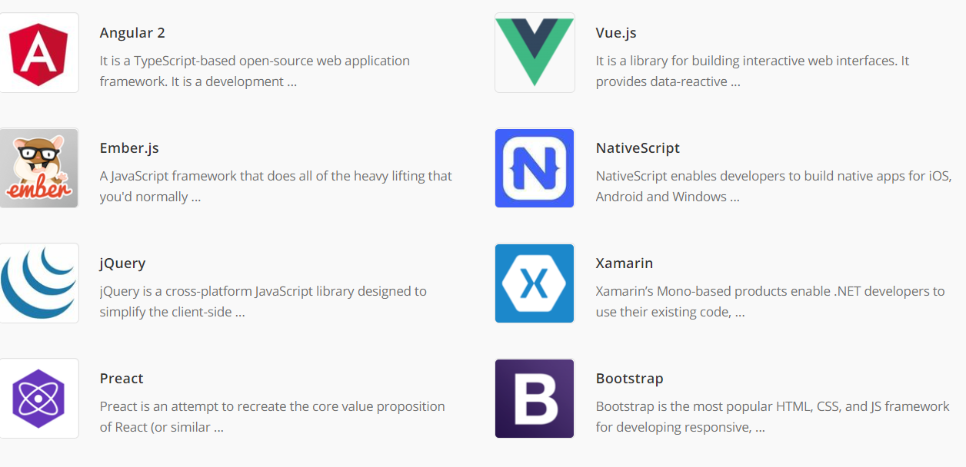
React alternatives
React

Slide 9
How to Start a New React Project: Create React App
  Step1: Install Node
This is because by installing Node you also get npm, which is a package manager for JavaScript
  Download and install Node.js from: https://nodejs.org/en/download/
  Open command prompt (Windows), terminal (Mac or Linux)
  Step 2: Create your React app
  Using Command Prompt
  Go to the folder/directory where you want do projects
  cd /d D:\IIIT_SriCity\Academics\2022-23\FSD2\React
  Create an app (npx create-react-app first-app-test) and change the path(cd first-app-test)
  App name should be in small letters only
  run npm start
React

Slide 10
How to Start a New React Project: Create React App
  Step 2: Create your React app
  Using Visual Studio Code
  Open visual studio code and open the first-app-test folder
  In visual Studio code goto terminal in menu and goto new terminal
  Install npm in the terminal by using npm install
  Create an app (npx create-react-app first-app-test) and change the path(cd first-app-test)
  run npm start
  Stop the server use the short cut Ctrl + c
React

Slide 11
Next-Gen JavaScript
  JS is evolving quickly and therefore new features can looks different
  var, let and const:
  Variables defined with var keyword can be re-declared
  Variables declared with the var can NOT have block scope
  Variables defined with let cannot be re-declared
  Variables declared with the let can have block scope
  Variables defined with const cannot be re-declared
  Variables defined with const cannot be re-assigned
  Variables defined with const have block scope
  Always use const when you declare:
  A new Array, A new Object, A new Function, A new RegExp
Use the link https://jsbin.com/wigocutiza/edit?js,console to run programs
React

Slide 12
Next-Gen JavaScript
  Arrow Functions:
  function myFnc(){ const myFnc=()=>{
  ----- -----
  } }
  Example1: Example2:
  const myFnc=(name)=>{ const myFnc= name =>{ //If we pass only one
  console.log(name); //argument parenthesis is not required.
  } console.log(name); //Other wise required
  myFnc('Chandra'); }
  myFnc(‘Mohan');
  Example3: Example4:
  const multiply=(num)=>{ const multiply= num => num*2;
  return num*2; console.log(multiply(5));
  }
  console.log(multiply(5));
React

Slide 13
Next-Gen JavaScript
  Exports and Imports (Modules):
  JS provides feature to write code in multiple files
  Person.js utility.js
  const person={ export const clean= () => {…}
  name: ‘Max’ export const baseData =10;
  }
  export default person //if you export with default
  apps.js
  import person from ‘./person.js’ //if default export then import with
  import prs from ‘./person.js’ //different name also acceptable
  import {clean} from ‘./utility.js’ //named exports
  import {baseData} from ‘./utility.js’ //named exports
  import baseData as bdata from ‘./utility.js’
  import * as bundled from ‘./utility.js’
React

Slide 14
Next-Gen JavaScript
  22-09-2022 (2nd Class)
  Classes:
  Classes are essentially blue prints for objects
  class Person{
  name: ‘Chandra’;
  call= ()=>{….};
  }
  Usage--→ const myPerson = new Person()
  myPerson.call()
  console.log(myPerson.name)
  Classes are also supports inheritance
  class Person extends Master
React

Slide 15
Next-Gen JavaScript
  Spread and Rest Operators: both represented with same symbol
  Spread (…) used to split up array elements or object properties
  const newArray = […oldArray,1,2]
  const newObject = {…oldObject,newProp:5}
  Example 1:
  const array =[1,2,3];
  const newArray=[array,4];
  console.log(newArray);
  Example 3:
  const Person= {
  Name: ‘Chandra’
  };
  const newPerson={
  …Person,
  Age:35
  }
  console.log(newPerson);
  Example 2:
  const array =[1,2,3];
  const newArray=[…array,4];
  console.log(newArray);
React

Slide 16
Next-Gen JavaScript
  Rest(…) used to merge a list of function arguments into an array
  function sortArgs(…args){
  return args.sort()
  }
  Example 1:
  Const filter = (…args) => {
  return args.filter(el => el ===1);
  }
  console.log(filter(1,2,3));
  Destructuring:
  Easily extract array elements or object properties and store them in variables
  Array:
  [a, b]=[‘Hello’, ‘Chandra’];
  console.log(a);//Hello
  console.log(a);//Chandra
  Object:
  Const {name}={name:‘Chandra’,age:35}
  console.log(name);//Chandra
  console.log(age);//undefined
React

Slide 17
Next-Gen JavaScript
  Primitive and Reference Types:
  Numbers, Boolean, strings are primitive types
  Example1
  const num1=1;
  const num2=num1;
  console.log(num2);//1-Simply copy the value from num1 to num2
  Objects and Arrays are reference types
  Example2: Only reference is created
  const person1 = {
  name: 'Chandra'
  };
  const person2 = person1;
  //person1.name = ‘Mohan’
  console.log(person2);
  Example3:To make an original copy
  const person1 = {
  name: 'Chandra'
  };
  const person2 = {
  …person1
  };
  //person1.name = ‘Mohan’
  console.log(person2);
React

Slide 18
Next-Gen JavaScript
  Refreshing Array Functions:
  The map() function picks each element from array and send to a function
  Example1
  const numbers = [1, 2, 3]
  const doubleNumber = numbers.map((num)=>{
  return num*2;
  })
  console.log(doubleNumber);
React

Slide 19
Working with Components
  What are components:
  React is all about components because all user interfaces in the end are made up of components
  Reusable building blocks in the user interface
  Component contains HTML,CSS, JavaScript
  Why Components
  Reuasbility aspect
  Seperation of concerns (Modularity)
  How is a Component Built?
  React component contains HTML, JavaScript (and CSS)
  React allows to create re-usable components and combine those components
  Build your own, custom HTML elements
React

Slide 20
JSX
  JSX stands for JavaScript XML
  JSX is a HTML code inside JavaScript
  Write XML-like code for elements and components
  JSX tags have tag name, attributes, and children
  JSX makes your react code simpler and elegant
  function App() {
    return (
    <div>
    <h2>Let's get started!</h2>
    </div>
    );
  }
‘react-scripts' is not recognized as an internal or external command
npm install react-scripts
React

Slide 21
JSX
  Build your own, custom HTML elements
  It means built the components
  React is all about components
  Component is basically just custom HTML element
  Export and import components
  If components are exported with default then at the time of import we can use any component name
  export default Greet
  import Greet/Mycomponent from ‘./Componets/Greet’
  If we prepend export with const keyword then use same component name within {}//named exports
  export const Greet = () => <h1>Hello Students</h1>
  import {Greet} from ‘./Componets/Greet’
React

Slide 22
JSX
  JSX converts HTML tags into React elements
With JSX
const myElement = <h1>I Love JSX!</h1>;
Without JSX
const myElement = React.createElement('h1', {}, 'I do not use JSX!');
Expressions in JSX:
With JSX you can write expressions inside curly braces { }
const myElement = <h1>React is {5 + 5} times better with JSX</h1>;
Inserting a Large Block of HTML:
  const myElement = (
  <ul>
  <li>Apples</li>
  <li>Bananas</li>
  <li>Cherries</li>
  </ul> );
React

Slide 23
JSX
One Top Level Element:
The HTML code must be wrapped in ONE top level element
So if you like to write two paragraphs, you must put them inside a parent element, like a div.
  cons myElement = (
  <div>
  <p>I am a paragraph.</p>
  <p>I am a paragraph too.</p>
  </div>
  );
Alternatively, you can use a "fragment" to wrap multiple lines
This will prevent unnecessarily adding extra nodes to the DOM
A fragment looks like an empty HTML tag: <></>
  cons myElement = (
  <>
  <p>I am a paragraph.</p>
  <p>I am a paragraph too.</p>
  </>
  );
React

Slide 24
JSX
Attribute class = className
The class attribute is a much used attribute in HTML, but since JSX is rendered as JavaScript,
The class keyword is a reserved word in JavaScript, you are not allowed to use it in JSX
const myElement = <h1 className="myclass">Hello World</h1>;
Conditions - if statements
React supports if statements, but not inside JSX
To be able to use conditional statements in JSX, you should put the if statements outside of the JSX, or you could use a ternary expression instead
  const x = 5;
  let text = "Goodbye";
  if (x < 10) { text = "Hello"; }
  const myElement = <h1>{text}</h1>;
React

Slide 25
Folder Structure
  Starting point to check is index.html in public folder
  Next folder is src folder, we will work more during development
  Starting point for react application is index.js
  In any react application root component is App component
  The DOM element which will be control with react is div element
  App component represents the view what we can see in the browser
React

Slide 26
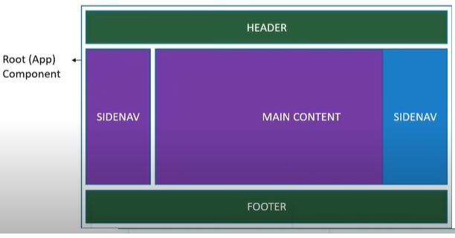
React Components
  Components code written in JS file
  Components are like functions that return HTML elements
Components are independent and reusable bits of code
They serve the same purpose as JavaScript functions, but work in isolation and return HTML
Components come in two types, Class components and Function components
When creating a React component, the component's name MUST start with an upper case letter
React

Slide 27
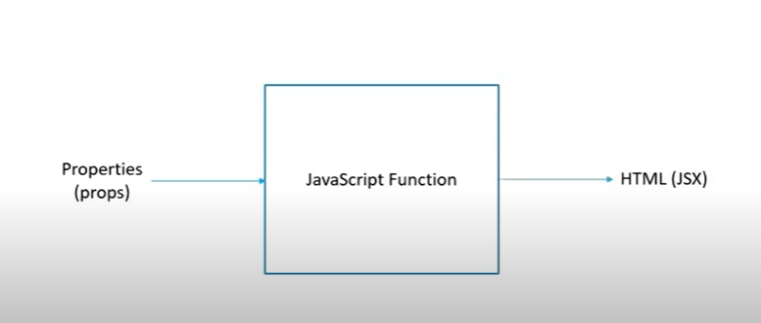
React Components: Functional component
Function Component
It is stateless component
These components can be written using much less code, are easier to understand
A function component returns HTML
Example: Greet.js
React

Slide 28
React Components: Functional Component
Components in Components
We can refer to components inside other components
Props
Components can be passed as props, which stands for properties
Props are like function arguments, and you send them into the component as attributes
React

Slide 29
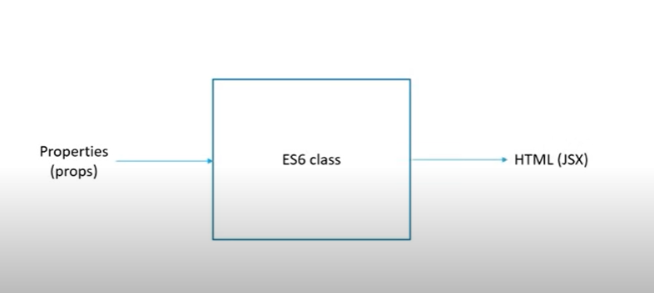
React Components: Class Component
It is a stateful component
A class component must include the extends React.Component statement
This statement creates an inheritance to React.Component and gives your component access to React.Component's functions
The component also requires a render() method, this method returns HTML
React

Slide 30
React Components: Class Component
Component Constructor
If there is a constructor() function in your component, this function will be called when the component gets initiated
The constructor function is where you initiate the component's properties
In React, component properties should be kept in an object called state
The parent component is invoked with super() statement, which executes the parent component's constructor function, then component has access to all the functions of the parent component (React.Component)
Example: ClassConstructor.js
Props in the Constructor
If your component has a constructor function, the props should always be passed to the constructor
Also to the React.Component via the super() method
Example: ClassConstructorProps.js
React

Slide 31
React Components: Class Component
Components in Components
We can refer to components inside other components
Example: NestedClassComponent.js
React Class Component State
React Class components have a built-in state object
The state object is where you store property values that belongs to the component
When the state object changes, the component re-renders
Creating the state Object
The state object is initialized in the constructor
Example: StateProps.js
React

Slide 32
React Components: Event Handling
Changing the state Object
To change a value in the state object, use the this.setState() method
When a value in the state object changes, the component will re-render, meaning that the output will change according to the new value(s)
Add a button with an onClick event that will change the color property
Example: ChangeStateProps.js
React Events
Just like HTML DOM events, React can perform actions based on user events
React has the same events as HTML: click, change, mouseover etc.
Adding Events
React events are written in camelCase syntax:
onClick instead of onclick
React

Slide 33
React Components: Event Handling
React event handlers are written inside curly braces:
onClick={print} instead of onClick=“print()".
React:
<button onClick={print}>Hello All</button>
HTML:
<button onclick=“print()"> Hello All</button>
Example: EventHandling.js
Passing Arguments
To pass an argument to an event handler, use an arrow function
Send "Goal!" as a parameter to the shoot function, using arrow function
Example: EventHandlingProps.js
React

Slide 34
React Components: Event Handling
React Event Object
Event handlers have access to the React event that triggered the function
In our example the event is the "click" event
Arrow Function: Sending the event object manually
Example: EventObject.js
Passing Arguments
To pass an argument to an event handler, use an arrow function
Send "Goal!" as a parameter to the shoot function, using arrow function
Example: EventHandlingProps.js
React

Slide 35
React Conditional Rendering
In React, you can conditionally render components
There are several ways to do this
if Statement:
We can use the if JavaScript operator to decide which component to render
Example: ConditionalIf.js
Logical && Operator:
Another way to conditionally render a React component is by using the && operator
Example: ConditionalLogAnd.js
React

Slide 36
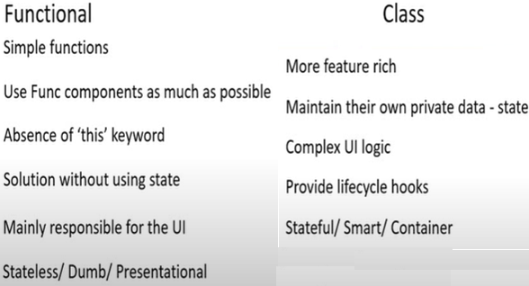
Functional Vs. Class Component
React

Slide 37
React Snippets
  React snippets
    rce- for class component
    rconst- for constructor
    clg- for console.log()
React

