Slide 1
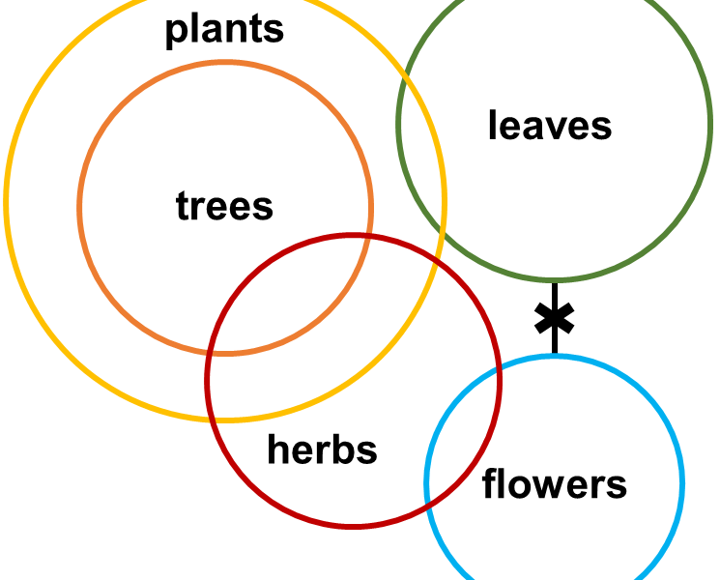
SYLLOGISMS -------------------------------------------------------- Deductions Using Venn Diagrams

Slide 2
SYLLOGISMS DEDUCTIONS USING VENN DIAGRAMS
Question type: Each question will have two or more statements known as ‘premises’. We must select the option (or the conclusions) which can be logically deduced from the given premises.
How to solve: We use Venn Diagrams to solve this type of questions. The given statements will be represented in the form of Venn Diagrams from which we can draw conclusions.

Slide 3
SYLLOGISMS DEDUCTIONS USING VENN DIAGRAMS
Types of statements
Positive statements:
All As are Bs
Some As are Bs
Negative statements:
No As are Bs
Some As are not Bs

Slide 4
SYLLOGISMS DEDUCTIONS USING VENN DIAGRAMS
Basic Venn Diagrams
Possible Venn Diagrams
A=B
All As are Bs
A
B
No A is a B
A
B
Some As are Bs
A
B
A
B
B
A
A=B
Some As are not Bs
A
B
B
A
A
B
Basic Venns
Alternate Venns

Slide 5
SYLLOGISMS DEDUCTIONS USING VENN DIAGRAMS
Statements:
(1)Some trees are papers
(2)All papers are inks
(3) Some inks are blue
Conclusions:
(1)Some inks are trees
(2)Some papers are Trees
(3) Some blue are paper
(4) Some blue are ink

Slide 6
SYLLOGISMS DEDUCTIONS USING VENN DIAGRAMS
Statements:
(1)Some cars are trucks
(2)Some trucks are cycles
(3) All cycles are tractors
(4) All tractors are bikes
(5) Some bikes are white
Conclusions:
(1)Some cycles are white
(2)Some bikes are Truck
(3) Some cycles are car
(4) Some white are cycle
(5) Some bikes are cycle
(6) All cycles are bike

Slide 7
SYLLOGISMS DEDUCTIONS USING VENN DIAGRAMS
Statements:
(1)All fruits are apples
(2)All apples are bananas
(3) Some bananas are orange
(4) Some oranges are grapes
Conclusions:
(1) Some oranges are apples
(2)Some grapes are fruit
(3) Some banana are fruit
(4) Some grapes are banana

Slide 8
SYLLOGISMS DEDUCTIONS USING VENN DIAGRAMS
Statements:
Some papers are pens
All pens are scales
No scale is marker
Conclusions:
I. No marker is paper
II. No marker is pen

Slide 9
SYLLOGISMS DEDUCTIONS USING VENN DIAGRAMS
Statements:
Some trees are paper
Some papers are pen
All pen are car
All cars are truck
No truck is cycle
Conclusions:
I. No cycle is tree
II. No cycle is paper
III. No cycle is car
IV. No cycle is pen

Slide 10
SYLLOGISMS DEDUCTIONS USING VENN DIAGRAMS
Statements:
All cakes are sweet
All sweets are good
Some goods are best
No good is chocolate
Conclusions:
I. No chocolate is best
II. No chocolate is cake
III. No chocolate is good

Slide 11
SYLLOGISMS DEDUCTIONS USING VENN DIAGRAMS
Statements:
All cakes are sweet
All sweets are good
Some goods are best
No good is chocolate
Conclusions:
I. No chocolate is best
II. No chocolate is cake
III. No chocolate is good

Slide 12
SYLLOGISMS DEDUCTIONS USING VENN DIAGRAMS
Statements:
Some papers are pens
All pens are scales
No scale is marker
Conclusions:
Some markers being paper is a possibility
All markers being paper is a possibility

Slide 13
SYLLOGISMS DEDUCTIONS USING VENN DIAGRAMS
Statements:
Some trees are papers
Some papers are pen
All pens are cars
All cars are trucks
No truck is a cycle
Conclusions:
All cycle being paper is a possibility
Some tree being cycle is a possibility
Some cycle being car is a possibility
All cycle being pen is a possibility

Slide 14
SYLLOGISMS DEDUCTIONS USING VENN DIAGRAMS
Statements:
Some papers are pen
All pens are scales
No scale is a marker
Conclusions:
Some papers are not markers
Some scales are not markers
Some markers are not paper

Slide 15
SYLLOGISMS DEDUCTIONS USING VENN DIAGRAMS
Directions: In each of the questions below are given two statements followed by two conclusions numbered I and II. You have to take the given statements to be true even if they seem to be at variance with commonly known facts. Read all the conclusions and then decide which of the given conclusions logically follows from the given statements, disregarding commonly known facts. Give answer
A) If only conclusion I follows.
B) If only conclusion II follows.
C) If either conclusion I or conclusion II follows.
D) If neither conclusion I nor conclusion II follows.
E) If both conclusion I and conclusion II follow.

Slide 16
SYLLOGISMS DEDUCTIONS USING VENN DIAGRAMS
Statement :
1. All men are girls.
2. Some girls are students.
Conclusions :
1. All girls are men.
2. Some girls are not students.

Slide 17
SYLLOGISMS DEDUCTIONS USING VENN DIAGRAMS
Statement:
I. All gardens are schools.
II. All schools are colleges.
Conclusions
I. All gardens are colleges.
II. Some gardens are not colleges.

Slide 18
SYLLOGISMS DEDUCTIONS USING VENN DIAGRAMS
Statement:
I. All Lotus are flowers.
II. No Lily is a Lotus.
Conclusions
I. No Lily is flowers.
II. Some Lilies are flowers.

Slide 19
SYLLOGISMS DEDUCTIONS USING VENN DIAGRAMS
Statements:
(1)All birds are Trees
(2)Some Trees are Hens
Conclusions:
(1)Some birds are Hens
(2)Some Hens are Trees

Slide 20
SYLLOGISMS DEDUCTIONS USING VENN DIAGRAMS
Statements:
(1)Roads are poles
(2)No pole is a House
Conclusions:
(1)Some Roads are Houses
(2)Some Houses are Poles

Slide 21
SYLLOGISMS DEDUCTIONS USING VENN DIAGRAMS
Statements:
(1)Some rooms are stones
(2)All stones are radios
Conclusions:
(1)Some rooms are radios
(2)Some stones are rooms

Slide 22
SYLLOGISMS DEDUCTIONS USING VENN DIAGRAMS
Statements:
(1)All tables are Chalks
(2)All chalks are Chairs
Conclusions:
(1) All tables are Chairs
(2) All Chairs are tables

Slide 23
SYLLOGISMS DEDUCTIONS USING VENN DIAGRAMS
Statements:
(1)Some dogs are bats
(2)Some bats are cats
Conclusions:
(1)Some dogs are cats
(2)Some cats are dogs

Slide 24
SYLLOGISMS DEDUCTIONS USING VENN DIAGRAMS
Statements:
Some teachers are adults
Some adults are poets
Conclusions:
I. Some teachers are poets
II. Some poets are teachers

Slide 25
SYLLOGISMS DEDUCTIONS USING VENN DIAGRAMS
Statements:
All cats are dogs
Some dogs are bees
Conclusions:
I. All bees are cats
II. Some cats are dogs

Slide 26
SYLLOGISMS DEDUCTIONS USING VENN DIAGRAMS
Statements:
All cats are dogs
Some dogs are bees
Conclusions:
I. All bees are cats
II. Some cats are dogs

Slide 27
SYLLOGISMS DEDUCTIONS USING VENN DIAGRAMS
Statements:
Some apples are bananas
All bananas are mangos
Conclusions:
I. Some mangoes are apples
II. All mangoes are apples

Slide 28
SYLLOGISMS DEDUCTIONS USING VENN DIAGRAMS
Choose the answer option where the first 2 statements logically lead to the third.
Statements
No nails are wires
Some hooks are wires
All hooks are nails
Some wires are not nails
No wire is a hook
All nails are hooks
(A) AED (B) BCF (C) BEF (D) ACE

Slide 29
SYLLOGISMS DEDUCTIONS USING VENN DIAGRAMS
The question below contains 3 statements followed by four conclusions. You have to determine which of the conclusions follow from two or more of the statements.
Statements
Some apples are flowers
No flower is a papaya
All papayas are baskets
Conclusions
(i) Some apples are baskets (ii) Some baskets are papayas
(iii) Some baskets are apples (iv) Some flowers are apples
All follows
None follows
Only II and IV follows
Only II and III follows

Slide 30
SYLLOGISMS DEDUCTIONS USING VENN DIAGRAMS
Statements: All cats are dogs.
No dog is a rat.
Conclusions: I. some dogs are cats.
II. No cat is a rat.
III. No rat is a cat.
IV. All dogs are cats.
Options: 1. Only I and II follow
2. Only I, II and III follow
3. Only III and IV follow
4. Only II and IV follow
5. Only III follows

Slide 31
SYLLOGISMS DEDUCTIONS USING VENN DIAGRAMS
Statements: No Port is a harbour
Some ports are capitals
All harbours are aerodromes
Conclusions: I. Some aerodromes are not ports
II. No port is an aerodrome
III. No harbour is a capital
IV. Some capitals are not harbours
Options: 1. Only I and IV follows
2. Only II and IV follows
3. Only III and IV follows
4. Only IV follows
5. None follow

