Slide 1

Cognitive Computing
Dr. Piyush Joshi
Assistant Professor
IIIT Sri City

Slide 2
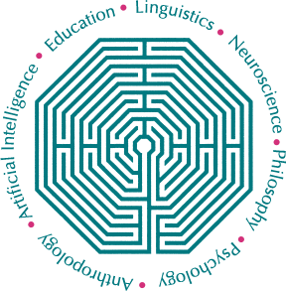
Cognitive Science Society
The Cognitive Science Society is a professional society for the interdisciplinary field of cognitive science.
It brings together researchers from many fields who hold the common goal of understanding the nature of the human mind.
The society promotes scientific interchange among researchers in disciplines comprising the field of cognitive science, including artificial intelligence, linguistics, anthropology, psychology, neuroscience, philosophy, and education.

Slide 3
Understanding Cognition
The word cognition, from the Latin root gnosis, meaning to know and learn, dates back to the 15th century.
Understanding how the human brain works and processes information provides a blueprint for the approach to cognitive computing.
By understanding cognition we can build systems that have many of the characteristics required to continuously learn and adapt to new information.
You will react differently for any particular situation.
This isn’t an innate reaction; it is learned as a response to a stimulus.

Slide 4
Cognition
Cognition is about knowing.
The collection of mental processes and activities used in perceiving, learning, remembering, thinking, and understanding.
Knowing has a relationship.
A relationship between Knower and known.
It is not about knower and world

Slide 5
Rationalism and Empiricism
Cognition is concerned with knowing.
There is a centuries old discussion about the roles of
the senses and experience
direct observation
reason, logic, and certainty
abstraction from particulars

Slide 6
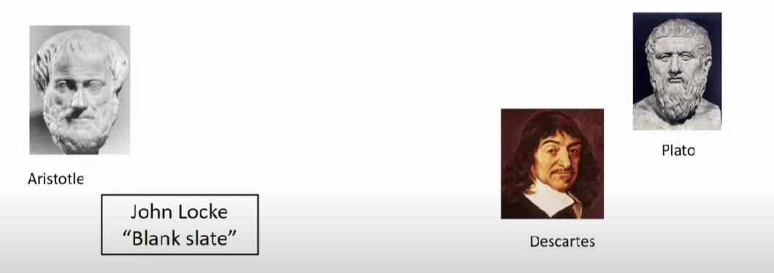
Empiricism Rationalism

Slide 7
Rationalism and Empiricism
Empiricism
Knowledge arises from direct experience and observation
Experimental science is empirical at heart
Knowledge obtained through the senses or by experiment is never 100% certain, and may be revised in light of new experience

Slide 8
Rationalism and Empiricism
Rationalism
Knowledge is arrived at through the application of reason or logic
Mathematical truth illustrates optimally certain knowledge
Ideally, knowledge should be completely certain
Sense experience does not produce certainty and is a poor basis for reasoning
Insists that “true” knowledge is justified

Slide 9
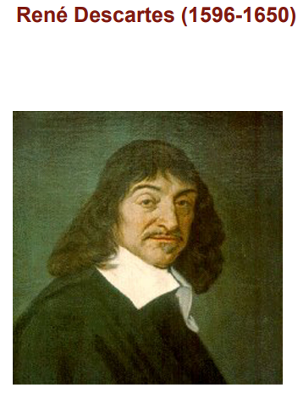
Descartes View
As a rationalist, he wanted to find a basis for certain knowledge.

Slide 10
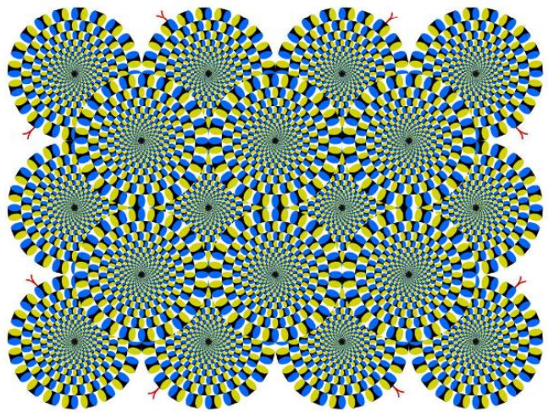
Descartes View
Misleading:
Descartes knew about hallucinations and illusions
He always tried to find justification behind knowledge
Want to find better reason
He knew senses can be fooled

Slide 11
Descartes View
[Suppose for the sake of argument that] I have convinced myself that there is absolutely nothing in the world, no sky, no earth, no minds, no bodies. Does it now follow that I too do not exist?
No: if I convinced myself of something then I certainly existed. But there is a deceiver of supreme power and cunning who is deliberately and constantly deceiving me.
In that case I too undoubtedly exist, if he is deceiving me; and let him deceive me as much as he can, he will never bring it about that I am nothing so long as I think that I am something. So after considering everything very thoroughly, I must finally conclude that this proposition, I am, I exist, is necessarily true whenever it is put forward by me or conceived in my mind. (Med. 2, AT 7:25)
Here is Descartes’ skepticism at work: Hence: I think, therefore I am.

Slide 12
Descartes View
Descartes said
Animals are machine and
Humans are separate part of the nature
We have soul (mind).
Choose to act and take responsibility

Slide 13
Descartes View
This project led Descartes to conclude that the mind was a completely distinct substance from matter....It is invisible, without dimensions, immaterial, unchanging, indivisible and without limit

Slide 14
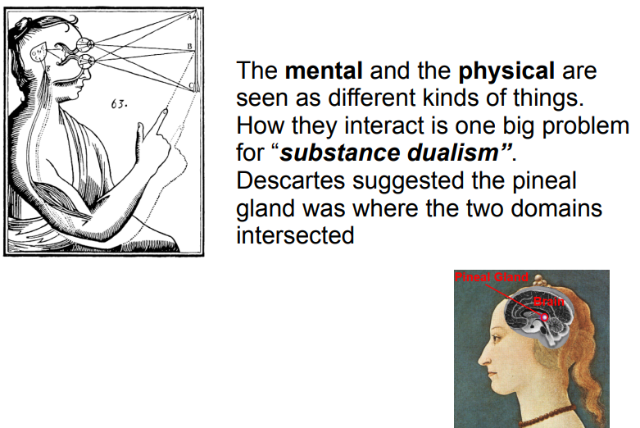
Descartes View

Slide 15
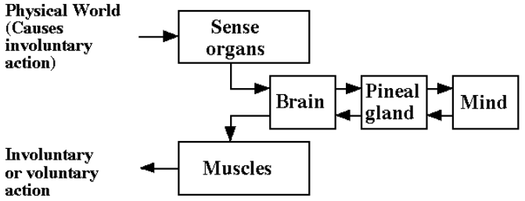
Descartes View

